Slide 1


Asset Acquisitions
Presented by Erika Eden & Jason Smock

Slide 2
Equipment Acquisition Methods
Purchase Order
Leases
Installment
Procurement Card
Donation
Transfers
Fabrication
Notes:
Consult ICSUAM 01401.00 for specific policy definitions: Administration of University Property
Provide example of the https://calstate.policystat.com/policy/11206798/latest

Slide 3


Purchase Order
The cost of the equipment includes the purchase price, applicable taxes and freight, and any other costs associated with preparing the equipment for its intended use.
Notes:
Each system in use to generate purchase orders

Slide 4
Leases
&
Installments
  Finance vs. Operating Lease
Typically account for Finance lease if asset meets tagging threshold
Option to buy the asset /transfer ownership at the end of lease term
Consult your Procurement Office and Financial Reporting prior to proceeding
Installment Purchases
University takes immediate ownership, payments spread over time
Notes:
Provide example of STD 158

Slide 5
Procurement Card
  Used to simplify the procure process
  Used for University funded transaction-No Auxiliary purchases
  Information required by the Property Management Office:
    Chartfield values-Fund/Deptid
    Location
    Costs
    Custodian

Slide 6
Donations
  In Kind Gifts
  Campus departments must coordinate with University Advancement
  Donation is correctly acknowledged
  University Advancement will itemize and obtain fair market value of donated gifts

Slide 7
Transfers
  Transfers of equipment must be in writing and approved by the Property Management Office
  STD 158 Form will be used to document acceptance of items transferred from another campus or state agency
  Fair market value of the asset will be determined at the time of transfer
Notes:
Provide example of STD 158

Slide 8

Fabrication of Equipment
Under special circumstances, equipment may be constructed by campus employees. Fabricated equipment that meets the definition of equipment will be tagged and inventoried by the Office of Property Management (Less Common)
Custom design, cost-effective, innovative solutions

Slide 9
Jointly Purchased Equipment
  Equipment purchased with a combination of the campus and other entities’ funds (auxiliaries, federal agencies, etc.)
  The funding source shall be noted on the purchase order
  Assets will be recorded as CSU (campus specific) if any portion of the funds used to acquire, install, or maintain the asset are from CSU sources

Slide 10

Example: Asset Basic Add Process

Slide 11
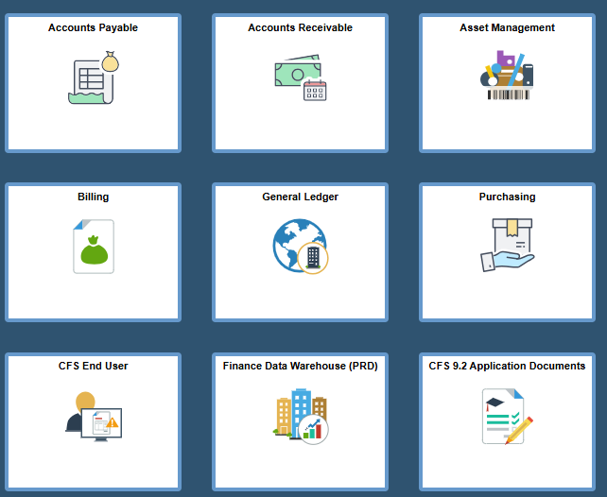
Systems Used

Slide 12
Asset Received
Notice from Distribution Services
01
Notice from campus department(s)
02
Review purchase information
03
Physically tag asset
04
Complete asset tagging sheet
05
Notes:
Provide example of asset purchasing information.
Example of asset tagging sheet

Slide 13
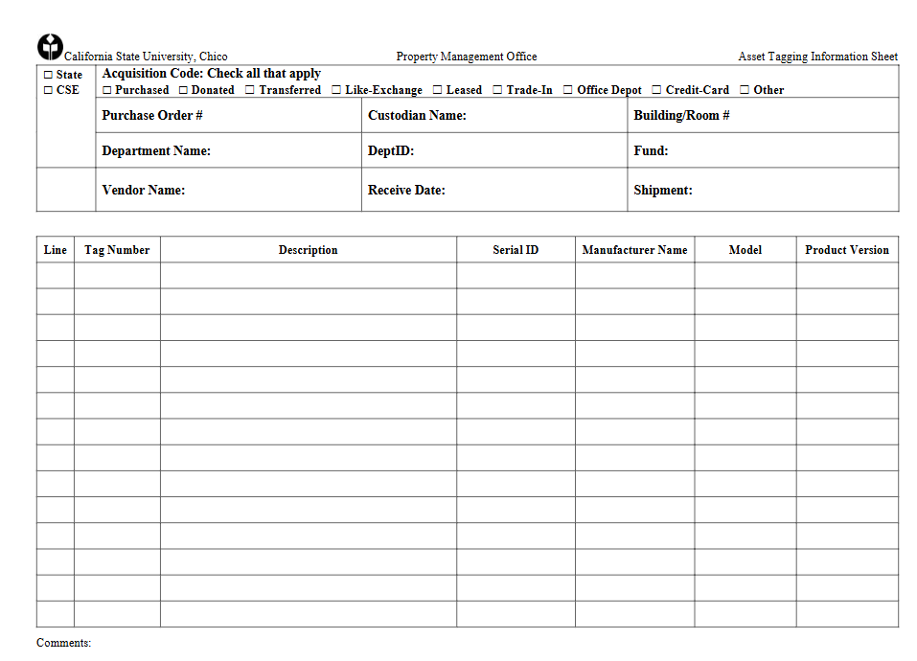
Asset Tagging Sheet
Notes:
Explain the use of the asset tagging sheet
Example of asset tagging sheet

Slide 14
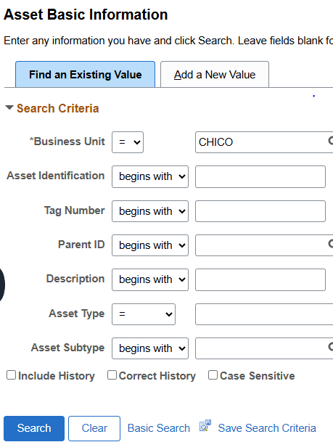
Create Asset
Ensure all necessary asset details are complete
Perform data entry
Notes:
Perform data entry function in asset management

Slide 15
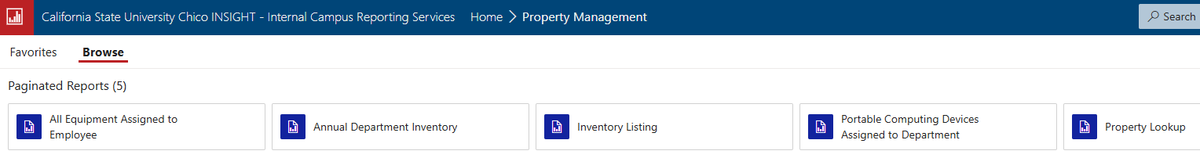
Review Acquisitions/Asset Maintenance
Notes:
Provide internal campus reporting example.
“Insight”.

