Slide 1


Cash, Banking & Investments
Ron Flatt
director of treasury operations – chancellor’s office

Slide 2

CSU Cash Management
Centralized:
  One banking platform—Wells Fargo Bank
  One integrated payments solutions - Transact
  One consolidated investment pool with16 Investment Managers
Benefits:
  Efficient use and investment of cash
  Lower fees and enhanced services
  Reduced risk
  Consistent reporting and accounting across the system

Slide 3
Cash Management Roles
Chancellor’s Office, Treasury Operations
  Provide customer service to campuses
  Manage banking policy and relationships
  Analyze and position daily cash of system
  Forecast cash needs
  Oversee investment portfolios and policies

Slide 4
Cash Management Roles
Campus
  Process deposits and disbursements
  Manage campus bank account user access and privileges
  Oversee campus accounting and reporting
Chancellor’s Office, Financial Services
  Facilitate virtual movement of funds between campuses and CO/campus
  Reconcile and report on systemwide investment accounts
  Manage accounting/reporting policy and resources
  Provide customer service and support to campuses

Slide 5
Bank Account Structure
Each Campus:
  One depository account - Cash, coin, checks, electronic
  Two disbursement accounts
    Electronic
    Checks
Concentration account
Zero balance account structure
  Each banking day, all accounts zero out
  Balances roll up to one CSU master account

Slide 6
CSU Cash Management
Size & Scope
  Wells Fargo
  635,000 banking transactions
    Deposit transactions—160,000
    Disbursement transactions—475,000
  Total volume—$15.3 billion
    Deposits—$8.2 billion
    Disbursements—$7.1 billion
  Transact FY2023 - 24
  Transactions 4.5 billion
    Credit card transactions – 3.3M
      $1.0 billion
    ACH/Wire transactions – 904,000
      $3.5 billion
    Checks – 163,000
      $1.0 billion
    Cash 74,000
      $30 million
  Total Volume - $5.5 billion
    Credit card fees
              Users - $22 million
              Campus - $1.25 million

Slide 7
Cash Management – Cash Cycle
Wells Fargo Bank
System Disbursement
System Deposits
Liquidity Portfolio
Intermediate Duration Portfolio
Total Return Portfolio
Daily

Slide 8
Investment Structure
Liquidity Portfolio
  Sufficient and immediate liquidity to meet operating needs
  Investment objectives are safety of principal and liquidity.
  $2.1 billion as of 12/31/24
Intermediate Duration Portfolio (IDP)
  To provide opportunity for modest, additional risk adjusted returns on CSU funds not needed for immediate liquidity.
  $1.3 billion as of 12/31/24
Total Return Portfolio (TRP)
  Balanced portfolio, including equities and real assets
  Investment objectives are to achieve a prudent total return within a moderate risk level.
  $3.0 billion as of 12/31/24
Surplus Money Investment Fund (SMIF)
  State investment portfolio—$292 million as of 12/31/23

Slide 9
Investment Earnings
Liquidity, IDP, and SMIF earnings
  Distributed to campuses in late summer/early fall
  Amount based upon prior fiscal year earnings
  $506 million over last four years
    $185M FY24/25
TRP earnings
  Determined by CSU Investment Advisory Committee
  Distributed to campuses in fall
  By law, may only be used for capital needs
  $257 million over last three years
    $95.5M FY24/25

Slide 10

Bank of CSU - Overview
What is the “Bank of CSU”?
CSU Consolidated Investment Pool
  Liquidity Portfolio (formerly SWIFT)
  Intermediate Duration Portfolio
  Total Return Portfolio
Wells Fargo Concentration Account
  Depository – zero balance
  Paper Disbursements – zero balance
  Electronic Disbursements – zero balance

Slide 11
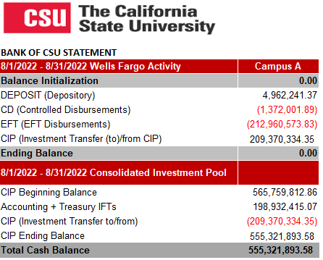
Bank of CSU
Statement
Includes:
Wells Fargo Activity
Consolidated Investment Pool

