Slide 1


UBIT Packet Preparation
Unrelate business income tax (UBIT)
What it is, reviewing revenues, allocating expenses, completing the packet.
Notes:
Hello and good morning. My name is Lynnetta Zuzow. I am an accountant at Cal Poly San Luis Obispo and have been with the university for 10 years. I have a master’s degree in taxation and have worked on UBIT for about 5 years.
Today I’m going to spend some time talking about unrelated business income tax, or as we call it, UBIT and the UBIT packet. In this presentation we will walk through most of the schedules used in the UBIT packet. But first let’s discuss, what is UBIT.

Slide 2
Understanding UBIT
What is UBIT?
    It is a tax on unrelated business Income of exempt organizations.
  Who is Subject to UBIT? (Chapter 1, Pub 598)
    State and municipal colleges and universities.
  What is considered an unrelated trade or business? (Chapter 3, Pub 598)
    Business activities, conducted on a regular basis that do not substantially relate to the school’s exempt purpose, are considered unrelated business activities.
    Chapter 3 of Publication 598 provides examples of related and unrelated business activities.
        Examples of unrelated business activities:
        Special Events Parking - revenue generated from parking for a performances put on by professional entertainers, open to the public.
        Compost Sales – revenue generated from sale to the public from compost produced by the university.
        Live-Scans – revenue generated for live-scans performed for non-campus related individuals.
Notes:
UBIT is a tax on unrelated business income, of an exempt organization.
Who is subject to UBIT? Various entities are subject to this tax and in Chapter 1 of IRS publication 598, state universities are explicitly identified as being subject to UBIT.
What makes an activity an unrelated activity? Basically, it’s an activity happening regularly on campus that does not substantially relate to the university’s educational purpose.
There are some resources you can use to learn more about UBIT including IRS publication 598. Chapter 3 of this publication provides some examples of both related and unrelated activities, to help get a feel for what is and what is not considered an unrelated activity.
Another source that has good examples of UB activities can be found on the CSYOU tax administration website. On there you can find slides from an older UBIT workshop that provide some relevant examples and other information that I recommend checking out.
Some examples from our campus include 1. special events parking, 2. compost sales, and 3. live-scan services.

Slide 3
UBIT Packet Prep: Getting Started
Purpose of the UBIT Packet
  To organize activities for each campus, to report on the annual IRS form 990-T (Exempt Organization Business Income Tax Return).
  Show due diligence to report all UBIT revenue to the IRS.
  Tip: Start tracking your time to calculate a tax prep deduction included on Schedule E of the packet.
  Getting Started:
  Identify Potential Unrelated Business Activity Revenue
  Analyze UBIT Revenue
  Allocate Expenses to Offset UBIT Revenue
  Enter Required Detail on the UBIT Packet
Notes:
Why do we prepare the packet? The purpose of the UBIT packet is to organize our unrelated activities into a manageable source for the Chancellor’s office, who uses these packets to prepare a consolidated annual 990-T tax form filed with the IRS.
Each campus’s UBIT packet and supporting schedules provides evidence that we have done our due diligence to ensure we are in compliance with the IRS.
Before we walk through the packet, I want to mention my first tip on packet preparation.
Start tracking any time spent working on UBIT. You will need a good estimate of time spent to calculate a tax prep expense deduction reported on schedule E.
Now that we understand what UBIT is and why we prepare the packet, let’s move on to getting started.
Completing the UBIT packet can be broken down into four steps.
Identify potential UBIT revenue
Analyze this potential revenue to determine how much, if any of this revenue is subject to UBIT
Allocate expenses to offset the UBIT revenue
Enter the information into the UBIT packet.

Slide 4
1. Identify UBIT Revenue 2. Analyze
REVENUE REVIEW
Common UBI Activities include:
  Facility rentals, conference centers, sports camps
  Health & recreation center memberships Catering & personal services
  Personal property rentals
  Corporate Sponsorships
  Advertising
  Royalty agreements
  Travel Tours
  Golf course
  Bookstore
EXCLUSIONS
  Capital Gain Transactions
  Interest & Dividends
  Rental Income from Real Property
  Royalties
  Research Activities
  Volunteer Activities
  Donated Merchandise
  Convenience (of university’s students, faculty or employees)
Publication 598, chapter 4 goes into more detail of these exclusions from UBI
Notes:
First, we need to identify any activities happening around campus that are not related to the educational purpose of the campus. At this point, all campuses already have the majority of these activities identified and you can use last year’s UBIT packet as a starting point.
If you are the person tasked with completing the UBIT packet, you will want to keep an eye and ear out for any new activities that might be subject to UBIT. These activities might be identified by postings in the campus newspaper, or website. You could also review the revenue in any new funds to see the source of the revenue and if they have UBIT potential.
On the left side of this slide is a list of common unrelated business income producing activities.
Once you have UBI activities identified, you will want to analyze this revenue to narrow down which portion of this revenue is subject to UBIT.
Some revenues are excluded from UBIT that you want to familiarize yourself with.
On the right side of this slide are listed several of the exclusions. Publication 598 has examples in Chapter 4. Also, the tax workshop slides on the CSYOU website have some good examples.
A couple of examples of these exclusions are rental income from real property when no services are included, and revenues generated from activities that provide a “convenience” for university students and employees.
An example of this would be a laundry facility on campus for students. Vending machines would be another example.

Slide 5
3. Deductions – Allocating Expenses
Expenses, depreciation, & other deductions directly connected to the unrelated trade or business qualify as direct deductions to the extent that they are otherwise allowable tax deductions.
  Salaries & Wages
  Repairs & Maintenance
  Bed Debts
  Employee Benefits
  Supplies & Services
  Printing
  Utilities
  Advertising
  If Sale of Goods,
    Returns & Allowances
    Cost of Goods Sold
  Schedule E-2a is a template to help organize expense allocations.
  Revenue & Expense Transactions download can be used to create a P&L schedule.
Notes:
You are allowed to allocate expenses related to generating UBIT revenue, to reduce the potential tax liability for each activity.
Expenses directly related to the production of unrelated business income can be directly deducted, if these expenses would otherwise be deductible.
Listed here are some of the most common examples of expenses that can be used as deductions.
The UBIT packet includes a template, schedule E-2a, to help with allocating expenses. Or you can create your own profit and loss schedule to allocate expenses.

Slide 6
3. Deductions Continued…
When a portion of total revenue is deemed to be unrelated business income, then the expenses, depreciation, & other deductions must be allocated between the related revenue & unrelated revenue.
  Example, you’ve identified an activity as potentially subject to UBIT, and upon review of that activity’s revenue you’ve determined that 46% of the revenue is UBI, you may deduct 46% of the expenses related to this activity from the UBI.
  Tip: Program codes applied to revenue identified as UBI & expenses directly associated with UBI revenue can help in allocating expenses.
Notes:
When expenses are associated with both related and unrelated business activity, these expenses should be allocated between the two on a reasonable basis.
For example, if you have an activity, say something like live-scans, and you’ve determined that 46% of these live scans performed are subject to UBIT, then you can deduct 46% of the expenses related to providing live-scan services.
Tip, using program codes is a good way to flag revenues & expenses associated with an unrelated activity.

Slide 7
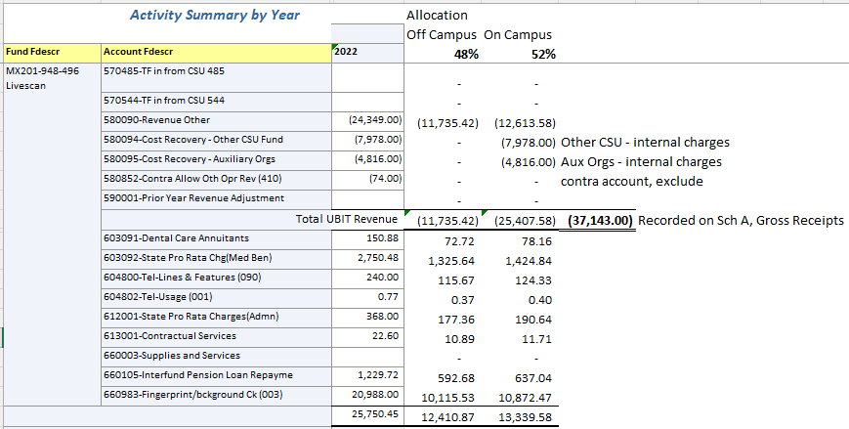
Example:
P&L Allocating Revenues & Expenses
Notes:
I mentioned that you can utilize the Schedule E-2a or create your own P&L statement for allocating expenses. On our campus, we create profit and loss schedules for each activity. We download revenue & expense transactions and allocate expenses based on the percentage of UBI revenue to total revenue.
This slide is an example of one of the simple P&Ls we use to organize information to report on the packet. We have a fund for the campus Live-scan activity and the office that runs the live-scans records revenue into a specific chart string. The office also tracks how many of the live-scans are done for on-campus affiliates versus off-campus third parties. This is how we determine the percentage of the revenue that is subject to UBIT. We use this percentage to allocate expenses to offset the revenue.

Slide 8
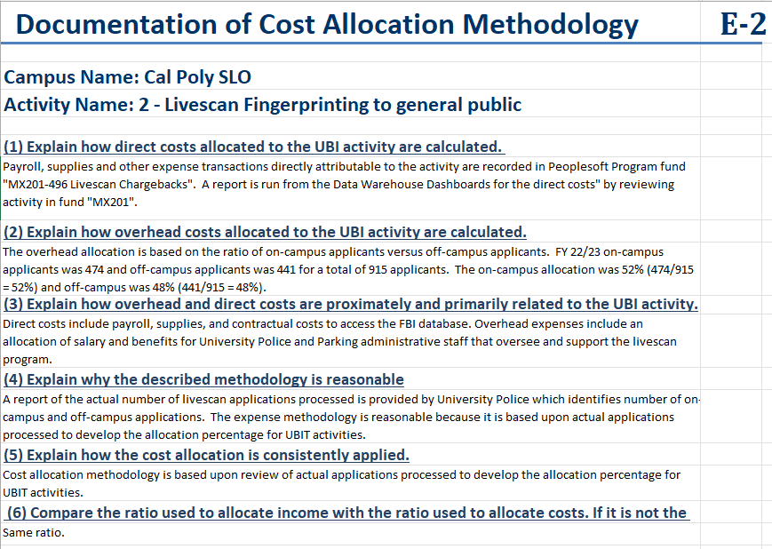
Schedule E-2: Cost Allocation Methodology
Schedule E-2
Documentation of how expenses are allocated.
Schedule E-2a
Template for expense allocations
Provides examples of common deductible expenses.
Treasury Regulation 1.512(a)-1 provides detailed instruction on cost allocation.
Notes:
Since we are discussing the allocation of expenses, I wanted to take a moment to discuss schedule E-2. This schedule requires an explanation on how expenses have been allocated for each activity and should be included for any activity reported on schedule E, the summary schedule near the end of the packet.
As you work through your expense allocation for each activity, it is a good time to review and complete your schedule E-2.
I’ve also added a little detail here about the schedule E-2a, if you prefer to use it for your expense allocations.
For more detailed instruction on cost allocation, you can refer the the treasury regulation I’ve listed here.

Slide 9
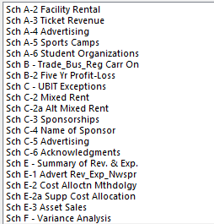
4. Preparing the Packet
List of supporting schedule templates
Grouping of tabs by activity
Example: Athletic Field & Classroom Rentals
Tip: Put the activity number on each tab & alternate tab colors.
Notes:
Now that you have identified your UBI revenue and allocated expenses, we are going to discuss entering this information into the UBIT packet.
On the left of this slide is a list of most of the schedules provided in the packet.
There are 14 supporting schedules, and several summary schedules. Each of these schedules have instructions at the top highlighted in yellow that describe when the schedule is needed and how to complete it.
Each UBI activity you’ve identified will have some combination of these schedules.
I recommend preparing the various schedules, one activity at a time.
On the right side of this slide, is an example of two groupings by activity from our campus. The green tabs are schedules completed for athletic facility rentals and the blue tabs are schedules completed for classroom rentals.
I’ve added a tip here, to include the activity number in addition to the activity name on each tab. Also color code your tabs and alternate the tab colors, to help distinguish the tabs of one activity from another.

Slide 10
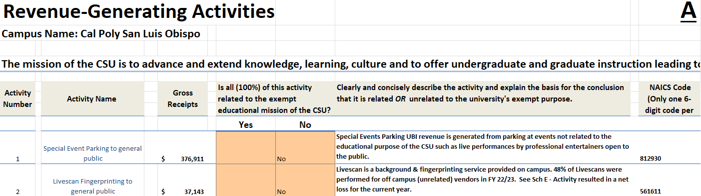
Schedule A: Summary of Activities
Tip: Gross Receipts is the total revenue in an activity identified as potentially subject to UBIT. The actual amount subject to UBIT may be less.
Notes:
The first tab in the packet is the Certification & checklist. I’ll save that for last as that is usually when I prepare it.
The next tab is Schedule A and is a summary of the activities identified as being subject to UBIT. Each year, I copy the prior year’s Schedule A and insert it into the new packet. I delete the data from the Gross Receipts column and update it with current year numbers. I also read through the detail in the other columns to be sure it is still relevant and up to date.
Tip: Gross Receipts are the total of revenues in an activity identified as potentially subject to UBIT. The actual amount subject to UBIT may be less.

Slide 11
Schedule A-2: Facility Rental Evaluation
Rental of Campus Facilities
Examples include:
Dorm Room Rental
Athletic Field Rental
Theatre Rental
Classroom Rental
Include third party organizations that rent facilities of the campus.
Example: Local dance studios rent the theatre for recitals.
Do not include campus department rental of facilities.
Example: Classroom rental for a summer course being taught.
The organization’s purpose may or may not align with the educational purpose
of the university but still be reported on Sch A-2.
Notes:
Schedule A-2 is included for any activity that involves rental of university facilities. These rentals may include dorm rooms, athletic fields, theatre space, and classrooms. On this schedule you will list primarily third-party orgs utilizing a state facility and the nature of the event put on by the organization. These rentals are most common during the summer when campus facilities are traditionally not occupied.
An example I’ve listed here of an event to include on schedule A-2 is the rental of the theatre by a local dance studios for yearly recitals.
An example of something not to include would be classroom rental for a summer course. Such a class on our campus that comes to mind is a cheesemaking course available through extended ed & put on by the Dairy department.
In my experience, this schedule can be very time-consuming because not only must you identify organizations that are renting facilities but also must include a description of the event the being hosted, and why or why not it is related to the educational purpose of the university. This can take a lot of time to research.
That is why I’ve included the following tip I’ve found helpful in saving time in the long run.

Slide 12
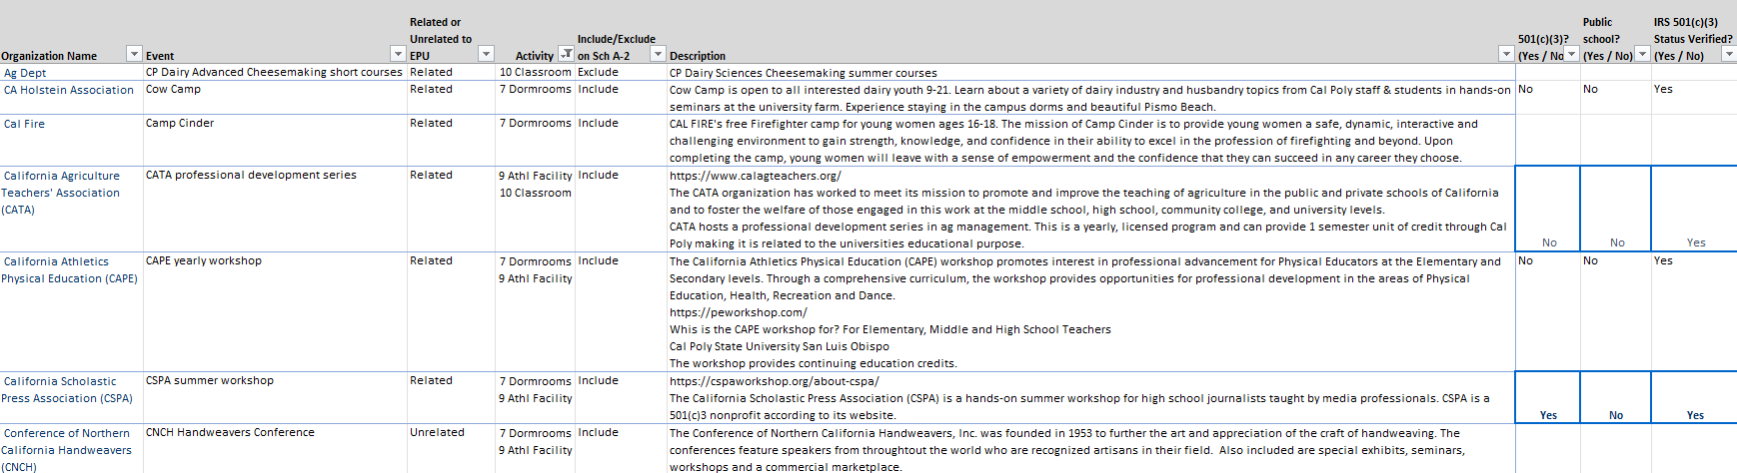
Tip: Create a reference spreadsheet that includes descriptions of events reported on Sch A-2. Include all the detail required on Sch A-2. Build this list each year to reduce duplicate research.
Notes:
Create a worksheet where you keep the description for every organization and event you enter on any schedule A-2. Each year, add any new organizations & events to the list. Many of these organizations return each year or every other year so it’s nice to not have to redo the research each year or dig back through prior year UBIT.
We created our spreadsheet to include everything needed for A-2 and then added some additional columns we’ve found helpful, like which activity it has been previously reported on.
It’s also helpful when someone new steps into UBIT reporting and encounters schedule A-2.
It occurred to me to create this list after the COVID restrictions lifted and suddenly we had events happening again that needed to be reported on this schedule.

Slide 13
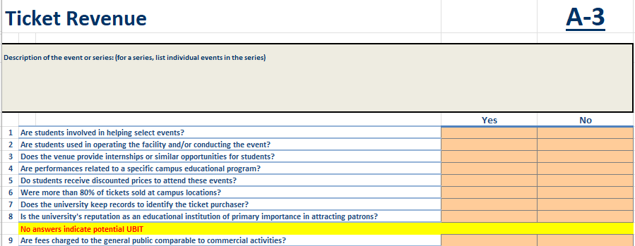
Schedules A-3 & A-5
A-3: TICKET REVENUE
A-5: SPORTS CAMPS
Section A – Camps Operated by the Campus
Section B – Camps Operated by Unrelated Third-Parties
Section C – Camps Operated by Coaches or Other CSU Employees
Notes:
Schedule A-3 is for ticket sales revenue. The schedule consists of a series of yes or no questions to help determine if the revenue is subject to UBIT and is relatively straightforward.
Schedule A-5 is related to sports camps and requires a description of each camp. The schedule is split into the three sections listed on this slide.
Because these camps involve sport facility rentals, there is usually an overlap with reporting on Schedule A-2. If you include the description of these sports camps on your tracking spreadsheet described on the last slide, it will help you complete this schedule quickly.

Slide 14
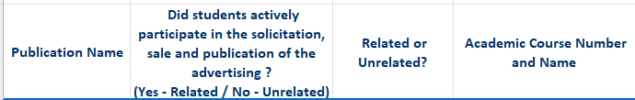
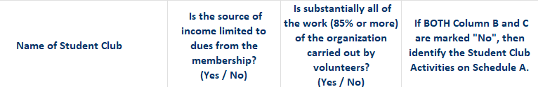
Schedules A-4 & A-6
A-4: ADVERTISING
Publication Name
Did Students Actively Participate
Related or Unrelated
Course # & Name
A-6: STUDENT ORGANIZATIONS
Name of Student Club
Membership Income Only
85%+ Work Performed by Volunteers
List on Schedule A
Notes:
I’ve grouped schedule A-4 and A-6 on this slide as they both similarly formatted with four columns of detail to provide.
Schedule A-4, is for advertising revenue.
This schedule helps determine if any advertising revenue is related or unrelated to the educational purpose by determining if students are involved in the sale or publication from which advertising revenue is generated. If students are involved, the advertising revenue is related.
Schedule A-6, is for Student organizations.
This schedule focuses on whether the income from a student org is from membership dues only and if 85% or more of work done was performed by volunteers. If the answer to both of these questions is no, then the student org must be listed as an activity on schedule A.

Slide 15
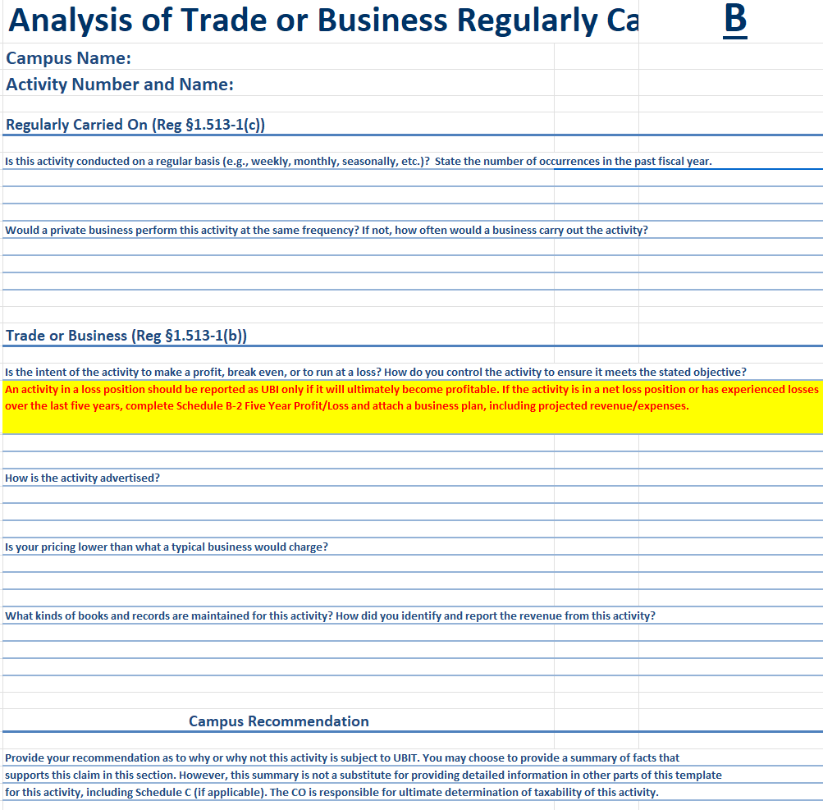
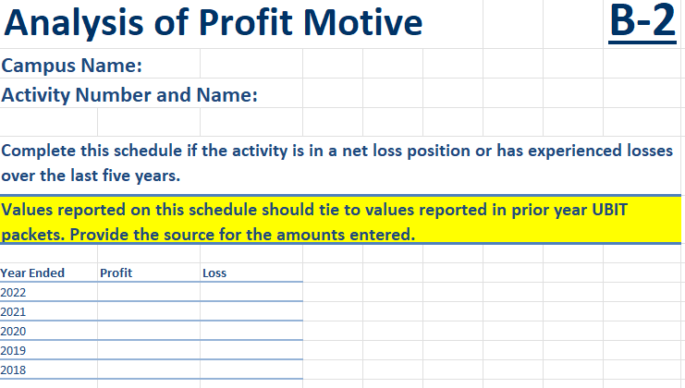
Schedules B & B-2
B: ANALYSIS OF TRADE OR BUSINESS REGULARLY CARRIED ON
B-2: ANALYSIS OF PROFIT MOTIVE
Notes:
Schedule B, is an analysis of each activity to help determine if it is subject to UBIT based on a series of questions. The final portion of this schedule asks you to provide a recommendation on why or why not the activity is subject to UBIT.
Schedule B-2, analysis of profit motive, is generally one of the easier schedules in the packet because you only need to report an activity’s net profit or loss, and only if the activity has experienced a loss in the previous five-year span.
I want to point out that there are instructions on this schedule to include a business plan if the activity aims to become profitable. For our campus, most activities have the intent to break even so we have never had to provide a business plan. That may be different for your campus. So, keep that in mind.

Slide 16
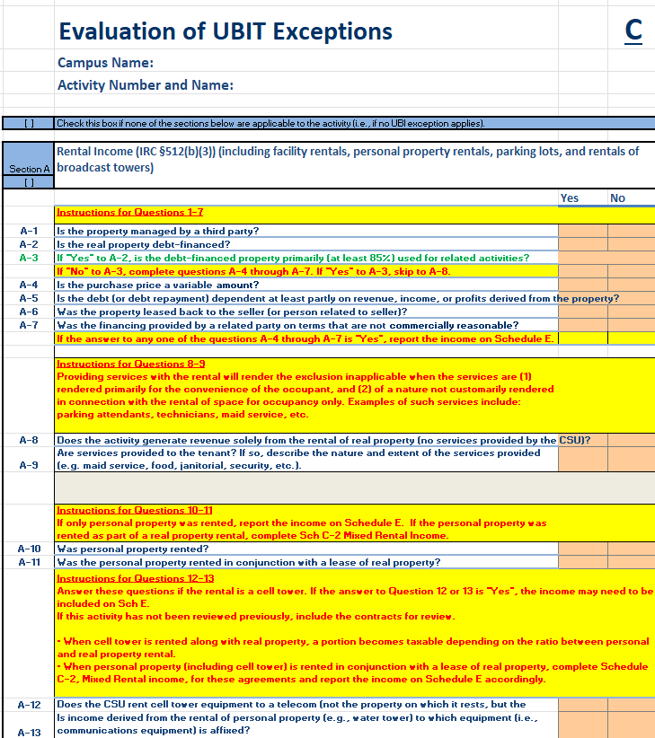
Schedule C: Evaluation of UBIT Exceptions
RENTAL INCOME
ROYALTIES
CORPORATE SPONSORSHIP
CONVENIENCE OF CSU STUDENTS, FACULTY & STAFF
VOLUNTEER LABOR
DONATED MERCHANDISE
RELIEF OF GOVERNMENT BURDEN
GAINS & LOSSES FROM DISPOSITION OF PROPERTY
Notes:
Schedule C is an evaluation of UBIT exceptions. This schedule is used when you believe one of the activities identified as potentially being subject to UBIT meets an exception.
On the left of this slide is a list the 8 exceptions on the schedule. For each exception, the schedule provides a series of questions to help determine if that activity does, in fact, meet the exception.
On this schedule, do not select multiple exceptions. Choose only one exception that you feel applies to the activity and answer yes or no to the questions, to verify if the exclusion applies. If your activity does not meet the criteria of any of these exclusions, do not include a schedule C for the activity.

Slide 17
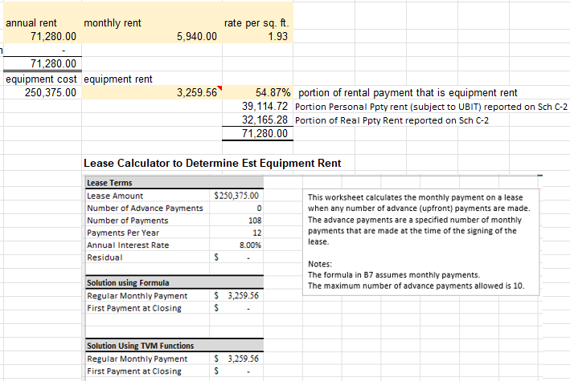
Schedule C-2 MIXED RENTS
C-2: MIXED RENTS
Non-taxable: Real Property
Taxable: Personal Property
Ratio of personal property to real property determines if income is reportable.
If ratio of personal to real is:
<10% Not Reported
>=10% and <=50% Personal Value Reported
>50% Full Amount Reported
Notes:
Schedule C-2 is a calculation of the taxable portion of a rental agreement that includes both real property (space rental) and personal property, such as equipment. Completing this schedule takes heavy lifting in the beginning to determine how much of the rent should be allocated as rental of the space versus rental of the equipment. Start by looking at the rental agreement to see if it specifies if equipment is included in the rent. Often when equipment is included in a rental agreement, an attachment will be included listing the property. Use this to help determine an estimate of rent associated with the equipment.
We have a bowling alley on our campus that is rented to a third party and includes the bowling equipment, which was listed on the rental agreement. My predecessor used the equipment list to research an estimated cost and useful life of the equipment. He then used a lease calculator to estimate the monthly value of rent associated with the equipment.
On the right side of this slide is a screenshot of that calculation for the bowling alley.
By taking the estimated monthly equipment rent over the total monthly rent, we calculated the percentage associated with the rental of the equipment. This percentage determines how much, if any of the rent is subject to UBIT.
If the ratio is less than 10% the real property rental income does not need to be reported. If the ratio is greater than 10% but less than 50%, only the rental value of the personal property is reportable, and if the ratio is greater than 50% the full amount of the rental income is reportable.

Slide 18
Schedules C-3, C-4, C-5, & C6: SPONSORSHIPS
C-3: CORPORATE SPONSORSHIP INCOME
C-4: SPONSORSHIP AGREEMENTS
C-5: ADVERTISING RETURN BENEFITS
C-6: ACKNOWLEDGEMENTS
C-3 Provides list of all sponsorship agreements.
C-4 Completed for sponsorships where sponsor is receiving benefits in return for payment to the university other than advertising.
C-5 Completed for sponsorship agreements with return benefits that include advertising.
C-6 Sponsorship agreements with no return benefits, only an acknowledgement.
Notes:
Schedules C-3 through C-6, are all schedules for sponsorship agreements.
C-3 lists all sponsorship agreements of the university.
For UBIT, sponsorship agreements are split into three categories. Those with return benefits that do not include advertising, those that include advertising, and those that include no other return benefit other than an acknowledgment, not considered advertising.
C-4 provides detail of sponsorship agreements that include return benefits other than advertising.
C-5 provides detail of sponsorship agreements whose return benefits include advertising.
And C-6 includes details for sponsorship agreements that have no return benefits, only an acknowledgement.
The calculation of taxable versus non-taxable benefits can vary based on the agreement, so I’m not going to go in depth on these schedules.

Slide 19
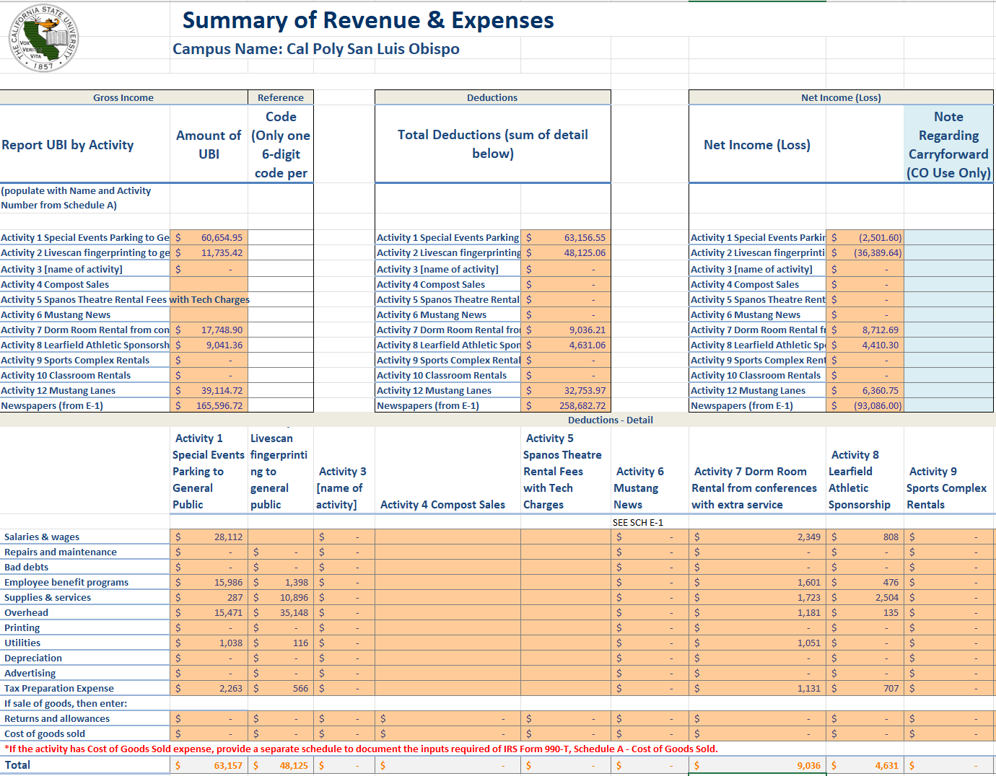
Schedule E: Summary of Revenues & Expenses
Tip: When working on expense allocations, create a summary of expenses based on those listed on Schedule E.
Notes:
Schedule E is the summary of revenues and expenses for any activity that generates taxable income. If the activity reports a loss for the year, it is still included on this summery schedule.
At the beginning of this presentation, I mentioned that creating a P&L for each activity is helpful for allocating expenses. You will use that detail from these P&Ls on schedule E. Here is where we enter unrelated income and the associated expense deductions, including a deduction for tax preparation.
Tip: While working on your expense allocation, create a summary of expenses based on the deductions listed on this schedule.
For instance, utilities might be several lines on your P&L that include electricity, natural gas, & telephones. If you create a summary on the P&L, consolidating these expenses into one of the expense categories on schedule E, like utilities, it can help reduce the time spent completing this schedule.

Slide 20
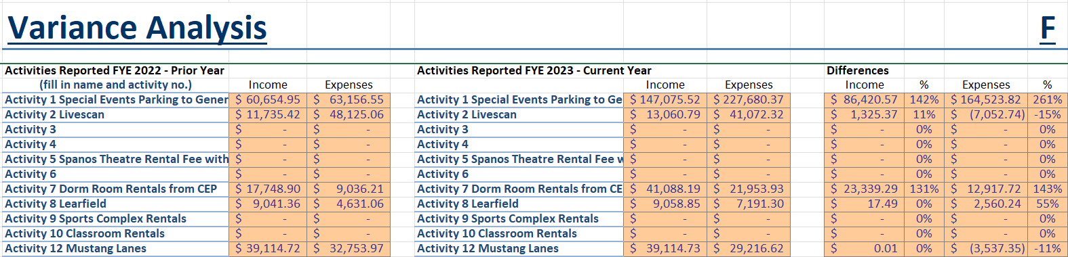
Schedule F: Variance Analysis
Compares prior year’s income & expense to current year’s income & expense.
Variance exceeds BOTH 10% and $10,000, explanation is required.
Tip: When reviewing revenues, note any unusual additions or reductions to help explain variations on Schedule F.
Notes:
The next schedule I’m going to talk about is schedule F, which is the variance analysis of schedule E. It compares the prior year’s revenues and expenses with the current year’s revenues and expenses for those activities subject to UBIT.
If the difference in income and expenses between the two years is greater than 10% AND greater than $10,000, you will need to provide an explanation.
Changes in staffing, including new management hires or retirements, can cause a substantial variance. Revenue from a prior year being received in the current year can skew the revenues, causing a reportable variance. An increase or decrease in third-party activity, such as summer camps and conventions held on campus, may also account for fluctuations that require an explanation.
In my experience, most fluctuations stem from variations in revenue, so my final tip in this presentation is, when reviewing revenues each year, note if there is something unusual in a particular activity that may cause a fluctuation warranting an explanation on schedule F.

Slide 21
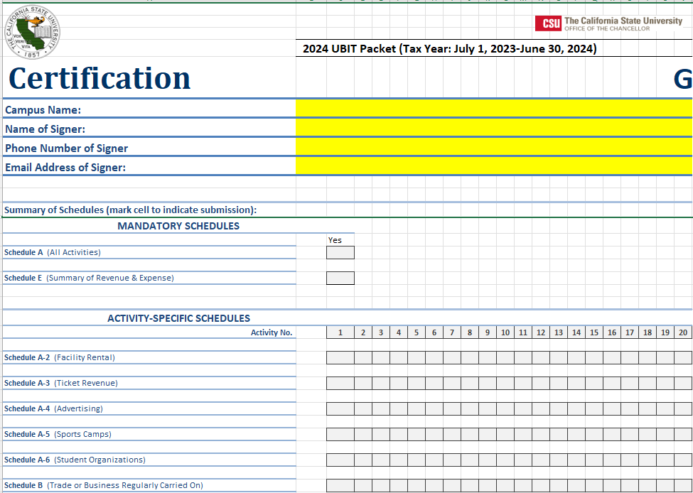
Certification & Checklist
Notes:
The final tab in the packet I want to discuss is the certification and checklist. This tab is the last tab in the packet I complete and is where the designated signer will sign off that the packet is finalized and ready for the Chancellor’s office to review.
The checklist tallies all the schedules included in the packet by activity.
Once you are done with this tab, you are ready to submit your UBIT packet to the Chancellors office. You are done!

Slide 22
Resources:
IRS Publication 598: Tax on Unrelated Business Income of Exempt Organizations
https://www.irs.gov/pub/irs-pdf/p598.pd
CSYOU Tax Administration:
https://csyou.calstate.edu/Divisions-Orgs/bus-fin/Financial-Services/sfsr/tax-administration/Pages/default.aspx
IRS Website: Unrelated Business Income Tax
https://www.irs.gov/charities-non-profits/unrelated-business-income-tax
Lynnetta Zuzow
lzuzow@calpoly.edu
805-756-5812
Notes:
And that concludes my presentation! Thank you for watching! I hope this has given anyone new to UBIT a general overview of the packet and the process to complete it. And for those of you who have experience completing the packet for your campus, I hope seeing a glimpse of how we do it on our campus was helpful.
I’ve listed some of the resources I mentioned during the presentation.
I’ve also included my contact information if you ever want to reach out to me regarding UBIT.
We can open it up to questions.

