Slide 1
Streamlining SFS Processes

Slide 2
Goals of Presentation
Share CSUSM’s approach to common processes we all facilitate in one way or another
Spark ideas
Hopefully lead to improved processes and new efficiencies at your campus, allowing resources to be reallocated to high-value activities

Slide 3
Tracking AR and Collection Agency Placements

Slide 4
Tracking AR and Collection Agency Placements
The case for using PeopleSoft delivered Credit History

Slide 5
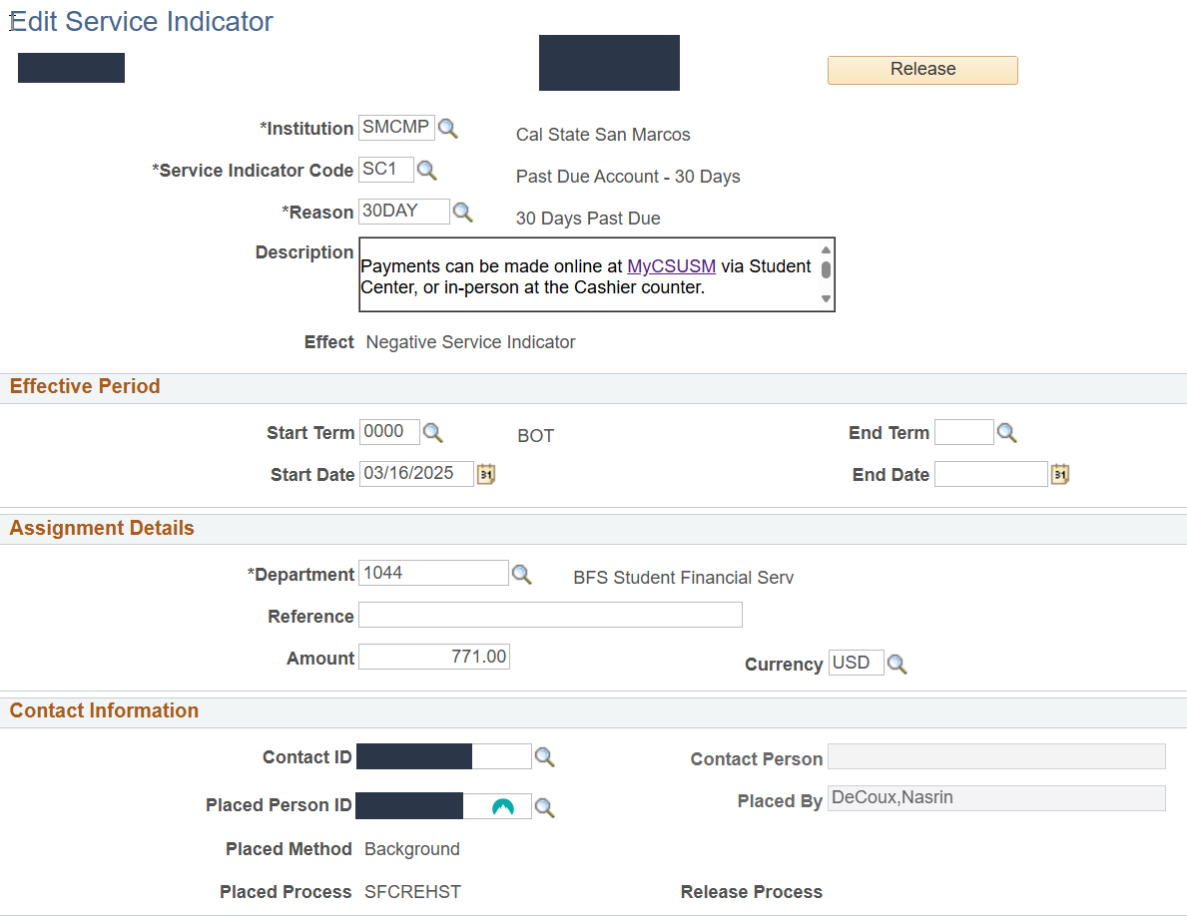
Credit History
System automatically adds, updates, or deletes service indicators that align with your thresholds & aging categories
Indicator placed will be the aging category that is the most past-due
Indicator includes the amount past-due; easy for student and staff to view

Slide 6
Credit History
Reporting is extremely easy

Slide 7
Credit History
Audit – Service Indicator includes time/date stamps that helps you confirm when an indicator was added, changed, or deleted

Slide 8
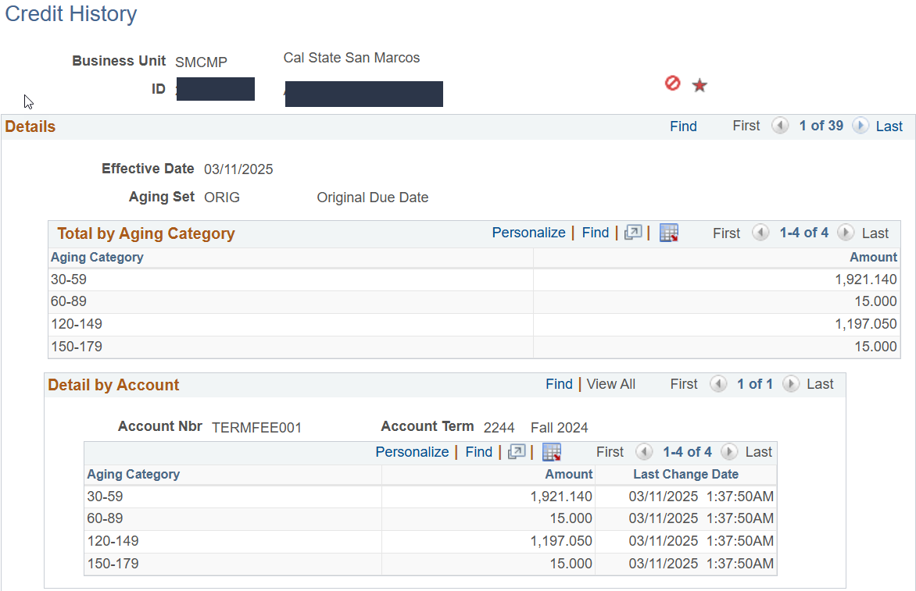
Credit History
Credit History page reveals all past-due totals by aging category

Slide 9
Credit History – Alternative Options
Create an SQR that works similarly to Credit History, updating a “past-due” indicator with the amounts pulled from a query
Using query and mass assign, add and remove past-due indicators

Slide 10
Credit History
Questions regarding Credit History?

Slide 11
Tracking AR and Collection Agency Placements

Slide 12
Tracking AR and Collection Agency Placements
How CSUSM facilitates Agency placements and updates

Slide 13
Collection Agency Placements & Updates
San Marcos uses a daily automated process that identifies students who are “collection agency ready” (having a past-due amount above our threshold of $750 which is 150 days past-due and not already with agency and does not have an indicator active that prevents collections)
Students who meet this criteria have an ‘SCA’ (student collections agency) indicator added via the process; ‘Add Date’ of the indicator is the ‘Delinquency Date’ used with agency; Students can have multiple SCA indicators as they are term-specific to align with the requirements of Williams & Fudge
The indicator will include the amount they are past-due by 150 days in the Amount field

Slide 14
Collection Agency Placements & Updates
The process also identifies students who’s past-due amount that is 150 or more days is different today, versus what is currently in the ‘amount’ field on the ‘SCA’ indicator; this is accomplished by comparing the amount due from ITEM_DUE_SF compared to the amount in the ‘amount’ field of the indicator
If the amount is different, the process will update the amount in the ‘amount’ field on the ‘SCA’ indicator
If the amount that is past-due by 150 or more days has changed to zero, the process will delete the ‘SCA’ indicator

Slide 15
Collection Agency Placements & Updates
A scheduled query runs daily, and sent to our collector for review
The report will contain ‘Adds’ (ready for placement or a new term being added for a student), ‘Changes’ (additional amounts to a term already with the agency), and ‘Deletes’ (a past-due amount by 150 or more days no longer exists);
Report is structured in a format that meets Williams & Fudge’s needs, enabling them to use the excel file to upload new adds (new placement or a new term for an existing placement), add new amounts to an existing term, and delete when last payment has cleared

Slide 16
Collection Agency Placements & Updates

Slide 17
Collection Agency Placements & Updates
File format used for Williams & Fudge

Slide 18
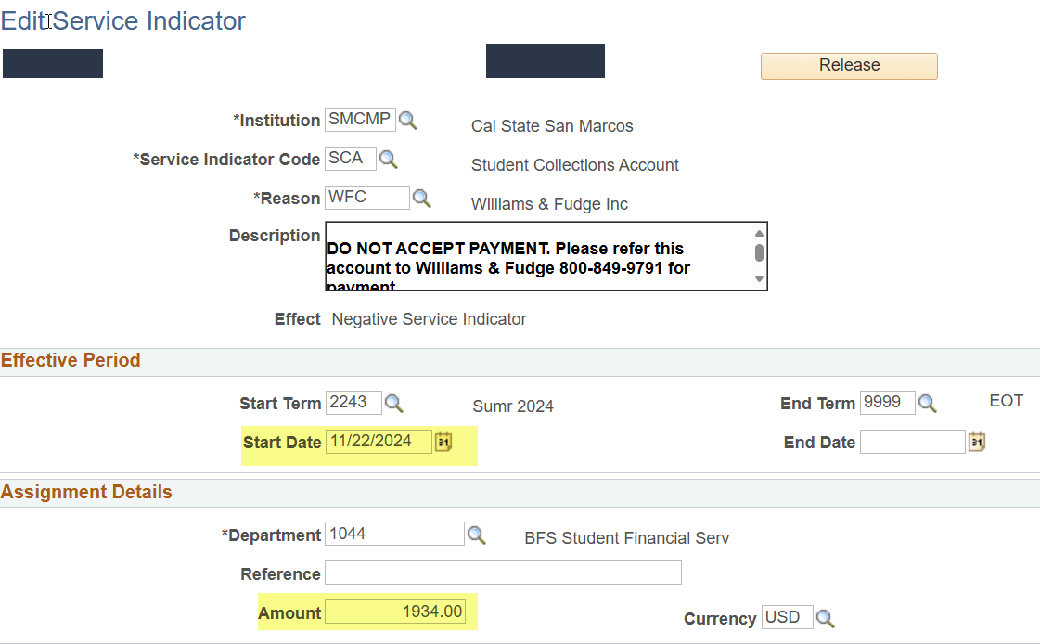
Collection Agency Placements & Updates
Service Indicator data matches data sent to Collection Agency
The amount is specific to the term, and the start date of the indicator is the Delinquency date

Slide 19
Collection Agency Placements & Updates
Benefits of this process:
Massive reduction in manual work by collector
Tracking agency amounts by term aligns with needs of Williams & Fudge
Amount changes – up or down – are tracked and updated in the Agency indicator automatically
Greater visibility and reporting capabilities as to number of students with agency, amounts, and success rates of agency
Easier to maintain accuracy between PeopleSoft and Agency

Slide 20
Collection Agency Placements & Updates
Questions regarding Collection Agency Placements & Updates?

Slide 21
Franchise Tax Board

Slide 22
Franchise Tax Board
Franchise Tax Board is processed nearly the same as collection agency placements
Query identifies a debt that is $10 or more and 150 days past due, and an ‘FTB’ indicator does not exist, nor does a ‘write off’ or ‘do not collect’ indicator
Process adds an FTB indicator, adding the amount that is past-due by 150 days or more in the ‘amount’ field

Slide 23
Franchise Tax Board
Process looks for variances between the amount due from ITEM_DUE_SF and the amount in the ‘amount’ field of the FTB indicator
If amounts do not match, the FTB indicator’s amount is updated with the new amount (up or down)
The “change” process will ignore FTBs that have already been kicked back by FTB (accomplished by changing the reason code of the FTB indicator)

Slide 24
Franchise Tax Board
Process also looks for amounts past due by 150 days, and amount has dropped below $10
Process will delete FTB if that criteria is met
Resource responsible for FTB gets a scheduled query delivered daily with new Adds, Changes, or Deletes

Slide 25
Franchise Tax Board
Sample Daily Report:

Slide 26
Franchise Tax Board
Benefits of this process:
Reduction in manual work (no more “master spreadsheets” and manual look-ups for changes, etc.)
Reduction in errors
FTB and PeopleSoft in sync
Quicker updates to FTB

Slide 27
Veteran Students

Slide 28
Veteran Students
Is your campus fully utilizing the veteran benefits mod?
If not, you may be missing out on an opportunity to streamline your processes related to tracking veteran payments!

Slide 29
Veteran Students
A nightly process runs that identifies any veteran student who has new enrollment or had a change to their enrollment or financial aid (aid that can pay tuition only)
New enrollment, or changes to existing enrollment, create an “in review” row in the Tuition Worksheet page
This allows SFS and/or certifying officials the ability to certify Tuition and Fees accurately and quickly catch changes that may impact what has already been reported

Slide 30
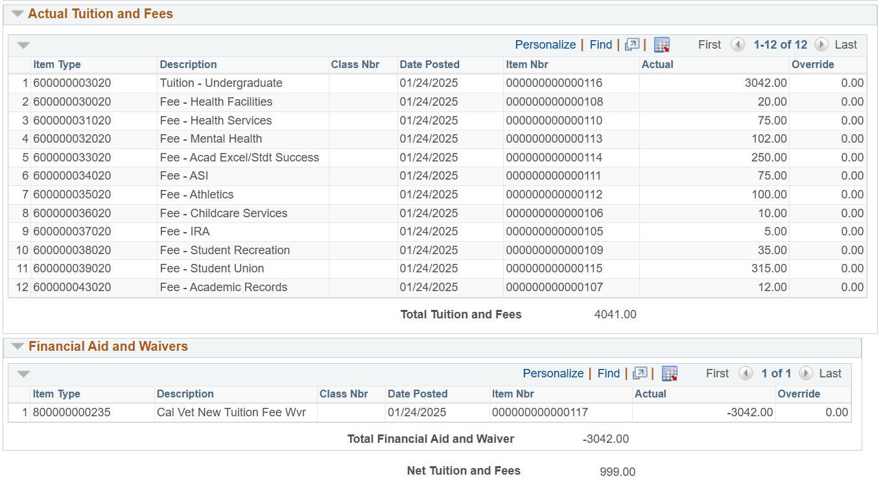
Veteran Students
The ‘Veterans Tuition Worksheet’ contains all the fees and financial aid that are associated with the student’s enrollment for a specific term
Upon review and confirming, a certifying official will change the status to ‘reported’

Slide 31
Veteran Students
Using query, it’s easy to identify who’s enrollment or aid has changed, allowing for quicker response for updating the VA, adjusting a third-party contract, and adjusting payments (or aid) on the student account where necessary

Slide 32
Veteran Students
Veteran Benefits Mod (Tuition & Fees) Process

Slide 33
Veteran Students
Benefits of this process:
Easier for Veteran Center and SFS to stay in sync
Quicker to catch students who need their benefits or aid adjusted
With quicker catches to changes, easier to collect additional payments if necessary

Slide 34
Veteran Students
Queries that help SFS with veteran benefits processes

Slide 35
Veteran Students
Queries that help SFS with veteran benefits processes
“Tuition & Fees changes”
What it does: Identifies students who’s tuition and fees that are reportable to the VA has changed since the initial certification of T&F
Benefits: Helps SFS catch changes quickly and adjust third party up or down as necessary

Slide 36
Veteran Students
Queries that help SFS with veteran benefits processes
“Veteran Student and NONRES Present”
What it does: Identifies students using Veteran benefits and also have nonresident tuition on account
Benefits: Helps SFS staff ensure veteran-benefit students are not improperly charged nonres tuition

Slide 37
Veteran Students
Queries that help SFS with veteran benefits processes
“Cal Vet and Aid”
What it does: Identifies students who have cal vet waiver, but also awarded a tuition-based grant
Benefits: Helps SFS remove Cal Vet waiver so tuition paid by grant instead

Slide 38
Financial Aid Adjustments

Slide 39
Financial Aid Adjustments
As it has been determined that financial aid adjustments that create a new balance should be considered “new debt”, San Marcos updates the due-dates for any debt that results from an aid adjustment
Due Dates are updated to the same date as the adjustment, so students are not instantly past-due with late fees and holds
Students are sent an email notifying them of the adjustment resulting in a balance

Slide 40
Financial Aid Adjustments
A query runs daily that identifies when an ‘F’ item type is reversed, and a balance greater than zero exists
Query identifies each line item that was impacted by the financial aid adjustment
Process updates each line item’s due date with today’s date

Slide 41
Financial Aid Adjustments
Sample:
Student has a reduction of Middle Class Scholarship of $288 on 3/19/25

Slide 42
Financial Aid Adjustments
Sample:
Student has a reduction of Middle Class Scholarship of $288 on 3/19/25

Slide 43
Financial Aid Adjustments
Sample:
Reduction resulted in a balance owed on the refund line item

Slide 44
Financial Aid Adjustments
Sample:
Process updated the line item to have the 3/19/25 due date

Slide 45
Financial Aid Adjustments
Benefits of this process:
Significant reduction in manual work
No need to manually track aid adjustments
No need to manually apply an indicator to defer amounts or protect them from late fees or holds, and then track when it can be removed
Due Dates reflect accurately in system for students and staff
Student will not be instantly past-due for debt that was just created today

Slide 46
Financial Aid Adjustments
Questions on Financial Aid Adjustments?

Slide 47
Outstanding Checks

Slide 48
Outstanding Checks
When our team is notified of an outstanding check, we:
Place an “outstanding check” indicator on the student account
Automated/nightly process adds an outstanding check checklist on student account
Process automatically sends a communication to the student the same day, and every 30 days from there, for up to 4 months, until the student cashes the check
Upon check being cashed, checklist is completed and indicator removed

Slide 49
Outstanding Checks
Benefits of this process:
Checklist shows in the student’s “To-Do Items” in their Student Center
Checklist placement and communications are automated

Slide 50
Resources

Slide 51
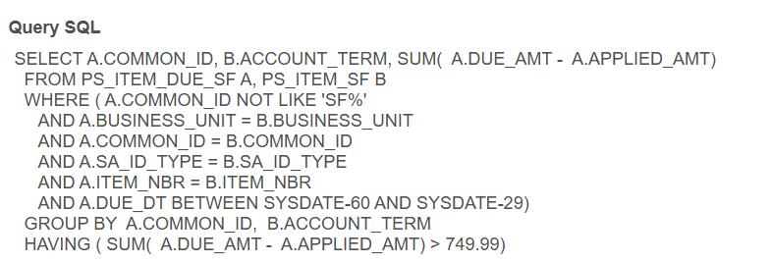
Resources
Query to identify who is past-due between 30 and 59 days, and $750 or greater

Slide 52
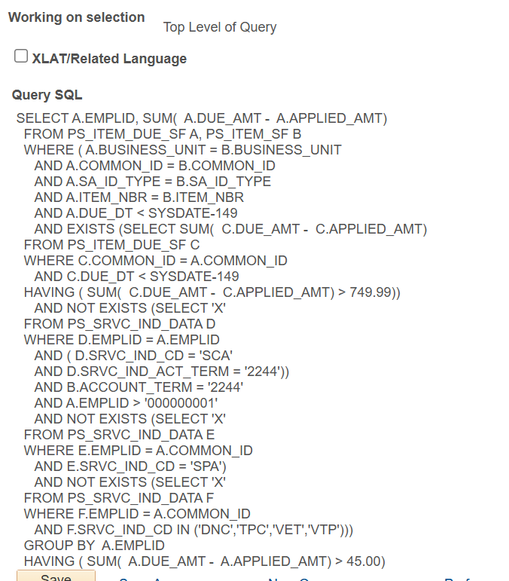
Resources
Query to identify who is ready for collection agency placement

Slide 53
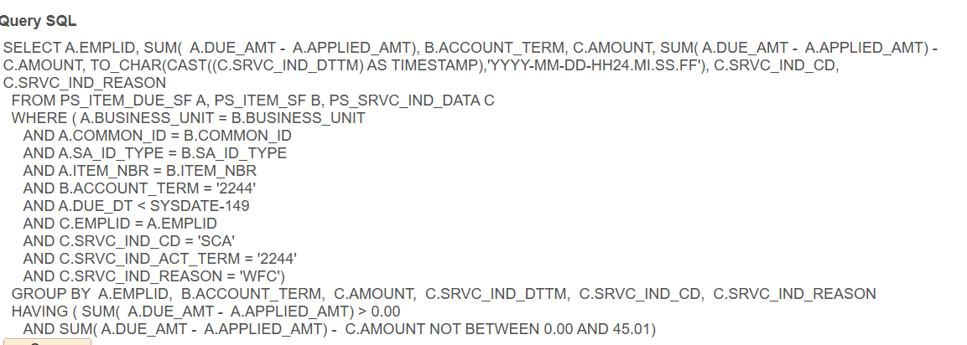
Resources
Query to identify who’s 150+ past-due amount is different than what is in the amount field of the collection agency indicator

Slide 54
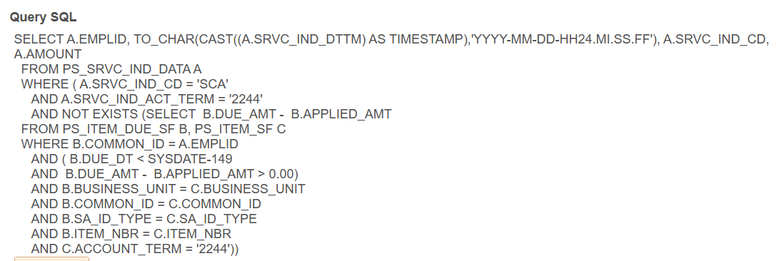
Resources
Query to identify who’s collection agency indicator can be deleted (a 150+ amount no longer exists)

Slide 55
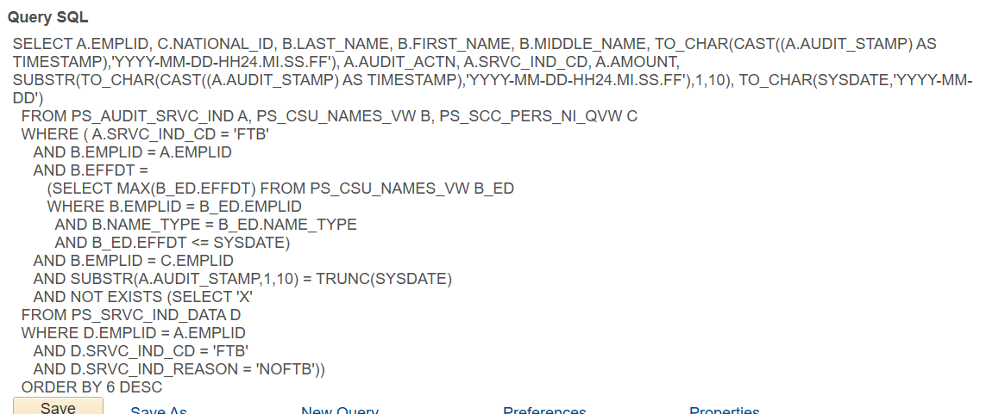
Resources
Sample daily activity report for FTB indicator that is sent to resource maintaining FTB

Slide 56
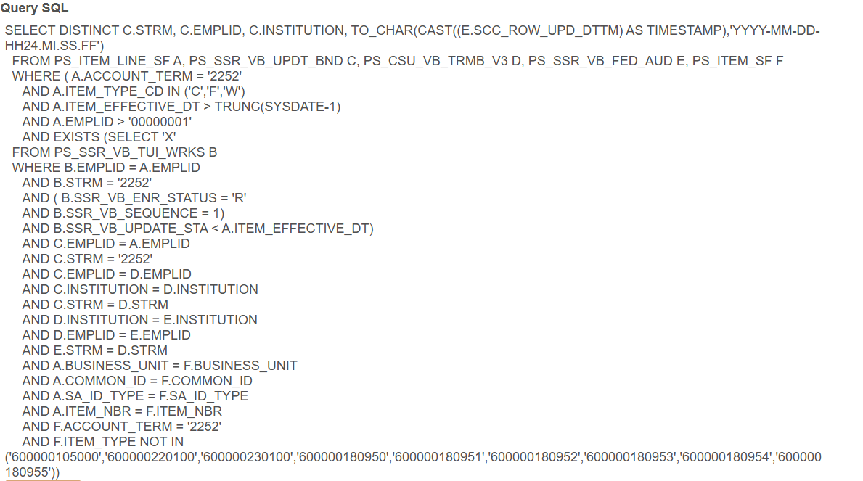
Resources
Query to identify students using veteran benefits and a recent change to enrollment or aid has occurred since original T&F certification

Slide 57
Resources
Query that identifies an FA line item that was reversed and a balance exists
SELECT A.EMPLID FROM PS_ITEM_LINE_SF A WHERE ( A.ITEM_TYPE_CD = 'F' AND A.LINE_AMT > 0.00 AND A.POSTED_DATE > TRUNC(SYSDATE-1) AND EXISTS (SELECT 'X' FROM PS_ACCOUNT_SF B WHERE B.EMPLID = A.EMPLID AND B.ACCOUNT_TERM IN ('2114','2212','2213','2214','2222','2223','2224','2232','2233','2234','2242','2243','2244','2252','2253','2254','2262','2263','2264') AND B.ACCOUNT_BALANCE > 0.00))

Slide 58
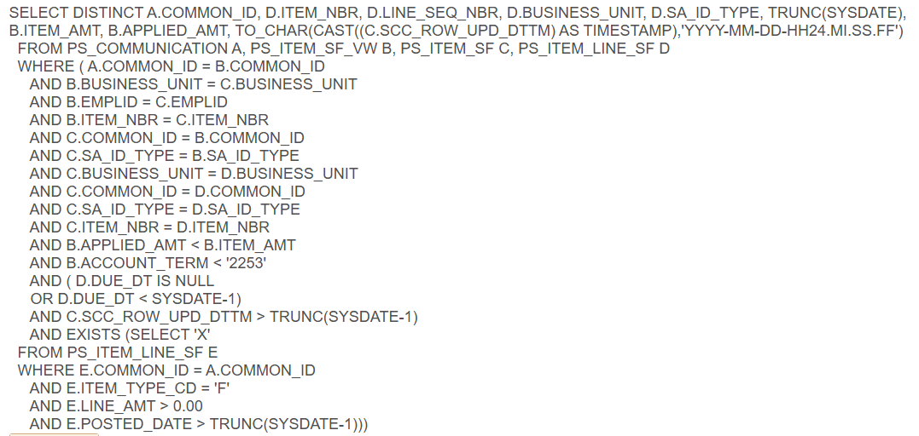
Resources
Query that identifies the exact line items that were impacted by an FA reversal and need a new due date

Slide 59
Questions?

Slide 60
Thank you

