Slide 1


Strategic Procurement & Contracting in the CSU
Sara Bonakdar
Associate Vice President, Strategic Business Services

Slide 2
Topics
CSU Authority & State Sovereignty
Legal Entities on Campus
Vendors: Public vs. Private
Delegated Authority
23C Procurement
Sourcing
Solicitations
Accessible Technology
Methods: Requisitions, Procurement Card, Direct Pay
Insurance

Slide 3
CSU Authority
Who are you, CSU?
  CSU is the State of California acting in a higher education capacity
  Acts through it’s Trustees of the California State University
  Created and defined by Statute
  A single legal entity with 22 campuses and the CO
“As Chief Procurement Officers we are dedicated to driving value and using the collective power of the CSU as one procurement team of 100+ professionals.”
– 23CPlan

Slide 4
CSU Authority
Constitution
Articles
Legislature Governor
Codes
Board of Trustees
Regulation Resolution
Chancellor
Executive Order
Campus President
University Policies

Slide 5
State Sovereignty
State Sovereignty is a constitutional tenet found in the tenth Amendment to the U.S. Constitution and within State constitutions
To do business in California, businesses must comply with state statutes and requirements
Persons dealing with State agency are presumed to know the law

Slide 6
Legal Entities
The campus is the State of California acting in its higher education capacity.
Other legal entities on a campus include:
  Auxiliaries: Foundation, Associated Students, etc. 501(c)(3) non-profit corporations.
Self-support activities are State activities with an enterprise fund. Examples include parking, housing, extended education programs.

Slide 7
Public vs. Private
Private
  Confidential, proprietary, secret
  Knowledge is Business Advantage
  If it is legal it’s okay
  Survival of the fittest
  Moves very fast, decisions made quickly
  Profit motive / incentive
Public
  Open & Transparent
  Inclusive & Fair process
  Public Records Act
  Protest of Awards
  Driven by Statute & Policy
  Low bid / cost controls
  Time required for process
  Public funds

Slide 8

Delegation of Authority
Authority to sign purchase orders, contracts, interagency agreements, and to certify contractual documents is limited to Procurement Officers and Administrators who have been duly delegated in writing by the Campus President or designee.

Slide 9
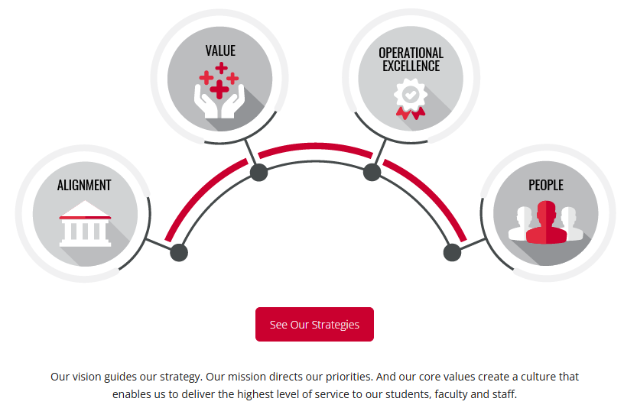
Collaboration – 23C Procurement
As Chief Procurement Officers (CPOs), we’re dedicated to driving value and using the collective power of the CSU as one procurement team of 100+ professionals. As we established our 23C Procurement three-year plan we took the time to understand the challenges and opportunities facing our individual campuses. Although we see many headwinds in the future, we found alignment with the setting of 23 goals that will contribute $65 million in value over the next three years. Overall we know we can succeed by working together and growing people who fulfill the vision.
Link to 23C Procurement

Slide 10
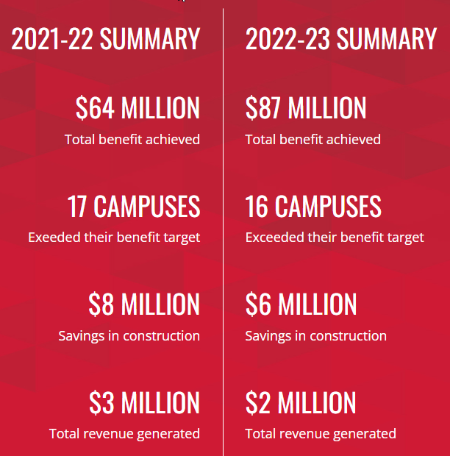
Collaboration – Shared Standards
Our vision is to support the CSU’s mission of educating tomorrow’s leaders by becoming a strategic partner contributing to the financial health of the CSU, higher education and bolstering California’s economy
Our mission is to be a trusted partner through collaboration to maximize value across the CSU by optimizing the procurement of goods and contracted services
Our commitment to customer service excellence will be guided by our core values: Integrity, transparency, inclusiveness and professionalism

Slide 11

Procurement at the Campus
Usually in the Administration & Finance Division
Consisting of multiple work units, not always the same at every campus
  Procurement & Contracting, includes Public Works
  Distribution Services: Sending and receiving mail and parcels
  Asset Management: Tagging assets, inventory, disposal of assets
  Accounts Payable and Travel
  Reprographics, Print Services, Copier Programs
  Risk Management
Alex Rosales, Fullerton – This year’s CPOA President

Slide 12
Contracts & Agreements
Goods & Services
Clinical Internships: Teaching, Nursing, etc.
Memorandum of Understanding (MOU)
Inter-agency & Intra-agency
Capital Equipment Leases
Real Property Leases (Ground or Facility)
Tax-Exempt Financing
Emergency Agreements
Auxiliary
  Signature authority is delegated by the President

Slide 13
Sourcing
Our faculty buy:
  Microscopes, telescopes, chemicals, animals, sensors, lasers, wind tunnels, furniture, etc.
Our students clubs and athletic teams charter:
  Planes, buses, and boats
Our facilities management builds and maintains:
  Buildings and their systems, roads, domestic water infrastructure, thermal storage plants, electrical substations
Our information technology divisions buy:
  Computers, servers, software licenses, data security applications and hosting platforms
Our housing programs buy:
  Dorm furniture, mattresses and food service

Slide 14
Solicitations
Fair and Open Competition
  The CSU is committed to a policy of promoting fair and open competition
  Education Code and Public Contract Code
Bidding
  To meet the requirements for the requested goods or services
  Comply with legal policies and requirements
  Ensure prudent use of public funds
  Reduce/eliminate favoritism, fraud, and corruption
  Provide qualified firms fair opportunity to participate

Slide 15
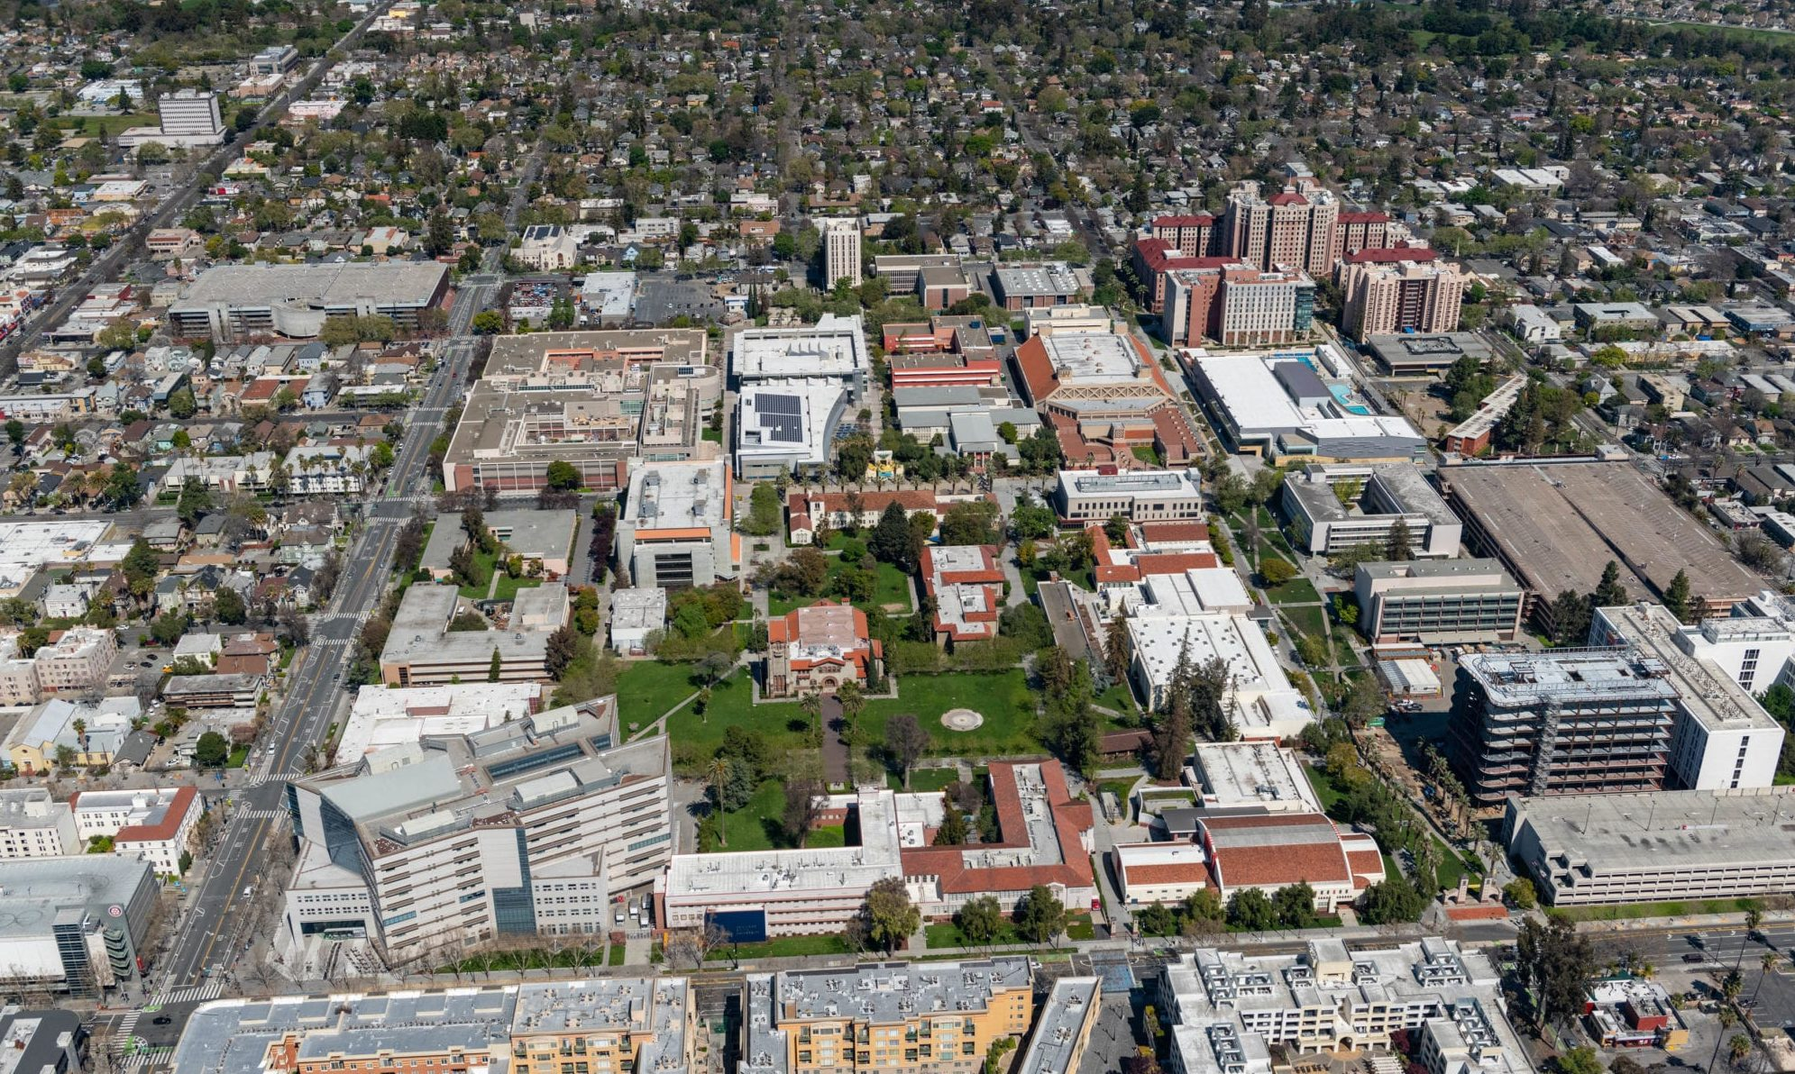
Sourcing
We are small cities:
  457,992 students; 56,256 employees
  With streets, housing, buildings, utilities, clinics, etc.
  Open 24/7, 365 D/Y
  CSU Combined Procurement
    FY 21-22: $3.0B
    FY 22-23: $3.2B
    FY 23-24: $3.4B
    FY 24-25: $2.5B (to date)

Slide 16
Solicitations – CSU Policy Requirements
Type | Less than $49,999 | $50,000-$100,000 | $100,001-$500,000 | > $500K
Goods | Competition not required but an informal solicitation is highly recommended | SB/DVBE Option OR Three (3) informal quotes | SB/DVBE Option (up to $250K) OR Formal solicitation, advertised in CSUBUY (10 Business Days)
Services | Competition not required but an informal solicitation is highly recommended | SB/DVBE Option OR Three (3) informal quotes | SB/DVBE Option (up to $250K) OR Formal solicitation, advertised in CSUBUY (10 Business Days)
ITR Goods | Competition not required but an informal solicitation is highly recommended | SB/DVBE Option OR Three (3) informal quotes | SB/DVBE Option (up to $250K) OR Three (3) informal quotes | Formal solicitation, advertised in CSUBUY (10 Business Days) *Feasibility Study may apply for ITR estimated at $1M+
ITR Services | Competition not required but an informal solicitation is highly recommended | SB/DVBE Option OR Three (3) informal quotes | SB/DVBE Option (up to $250K) OR Three (3) informal quotes | Formal solicitation, advertised in CSUBUY (10 Business Days)
**IT purchase requisitions are subject to CSU ATI and Information Security policy requirements

Slide 17
Accessible Technology
“It is the policy of the CSU to make information technology resources and services accessible to all CSU students, faculty, staff, and the general public regardless of disability”
All CSU programs, services, and activities should be accessible to all students, staff, faculty, and the general public
  This encompasses all technology products used to deliver academic programs and services, student services, information technology services, and auxiliary programs and services

Slide 18
Methods
Requisitions
  A requisition submission is a request to Procurement to purchase supplies, goods, and/or services on behalf of the University/requesting department
Low Value Purchases – Reference CSU Contracts & Procurement Policy Section 4.
  Direct Pay: Items on the Direct Pay list may be processed
    Books, subscriptions, permit fees, postage fees, etc.
  Catalog Purchases on CSUBUY: CSU master contracts with online ordering
    Existing/awarded contract on behalf of the CSU and its campuses
  Procurement Card: Departments may use the P-Card for routine, day-to-day commodity purchases to achieve cost savings and improve processing time

Slide 19
Insurance Requirements
Requisitions for onsite services require specific insurance coverage and documentation before orders can be generated
General Liability, Business Automobile Liability, and Workers Compensation insurance are required with specific limits
Procurement confirms that the insurance carrier holds a current A.M. Best’s rating of A:VII and is authorized to conduct business in California

Slide 20
Insurance
The State of California has elected to be self-insured for its general liability, vehicle liability, workers’ compensation and property exposures. As a state agency, the CSU Office of the Chancellor, the Trustees, and the 23 CSU campuses are included in this self-insured program, administered through the CSU Risk Management Authority (CSURMA), A Joint Powers Authority.
CSURMA programs include:
  Pooled Liability
  Pooled Workers’ Compensation
  IDL/NDI/UI
  Property Program
  Athletic Injury Medical Expense (AIME)
  Auxiliary Organizations Risk Management Alliance (AORMA)

Slide 21

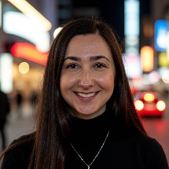
Contact Info
Sara Bonakdar - San Jose State University
Associate Vice President, Strategic Business Services
sara.bonakdar@sjsu.edu
408-924-1561

Slide 22
Resources

Slide 23
Federal & State
U.S. Constitution – Bill of Rights (10th Amendment)
Donahoe Act 1960
California Law (29 Codes)
California Code of Regulations

Slide 24
Procurement Sites & Associations
NIGP Institute for Public Procurement
National Procurement Institute (NPI)
National Association of Education Procurement (NAEP)
Institute for Supply Management

Slide 25
Chancellor’s Office Sites of Interest
CSU Policy Library
CO Contract Services & Procurement Site
Supplier Resources
Capital Planning Design & Construction
Auxiliary Organizations of the CSU
CSU Fact Book
Reporting Transparency (contract award by campus)
Risk Management
Accessible Technology Initiative

