Slide 1
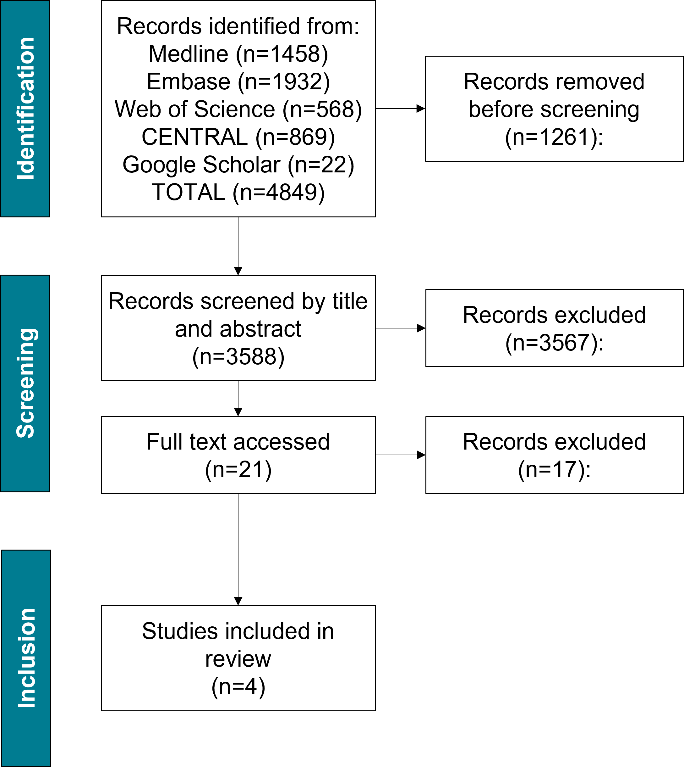
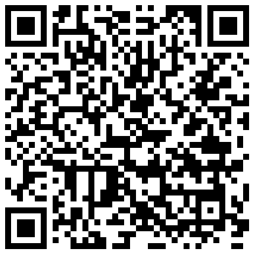
Public health effectiveness of warm spaces during periods of adverse cold weather:
a systematic review of the literature
Natalie Adams¹, Charles Dearman¹, Katya Brooks¹, Agostinho Sousa¹, Nicola Pearce-Smith¹, Carl Petrokofsky¹
¹UK Health Security Agency
INTRODUCTION
RESULTS
DISCUSSION
In some countries, such as Canada and the USA, warming centres have been a longstanding approach to sheltering some of the most vulnerable members of society from extreme cold weather.
In England, recent cold winters coupled with concerns around the costs of heating, has seen the emergence of small-scale, local interventions to establish warm spaces.
However, the effectiveness of warm spaces in improving the health and wellbeing of attendees is unclear.
AIM: To establish the evidence base for warm spaces as a public health strategy.
Four studies were identified for inclusion in the final review; all of which were qualitative.
Studies were from three countries; Canada (n=2), USA (n=1), UK (n=1).
Three studies focused on warm space provision for rough sleepers.
One study used interviews from the local community in which a warm space was located.
Warm spaces are often located in community venues that people visit for other purposes.
In England, there are several examples of partnerships between local authorities, communities and third sector organisations to offer a warm space, and resources, for example hot drinks and internet access.
In Canada and the USA, warm spaces are usually provided specifically for rough sleepers and offer multiple additional services and support. Findings from these warm spaces may not be representative of warm spaces offered to the wider population.
There was limited evidence on the effectiveness of warm spaces on health and wellbeing due to a lack of evaluation of existing facilities.
Future development of warm spaces should consider evaluating impacts of attendance on health and wellbeing such as cold-related morbidity and mortality as well as wider measures of health and wellbeing including loneliness and isolation.
Provision of refreshments is a facilitator for attending warm spaces
Figure. Hot drinks from Microsoft PowerPoint
No studies directly assessed health and wellbeing outcomes following use warm spaces; studies focused on the characteristics of attendees and the barriers and facilitators to using warm spaces.
Health outcomes assessed included physical and mental health, substance use.
Wellbeing outcomes assessed included safety and security.
Barriers to the use of warm spaces included security concerns, travel or access issues, caring or work commitments, lack of knowledge of or understanding about warm spaces.
Facilitators for the use of warm spaces included provision of food/drink, offering social activities and interaction, welcoming atmosphere, advice and support services for cold weather, easy access via public transport and flexible opening hours.
METHODS
Systematic review using electronic databases (MEDLINE, Embase and Web of Science) as well as CENTRAL and Google Scholar from 1 January 2010 to 14 February 2023.
Screened for inclusion based on titles and abstracts and then full text by two reviewers independently.
Quality assessment using The Mixed Methods Tool (MMAT).¹
REFERENCES
Scan QR code for protocol
Hong QN, Pluye P, Fàbregues S, Bartlett G, Boardman F, Cargo M, Dagenais P, Gagnon M-P, Griffiths F, Nicolau B, O’Cathain A, Rousseau M-C, Vedel I. Mixed Methods Appraisal Tool (MMAT), version 2018. Registration of Copyright (#1148552), Canadian Intellectual Property Office, Industry Canada.
Figure. Flow diagram of review process

