Slide 1


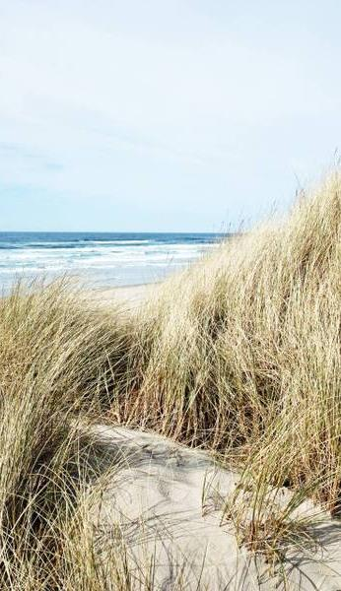
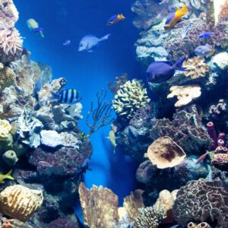

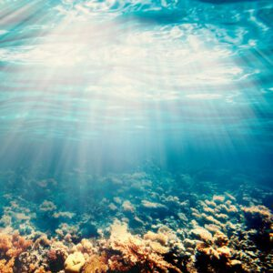


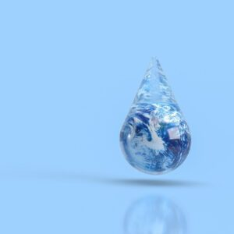
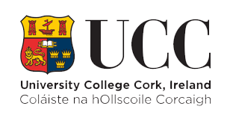
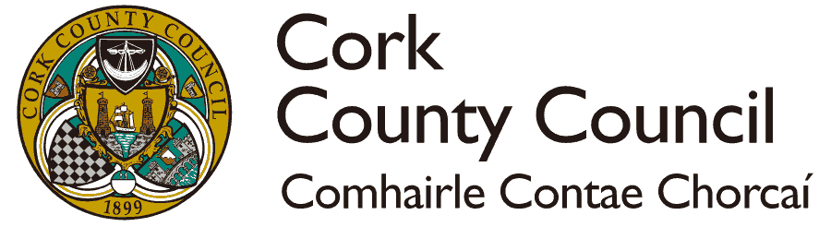
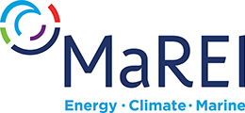
The Atlantic-Artic Agora Project A blueprint for the restoration of marine and coastal ecosystems and increased climate resilience through cross-sectoral cooperation and transformative innovation
Emma Verling, Camila Tavares, Darragh O'Suilleabhain, Lee W Pay
A-AAGORA will work towards achieving the European Commission Mission ‘Restore our Ocean and Waters by 2030’ objectives.
Mission objectives
To this end, A-AAGORA will
Carry out demonstration activities in three regions covering the Atlantic-Arctic basin.
Co-identify areas and locations where the tested Nature Base Solutions are replicable.
Co-develop blueprints for the Atlantic-Arctic lighthouse.
Develop an Atlantic-Arctic digital knowledge system to support transformative innovation processes.
Provide innovative solutions to the market and foster deliberative democracy.
To Protect and restore marine and freshwater ecosystems and biodiversity.
Duration
01/12/22 – 31/05/26
To prevent and eliminate pollution of our ocean, seas and waters.
Partners
30 partners across the EU
Demostration areas
Ireland – Norway - Portugal
To make the sustainable blue economy carbon-neutral and circular.
More information
https://a-aagora.eu/

