Slide 1
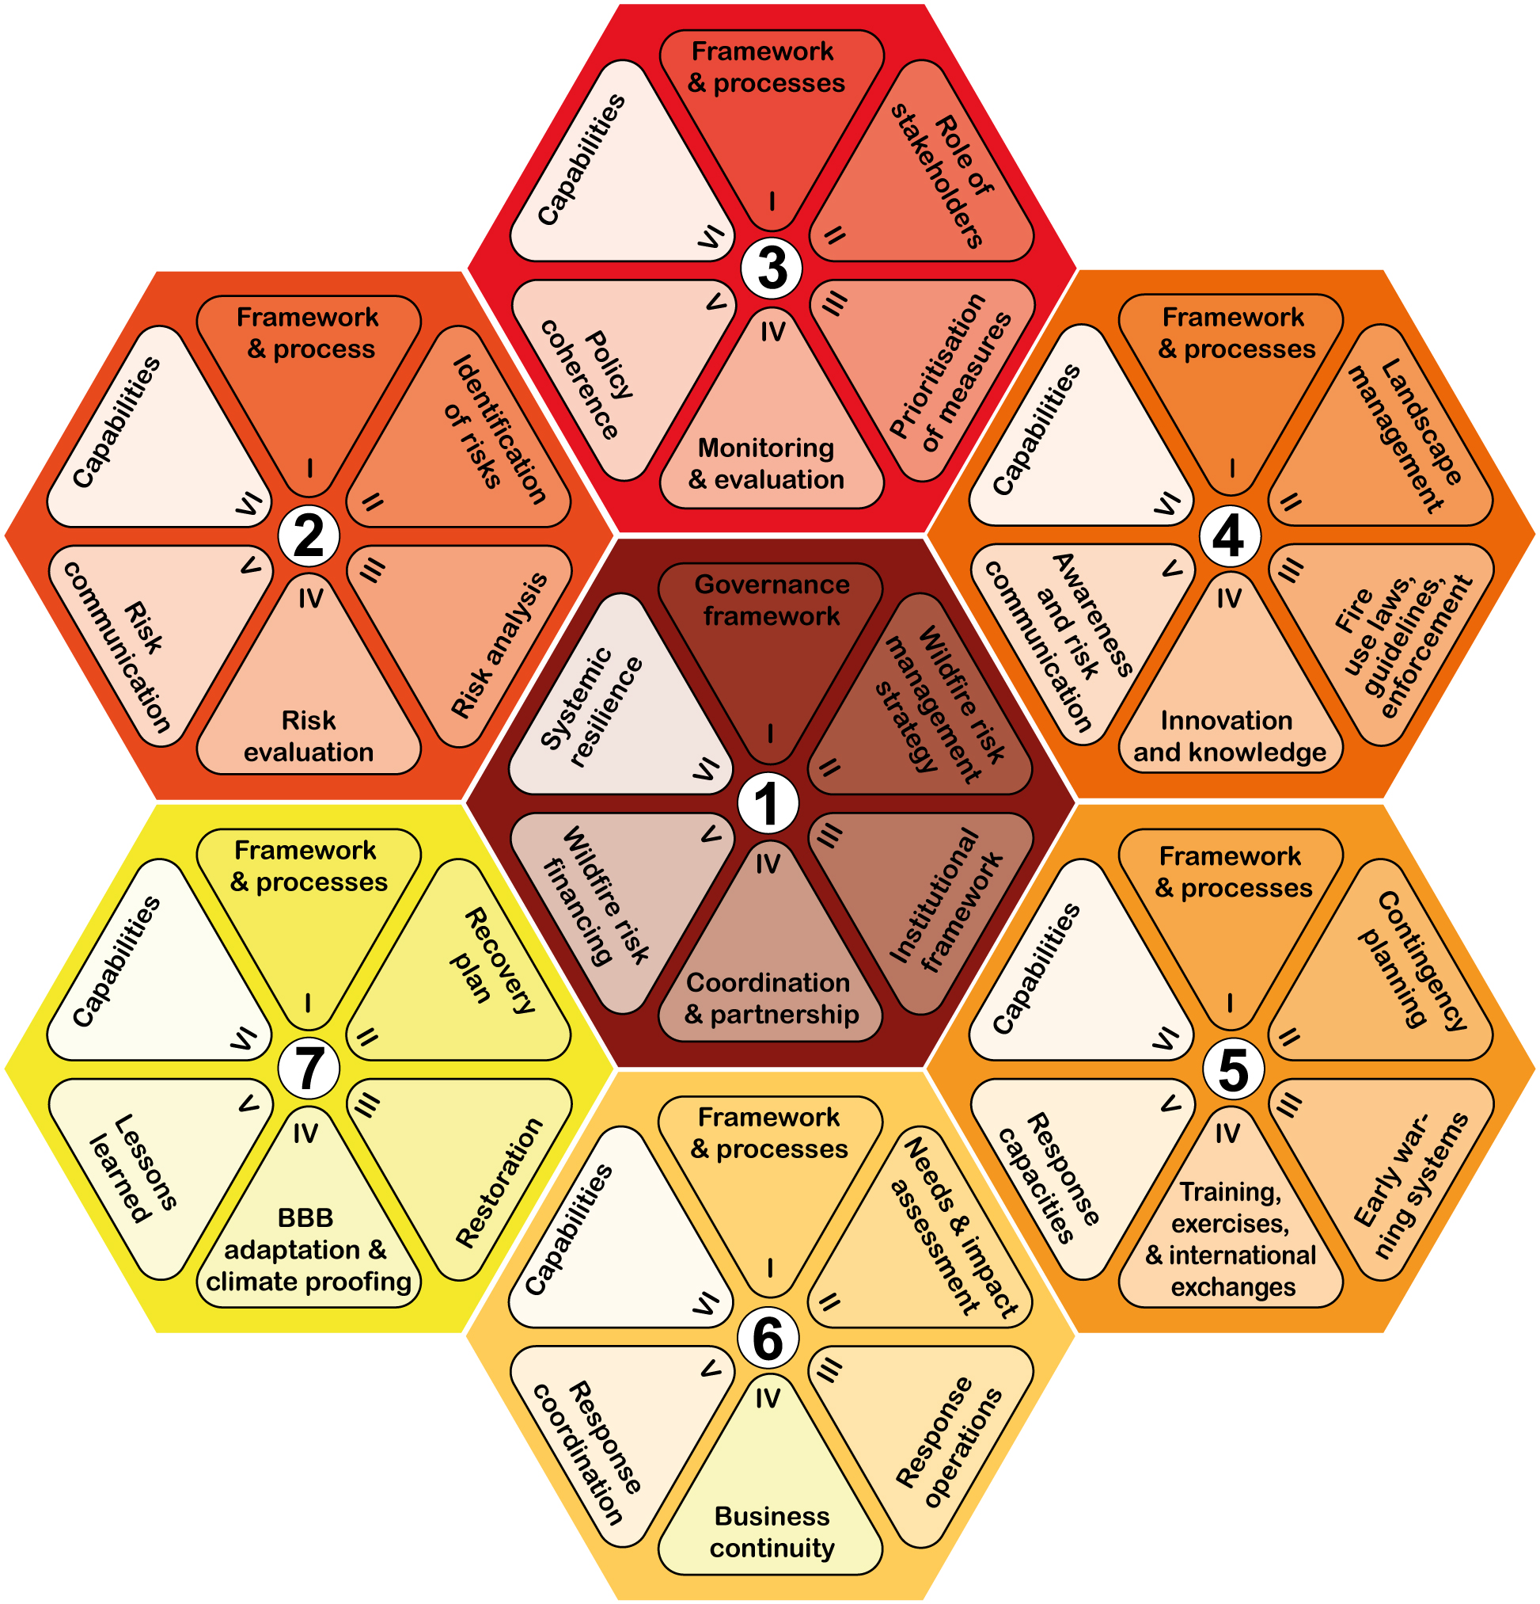
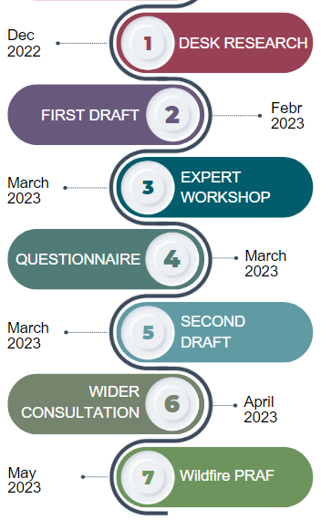
WILDFIRE RISK MANAGEMENT IN A CHANGING CLIMATE: A COMPREHENSIVE ASSESSMENT FRAMEWORK TO CONDUCT PEER REVIEWS UNDER THE UNION CIVIL PROTECTION MECHANISM.
Casartelli V., Mysiak J. 2023 – Euro-Mediterranean Center on Climate Change | Ca’ Foscari University of Venice
Provides a country/region with an excellent opportunity to reflect on its readiness to cope with natural and human-induced related disasters and to identify ways of improving risk management systems.
WILDFIRE PEER REVIEW ASSESSMENT FRAMEWORK – Wildfire PRAF*
PROCESS & TIMELINE
WILDFIRE RISK MANAGEMENT PLANNING
2022 wildfire season (11 UCPM activations)
GOVERNANCE of WILDFIRE RISK MANAGEMENT
Launch of the EU Wildfire Prevention Action Plan
Targeted UCPM Wildfire peer reviews
Development of a Wildfire PRAF to support consistent and comparable reviews across EU
OBJECTIVES & CHARACTERISTICS
Guide for the peers to assess the wildfire DRM system of a country/region
WILDFIRE RISK ASSESSMENT
WILDFIRE PREVENTION
Self-assessment tool for countries/regions
Composed of 7 thematic areas (hexagons) made up of 6 topics (wedges)
Flexible, to support both comprehensive and thematic peer reviews
RECOVERY & LESSONS LEARNED
WILDFIRE PREPAREDNESS
WILDFIRE EMERGENCY REPONSE
*The Wildfire PRAF (Casartelli V., Mysiak J. 2023) was financed by the European Union and developed within the UCPM Peer review programme 2020-2024 by

