Slide 1
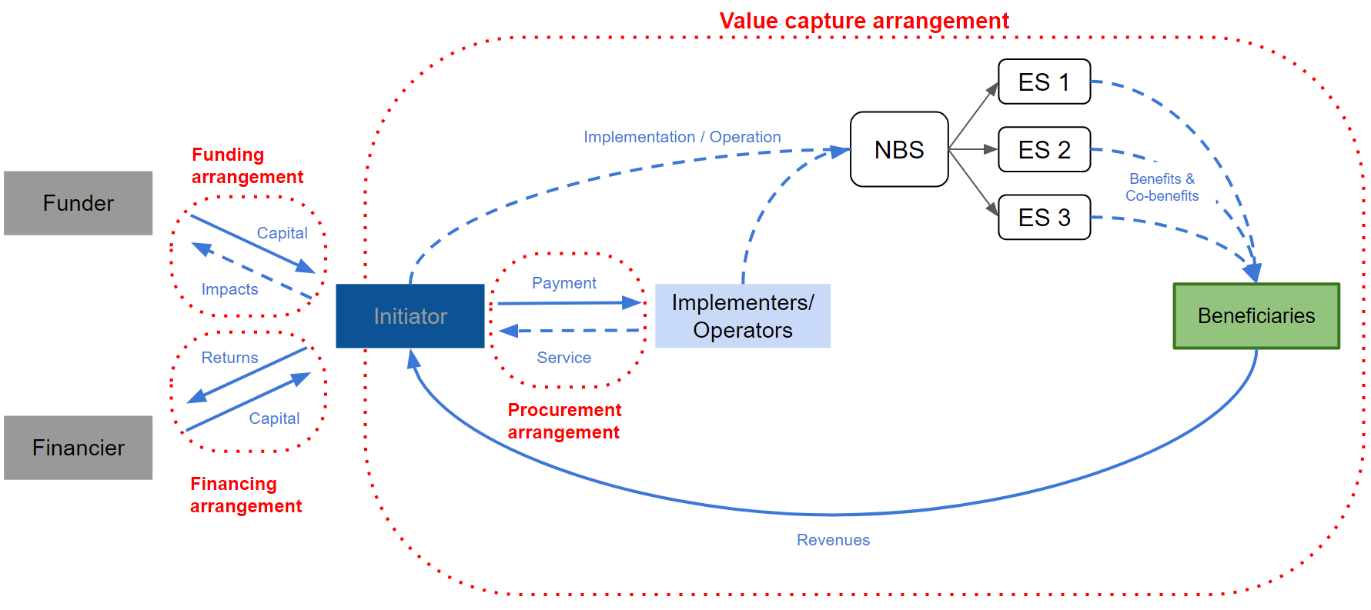
Key innovations in financing nature-based solutions for coastal adaptation
Fausto Favero, PD Dr. habil. Jochen Hinkel, Global Climate Forum
INTRODUCTION
Limited financing hinders the implementation of NBS. The literature suggests that financial innovation can help address the issue, yet empirical evidence supporting this is scarce.
QUESTION
Which innovative financing arrangements have been implemented for nature-based solutions for coastal adaptation?
LEGEND
Funder/
financier
Ecosystem service (ESS)
ESS generation
Non-monetary flows
Capital flows
Implementers
ESS Beneficiary
PRELIMINARY RESULTS
Enabling market development and garnering public support are often key to unlocking private investments through innovative financial instruments
Comprehensive stakeholder partnerships are often crucial for the long-term financial sustainability of NBS.
Without appropriate governance, scaled-up finance can entail potential pitfalls in terms of social and ecological NBS performance.

