Slide 1


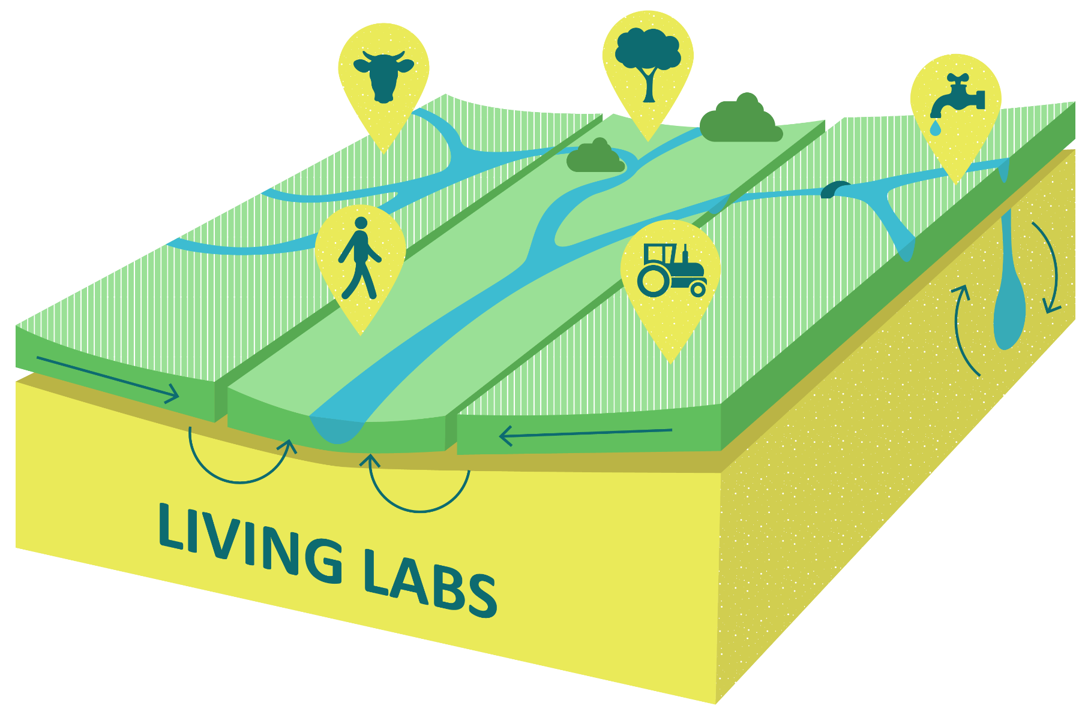
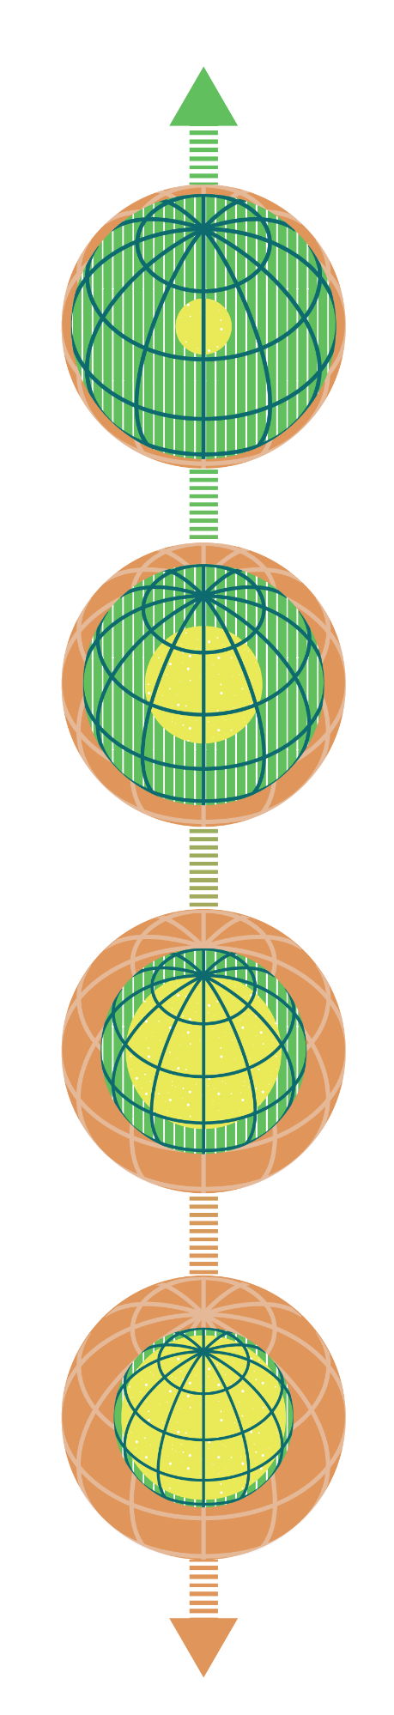
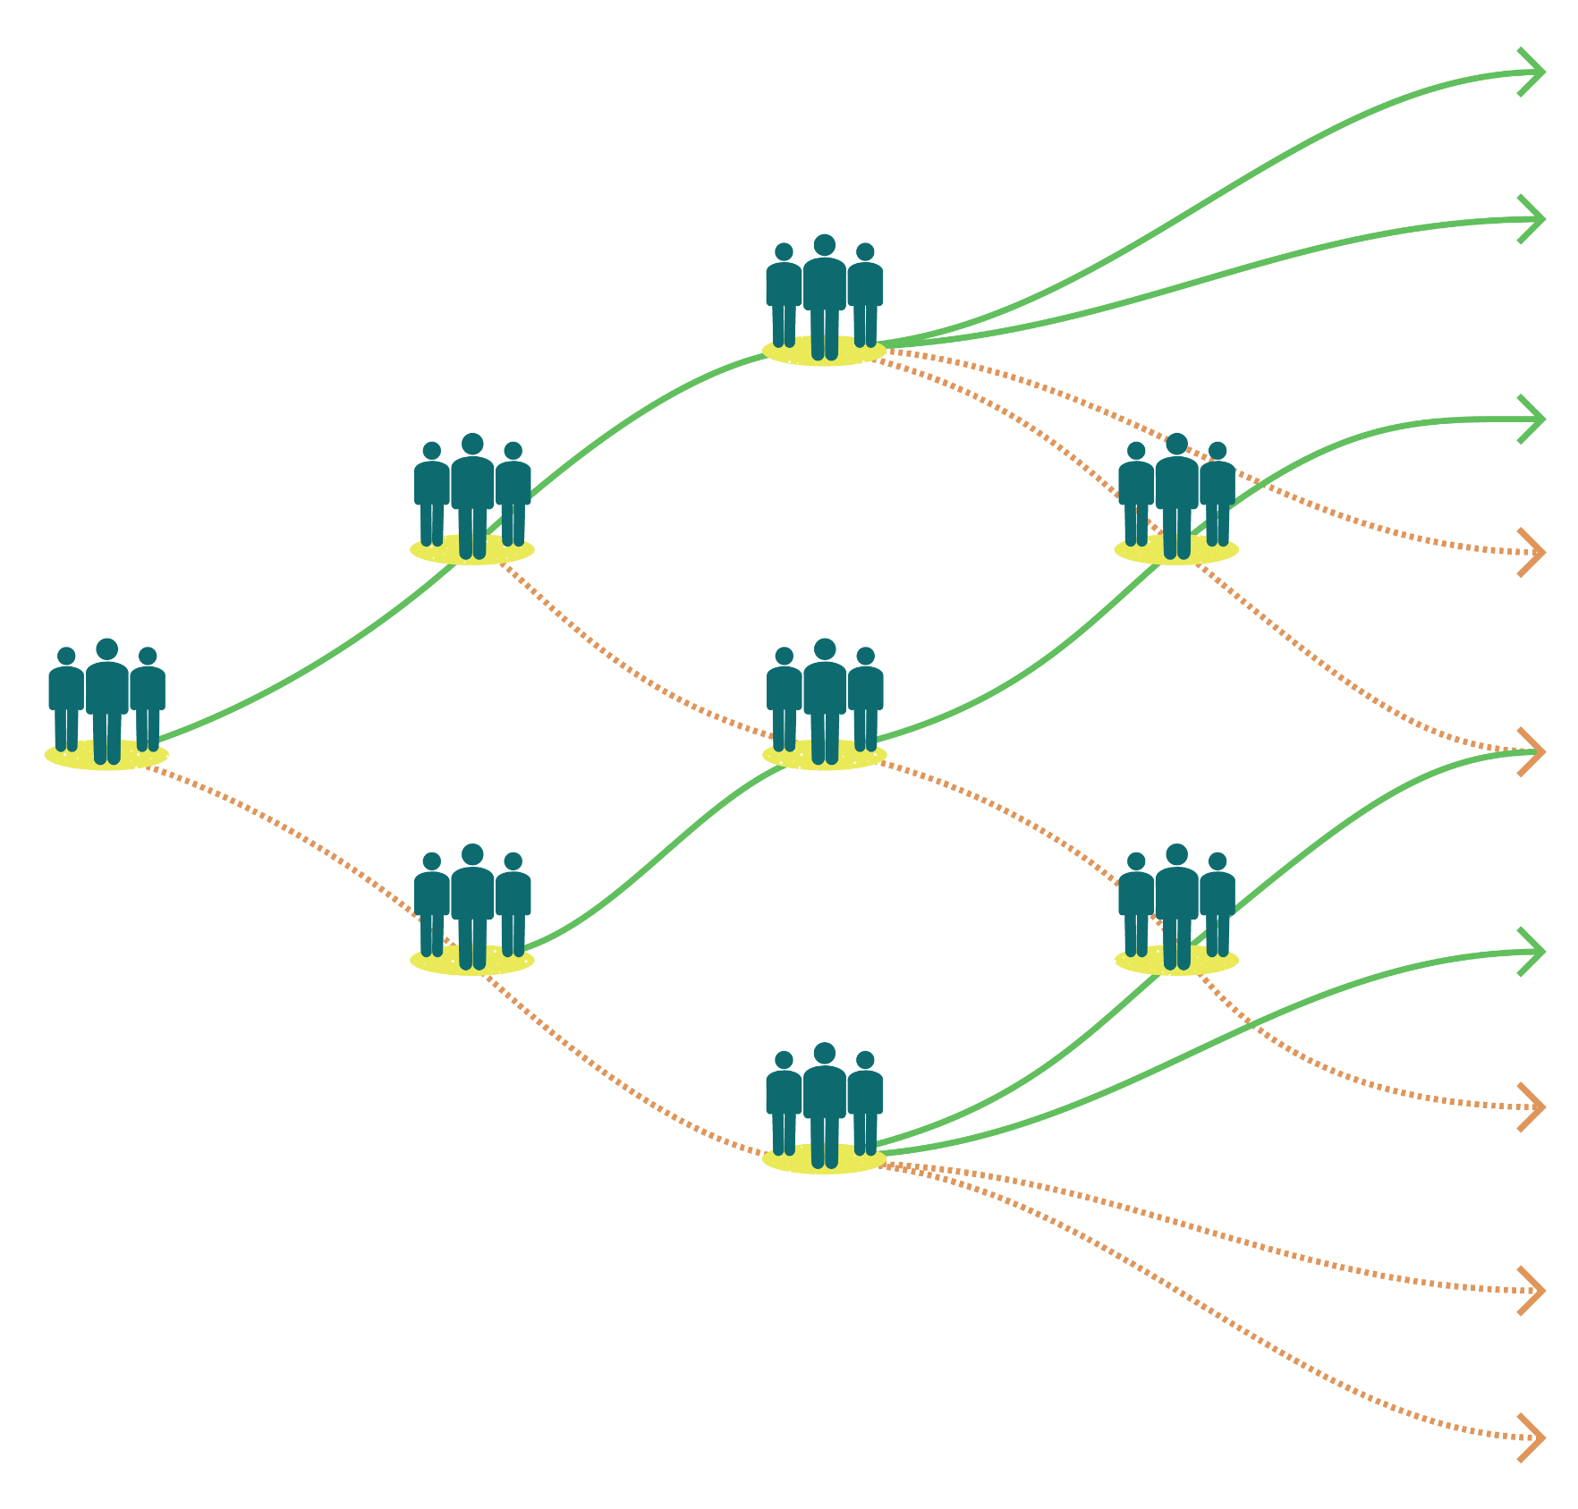

Bridging the gap between in theory and practice in applying climate resilient development pathways
Wout Sommerauer
PhD candidate Water systems and global change
Wageningen university and research
Background
Methods
Preliminary results
Climate Adaptation addresses the physical environment but also impacts socio-economic and socio-cultural values (figure 1). This creates a case to plan alongside development and in conjunction with stakeholders.
Recognizing these underlying values and conditions of stakeholders, leads to suboptimal adaptation or even maladaptation. This positions pathways approaches as an effective in addressing societal and climate change related challenges (figure 2).
Climate resilient development pathways (CRDP) constitutes a move from a more isolated climate adaptation focusing on thresholds towards sustainable development (Werners et al. 2021).
There are limited examples of climate resilient development in practice (Schipper 2020).
Evaluating pathways cases using systemic problem structuring methods on (Midgley et al. 2013):
Context
Purpose
Methods
Outcomes
Through:
Literature review on current insights related to context, purpose and methods.
Interviews with different stakeholders involved in pathways workshops in the Netherlands
Observation protocols to observe potential influences between context, purpose, methods and outcomes.
And comparing the variables to the desired outcomes of CRDP (Werners et al. 2021) which are as follows:
Undertaking climate actions for meeting sustainable development goals.
Mainstreaming climate action and development
Promoting collaborative learning, adaptive decision-making and adaptive capacity.
Accounting for multiple drivers
Balance of quantitative and qualitative data
Trying to model all potential outcomes is time and cost intensive with diminishing returns, embracing uncertainty is unavoidable though difficult to bring into practice.
Address partisan issues
When scoping the workshop do not exclude subjects that are considered partisan in a particular context. Otherwise, this might frustrate progress in other aspects of the pathways process.
Value existing reports and data
Using the outcomes from earlier visions and modelling processes speeds up pathways creation. However, this might create bias which limits inclusivity and diversity of stakeholder input.
Different desired outcomes require different timelines
Collaborative learning can be achieved in single pathways creation workshops however implementation and reflection on measures often require multiple workhops.
Discussion
Follow up research into:
Addressing the various scales involved in decision making, what synergies and trade-offs occur between geographical scales in which pathways are constructed?
What is the impact of CRDP on the sequencing of short-term Adaptation measures, compared to regular policy processes?
Often overlooked in practice is creating a monitoring and evaluation framework, making pathways difficult to appraise for their long-term benefits. What is an effective MEL framework to monitor progress to sustainable futures?
Figure 1, different climate impacted functions in rural areas on the Dutch sandy soils
Objective
Find and reflect on lessons from pathways case studies on how to bring climate resilient development pathways into practice using participatory methods.
Question
What lessons can be drawn from applied pathways concepts on how to co-create climate resilient development pathways to contribute to the associated desired outcomes?
Acknowledgements
Prof. Dr. F. Ludwig
Dr. S. Werners
Dr. B. Bolt , van der
CASTOR project members and design team
Figure 2, Pathways to alternate future states

