Slide 1
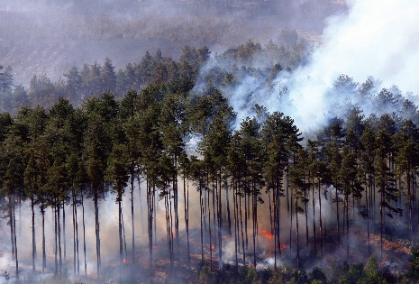
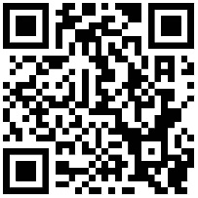
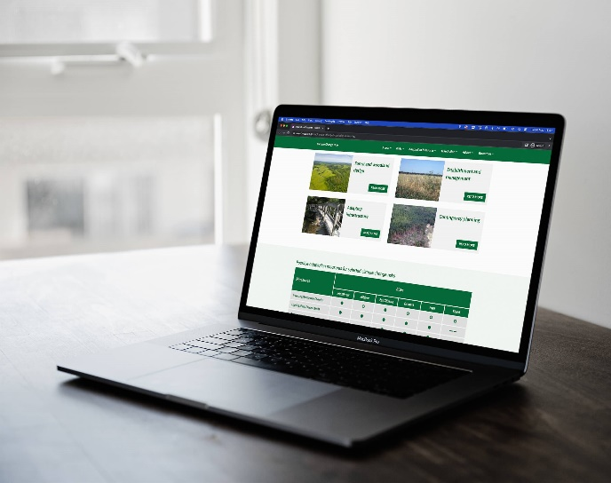
Climate Change Hub: Experience and lessons learnt in developing a knowledge exchange platform for forest managers
K.Monk, G.Atkinson and J.Morison Forest Research, Alice Holt, Farnham, Surrey, UK climate.change@forestresearch.gov.uk
1. Introduction
Despite growing awareness of the risks from climate change to forestry, such as drought, wildfire and pest and disease outbreaks, there are barriers to uptake of adaptive practice by forest owners and managers. These include difficulties in understanding scientific information, uncertainty over what are trusted information sources and lack of examples of adaptive practice in action. We took practical steps to overcome these barriers, including the creation of a knowledge exchange platform, to centralise and distil climate change information and guidance for forestry practitioners.
2. Methodology
Definition, development, agreement and publication of new government guidance on adaptation within the official UK Forestry Standard framework
Steering Group established to scope options for an online resource and provide input and feedback during the project
Funding gained from partners to build a knowledge exchange hub on the Forest Research platform and create new resources
Phased approach to ongoing content development and bi-annual content review with subject matter experts
3. Results
4. Key learnings
Simplified and distilled complex information and guidance
User engagement through dynamic use of video and imagery
Centralised key resources e.g., case studies, fact sheets, publications
Tailored information by geographic region
Signposting to more detailed information on trusted external websites
Landing pages for different target audiences
Feedback from site users via publication download form
The project has highlighted the importance of
Early stakeholder buy-in
Designing feedback mechanisms for site users
Communications planning with partners to raise awareness of the platform
Involving non-specialists to help simplify complex advice to practitioners
In the future, we have the potential to work in partnership with organisations in the UK and Europe to share and promote both research and practitioner feedback, creating a virtual community of adaptive practice.
References
Atkinson, G and Ambrose-Oji, B (2017) What do Forest Managers want to know about adaptation? Forest Research Report, Pages 6 -11
Lawrence, A., (2016) Adapting through practice: Silviculture, innovation and forest governance for the age of extreme uncertainty, Forest Policy and Economics
Fuller, L and Quine, C (2016) Resilience and tree health: a basis for implementation in sustainable forest management, Forestry: An International Journal of Forest Research, Volume 89, Issue 1, Pages 7–19

