Slide 1


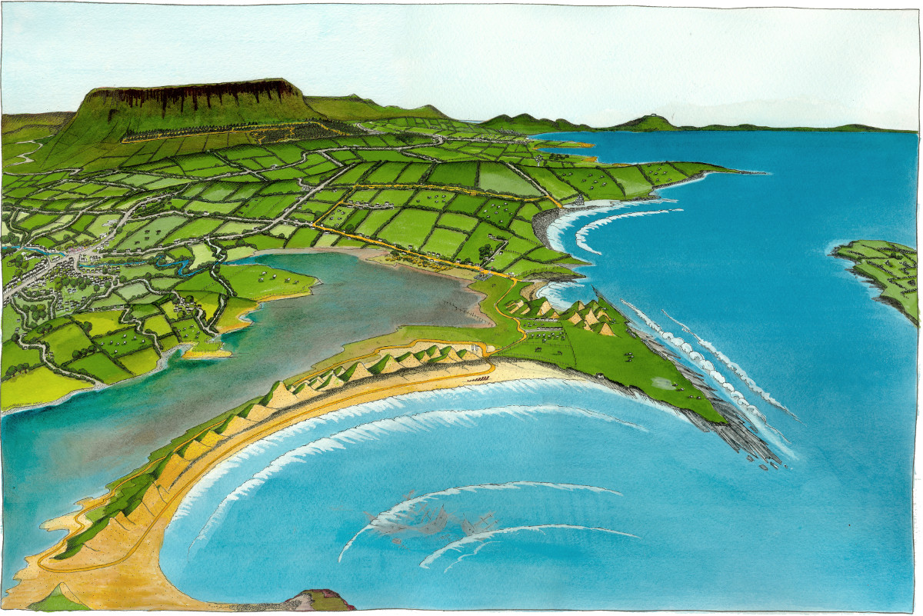
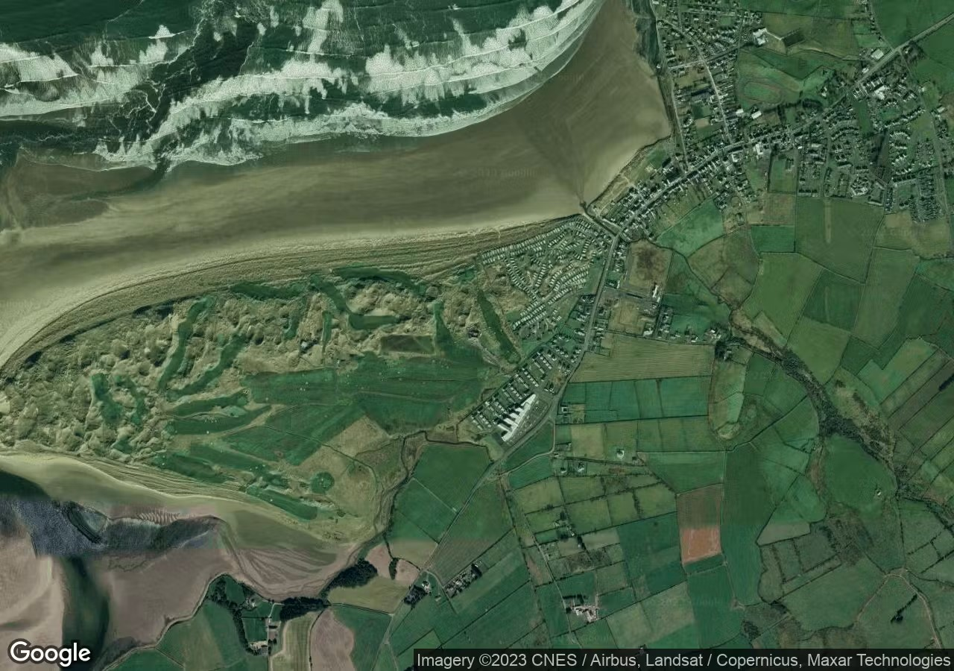
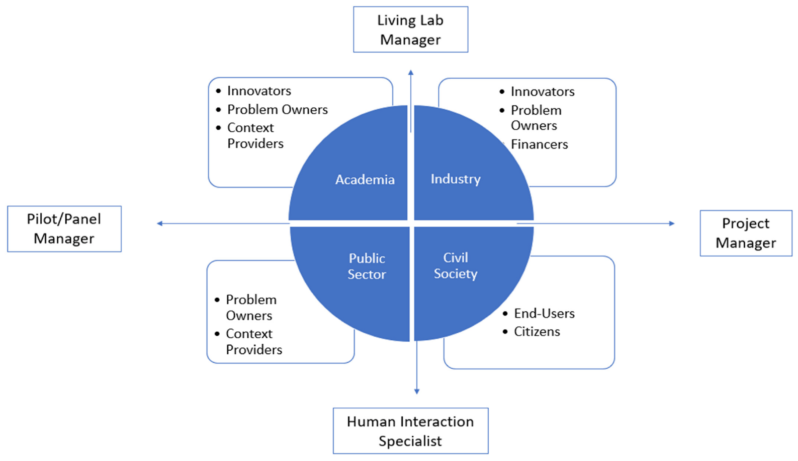
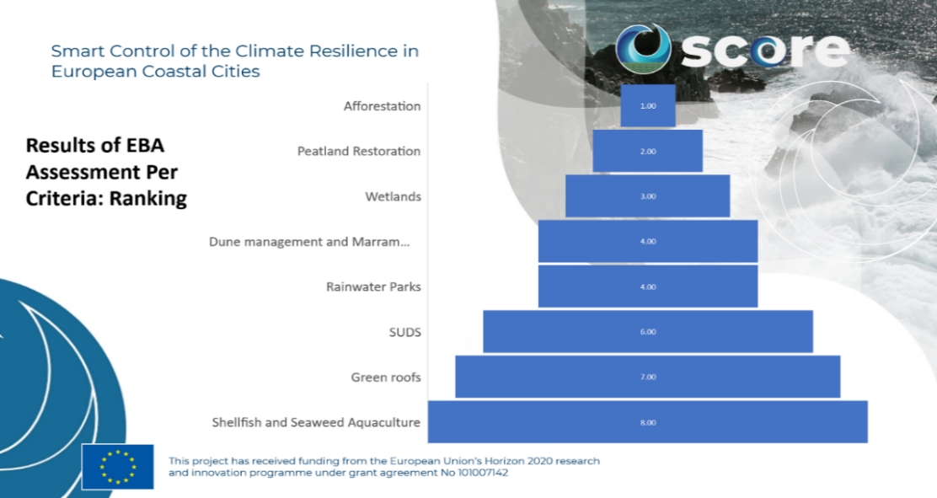
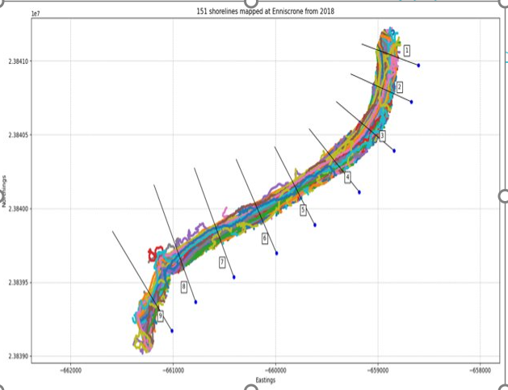
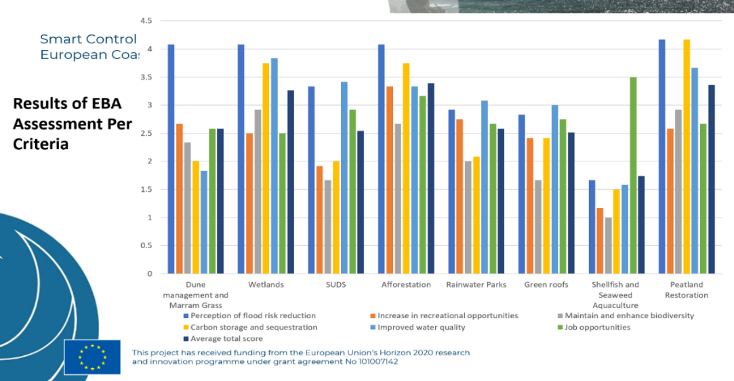


Smart control of the climate resilience
in European coastal cities
Assessing the Utility of Ecosystem-based Adaptation for Building Resilience Against Sea-Level Rise and Coastal Hazards on Ireland’s West Coast through Multi-Criteria Analysis and Cost-Benefit Analysis
Ananya Tiwari, Dr.Iulia Anton and Dr. Salem Gharbia
Atlantic Technological University (ATU), Ash Lane, Sligo, F91YW50, Ireland.
STUDY AREAS
COST BENEFIT ANALYSIS OF SAND DUNE MANAGEMENT
.
ABSTRACT
The West Coast of Ireland is a region filled with natural beauty, economic opportunities, and home to an ancient culture and language. This region is under impending threat due to an increase in the intensity and frequency of storms and floods, and coastal erosion. To address this, ATU Sligo in collaboration with the EU SCORE project and the Sligo County Council, has set up a Coastal City Living Lab (CCLL) in Sligo. The CCLL uses a real-life testing environment involving stakeholder engagement, ecosystem-based adaptation, and smart technologies (like sensors and digital twin) to monitor and address coastal climate change. The ecosystem-based adaptation (EBA) strategies in Sligo are being studied through stakeholder-engagement (multi-criteria analysis) as well as expert-based assessment (cost-benefit analysis). Multi-criteria analysis (MCA) is being conducted with stakeholders from academia, industry, public sector and civil society to assess and rank the most effective EBA solutions for Sligo County based on six identified evaluation criteria. This will contribute to local policy documents, spread awareness about EBAs, as well as inform and encourage the uptake of EBA solutions. In addition to this, a cost benefit analysis (CBA) of selected EBA measures (like sand dune management) is being conducted to assess its role in reducing erosion as well as its environmental and socioeconomic co-benefits. For this, two study sites (Enniscrone and Streedagh) have been selected in Sligo County. Using satellite-based imaging, data is being gathered on the changes in shoreline erosion before and after the implementation of sand dune management, a prominent EBA across Ireland. These exercises are helping not only in initiating a dialogue about EBAs amongst local authorities and stakeholders, but also in assessing its impact as opposed to engineering-based measures. Based on the results of both these socio-economic appraisal exercises, the Sligo County Council plans to implement more EBA projects, to build coastal resilience.
Streedagh, Sligo County
Enniscrone, Sligo County
Stakeholders in a Coastal City Living Lab
.
Shoreline has been mapped using satellite imaging at Enniscrone and Streedagh beaches to study erosion rate for four scenarios: with dunes, without dunes, dunes with marram grass and dunes with chestnut fencing
The erosion rate is being modelled with storm, wind/wave, and sea-level rise data to create future projections
The costs and benefits (like erosion reduction and property protection, biodiversity, tourism) are being monetised to create present and socioeconomic future scenarios, and this NBS is also compared with grey infrastructure
Acknowledgements to Dr. Luis Campos Rodrigues, Mar Riera Spiegelhalder, And Khurram Riaz for their contributions.
.
MULTI-CRITERIA ANALYSIS RESULTS
This project has received funding from the European Union’s Horizon 2020 research and innovation programme under grant agreement No 101003534.
www.score-eu-project.eu | contact@score-eu-project.eu

