Slide 1

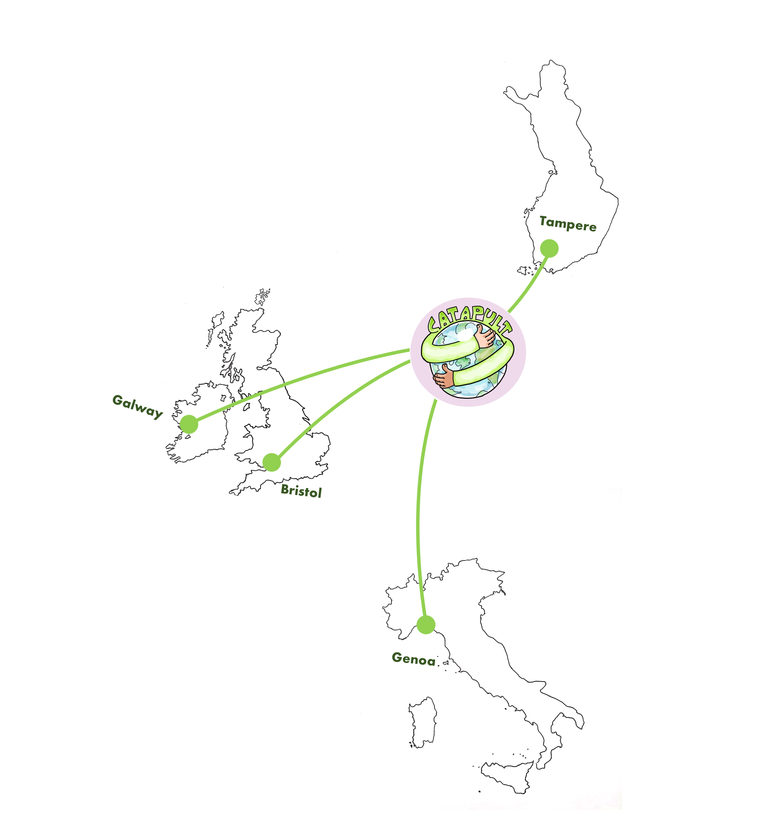





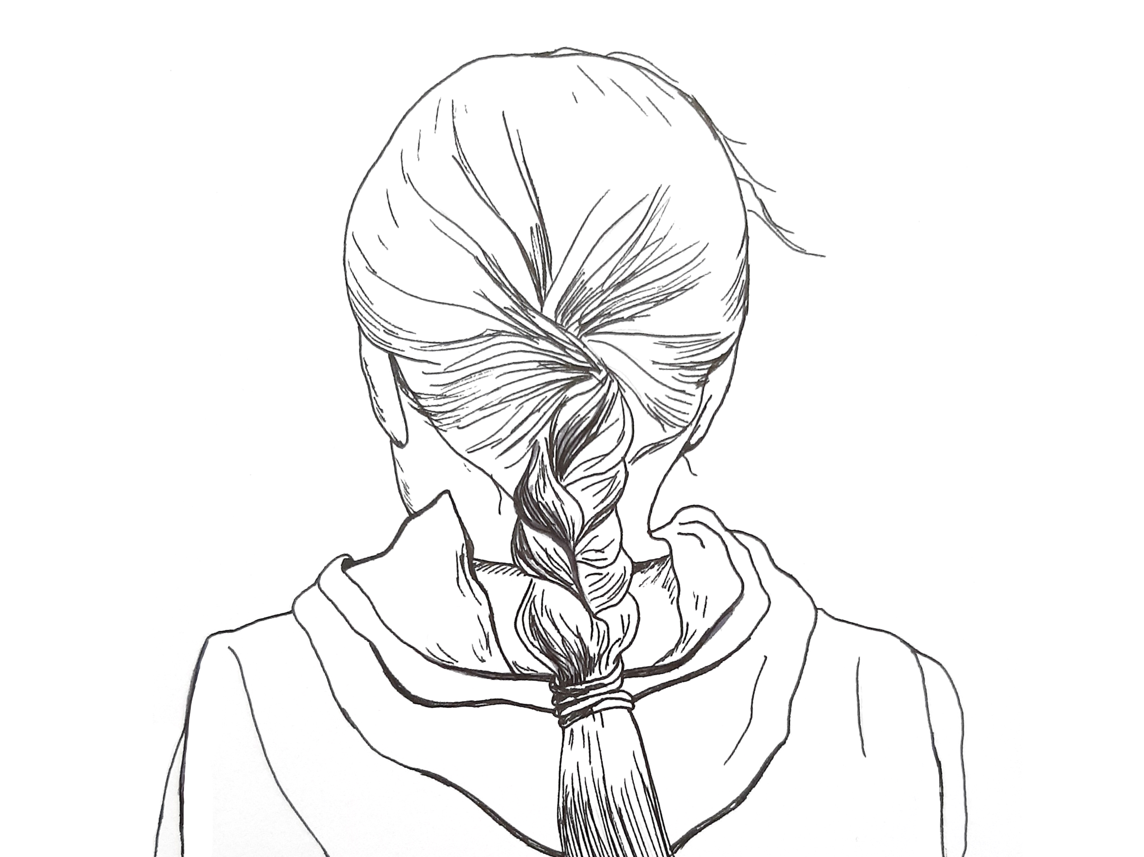








Educators' Perceptions on Climate Change Education: Lessons Learned from Project CCC-CATAPULT
Climate Change Education
Climate change education (CCE) refers to teaching and learning that is connected to climate change. CCE is more than learning about the content and facts of climate change; it is interdisciplinary, holistic, and aims to support transformation, active citizenship, and hope (e.g., Cantell et al. 2019; Kagawa & Selby 2010).
Research aim and questions
Our aim is to understand formal and non-formal educators’ perceptions of climate literacy as a goal of CCE.
How do climate change educators perceive climate change education?
What do educators consider to be the central challenges to delivering and developing CCE?
We connect our findings to a number of themes across climate literacy: climate knowledge, skills and competences to act on climate change; personal meaningfulness and climate attitudes.
Data and methods
CCC-CATAPULT is a qualitative study with a phenomenological approach. The project incorporates a mixed-method approach (surveys; focus groups; interviews; and narrative mapping). For the purpose of this poster we draw from data gathered through semi-structured formal and non-formal educators' interviews collected during 2022 in four European cities or city-regions: Bristol (United Kingdom), Galway (Ireland), Genoa (Italy), and Tampere (Finland).
Educator’s Understandings of Climate Change Education
Educators consider CCE an essential area of learning for young people. They expressed a need for change to current curricula and acknowledge the role educators play in delivering CCE. Schools have a responsibility to teach CCE, but this responsibility is shared with non-formal settings.
However, some were reluctant to say educators were responsible due to workload concerns. Educators face limitations resulting from access to training, resources, expertise and time.
The Role of Educators in Climate Change Education
Educators identified difficulties delivering CCE in relation to the eco-anxiety and burdensome feelings experienced by both young people and themselves. Challenges vary in cross-national comparison (conflicting views, polarised classrooms, political dimensions, lack of resources and time).
36
CITY/CITY-REGION
Educator interviews
Suggestions for improving CCE
Educators need updated tools and training for CCE
CCE should be implemented more clearly into national and local curricula
Curriculum planning requires an ascending approach and should be worldview considerate
CCE should promote climate mitigation and adaptation instead of concentrating on the problem
teachers from formal educational settings and representing different subject areas
N. of
interviews
Bristol
UK
Galway
Ireland
Genoa
Italy
Tampere
Finland
Formal
Educators
6
4
4
5
supporters of learning/worldview formation from non-formal or non-educational settings
N. of
interviews
Bristol
UK
Galway
Ireland
Genoa
Italy
Tampere
Finland
Non-formal
Educators
5
4
4
4
CCC-Catapult: Challenging the Climate Crisis: Children’s Agency to Tackle Policy Underpinned by Learning for Transformation
The project examines children’s climate agency, the value-action gap and means to bridge this gap in four European city-regions. Through an ethos of co-production we explore young people’s social norms, worldviews, and emotions in relation to climate change, in addition to educators’ views on climate change education. The project strives to enable transformative learning for climate change education, proposing policies to support these developments. The project is funded through the JPI CLIMATE initiative from Dec 2020 to Nov 2023.
Authors
Dr. Essi Aarnio-Linnanvuori, Tampere University
Dr. Rosamund Portus, UWE Bristol
Dr. Kathy Reilly, NUI Galway
Dr. Inkeri Rissanen, Tampere University
Dr Sabrina Sposito, University of Genoa
Prof. Dr. Lindsey McEwen, UWE Bristol
Follow us!
https://ccc-catapult.org/
@challenging_climate_crisis
@CCC_CATAPULT

