Slide 1
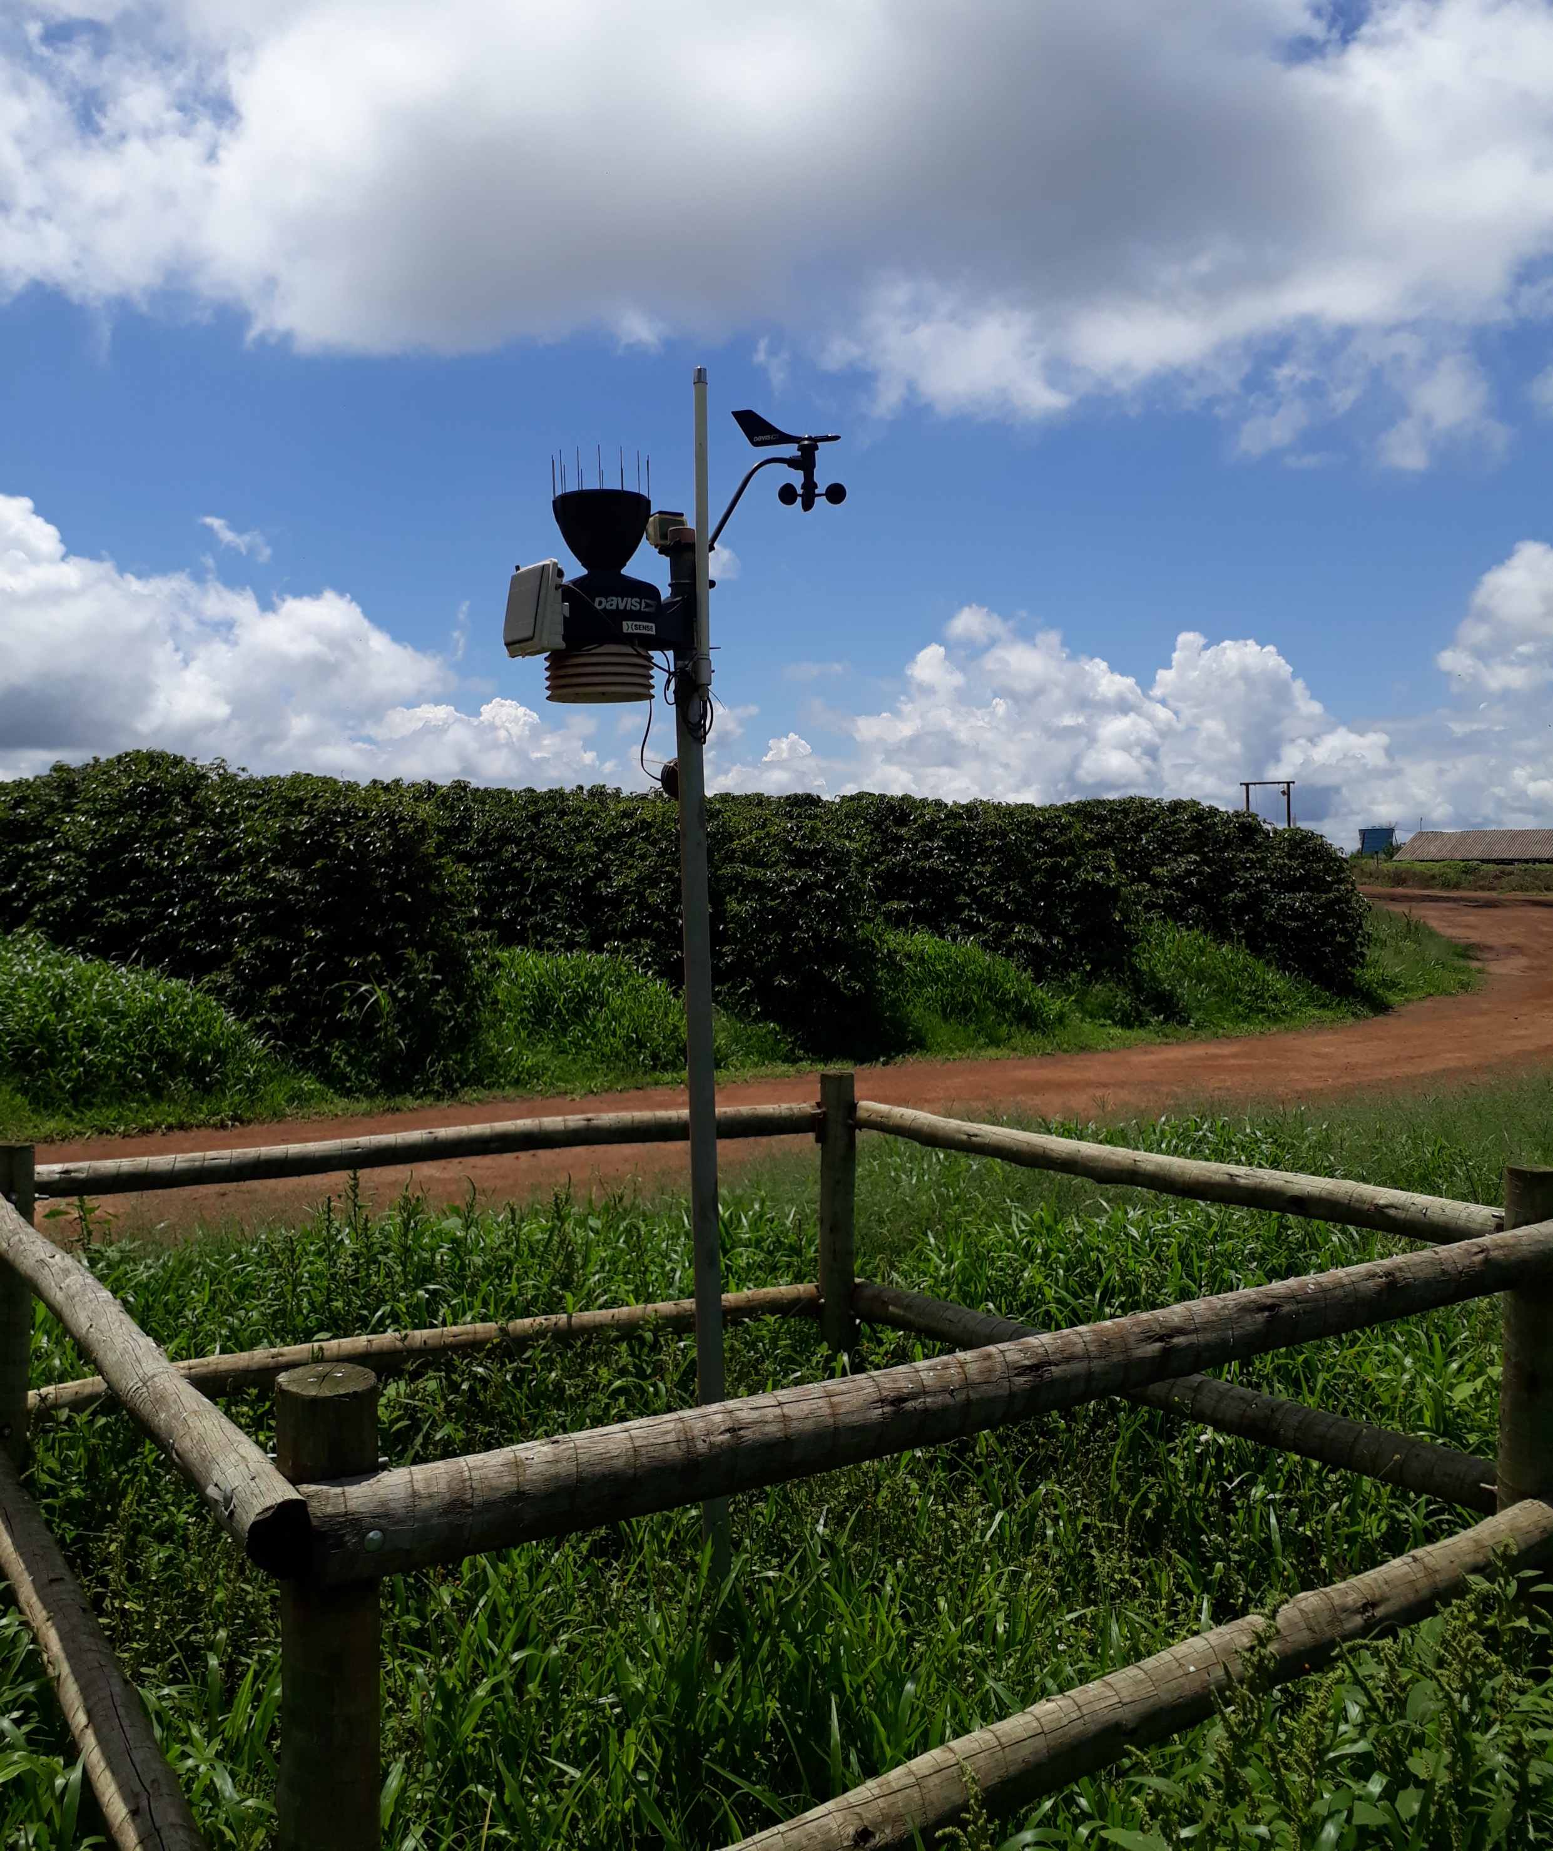
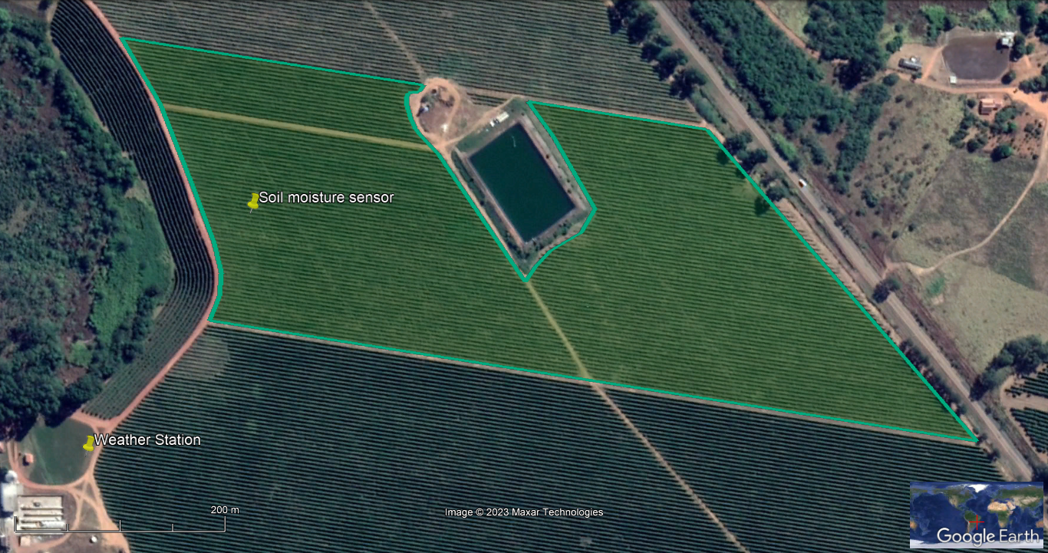
OPTIMIZING IRRIGATION SCHEDULING FOR WATER SAVING IN FARM RESERVOIRS UNDER DIGITAL AGRICULTURE CONDITIONS
Thematic topic: 4. Preparing for More Frequent and Severe Climate Extremes
André L. R. Pessina¹ • Jarbas H. de Miranda² • Martino Poretti³ • Mario Cerutti⁴ • Veronica Rossi⁵ • Carolina Guercio⁶
1xFarm Technologies SA, Manno, TI, Switzerland. E-mail: andre.pessina@xfarm.ag; 2Department of Biosystems Engineering, Luiz de Queiroz College of Agriculture, USP, Piracicaba, SP, Brazil. E-mail: jhmirand@usp.br; 3Head of Research and Development, xFarm Technologies SA, Manno, TI, Switzerland. E-mail: martino@xfarm.ag; 4Chief Institutional Relations & Sustainability Officer, Lavazza Group, Torino, PIE, Italia. E-mail: mario.cerutti@lavazza.com; 5Sustainability Senior Manager, Lavazza Group, Torino, PIE, Italia. E-mail: veronica.rossi@lavazza.com; 6Lavazza Foundation Senior Specialist, Lavazza Group, Torino, PIE, Italia. E-mail: carolina.guercio@lavazza.com
INTRODUCTION
be useful in ensuring the viability and continuity of irrigation during dry periods. Knowing the optimal amount of irrigation to minimize water stress could be used to better manage the limited stored water and reduce wastes to overcome absence of rain (Hrustek, 2020). The objective of this work was to report the use of a decision support system to reduce water use in an irrigated coffee plantation in Minas Gerais, Brazil, and to demonstrate how digital transformation of crop production could assist in the rational use of available irrigation water during dry periods.
DESCRIPTION
CONCLUSIONS
Digital transformation is essential to adapt agricultural production to climate change (Adamides et al., 2020). Irrigation systems have grown increasingly important since the distribution of rainfall has become more unequal throughout the year, with more frequent droughts and flash floods (Neto et al., 2016). Reduced rainfall at certain periods of the year also impacts the availability of water for irrigation, making rationing between crop fields necessary. The use of the Internet of Things, integrating sensor data, and algorithms can
A weather station and a soil moisture sensor were installed on a 14.2 hectare irrigated Arabica coffee field in Patrocínio, Minas Gerais, Brazil. The farm had a standard irrigation schedule of 5 h⁻¹ day⁻¹ per irrigated sector with a flow rate of 118 m³ h⁻¹ in the studied sector. After the implementation of the new irrigation schedule, during the 4 analyzed months (from 01 March 2021 to 30 June 2021), with the help of real-time measures of the sensors connected to the xFarm digital agriculture platform (xFarm Technologies SA), it was possible to reduce water use by ~30% compared to the previous irrigation recommendation used on the farm, with an average water saving of ~4900 m³ month⁻¹. Considering the amount of water saved in that period with the new irrigation recommendation, it would be possible to extend the irrigable period by ~1.6 months, if the new water consumption rate of ~29 m³ ha⁻¹ d⁻¹ was still applied, guaranteeing irrigation in longer dry periods with the same volume of stored water.
Applying digital agriculture tools, such as sensors and real-time monitoring software, can assist coffee growers in achieving hydric resilience. Extending the suggested optimization approach to other irrigating farms could also reduce the consumption of surface and subsurface water bodies that occasionally supply the irrigation reservoirs, according to granted volume of the responsible agencies and water availability. This reduction may result in more water being available for other farms in the same region, allowing farmers to ensure food security and continue in the field.
xSense PRO Weather Station (xFarm Technologies SA) installed on the farm.
REFERENCES
Adamides G et al. (2020) Smart Farming Techniques for Climate Change Adaptation in Cyprus. Atmosphere 11(6):557. DOI: http://dx.doi.org/10.3390/atmos11060557.
Hrustek L (2020) Sustainability Driven by Agriculture through Digital Transformation. Sustainability 12(20):8596. DOI: http://dx.doi.org/10.3390/su12208596.
Neto AR et al. (2016) Hydrological Processes and Climate Change in Hydrographic Regions of Brazil. Journal Of Water Resource And Protection 8:1103-1127. DOI: http://dx.doi.org/10.4236/jwarp.2016.812087.
ACKNOWLEDGMENTS: The authors thank xFarm Technologies, the team of the Laboratory of Soil Physics of the Department of Biosystems Engineering (ESALQ/USP), the Giuseppe and Pericle Lavazza Foundation, and the owners of Fazenda 5 Estrelas, namely, Mr. Ricardo Bartholo and Mr. Gustavo Bartholo. The authors also thank the ECCA2023 Team.
Satellite image from the coffee field, the water reservoir for irrigation and the location of the xFarm Technologies weather station and soil moisture sensor. Global location of the farm on the bottom right. Image from Google Earth Pro.
xNode Soil PRO soil moisture sensor (xFarm Technologies SA) installed on the farm.

