Slide 1
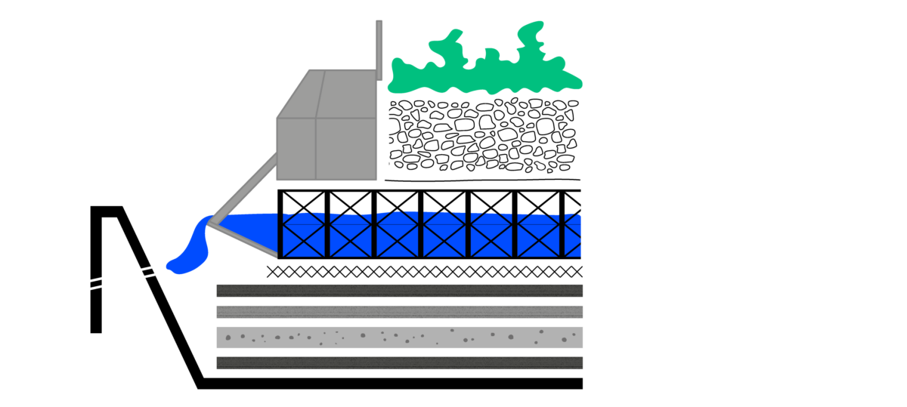
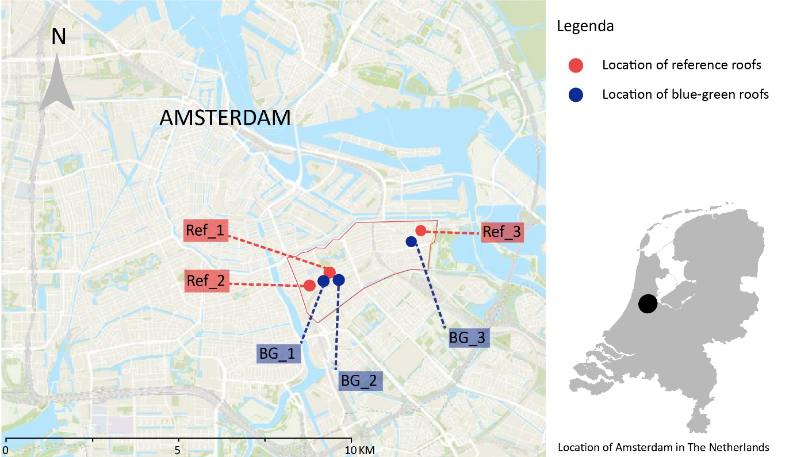
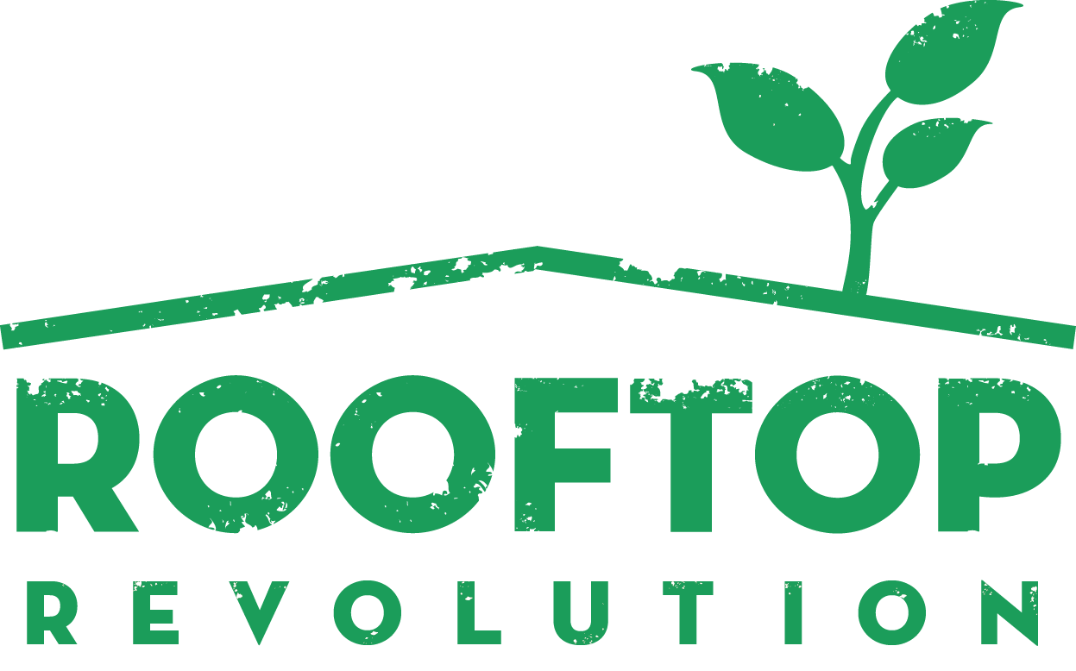
INFLUENCE OF BLUE-GREEN ROOFS ON SURFACE AND INDOOR TEMPERATURES ON A BUILDING SCALE
Lisanne Corpel, Dante Föllmi, Anna Solcerova, Jeroen Kluck
Nature-based Solutions
Roofs are seen with increased attention as a sustainable nature-based solutions to increase urban resilience during more extreme weather events. This resulted in a variety of roof systems of green and blue-green roofs designed as an integral part of the built environment due to their hydrological, insulative and biodiverse capacities. This study exanimated the impact of blue-green roofs that have been realized in the city of Amsterdam (NL).
Results
To detect the possible effects of the blue-green roofs, measured data from all monitored roofs have been analyzed. To limit the influence of day-to-day variation on the analysis of differences in measured temperatures, outside surface temperature measurements were averaged for each hour of a day.
Indoor temperatures
To investigate the effect of the blue-green roofs on the inhouse temperatures, standard deviations (STD) have been calculated. By computing STDs we
minimized the potential effect of uncontrollable external factors.
Scatter points underneath the reference line show days when the indoor temperature STDs were higher for reference roofs than for BG roofs. Lower STD values represent less variation during a 24-hour period, implying a smaller influence of outside climatological conditions (e.g., air temperature, radiation). The STD values for blue-green roofs appear to be in general lower than for the corresponding STD values for reference roofs, indicating a better insulative capacity of the BG roofs.
Winter
Differences in substrate temperatures for gravel and blue-green roofs were relatively small and negligible at night
Temperature measured in the water crate layer is the highest for most of the day
Temperature in the water layer experiences much lower diurnal amplitude (difference between daily max and min T; 2°C) compared to other surfaces (up to 4.5°C) or air (3.5 °C)
Newly constructed blue-green roof in Indische Buurt Amsterdam (BG-3)
Blue-green roofs
Green roofs with an additional rainwater storage are commonly referred to as blue-green roofs. Blue-green roofs have been mostly studied from the perspective of a higher water capture ratio, where the benefits of the extra water crate layers are often related to the potential of reducing pluvial flood risk or storm management. Nonetheless, blue-green roofs can also be beneficial from the perspective of temperature extremes mitigation.
The blue-green roofs realized in the RESILIO project consists of a green layer consisting of a substrate with a mixture of vegetation. The underlaying blue layer is a system of plastic water retention boxes with a storage capacity of 85 mm. The system enables a capillary rise of water from the crates to the substrate above and therefore provides the plants with additional water supply. During winter, the crates are empty to prevent water freezing in the storage and potential damage to the crates and the roofs.
Summer
Maximum daytime surface temperatures for blue-green roofs are on average 2-3°C lower than for gravel roofs with maximum difference of up to 8 °C
At night, average temperature differences for BG substrate and reference roofs fall within the uncertainty of the sensor
The water crate layer experienced the lowest absolute maximum temperature (25.1°C) and lowest diurnal amplitude (7.3°C) compared to up to BG substrate (18°C ) and gravel (22°C)
Maximum temperature within the water crate was reached at 19:00, 3-4 hours later compared to BG substrate (15:00) and gravel (16:00)
Biodiversity
Nature based solutions such as blue-green roofs can enhance urban biodiversity. (Blue-) green roofs are often divided into extensive (sedum roofs) and intensive roofs (herbaceous roofs and roof gardens). Intensive roofs allow for a much higher diversity of plants because of a thicker substrate layer and the presence of a water layer underneath the substrate. By providing more diverse vegetation, a significantly higher diversity of insects are attracted.
In the RESILIO project the vegetation on the roofs consists of native plant species. An inventory of biodiversity will be monitored from 2022 onwards to assess the actual impact on the urban fauna and flora.
Measurements
The measurements took place on three newly installed blue-green roofs (BG) in winter and summer of 2021. Three grey gravel roofs (Ref) were chosen as reference roofs based on proximity to the blue-green roofs and similar construction characteristics of the building and the roof.
At each site, the temperatures have been measured above the roof, in the substrate (or gravel), in the water crates (for blue-green roofs), and inside the building. The temperatures have been measured using Thermochron iButton temperature loggers with a measurement interval of 10 minutes.
Period | Measurement Period | Roofs used for analysis | Minimum air Temperature (°C) above BG roof | Maximum air Temperature (°C) above BG roof | Average air Temperature (°C) above BG roof
Cold | 07/02/2021 – 14/02/2021 | BG-1, Ref-1 | -8.5 | 2 | -2.8
Warm | 04/06/2021 – 16/06/2021 | BG_2,Ref_2 | 11.5 | 33.0 | 20.2
Warm | 16/07/2021 – 27/07/2021 | BG_2, Ref_2 | 14.5 | 32.5 | 20.4
Warm | 06/09/2021 – 10/09/2021 | BG_3,Ref_3 | 12.0 | 33.0 | 21.3
A blue-green roof realised in the RESILIO project planted with native species
Due to the lack of official heat- and cold-waves in 2021, alternative warm and cold periods were defined. For the warm period, the average 24-hour air temperature measured above all blue-green roofs had to be at least 20 °C for 5 consecutive days. For the cold period, the air temperature should not exceed 0 °C for at least 5 consecutive days.
Conclusions
The measurements in the water crate layers of blue-green roofs show an all-year-round temperature buffering effect. During summer days, the temperature in the water storage of the blue-green roof was much lower than other measured surfaces (up to 12 °C and 7 °C compared to gravel roofs and the blue-green roof substrate, respectively) and experienced the least diurnal variation. Similarly, the empty water crate layer showed up to 3 °C higher minimum temperatures during cold winter nights. Although the effect on indoor thermal comfort seems to be small, blue-green roofs are beneficial and contribute to overall greening of the city. The water storage enhances potential for growing more biodiverse vegetation.
Contact: l.a.corpel@hva.nl

