Slide 1
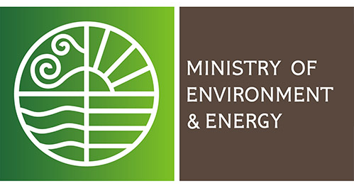
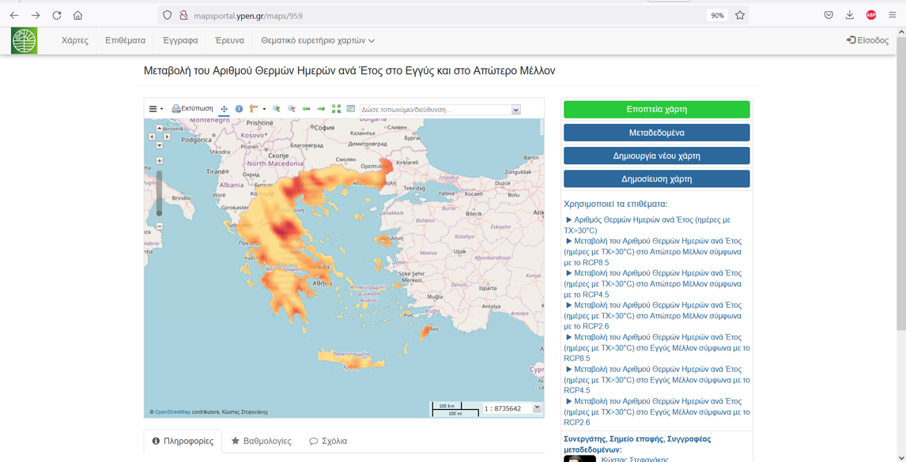
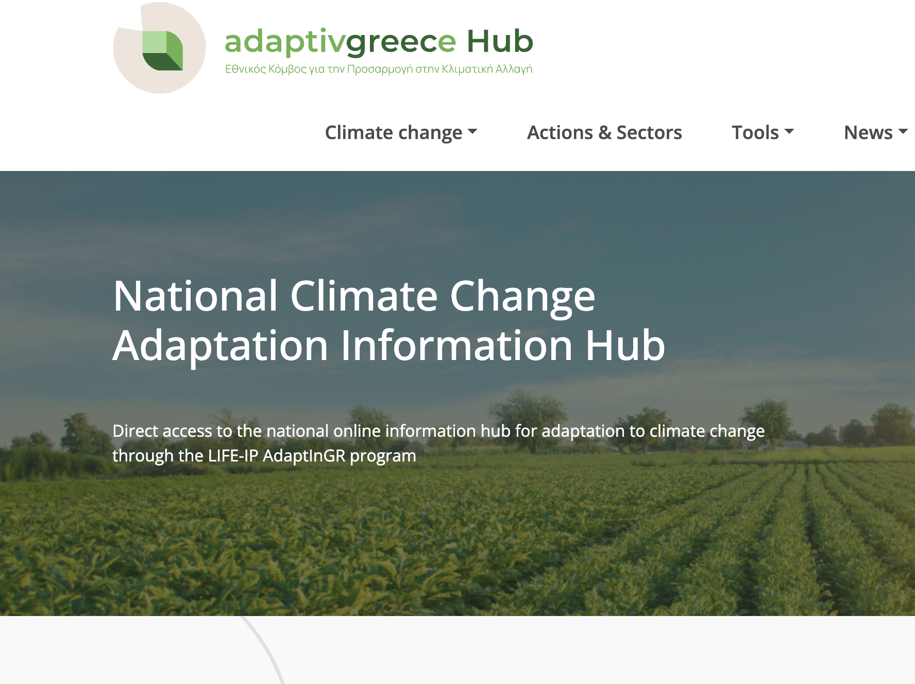
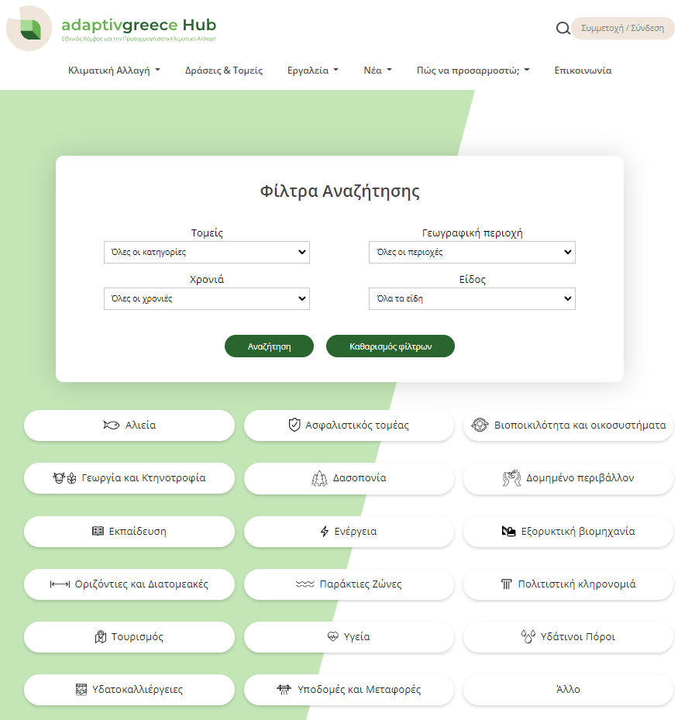
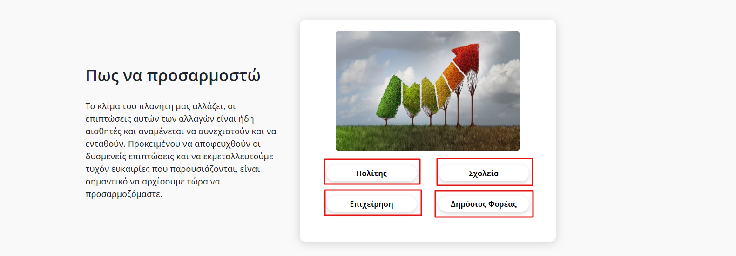
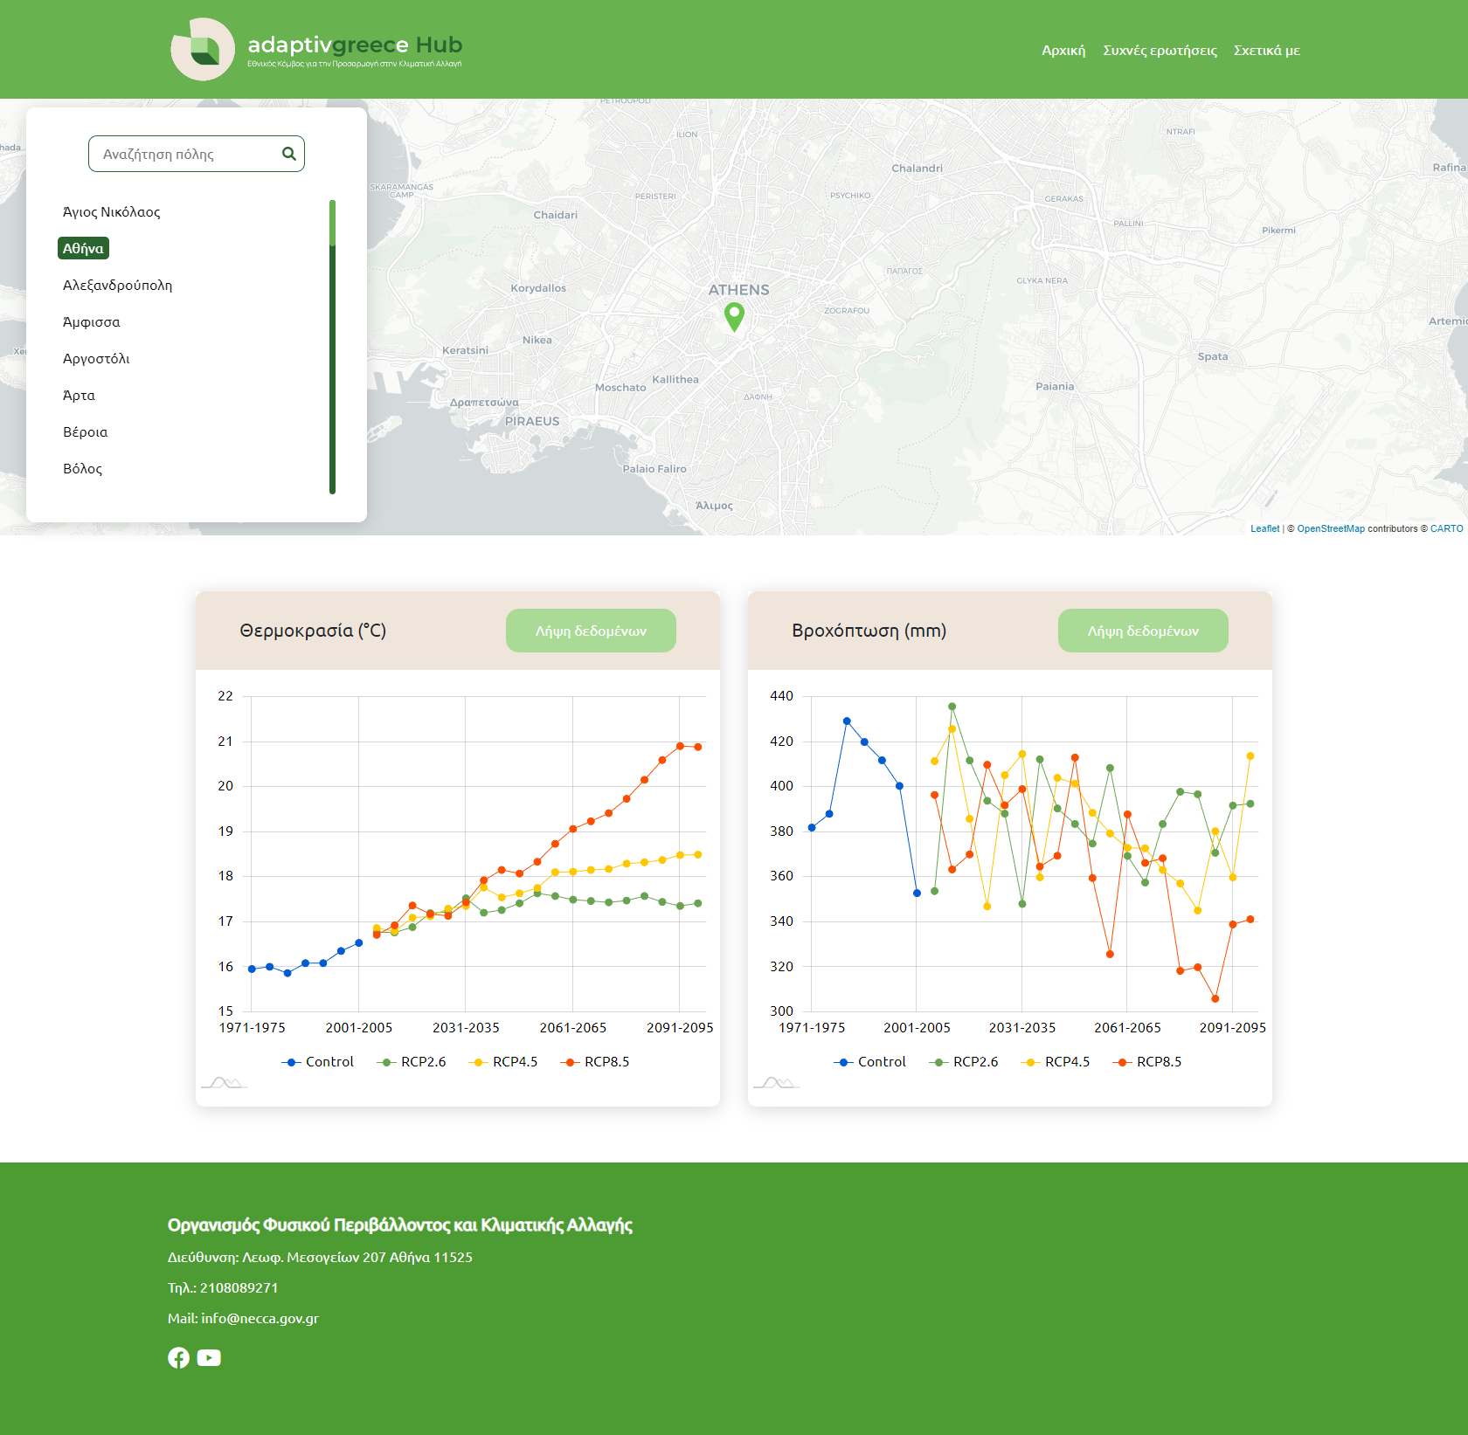
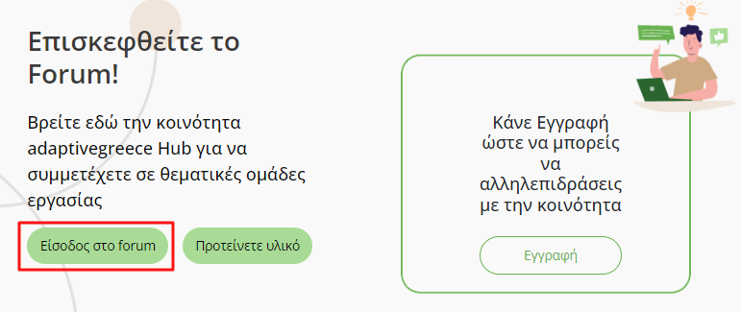
The development of the Greek Climate Change Adaptation (GCCA) Hub and the National Geoportal for the implementation of national adaptation policies
D. Konsta⁽¹⁾, G. Panagopoulou⁽¹⁾ , I. Kapsomenakis⁽²⁾, G. Kitsara⁽³⁾, G. Lemesios⁽³⁾, A. Karali⁽³⁾, K. Metheniti⁽¹⁾, E. Grigoriadou⁽¹⁾, S. Dramalioti⁽¹⁾, E. Karali⁽⁴⁾, A. Voudouri⁽¹⁾, M. P. Papadopoulou⁽¹⁾, C. Giannakopoulos⁽³⁾, S. Gazerian⁽²⁾, A. Poupkou⁽²⁾, S. Solomos⁽²⁾, P. Kalabokas⁽²⁾, C. Zerefos⁽²⁾
⁽¹⁾ Natural Environment and Climate Change Agency (NECCA), Greece | ⁽²⁾ Academy of Athens (AA), Greece | ⁽³⁾ National Observatory of Athens (NOA), Greece | ⁽⁴⁾ Ministry of Environnent and Energy (MEEN), Greece
N.E.C.C.A.
Abstract
Greece’s National Adaptation Strategy (NAS), adopted in 2016, aims at strengthening the country's resilience to climate change and its impacts. Among its five key objectives, the Greek NAS aims at supporting better-informed short-term and long-term decision-making process with regard to adaptation (Objective 1) and enhancing the adaptive capacity of the Greek society through raising awareness actions (Objective 5). The Greek Climate Change Adaptation (GCCA) Hub (https://adaptivegreecehub.gr/) and the online tool in the Geospatial Information Portal of the Greek Ministry of Environment and Energy (http://mapsportal.ypen.gr/thema_climatechange) - both developed in the framework of the integrated project “LIFE-IP AdaptInGR - play a vital role towards the achievement of the two abovementioned objectives of the NAS.
Introduction
Content of GCCA HUB
The GCCA Hub and the National Geoportal Tool
Greece released the Greek Climate Change Adaptation (GCCA) Hub (available on https://adaptivegreecehub.gr/) ιn September 2022.
Climate Change
Information on climate change, climate change adaptation policies and adaptation actions
Climate Change (Causes of CC, Impacts of CC worldwide and in Greece, Projections of Global Climate Change)
Adaptation and mitigation
Climate adaptation policy at International, European and national level and relevant legislation
The LIFE-IP AdaptInGR project
Actions and Sectors
Good practices and adaptation actions in different sectors
-filter per region, sector, year, and type of action
- not completed yet
News
Information related to adaptation news and events
Climate future projections at national scale are presented in two online web-Tools /Platforms
Both tools assess the climate change signal and impacts across Greece. They:
incorporate the produced climate projections, indices and maps, combined with geospatial data, providing high quality future climate information
host maps of twenty-two climatic indices, relevant to climate variability and risks, based on the ensemble mean of seven selected regional climate models for two future periods (2031-2060, 2071-2100) under three emission scenarios (RCP2.6, RCP4.5, RCP8.5)
http://mapsportal.ypen.gr/thema_climatechange
How to Adapt
Information targeted to different groups of interested parties
Citizens
Education - Schools
Business/ Private sector
Public Bodies
The Hub intends to:
provide tools and resources for assisting decision-makers across the different steps of the adaptation policy cycle,
raise awareness of adaptation among Greek citizens and climate vulnerable groups,
promote sharing of good practices among key adaptation stakeholders.
In addition, the produced (at national scale for Greece) future projections of several climate parameters, indices and maps combined with geospatial data, were incorporated also in the National Geoportal Tool of MEEN, a web-GIS tool which provides high quality climate information necessary to assess the climate change signal and impacts across Greece.
https://geo.adaptivegreecehub.gr/
Tools
Climate Projections (see National Geoportal)
Climate Proofing (information on climate change adaptation policies and actions)
Other tools (to be added)
Useful links (e.g. Climate-ADAPT)
Users can subscribe to the platform in order to:
participate in adaptation discussion forums and thematic groups
propose material to be included in the Hub
Next Steps:
⇒ The 2nd version of the Hub will be released by 2024 (including English version, updated content, updated sitemap, improved climate projections tool)
⇒ The final version will be released by the end of 2025
Conclusions
⇒ Once fully operational, the GCCA Hub along with the National Geoportal Tool will provide tools and resources that allow decision-makers and other key adaptation stakeholders to assess the impacts of climate change both regionally and locally, and plan appropriate actions and adaptation measures.
⇒ The GCCA Hub and National Geoportal are expected:
to improve the level of public awareness regarding climate change impacts and adaptation actions in Greece, which is currently considered low, especially among professional and other groups vulnerable to climatic hazards
to support significantly decision-making at the different stages of the adaptation policy cycle (e.g. the design and implementation of policies and actions), in different sectors and administrative levels.
Acknowledgements
The GCCA Hub and the National Geoportal Tool have been developed by the Natural Environment and Climate Change Agency of Greece (https://necca.gov.gr/en/home/) and the Greek Ministry of Environment and Energy (https://ypen.gov.gr), respectively, in the framework of the LIFE-IP AdaptInGR project (https://www.adaptivegreece.gr/el-gr/) – the most important project for adapting Greece to climate change.

