Slide 1
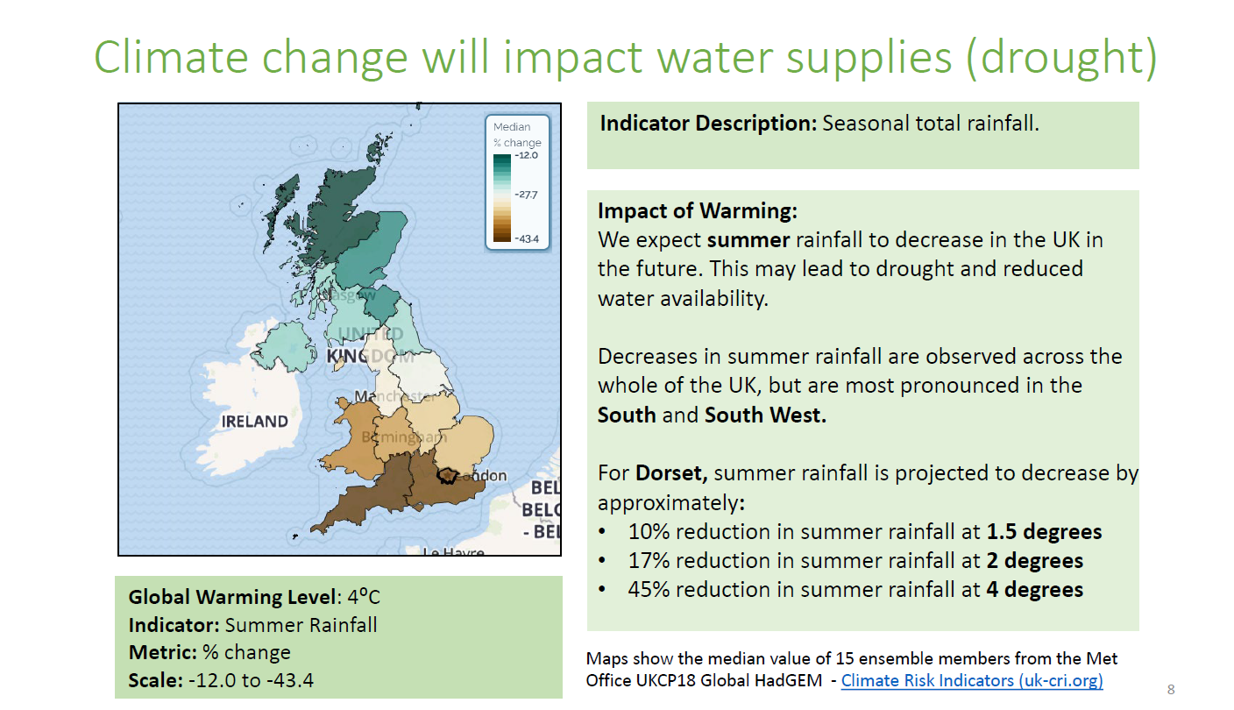
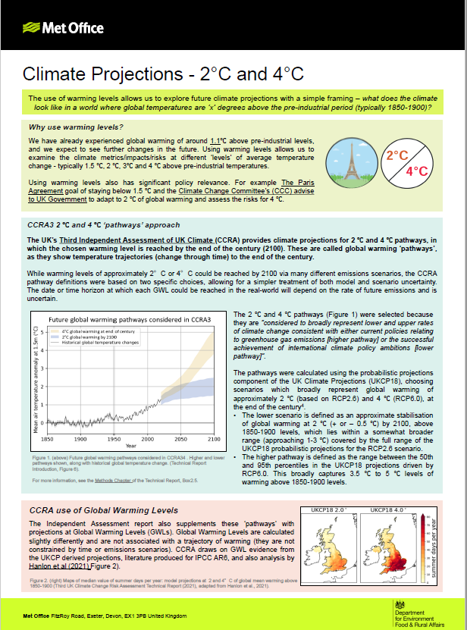
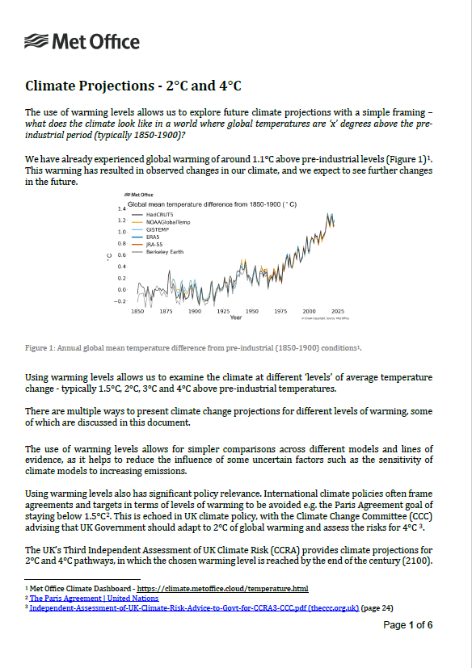
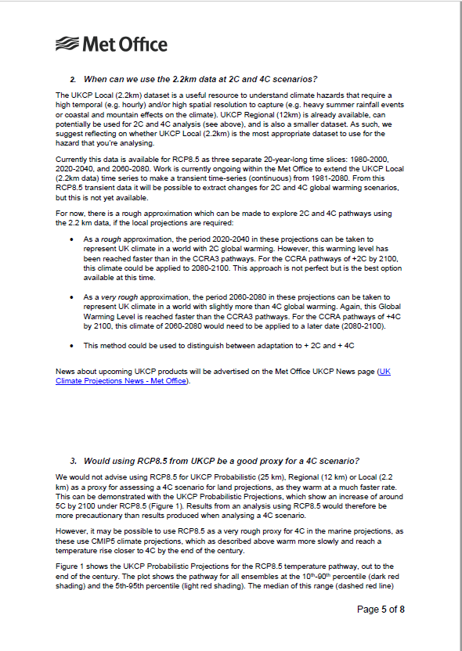
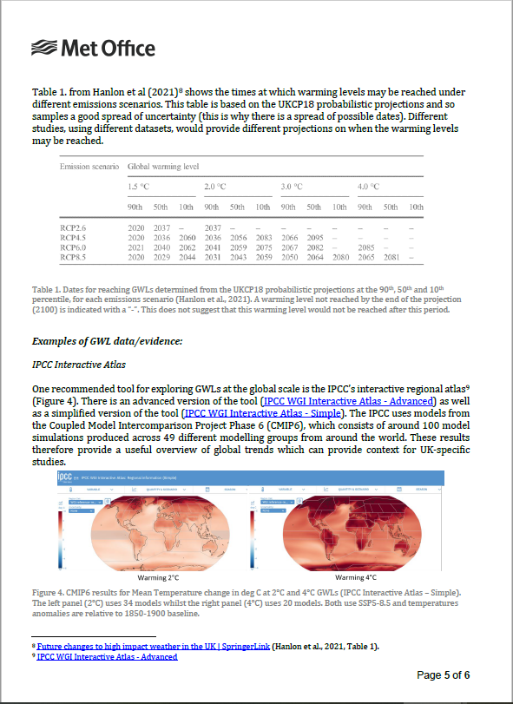
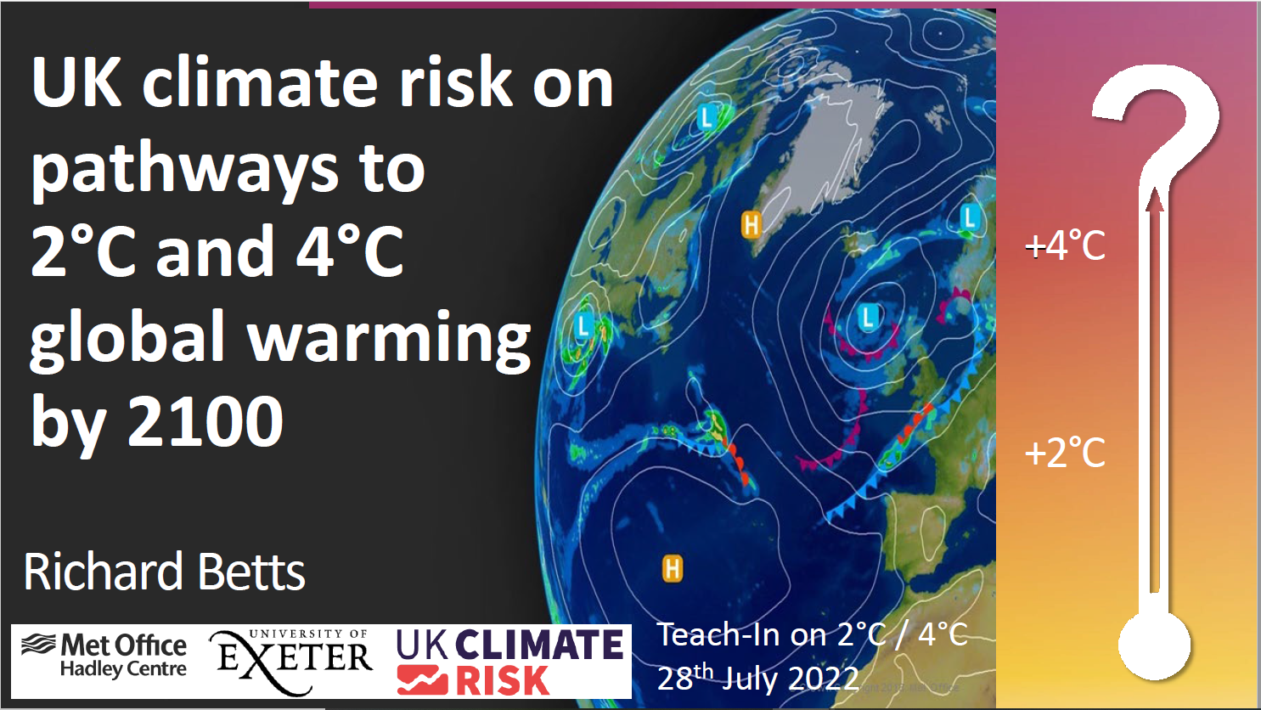
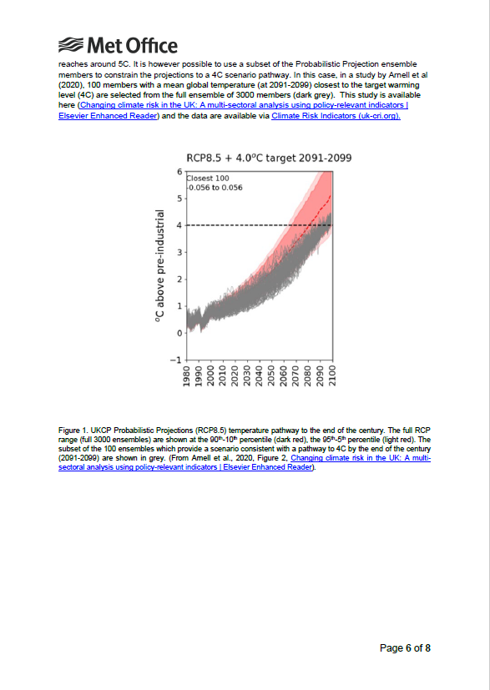
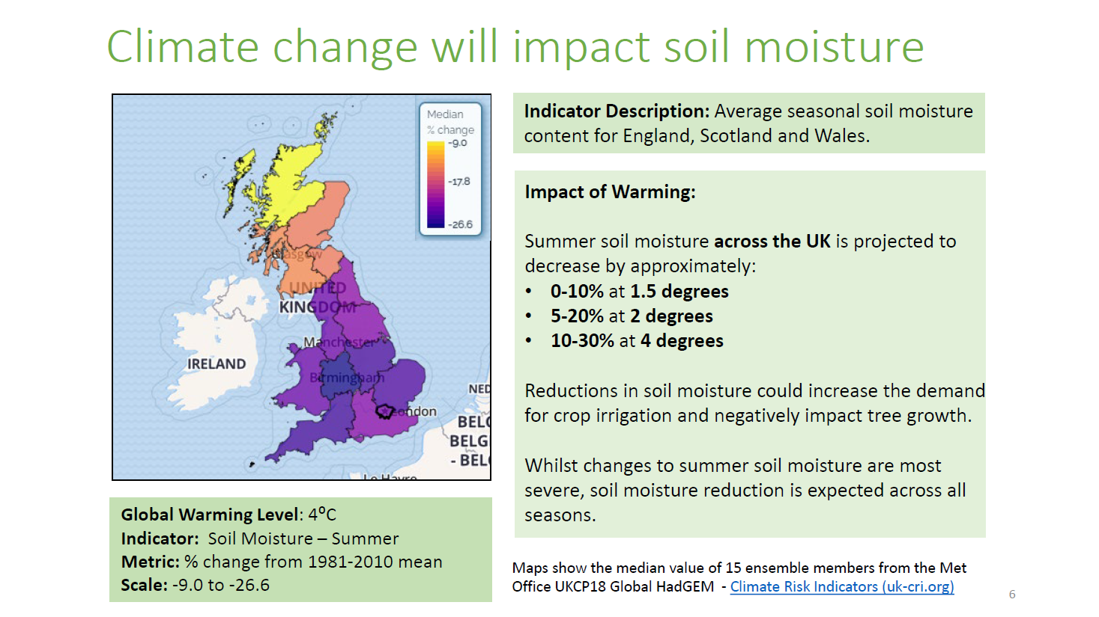
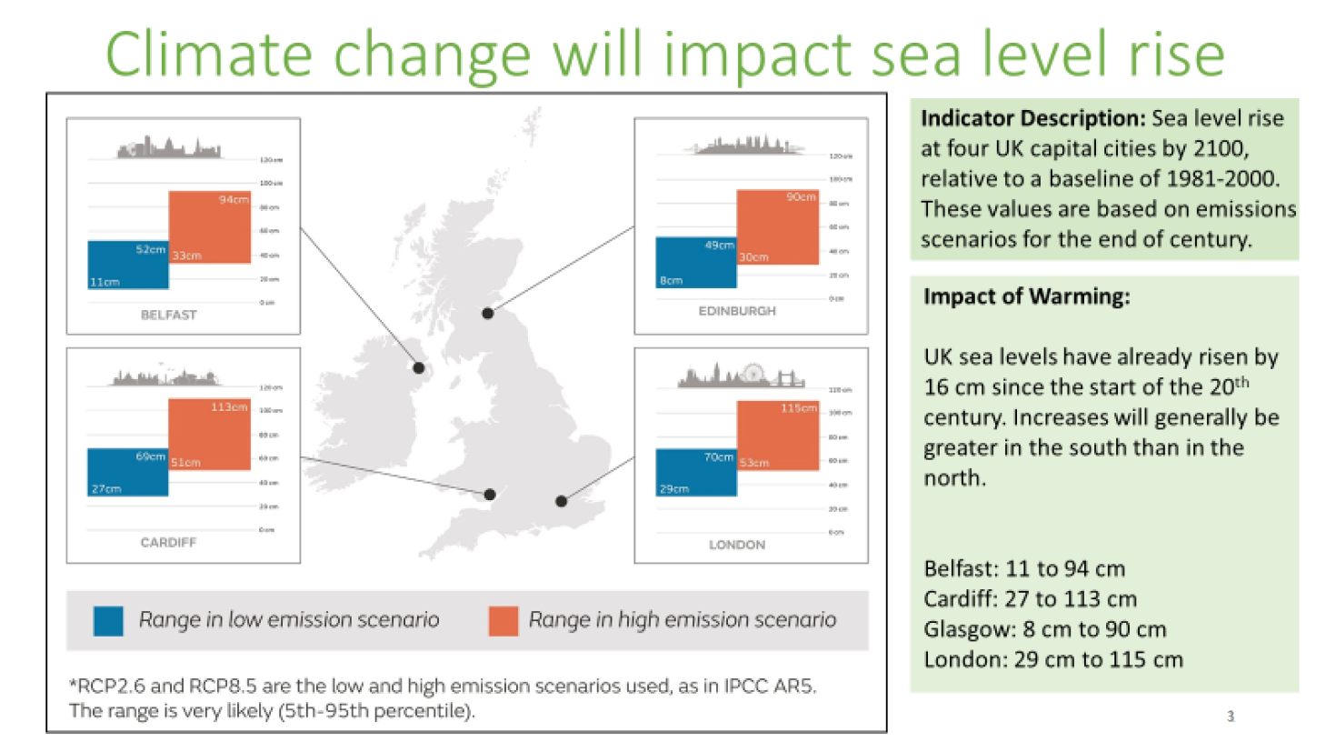
Integrating climate science into UK policy: knowledge integration as a climate service
Authors Lizzie Fuller, Alexander Askew, Alice Dring, Tyrone Dunbar, Joanna Jones, Katrina MacNeill, Rosie Oakes, Amy Waterson, Rose Willoughby, Daniel Williams
1. What is Knowledge Integration?
3. What do we do?
Translational climate services (knowledge integration) help to bridge the divide between science and action.
All UK government departments will be impacted by climate change.
Not all government decision makers have experience in using or interpreting technical information about weather and climate.
There is a need to communicate climate science information in a way that is useful and usable for decision makers.
This translational process can be called Knowledge Integration.
Communication
Facilitation
Research synthesis
Teach-ins /
workshops
Co-
development
2. Who are we, and who do we work with?
Science
translation
Impartial
advice
Parliamentary
questions
Infographics
Science
summaries
The Met Office Knowledge Integration team has expertise across both science and communications.
Our role is to maximise the impact of Met Office climate science. We do this by co-developing outputs which synthesise and communicate research in a way that’s tailored to end-user needs. We also steer underpinning science based on user needs.
We mainly work with people in Government, including from DESNZ (formally BEIS), Defra and FCDO, and we have secondees into climate teams in these departments. We also communicate with other Government departments and the public.
4. How do we do it?
Outputs of work for Government can take many forms, including written policy briefs, infographics, workshops and teach-ins – with the method of communication determined by the needs and preferences of users.
User needs are understood and explored through various user engagement methods (1-1 meetings, workshops, focus groups etc.)
Our delivery increasingly involves partnerships with external organisations and the incorporation of social science research to support the Met Office’s contribution to science communication and climate services.
5. Case Study: communicating warming levels for UK adaptation planning
The UK National Adaptation Plan (NAP) requires Government departments to report on climate risks at ‘2°C and 4°C’ warming levels. This approach is consistent with the UK’s Third Climate Change Risk Assessment, which provides the evidence base for the NAP.
However, those Government departments contributing to the NAP were finding the climate projections, as presented at 2°C and 4°C warming levels, complex to work with.
Because the Met Office produces key climate projections used in the CCRA, the KI team were well placed to facilitate engagement between Met Office scientists and policy makers.
A package of resources were produced to provide clarity on how the projections were created and could be used. These resources became more detailed as understanding of the ‘user requirement’ became clearer through continued engagement.
The resources included introductory slidedecks, a short briefing note, a longer science summary, an expert-led teach-in, and a follow-up FAQs document. The teach-in was attended by over 100 Government stakeholders.
This work was impactful because the KI team were able facilitate a dialogue between science experts and policymakers, allowing for the user need to be identified and met with the development of bespoke science communication materials.
INCREASING COMPLEXITY
Slide deck of maps showing impacts at 2°C and 4 °C
Raising awareness
Short briefing as introductory explainer - describes key concepts
Context building
Report of key science information, with links to resources
Main science content - written
Expert-led interactive teach-in (seminar)
Main science content – visual/audio
Further information in response to FAQs from teach-ins
Further technical guidance
Met Office Hadley Centre, FitzRoy Road, Exeter, Devon, EX1 3PB United Kingdom Email: elizabeth.fuller@metoffice.gov.uk
Email: knowledge.integration@metoffice.gov.uk
© Crown copyright | Met Office and the Met Office logo are registered trademarks
Notes:
Font size 25

