Slide 1
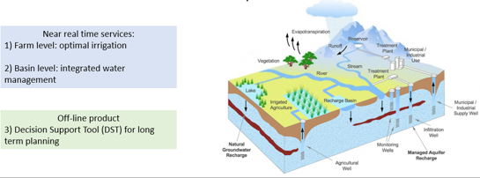
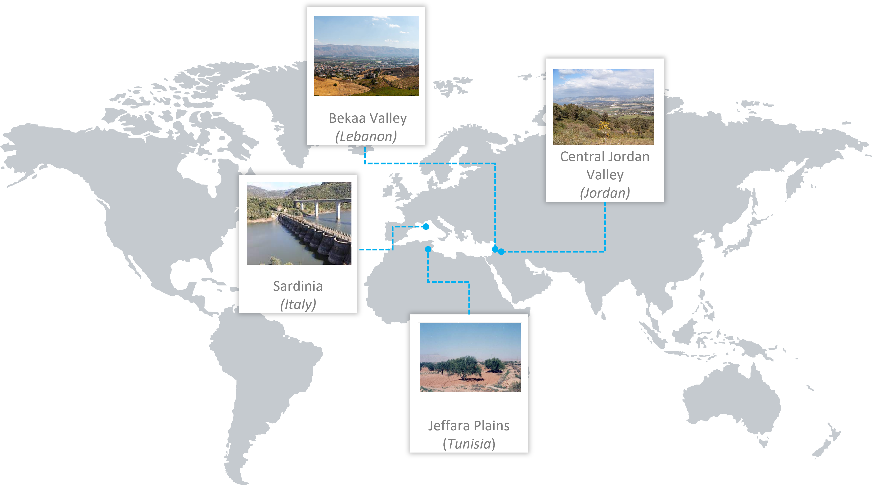
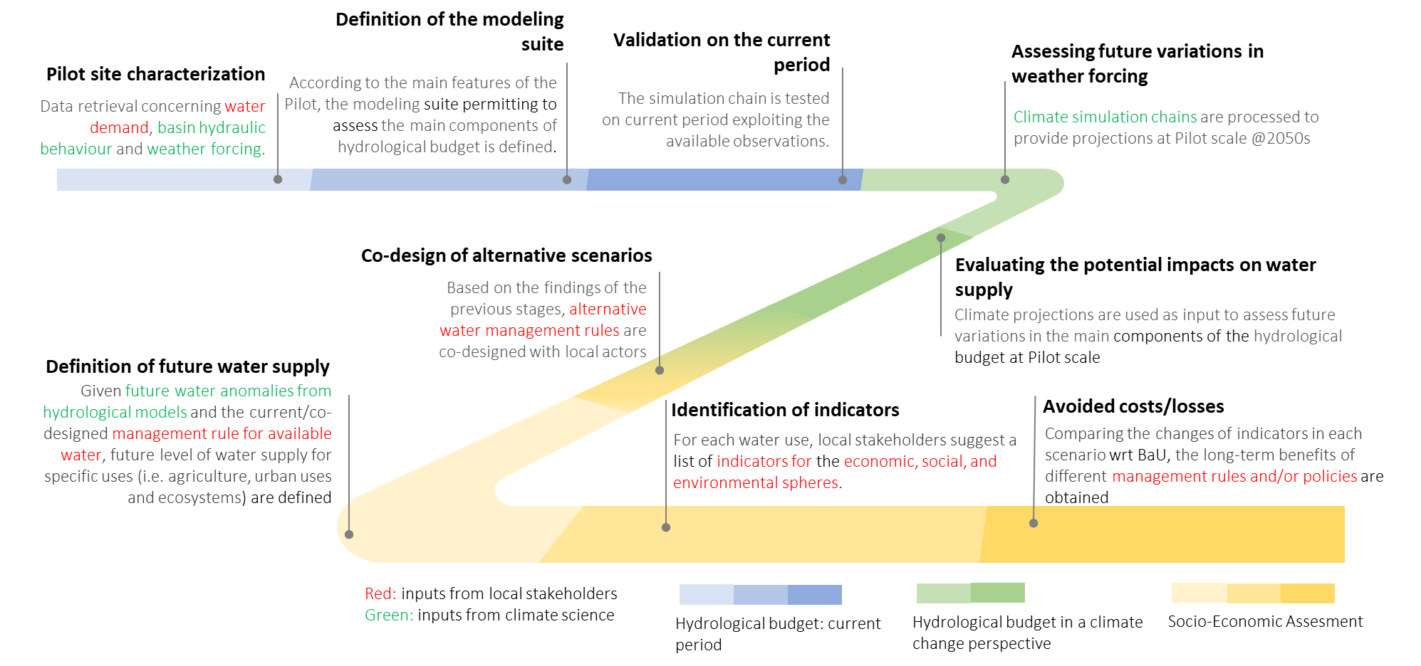
From weather forcing to economic losses: an integrated climate service for long term projections on water availability
Delpiazzo E.¹, Rianna G.², Padulano R.^{2,3}, Reder A.², Bosello F.¹
¹ CMCC, ECIP division, Ca’ Foscari University of Venice, EIEE; ² CMCC, REMHI division; ³ CMCC, IAFES division
Aim and Scope:
The ACQUAOUNT project aims to produce climate services to support robust decision making for water resource allocation at the farm and the basin level in the short run, and an off-line tool to evaluate how the adoption of such tools together with innovative policies to regulate the water sector will affect water availability in a longer perspective.
ACQUAOUNT Products:
Pilot Sites Location:
Production Chain of the DST Product:
This project is supported by the PRIMA program under grant agreement N2021.
The PRIMA program is supported by the European Union.

