Slide 1

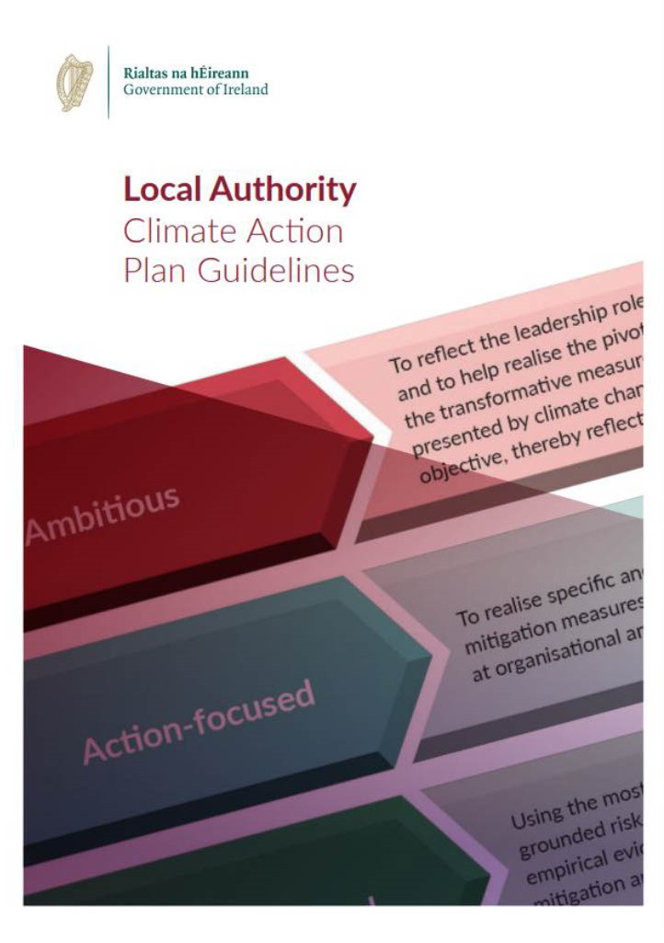
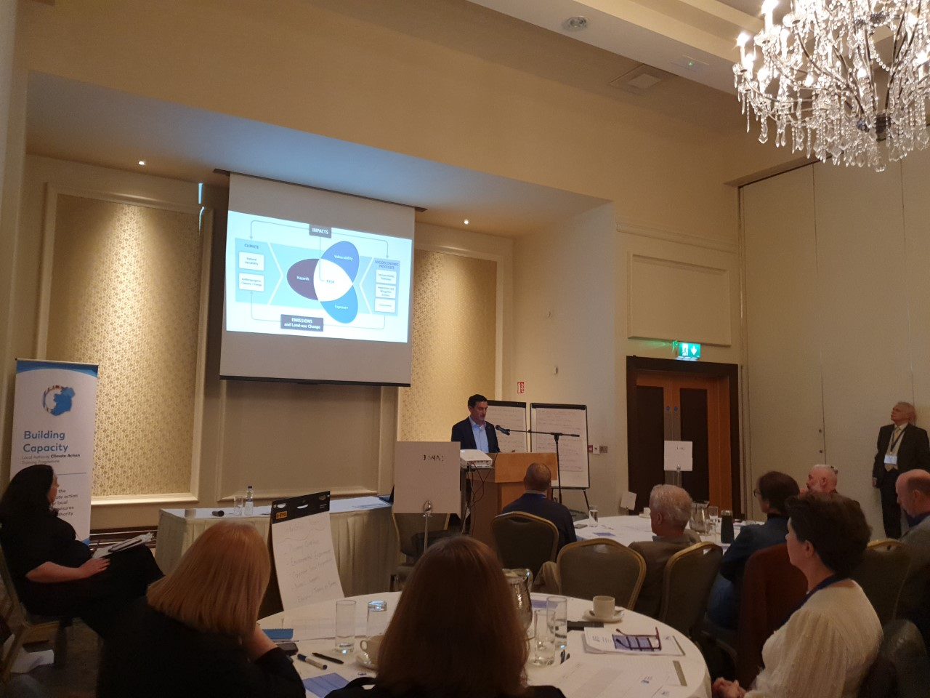


Climate Ireland: It’s time to adapt
Climate adaptation aims to support prosperity and well-being by building the resilience of communities, the economy, and the environment, to a variable and changing climate.
Climate Ireland, funded by the Environmental Protection Agency of Ireland, is inspired by the needs of stakeholders and their experiences of climate change and adaptation. Climate Ireland is a service that connects and integrates scientific research, policy-making and adaptation practice to enhance adaptation decision-making in Ireland. It brings together the key stakeholder groups responsible for addressing the challenges climate change presents.
Climate Ireland provides a mechanism to address not only local and national priorities as outlined in the National Adaptation framework but also European ones, addressing key objectives in the EU Mission Climate, particularly on the need to support regions in better understanding the climate risks they face now and in the future.
TOOLS RESOURCES RESEARCH GUIDELINES REPORTS TRAINING
Climate Ireland’s work revolves around :
Climate Adaptation Resources and Tools
Raise awareness and increase understanding of climate change and climate adaptation.
Provide the information and data required for climate adaptation planning in Ireland.
Support the development of sectoral and
local adaptation plans
Find out more
www.climateireland.ie
Contact us
info@climateireland.ie
Notes:
This methodology was developed by CI in collaboration with ASBN and DM Climate Action Regional Office (CARO)

