Slide 1
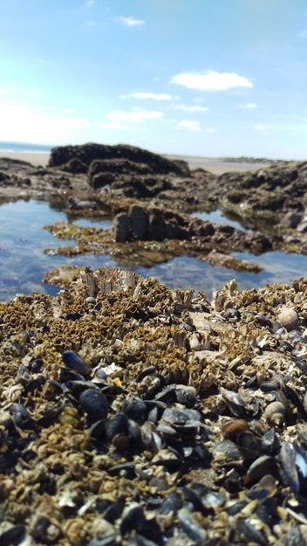
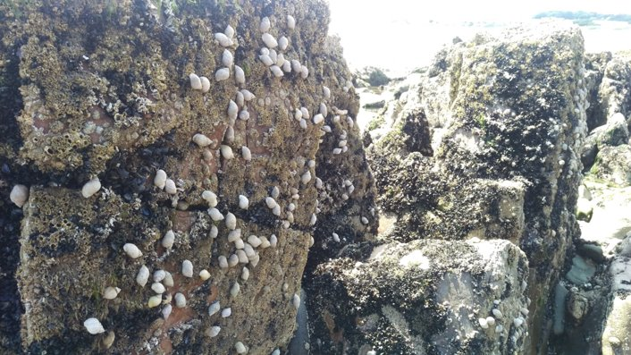
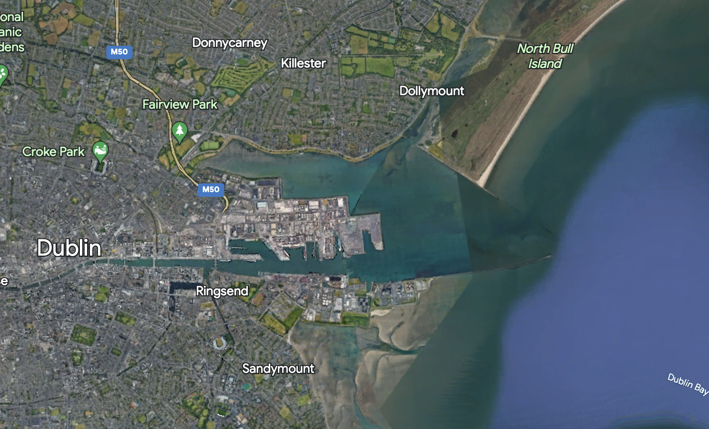
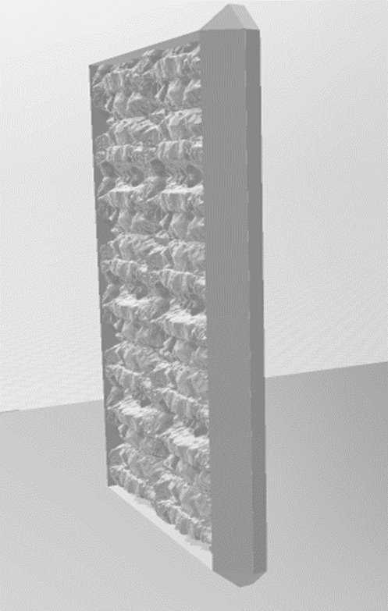
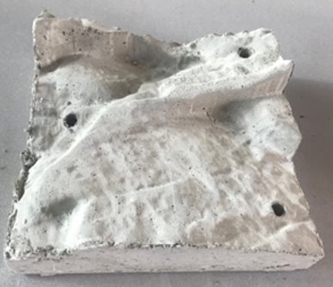
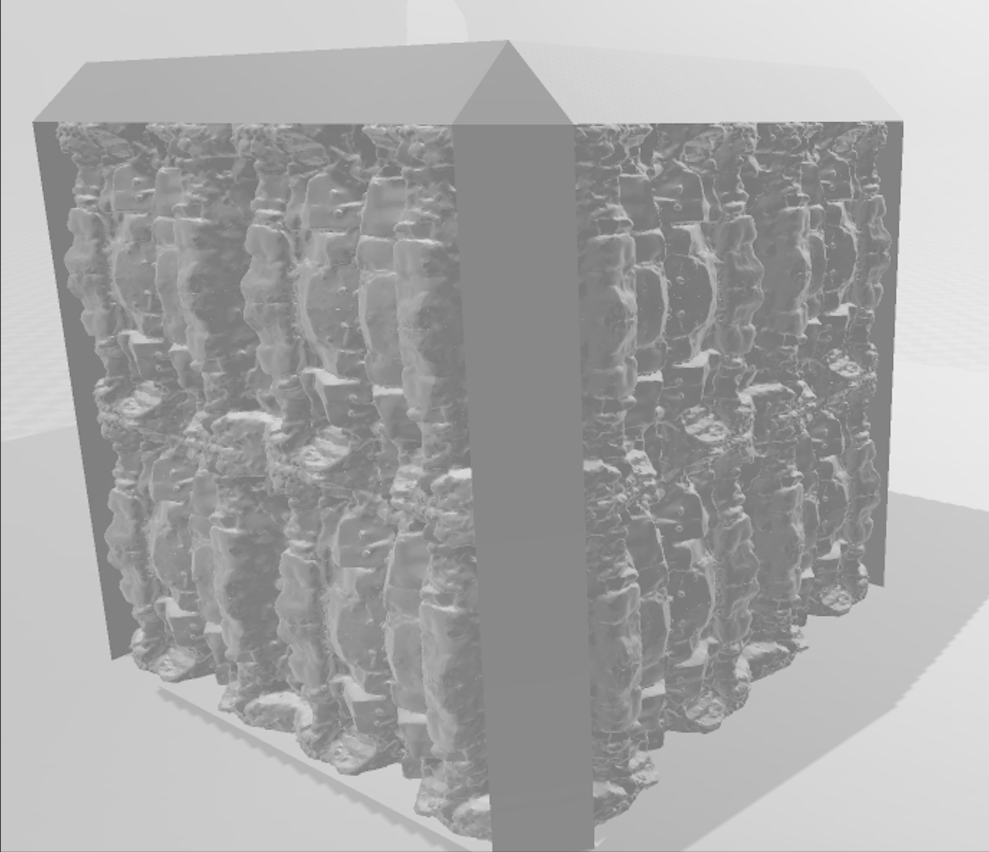
Scaled up approaches to eco-engineering in intertidal and subtidal marine habitats
Earth Institute and School of Biology and Environmental Science.
Email: caoimhe.morris@ucdconnect.ie
Caoimhe Morris, Jennifer Coughlan and Paul Brooks
BACKGROUND
Increased urbanisation along our coastlines has led to increased development of artificial structures that pose a significant threat to marine coastal ecosystems across the globe. These structures lack the characteristics that are important in structuring marine assemblages, affecting key interactions and species distribution. Combining ecology and engineering, eco-engineering aims to fulfil the needs of both human and marine organisms by incorporating features on artificial structures to support greater numbers of native biota.
AIMS
(a) understand the influence of inclination of small-scale eco-engineering units on diversity and abundance of intertidal species and
(b) to test the efficacy of scaled up eco-engineered structures to improve biodiversity on both intertidal seawalls and in subtidal habitats.
Natural shores
..but...
complexity
biodiversity
EXPERIMENTAL OVERVIEW
Experiment 1: Four replicate tiles with natural topography and graphically designed tiles were deployed on horizontal and vertical surfaces on artificial structures at two sites in Dublin Bay.
Experiment 2: Ten replicate wall panels with incorporated natural topography are due to be deployed on a seawall in Dublin Port in June 2023.
Experiment 3: Eight replicate habitat units with integrated topography will be deployed in two subtidal habitats in Dublin Port in July 2023.
Small scale
Large scale
Intertidal
Experiment 1
25 x 25cm
Intertidal
Experiment 2
180 x 150cm
Wall panels
Intertidal tiles
Subtidal units
Subtidal
Experiment 3
100 x 100 x 100cm
PREDICTED OUTCOMES
The predicted outcomes of this project will increase our understanding of eco-engineered habitats, building upon the evidence base for use in both future designs or retrofitting existing artificial structures at larger scales to reduce the impact on biodiversity and ecosystem functioning.

