Slide 1
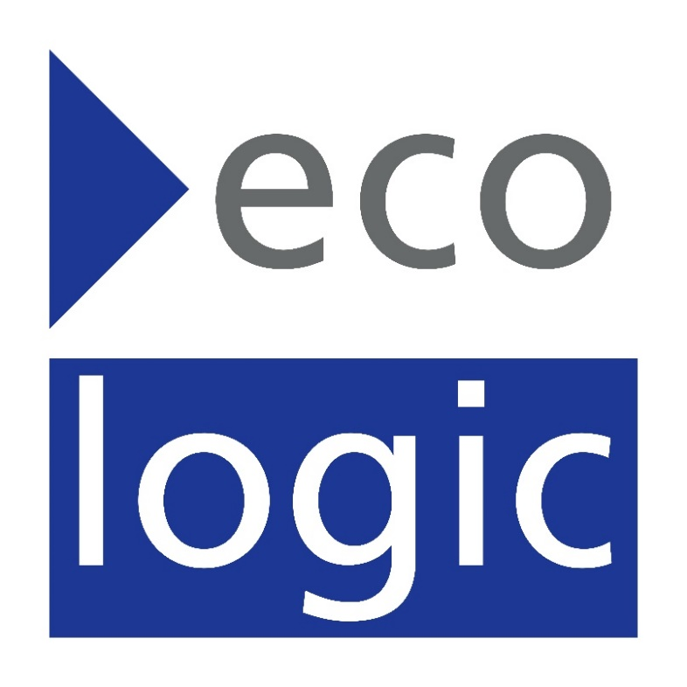
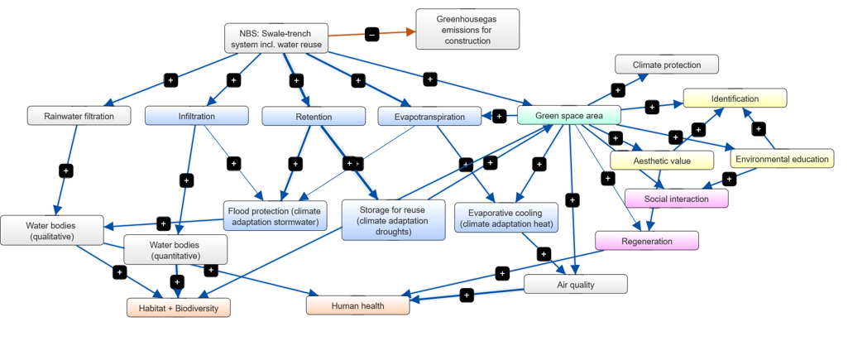
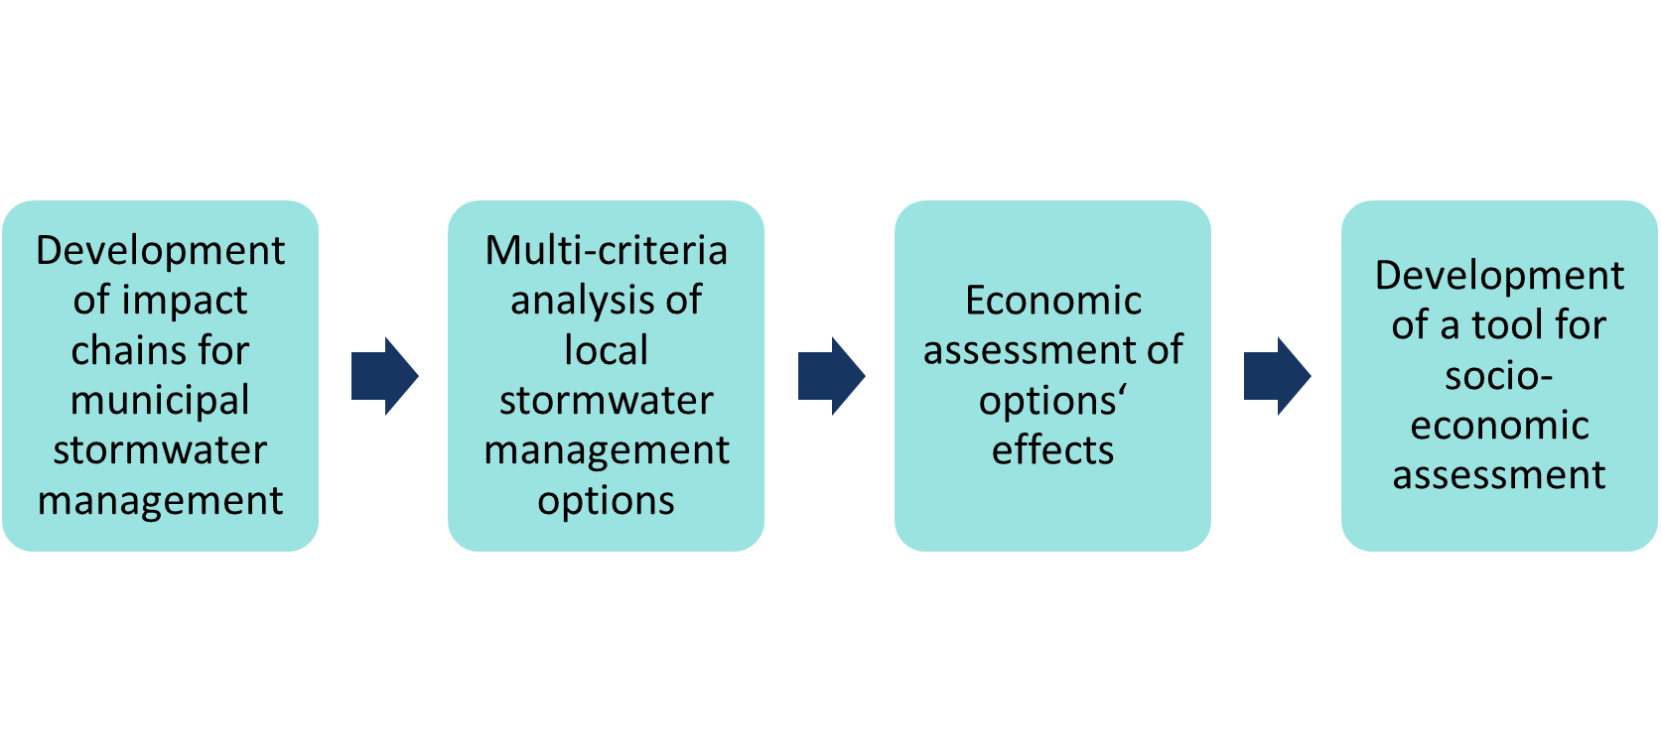
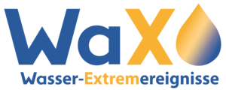
Climate adaptation and urban water systems: Fostering nature-based solutions and resilient governance systems
Jenny Tröltzsch, Hannes Schritt, Ulf Stein, Flora Dicke
Ecologic Institute, Germany, Berlin
Introduction to AMAREX project
Example: Impact map for nature-based solutions related to heavy rainfall and drought
Research project “Adaptation of Stormwater Management to Extreme Weather Events (AMAREX)”, funded by Federal Ministry of Education and Research (BMBF), Germany
Duration: Feb 2022 – Jan 2025
Project objectives:
Investigation of different types of stormwater management concepts and blue-green infrastructure (BGI) for their effects with regard to flood, heat and drought prevention
Development of a web platform for municipal stakeholders to serve as an information, communication, and decision-making tool
Development of a method and tool for socio-economic assessment of local stormwater management concepts
Work with selected pilot areas and stakeholders in Berlin and Cologne
Impact map represents impacts and benefits of stormwater management concepts and green-blue infrastructure related to heavy rainfall and droughts
It is based on a literature screening, which resulted in more than 40 impacts of green-blue infrastructure. The impacts have been structured.
This conceptional map will be used to further evaluate impacts as part of a semiquantitative assessment with a multi-criteria-analysis.
Research objectives and approach for socio-economic assessment
How can an integrated socio-economic assessment methodology for blue-green infrastructure support the selection of measures in municipal planning practice?
How can far-reaching additional benefits of BGI be reflected in the valuation?
How can robust monetary valuations of BGI measures on local level be generated?
Approach:
Possible criteria to evaluate blue-green infrastructure and nature-based solutions
Based on literature screening of more than 40 evaluation studies and tools
Criteria have been categorized into six categories
A selection of criteria will be used for multi-criteria analysis
Impacts water management
Water regulation Rainwater retention Local flood production Sediment retention Water quality
Further ecological impacts
Climate mitigation Air quality Microclimate Habitat quality & biodiversity Pollination
Social impacts
Urban green & recreation Living environment Scenic quality Health, quality of life & wellbeing Space for environmental education & cultural events Space for community activities
Economic criteria
Efficiency Investment costs Maintenance costs Personnel & financial resources
Implementation oriented criteria
Implementability Acceptance Flexibility re climate scenarios Political support Innovation potential Stakeholder participation Iterative process
Contact and funding
Jenny Tröltzsch, jenny.troeltzsch@ecologic.eu
Synergies / Trade-offs
Synergies and conflicts with other policies / measures Cross-sectoral measures

