Slide 1

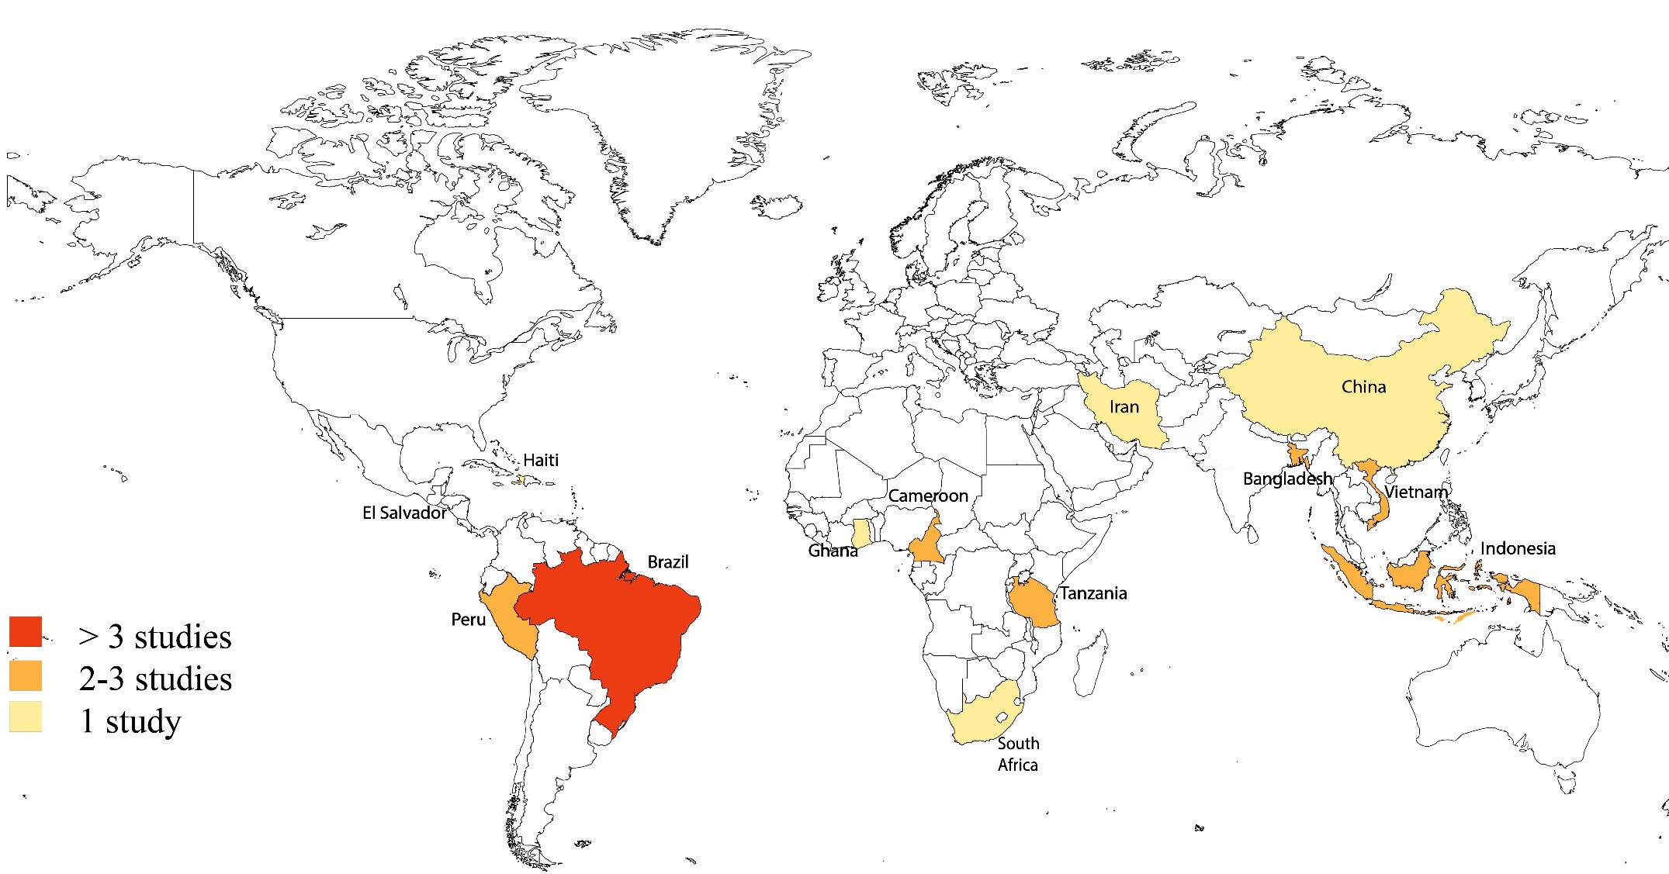

Mental health and wellbeing outcomes of climate change mitigation and adaptation strategies: A systematic review
Elaine C. Flores PhD MD MSc¹⁻³ Laura J. Brown⁴, Ritsuko Kakuma³, Julian Eaton³, Alan D. Dangour ¹
1 Centre on Climate Change & Planetary Health, LSHTM; 2 Stanford Center for Innovation in Global Health, Stanford University ; 3 Centre for Global Mental Health, LSHTM; 4 Institute for Global Health, University College London
Background
Planetary warming and extreme weather events have already affected the health and wellbeing of ~5 billion people globally.
The climate change crisis is one of human health, and a growing body of evidence highlights that climate change adversely impacts mental health and broader outcomes for population wellbeing. Low-and-middle-income countries (LMICs) are disproportionately vulnerable to climatic impacts and have the least resources to prepare for its consequences. There is clear evidence for the beneficial role climate change mitigation and adaptation responses can have for public health and their potential role on mental health and wellbeing outcomes. However, these strategies are being implemented in LMICs without considering their potential impact on mental health and wellbeing outcomes.
This review addresses this gap by compiling and assessing the evidence base on co-benefits for mental health and wellbeing in LMICs by (1) examining the impact of climate change mitigation and adaptation interventions on mental health and wellbeing outcomes in LMICs, (2) reviewing the evidence base of this association, and (3) evaluating the effect of those interventions by type, climatic/environmental risk, and by different population groups and context.
Figure 1 – PRISMA flow diagram of study selection
Findings
9,532 studies were initially retrieved, with 15 studies (12,255 participants) meeting the inclusion criteria. Twelve studies described evidence from single-adaptation strategies in nine LMICs, while three reported mitigation programme outcomes. Only two randomised evaluations assessed common mental disorders (e.g., depression, trauma, anxiety) using validated scales. Most studies evaluated broader wellbeing at the community and individual levels. Nine studies (53.3%) reported significant beneficial changes in mental health or wellbeing outcomes among intervention participants, while six (46.7%) obtained mixed results. No adverse intervention effects were reported, , though reporting and publication bias may be a factor. Despite positive effects reported, the practical significance and overall impact of the interventions remained unclear due to the heterogeneous reporting and gaps in effect size assessments (e.g., positive outcomes were observed in perceived benefits, self-efficacy, subjective wellbeing and material quality of life, structural and livelihoods measures, or disaster preparedness, however some studies did not report program effectiveness or provided qualitative insights).
Identification
Database Records identified (n = 9514)
Medline = 951
Embase = 1331
PsycInfo = 831
Global Health = 508
Cochrane = 2180
GreenFile = 614
Web of Science = 3099
Additional records (n = 18)
-Manual searches = 13
-Scheelbeek et al. report using the ‘Global Adaptation Mapping Initiative’ database* = 05
*Systematic searches from Scopus, Web of Science and Google Scholar from 2013 to 2020
Total potential records
(n = 9532)
Duplicates excluded (n=824)
-EndNote de-duplication (n=684)
-Manual de-duplication (n= 140)
Screening
Titles and Abstracts screened
(n= 8708)
Records excluded
(n= 8593)
Interpretation
Our review highlights the scarcity and limited nature of the current evidence, underscoring the need for further research of the relationship between climate change-linked strategies and mental health and wellbeing.
Despite widespread programming in this area, formal evaluations that measure these critical outcomes are lacking. Considering the current global climate and mental health crises, this scarce evidence represents a missed opportunity to ameliorate and prevent significant, long-term problems for the population's mental health and wellbeing. There is an urgent need for studies to explore how these interventions work and how to address mental health responses better while considering local factors with a transdisciplinary lens at all levels so that they can be readily translated into policy and action.
Full Texts Screened
(n=115)
Reports Excluded (n=100):
-Outcomes do not comply with eligibility criteria (n=33)
-Study design do not comply with eligibility criteria (n=65)
-Study is not related to climate change adaptation / mitigation strategies (n=2)
Included
Studies Included in the SR (n=15)
Methods
We carried out a systematic review, searching OVID Medline, Embase, PsycINFO, Global Health, Cochrane Library, GreenFile, Web of Science, and a subgroup of studies from the 'Global Adaptation Mapping Initiative' database to identify intervention and case studies published from 2013 to 2022. We included studies that: (1) examined mental health or wellbeing outcomes related to climate change mitigation and adaptation strategies or both in general adult populations >18 years old living in LMICs , (2) used controlled evaluations, quasi-experimental methods, pilot assessments or focussed case study designs to collect quantitative or qualitative data; (3) included indicators of successful mitigation and/or adaptation interventions linked to a change in mental health outcomes or outcomes related to psychosocial conditions and wellbeing (e.g., quality of life). We categorised studies by design, geographic region, target population, setting, environmental hazard, type and effectiveness of the strategy and primary outcomes. PROSPERO registry: CRD42021262711.
Figure 2 – Map with included studies distribution
@osahermosa2010 @LSHTM_Planet @StanfordCIGH
elaine.flores@lshtm.ac.uk
Improving Health Worldwide • www.lshtm.ac.uk

