Slide 1
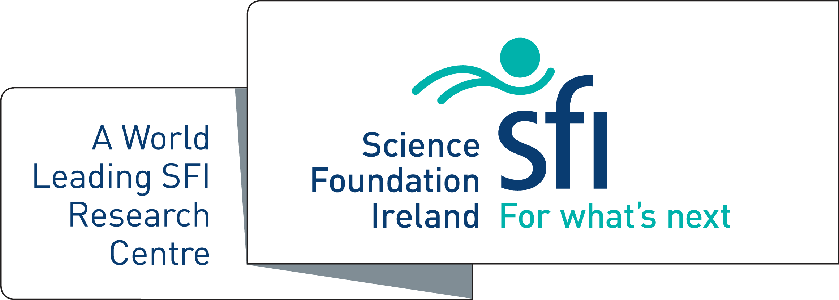
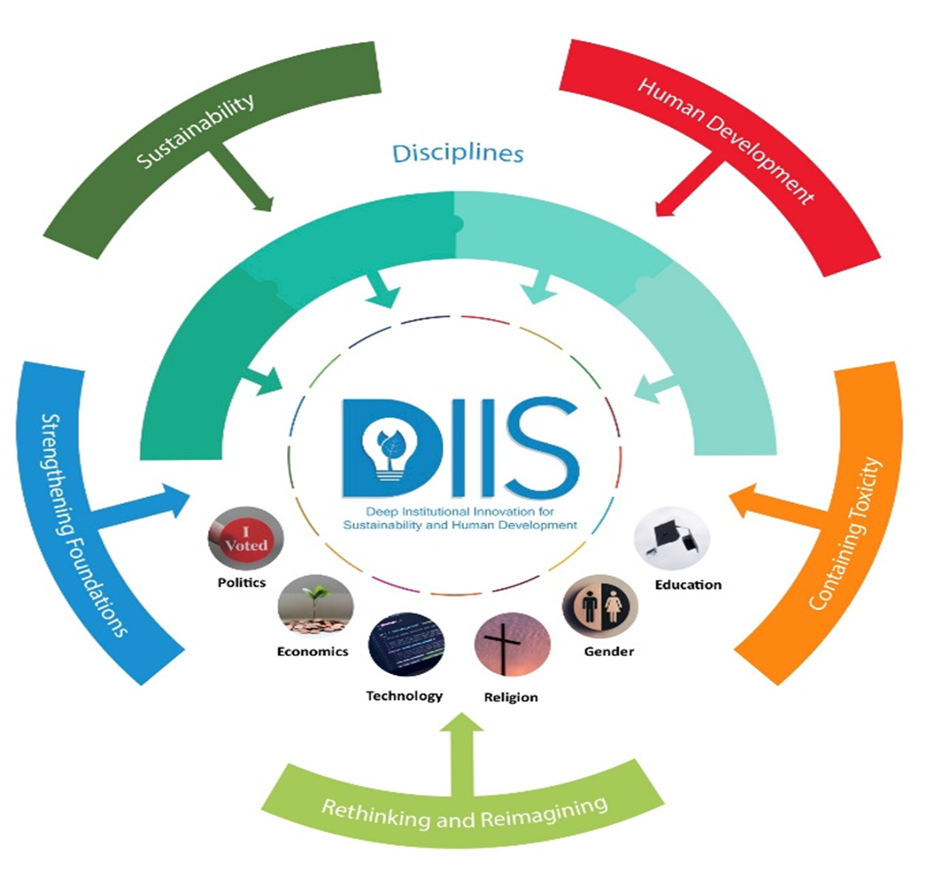
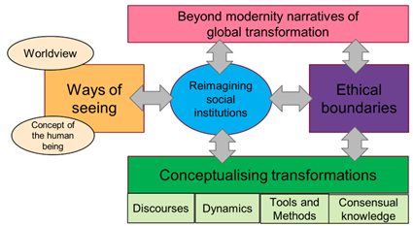
Non-Cognitive Predictors of Student Success: A Predictive Validity Comparison Between Domestic and International Students
Non-Cognitive Predictors of Student Success: A Predictive Validity Comparison Between Domestic and International Students
DIIS - Deep Institutional Innovation for Sustainability and Human Development
Indicative Blueprint for Transformational Change
Future work aims to develop a methodology for moving from the DIIS generative model to generating Scenarios of global transformation based on the following four steps:
Step 1: Identifying Ideational Drivers for Reimagining Individual Social Institutions
Step 2: Articulating Individual Social Institution Transition Pathways
Step 3: Exploring Systemic Linkages between Social Institutions and Articulating Whole of Society Change
Step 4: Generating Scenarios for Global Ethical Transformation
The first of these steps has been developed through DIIS publications and events and has identified the following starting points for re-imagining social institutions:
Authors: I. Hughes^{1,2}, A. Hernandez³,E. Byrne^{1,2,4}, M. Glatz-Schmallegger^{1,5}, J. Glynn⁶, W. Hynes⁷, K. Keohane⁸ and B. Ó Gallachóir^{1,2}
DIIS Scenarios –
A New Model for Reframing Whole of Society Transformation
AIMS
To reimagine the social institutions of politics, economics, technology, religion, gender and care, and higher education so they can better respond to this moment of deep transformation.
To challenge underlying assumptions by moving:
Beyond climate centrism – by including the daunting array of challenges we currently face
Beyond socio-technical transition – to deep societal transformation
Towards greater transdisciplinarity – by an integrative approach including explicit inclusion of gender, religion and education.
We are at a historical moment of potential deep transformation where multiple interconnected crises including climate change, species extinction, political crises, a cost of living crisis, the Covid-19 pandemic, are occurring simultaneously.
At this moment, many of the foundational social institutions upon which societies have relied for decades for stability and direction are failing and need to be reimagined. Moreover the optimisation of individual systems will be inadequate. A holistic approach is necessary.
 | Ideational | Organisations | Practices
Politics | Reconstituting democratic civil society
Economics | Beyond growth
Technology | Beyond Creative Destruction – Embedding RRI in society
Religion/Spirituality | Restoring the Sacred ; Engaging religious actors
Gender | Gender and racial equality & Containing violent hypermasculinity
Education | Using DIIS model as transformative educational tool
DIIS Generative Model of Transformation
The Reimagining of Social Institutions constitutes the core of societal transformation. This deep re-imagining is informed by four further elements of the model:
Narratives of Global Transformation
DIIS goes beyond both socio-technical transitions and deep transitions framings to a whole-of-society transformation framing – a move beyond modernity.
Ethical Direction
DIIS is an explicitly normative model of transformation - ethical directionality is essential to ensure transformation towards sustainability as flourishing/well-being.
Conceptualising Transformation
DIIS aims to model fundamental transformation of global society, within rapid timeframes, activated by reflexive, contagious and fast-spreading processes of social and technological change.
Ways of Seeing
Experimenting with transdisciplinarity, stakeholder engagement, and inclusion of perspectives from the arts, music and literature are integral to further developing the DIIS framing.
Indicative Scenario
Progress towards sustainability required the recognition of the deeply interconnected nature of the major social institutions in society and the need for fundamental transformation across politics, economics, technology, religion, gender and education. Beyond reforms at the ideational, organisational, and social practices levels in each of these areas, it became widely accepted that the move to sustainability required deep change at the twin levels of core ethical principles and landscape metarules and values that shape social institutions. Deep transformation for sustainability and human development, guided by reinvigorated ethical principles and moral leadership, is healing the deep wounds at the heart of human civilisation, including by: strengthening protections against dominance hierarchies including violent hierarchies, reducing inequalities and reversing social and environmental harm through reimagined models of economics and technology, reimagining the Sacred and reducing patriarchy and sectarianism in religion, and reducing gender polarities through greater value on care.
1 MaREI Centre, Environmental Research Institute University College Cork, Ireland 2 Environmental Research Institute, University College Cork, Ireland 3 German Institute of Development and Sustainability, and University of Duisburg-Essen, Bonn, Germany 4 Process and Chemical Engineering, University College Cork 5 valUse: Personnel - Management - Education, Eisenstadt, Austria 6 Center on Global Energy Policy, Columbia University SIPA 7 New Approaches to Economic Challenges Unit (NAEC), OECD, Paris, France 8 School of Sociology and Criminology, University College Cork, Cork, Ireland.
*Corresponding author email: ian.hughes@ucc.ie
Notes:
Please delete all notes!

