Slide 1
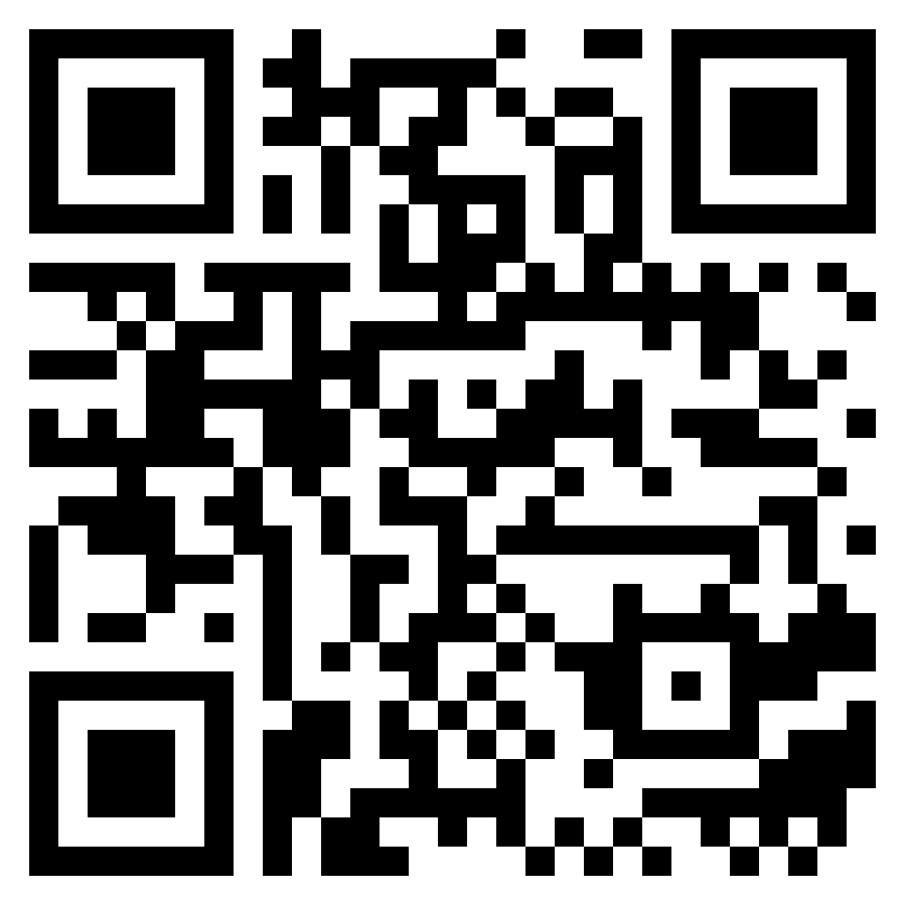
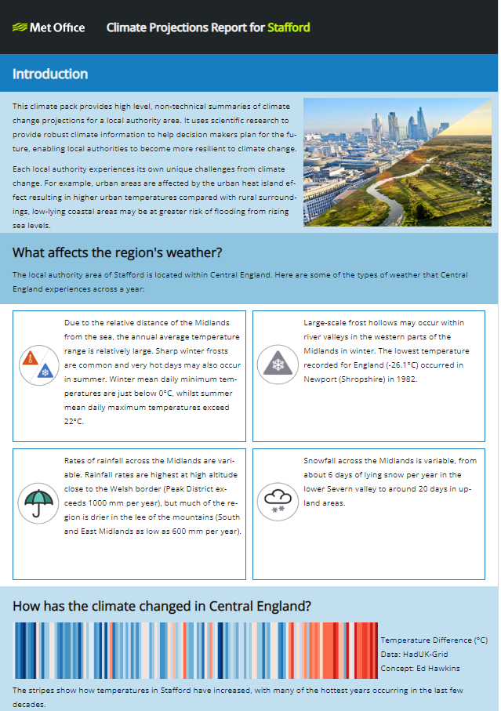
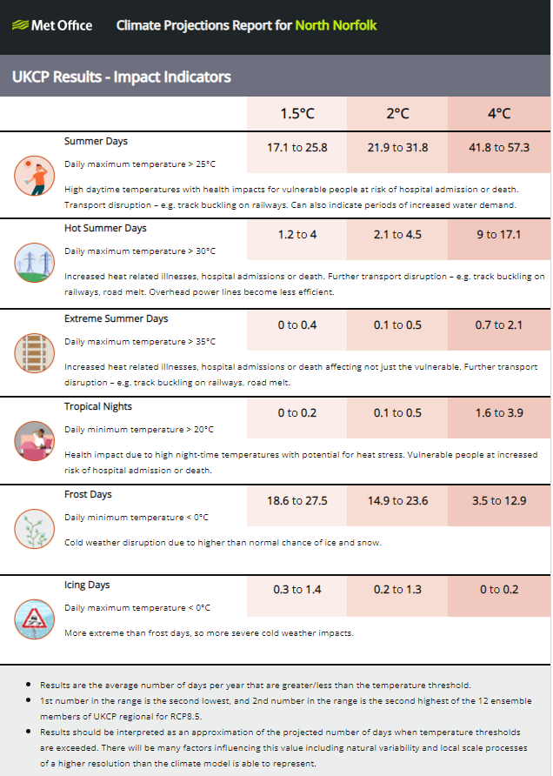
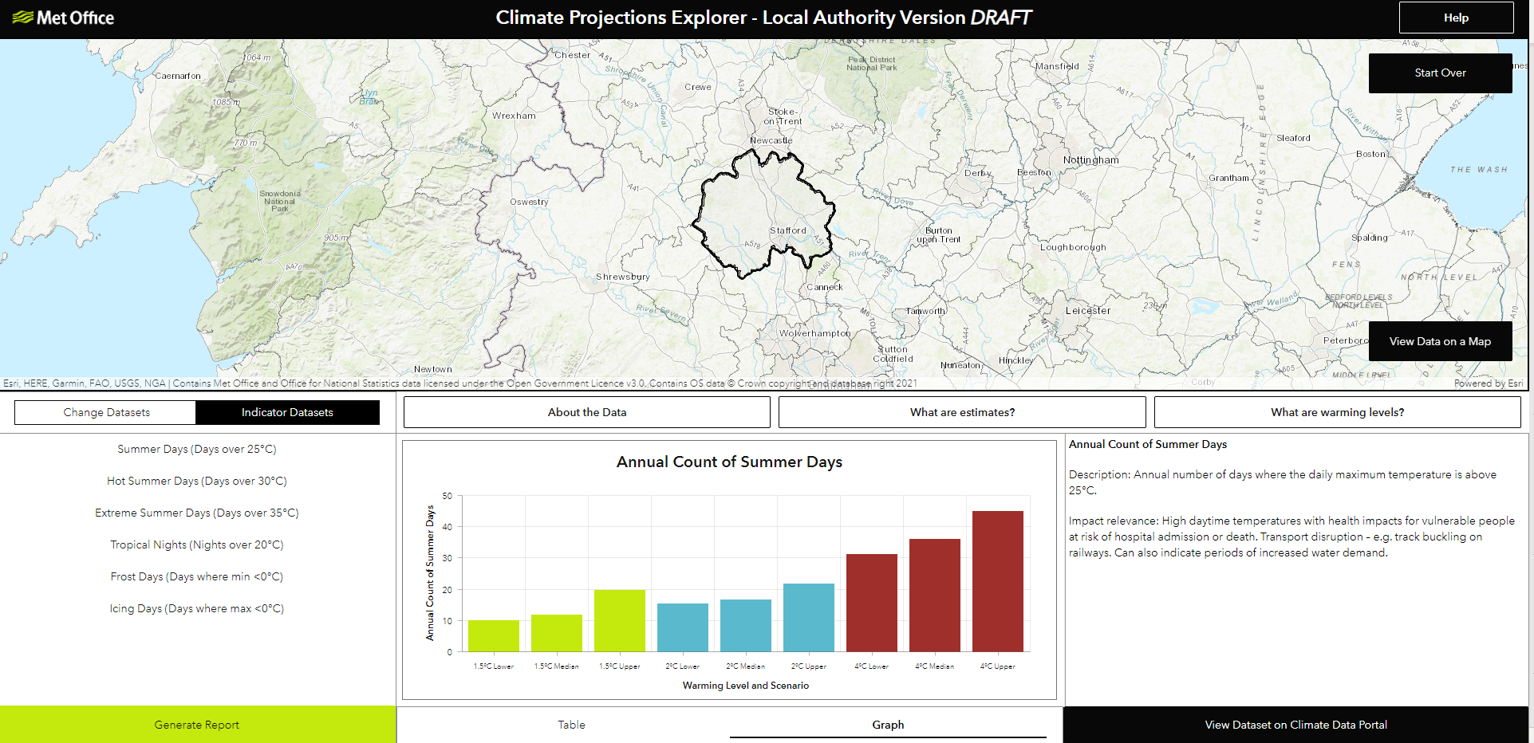
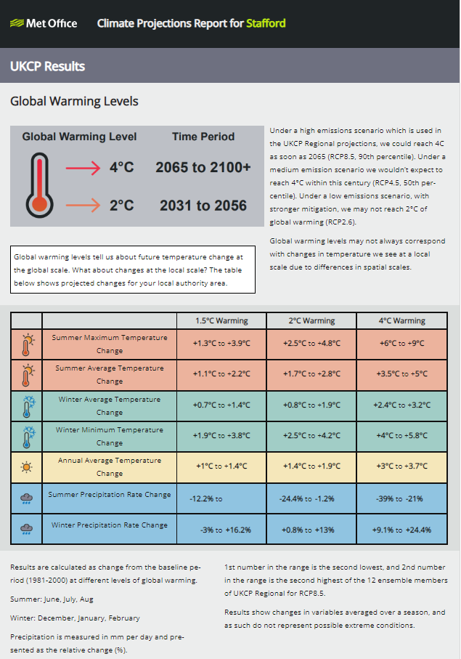
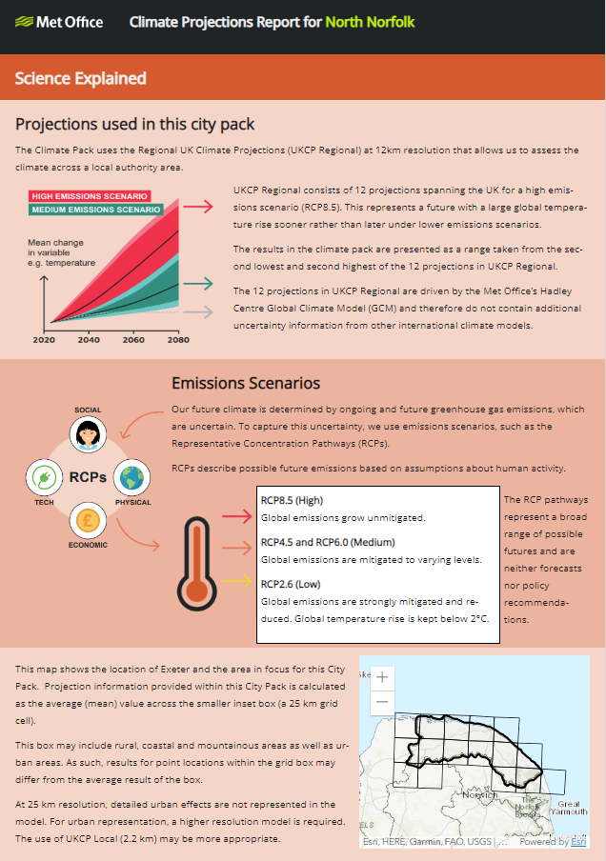
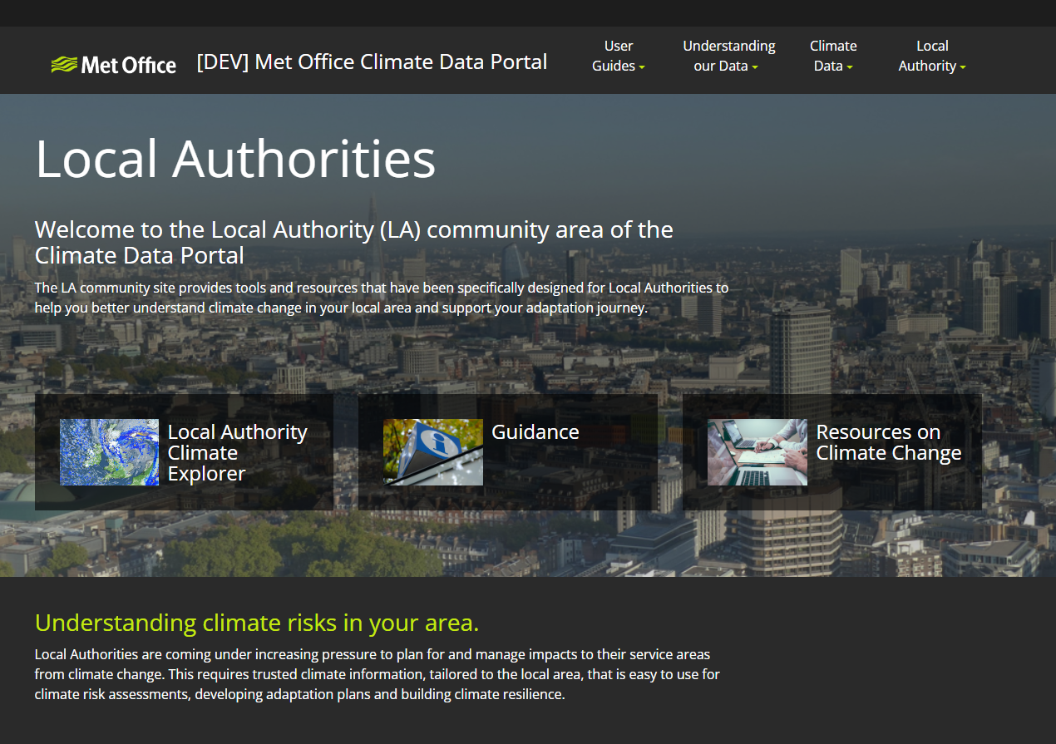
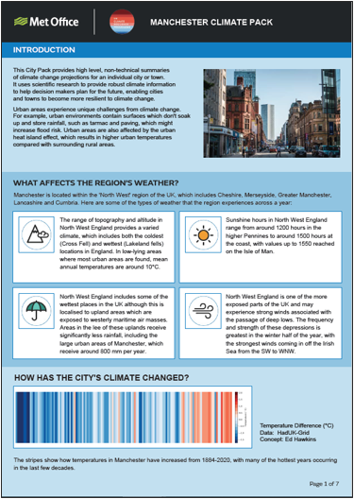
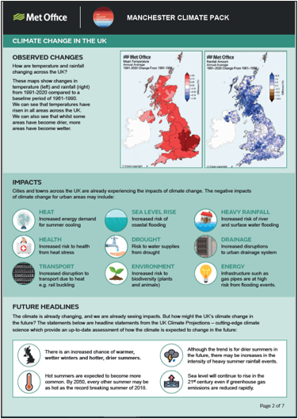
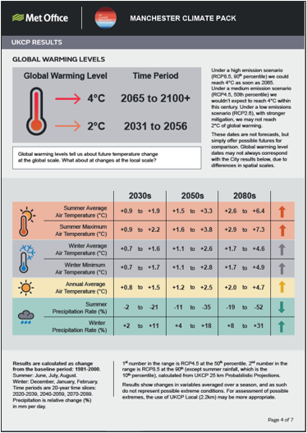
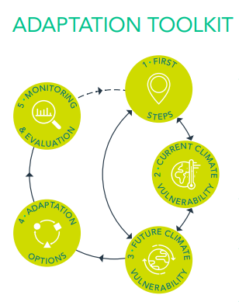
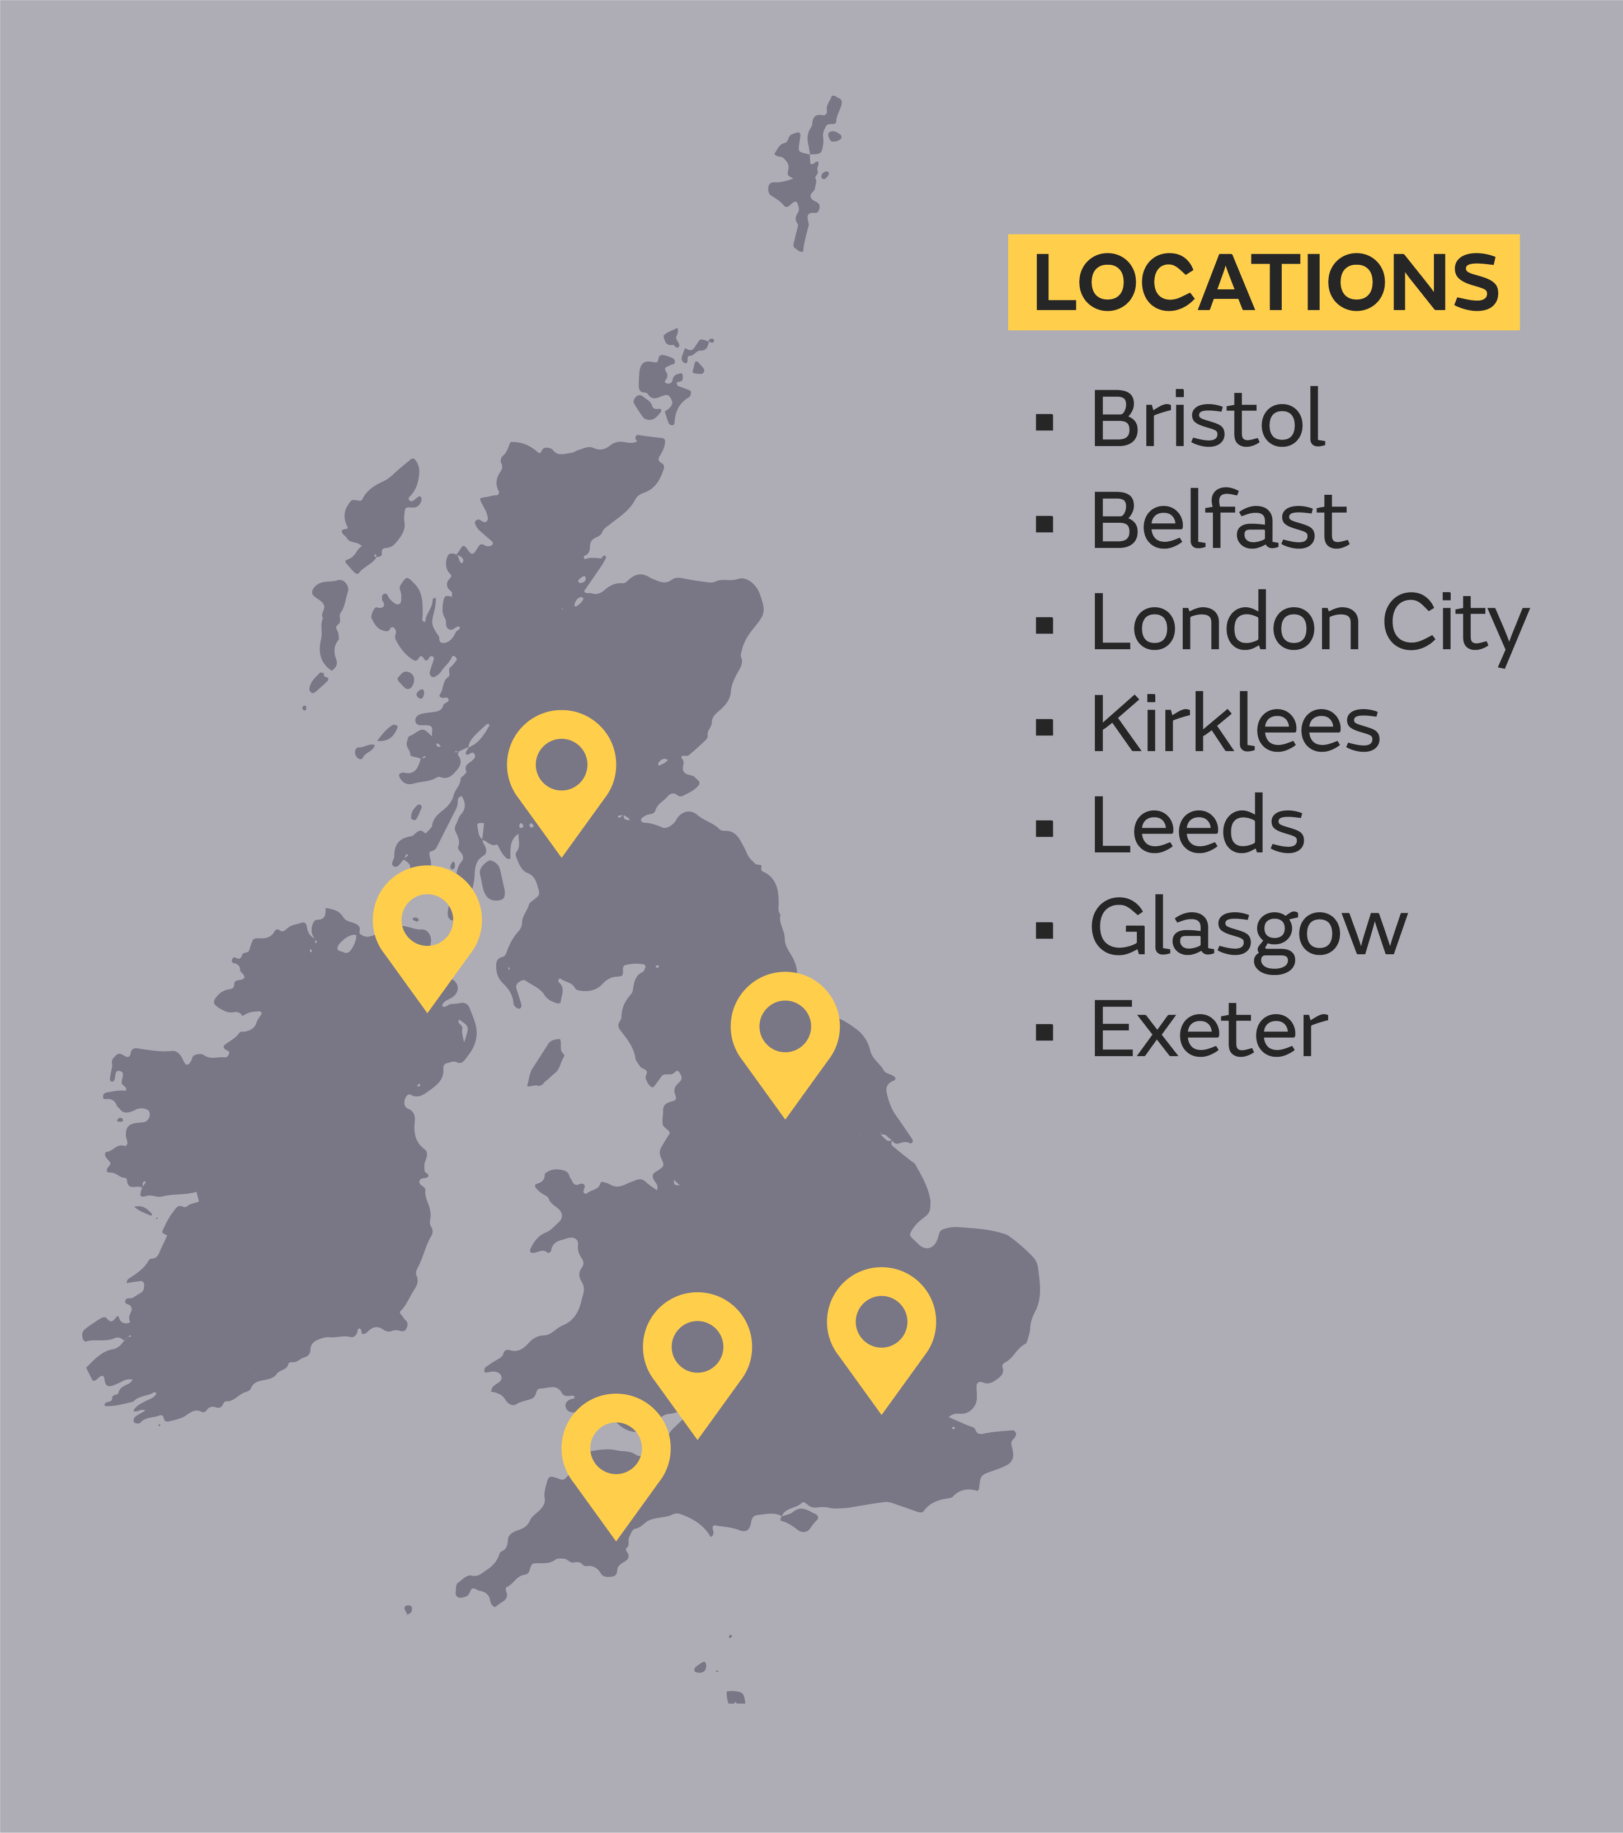
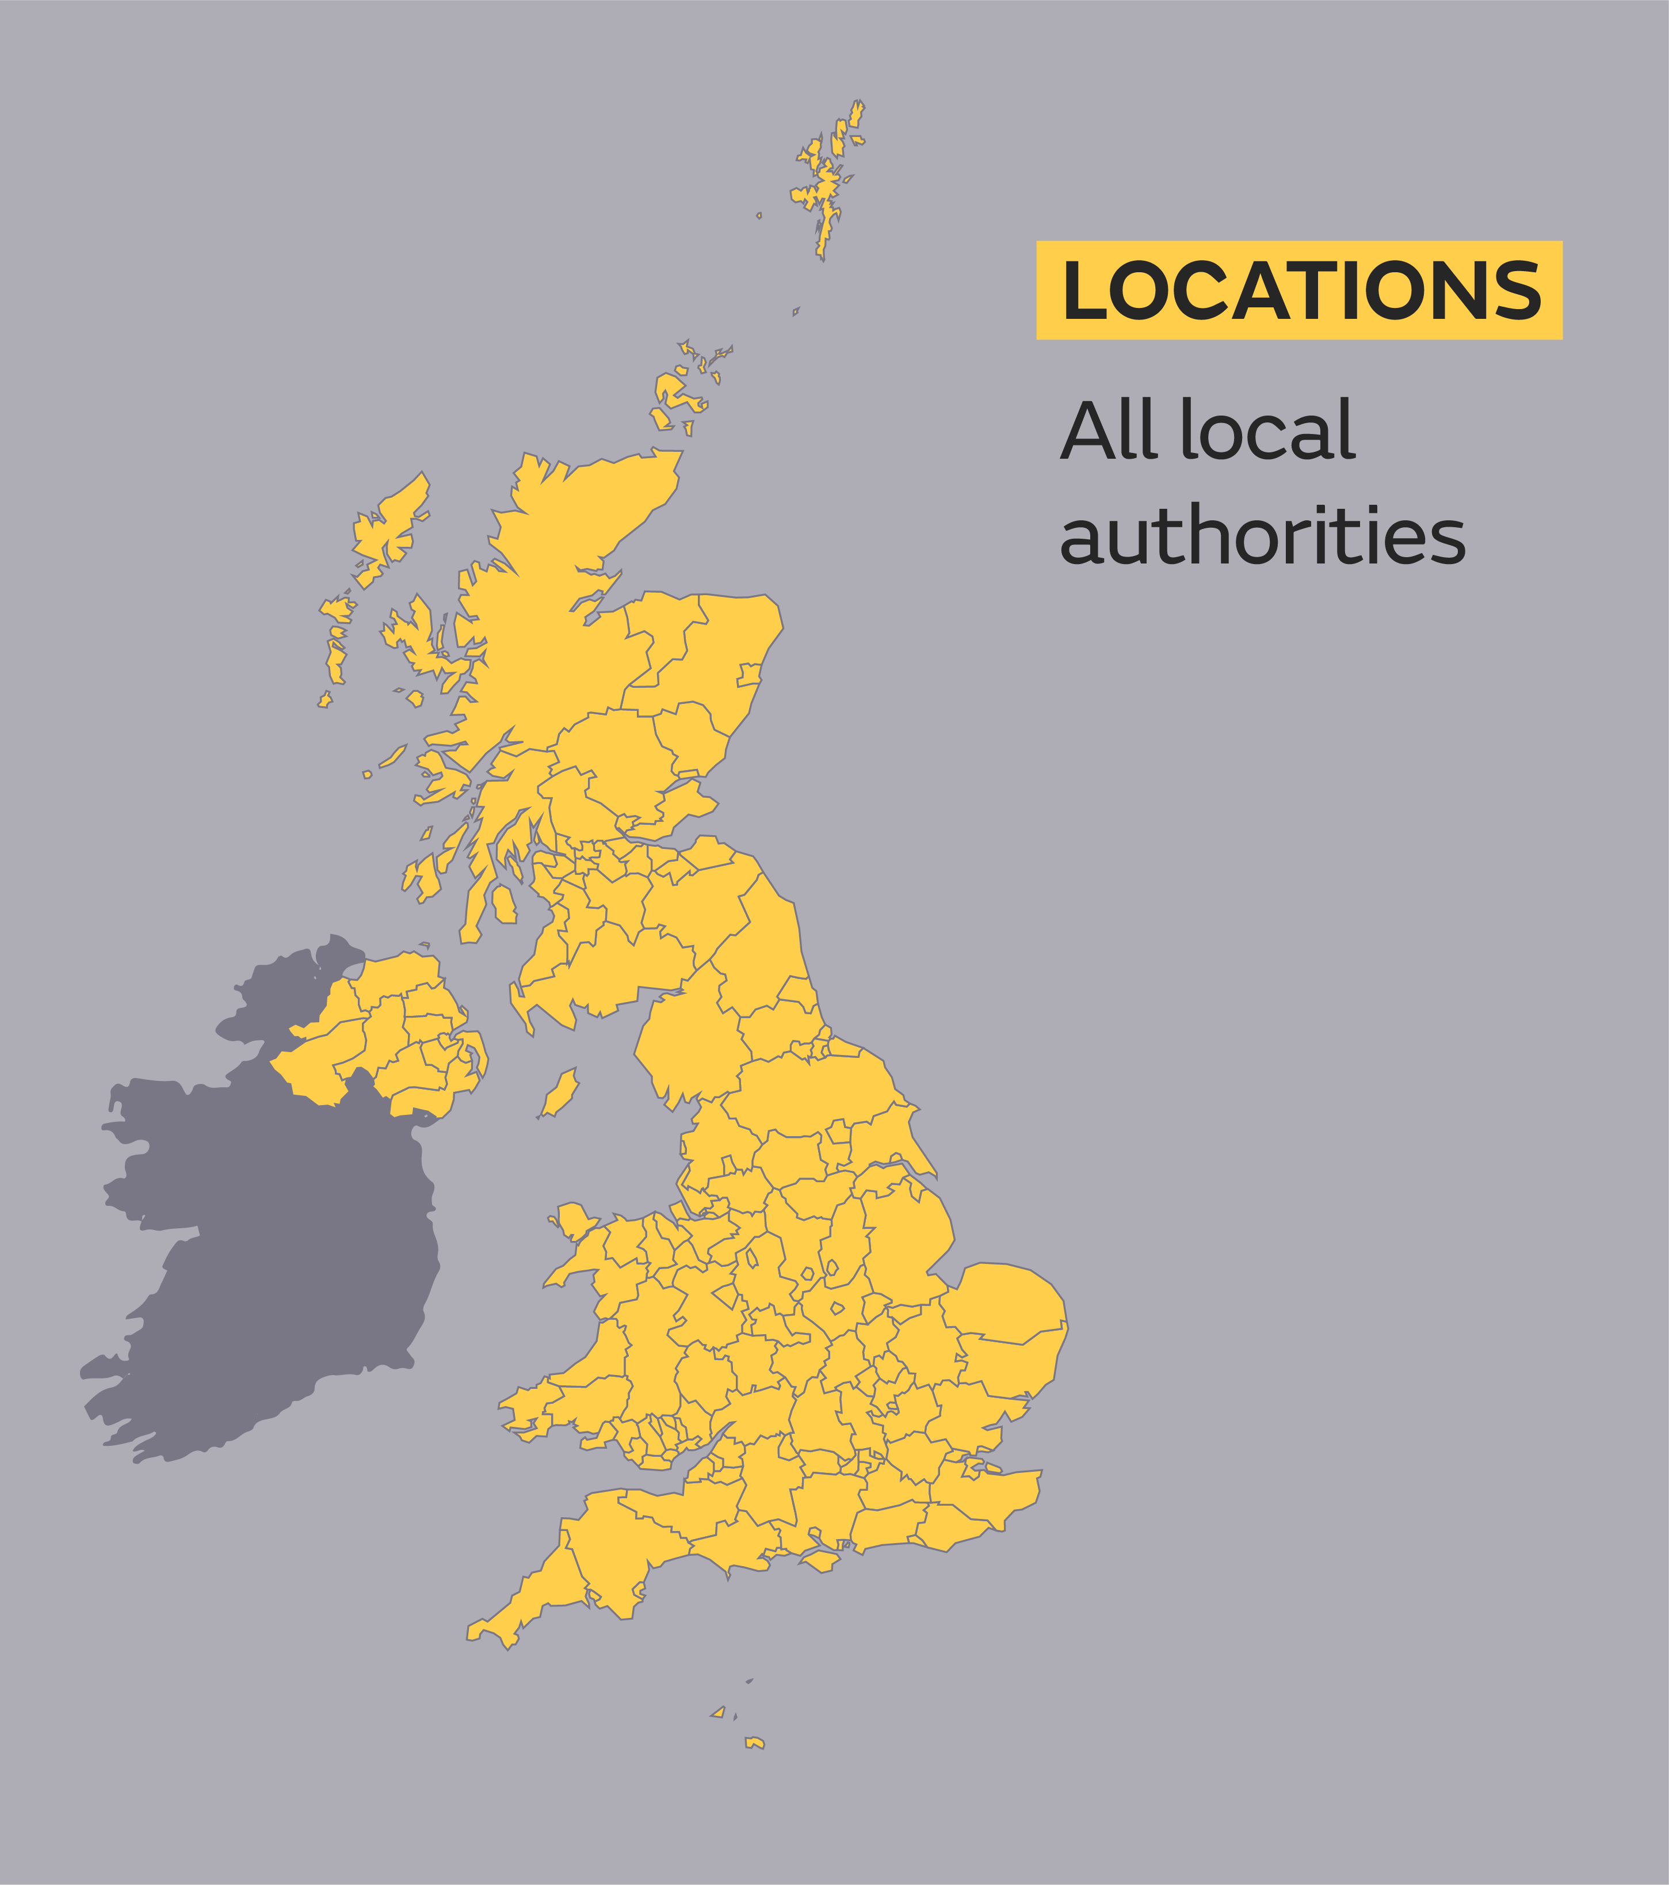
Victoria Ramsey, Alex Woods, Katie Hodge, Michael Sanderson, Anthony Veal, Josh Macholl, Emily Wallace, Natalie Garrett, Hayley Jones, Mathew Richardson, Jason Lowe, Elizabeth Fuller, Laurie Stevens (ESRI UK)
Upscaling an urban climate service from prototype
to operational service for Local Authorities
1. Introduction
2. Local Authority Climate Service
Met Office Climate Data Portal
In the UK, Local Authorities (LAs) are coming under increasing pressure to plan for and manage climate risks to their service areas. Many have declared climate emergencies requiring the development of climate change action and adaption plans. LAs have highlighted a need for clear and authoritative information for:
The Met Office launched a Climate Data Portal (CDP) to provide the UK Climate Projections (UKCP) data in a geo-spatial format. See QR code:
This provided an opportunity to use a range of ESRI applications to develop a more bespoke service aimed at LA’s, enabling the scaling up of our city pack service and climate information to all UK LA’s in ready to use formats.
Local Authority Climate Service
Raising awareness of the need to adapt
Identifying and prioritising climate risks and opportunities
Turning evidence into climate action
Local Authority Climate Projections Explorer
Local Authority Climate Pack
Local Authority Community Site
Supporting Local Plans
An interactive geo-spatial platform with UKCP data pre-processed to LA boundaries. It allows users to interact with climate data for a local area and overlay their own datasets. A range of variables are available including temperature, rainfall and sea level change, as well as decision-relevant impact indicators.
An enhanced version of the City Pack service summarising results for key climate change and impact variables for a local authority area that can be used as a communication and public engagement tool.
A hub providing supporting information on how to use the tools within the LACS. It also contains information on climate change and adaptation planning, along with useful infographics. Based on user feedback we added case studies on how LAs are using this information to build awareness and take action on climate issues.
.
The Met Office has co-produced a range of prototype urban climate services with LAs to assist them in their adaptation planning. Due to the success of the “City Pack” and “Urban Heat Service” we have received requests from other LA’s for this type of information. While the co-development process ensures users have a good understanding of the products and the information contained therein, there remains a challenge around scalability, namely how to cover all the LAs in the UK.
Using LA’s as a test case, this work has explored what tools and mechanisms are required to enable data provision at scale in a ready to use format that is relevant to decision making. Working closely with LA’s, a Local Authority Climate Service (LACS) has been developed as a proof of concept.
3. Working in Partnership
We have been testing the service with LAs to ensure the tools are relevant and easy to use. Initial feedback has been positive with many seeing the LACS providing significant benefits for their adaptation planning. The Met Office are hoping to launch the tool in 2023, subject to funding.
We have been working closely with organisations who support LAs in their adaptation planning to ensure the LACS aligns with the requirements of their adaptation toolkits and the LACS can be signposted to in their adaptation toolkits and advice.
This type of information is “worth its weight in gold” reducing time spent on data processing
A powerful incentive to induce behavior change by making the impacts feel more real and local
How to scale?
Source: Local Partnerships
Met Office FitzRoy Road, Exeter, Devon, EX1 3PB United Kingdom Tel: +44 1392 885680 Fax: +44 1392 885681
Email: urbanclimateservices@metoffice.gov.uk
© Crown copyright, 2023 | Met Office and the Met Office logo are registered trademarks

