Slide 1
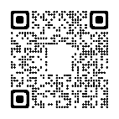
30 June – 3 July 2024 De Doelen International Congress Center
Rotterdam, The Netherlands

Slide 2
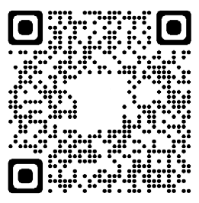
Why attend?
We are back!
Be part of the biotechnology network and be in the room with like minded community.
Plenary lectures
Hear presentations by stellar speakers who are leading biotechnological developments.
Invited speakers
Meet world leaders in their fields.
Your scientific results
Present your research to the most relevant audience as a poster or as one of 200 short talks selected from submitted abstracts.
Global perspective
Get a view on the latest research and trends in biotechnology in Europe and around the globe.
Voice of biotechnology in Europe
Become a member of the European Federation of Biotechnology.
Highlight events
Participate in events that focus on current challenges and controversies.
Trade exhibition
Get a closer look on the latest innovations on the market.
Become a sponsor
Present your products, services or activities and network with 800+ biotechnologists from academia and industry from 60+ countries.
Satellite events
Attend accompanying events – view the Programme for regular updates.
Publications Workshop
Designed to help young biotechnologists publish their work in leading biotechnology journals.
30 June – 3 July 2024 De Doelen International Congress Center
The Dutch Biotechnology Association (NBV) is pleased to host the World’s two longest running biotechnology Congresses, the 19th European Congress on Biotechnology (ECB2024) and 19th International Biotechnology Symposium (IBS2024) at their annual meeting, NBC-24, in Rotterdam, Netherlands.
REGISTER NOW
For further information email:
ecb@tfilodestar.com
Organized by
In association with

Slide 3
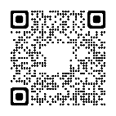
Register now

Slide 4
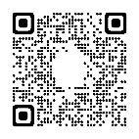
Abstract submission now open

Slide 5
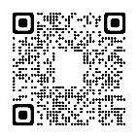
Become a sponsor or an exhibitor

