Slide 1
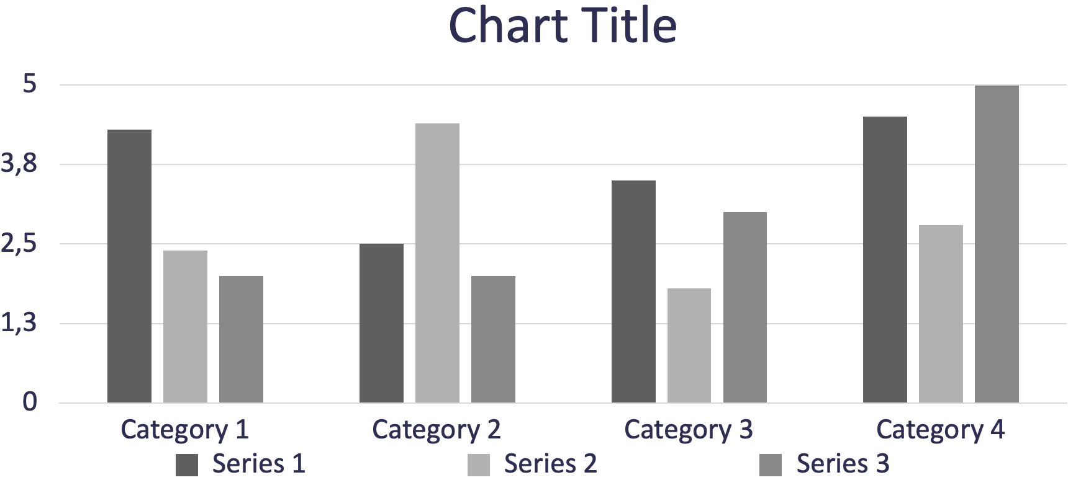
P o s t e r t i t l e g o e s h e r e
ADD YOUR
LOGOS HERE
Authors, FIRST NAME INITIAL, SURNAME, presenting author(s) underlined, Affiliations1 numbered in superscript
e.g. B. SMITH ¹, N. HARRISON ² ² and P. MATTHEWS²
1University of New South Wales, Sydney, Australia
2Royal Brisbane Hospital, Brisbane, Australia
INTRODUCTION
You may edit the size of the font, the sections distribution and the color scheme if wanted. All modifications concerning the background/title display are to be done at the Master Slide level
RESULTS
Importing / inserting files:
Images such as photographs, graphs, diagrams, logos, etc, can be added to the poster. Avoid long numerical tabl|es as they will be difficult to read.
To insert images, go through the menus as follows: Insert / Picture / From File. Locate the file on your computer, select and press OK. Please ensure all image files are JPEG/PNG, other formats may cause images to get corrupted after saving.
Be aware of the image size you are importing.
Notes about graphs…
For simple graphs use MS Excel, or create the graph directly in PowerPoint.
Graphs created in a scientific graphing program (e.g.. Sigma Plot, Prism, SPSS, Statistics) should be saved as JPEG or TIFF.
AIM
How to use this poster template:
Highlight this text and replace it by typing in your own text, or copy and paste your text from a MS Word document or a PowerPoint slide presentation.
METHOD
Tips for making a successful poster:
Re-write your paper into poster format i.e.. simplify everything, avoid data overkill.
Headings of more than 6 words should be in upper and lower case, not all capitals. Simplify the titles.
Do to write whole sentences in capitals or underline to stress your point, use bold characters instead.
When laying out your poster, leave white space around your text. Don’t overcrowd your poster.
Spell check and get someone else to proof-read.
The recommended font for captions is Calibri, no smaller than 15pt. Left aligned if it refers to a figure on its left. Start the captions right at the top edge of the picture (graph)
The recommended font for captions is Calibri, no smaller than 15pt. Left aligned if it refers to a figure on its left. Start the captions right at the top edge of the picture (graph)
CONCLUSIONS
Highlight this text and replace with your own text.
REFERENCES
Highlight this text and replace with your own text.
Can be Vancouver style i.e. 1 Meyer J-P et al. The treatment of high-grade superficial bladder cancer and carcinoma in situ with BCG – a questionnaire survey of Consultant practice in England and Wales. Urol Oncol 2002; 2;: 77-80
ACKNOWLEDGEMENTS
Highlight this text and replace with your own text.
CONTACT INFORMATION
Highlight this text and replace with your own text.

