Slide 1
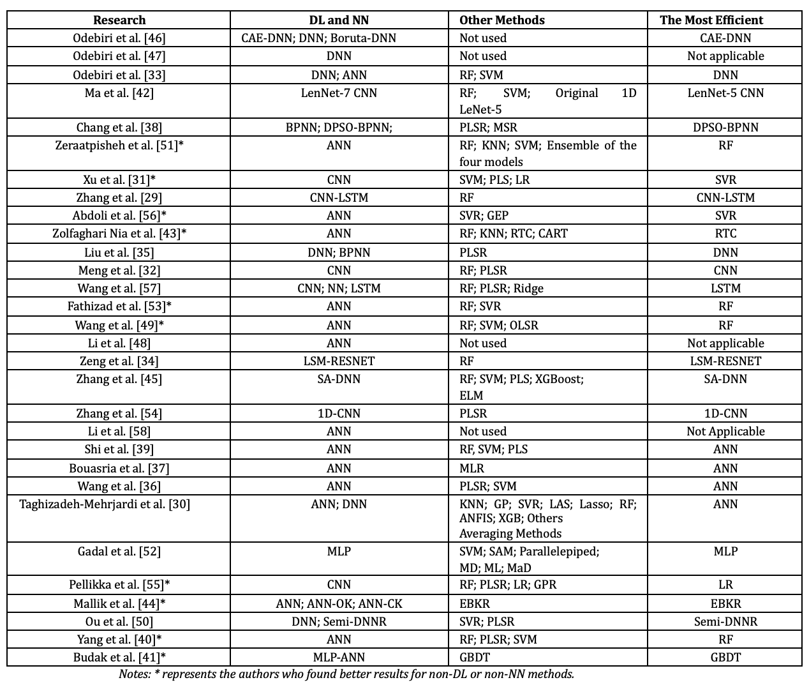
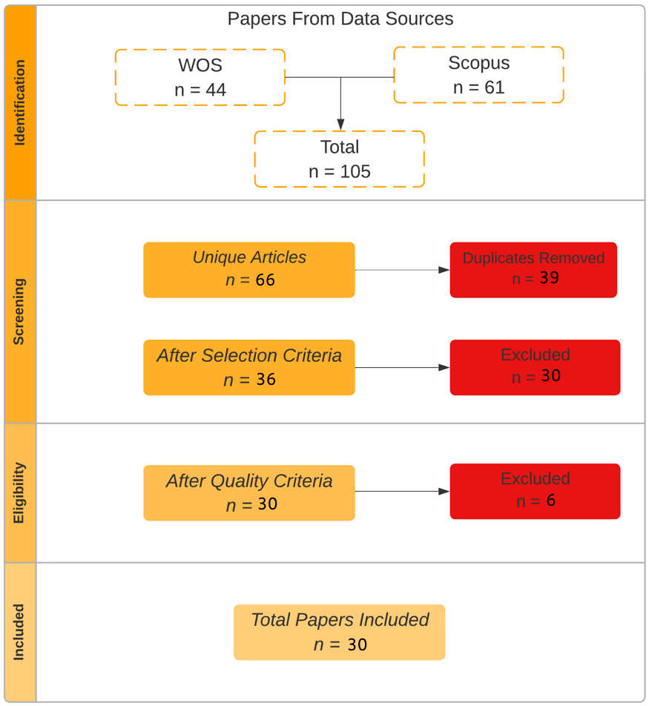
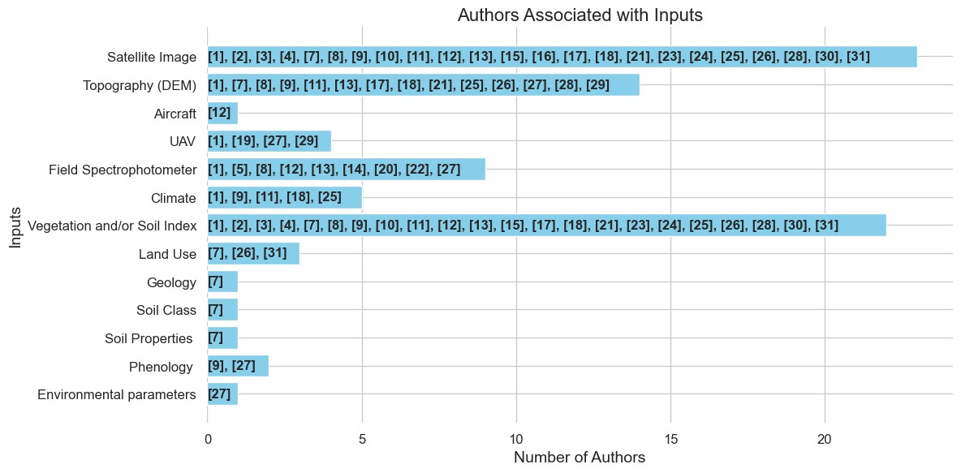
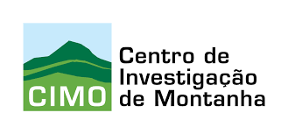
A Literature Review on the Use of ESA Satellite Data for Soil Organic Carbon Estimation Models with Artificial Intelligence Tools
Arthur A. J. Lima^{1,2,3,4}, Zulimar Hernández^{1,3}, Júlio Lopes^{1,4}, Antonio González², Rui Pedro Lopes^{1,4} & Tomás de Figueiredo^{1,3}
¹ Laboratório Associado para a Sustentabilidade e Tecnologia em Regiões de Montanha (SusTEC), Instituto Politécnico de Bragança, Campus de Santa Apolónia, 5300-253 Bragança, Portugal
² Universidade da Coruña, Grupo de Investigación Xestión Sostible dos Recursos Hídricos e do Chan (AQUATERRA), 15071 A Coruña, España
³ Centro de Investigação de Montanha (CIMO), Instituto Politécnico de Bragança, Campus de Santa Apolónia, 5300-253 Bragança, Portugal
⁴ Research Centre in Digitalization and IntelligentRobotics (CeDRI), Polytechnic Institute of Bragança, Bragança, Portugal
(E-mail: arthur.lima@ipb.pt, zulimar@ipb.pt, juliolopes@ipb.pt, antonio.paz.gonzales@udc.es, rlopes@ipb.pt and tomasfig@ipb.pt)
Introduction
Artificial intelligence models
Preliminary results underscore how promising Deep Learning (DL) models are in estimating SOC through the use of RS data. Among the studies analyzed, that used both ML and DL techniques, only 10 achieved better results with non-DL methods (Table 1). The possibility is considered that, in studies with an insufficient quantity of SOC samples obtained in the field, the DL methods were not fully leveraged, as methods based on these technologies require a considerable volume of data to achieve good results. This scenario further highlights how promising DL structures are in estimating SOC using RS data.
Agricultural soils play a crucial role in food security and climate change, as they accumulate and stabilizate Soil Organic Carbon (SOC). knowing the SOC amount is important to manage climate alarm [1], but sampling and subsequent laboratory analyses traditionally used for this purpose are very expensive and time-consuming, which is leading to explore alternative non-degradative and environmentally friendly methods. Using Remote Sensing (RS) tools could reduce time consumption and economic cost [2, 3]. However, the large amount of data needed for this type of evaluation requires advanced computer methods for the elaboration of SOC predict models [4]. A Literature Review (LR) with the aim of finding tools, advances, and gaps in the literature was conducted.
Satellite data
Data from the Sentinel satellites were the most used in this literature review. Of the 30 works selected, 23 used satellite data, and the most used by the authors were those from the sentinel collection, totaling 15 works, that is, 65%. The other 7 studies used data from field spectrophotometer or drone/aircraft.
Table 1. Methods used to estimate SOC and the most efficient of them
Methodology
Using the PRISMA method [5], 30 articles that used RS and Artificial Intelligence (AI) to estimate SOC were selected to LR (Fig. 1).
The keywords and synonyms chosen for this research were: “Deep learning” and “Neural network”; “Remote sensing”; “Soil organic carbon” and “Organic matter”. The period covered by this work is from 2021 to August 2023.
Notes: * represents the authors who found better results for non-DL or non-NN methods.
Fig. 1. Conducting stage results of the LR
Conclusions
Results
The inputs most used by the authors were those most correlated with SOC, namely vegetation and soil indexes, some satellite bands and data derived from DEM;
DL models are more robust than non-DL models and can converge better when working with complex RS data, however, a dataset with a large amount of data is required, especially SOC samples;
Data from Sentinel satellites collection were the most used by researchers.
Input data
Vegetation and soil indices (NDVI, SAVI, RVI, EVI and SRCI), specific bands from different satellites (red, red edge, green, SWIR and NIR bands) and Digital Terrain Elevation Models (DEM) using Transportation Radar Topography Mission (SRTM) were the input data of the most commonly used (Fig. 2).
References
[1] N. Agjee, O. Mutanga, and R. Ismail, “Remote sensing bio-control damage on aquatic invasive alien plant species,” South African Journal of Geomatics, vol. 4, no. 4, pp. 464–485, 2015.
[2] M. Mngadi, J. Odindi, K. Peerbhay, and O. Mutanga, “Examining the effectiveness of sentinel-1 and 2 imagery for commercial forest species mapping,” Geocarto International, vol. 36, no. 1, pp. 1–12, 2021.
[3] S. Khanal, J. Fulton, A. Klopfenstein, N. Douridas, and S. Shearer, “Integration of high resolution remotely sensed data and machine learning techniques for spatial prediction of soil properties and corn yield,” Computers and electronics in agriculture, vol. 153, pp. 213–225, 2018.
[4] O. Odebiri, O. Mutanga, J. Odindi, R. Naicker, C. Masemola, and M. Sibanda, “Deep learning approaches in remote sensing of soil organic carbon: A review of utility, challenges, and prospects,” Environmental monitoring and assessment, vol. 193, pp. 1–18, 2021.
[5] J. Cruz-Benito, “Systematic literature review & mapping,” 2016.
(Notes: DEM: Digital elevation mode; Aircraft: Manned Aerial Vehicle; UAV: Unmanned Aerial Vehicle.)
Fig. 2. Inputs used in the researches
Acknowledgments:
The authors would like to thank the Foundation for Science and Technology (FCT, Portugal) and the national funds FCT/MCTES (PIDDAC) for the financial support to CIMO (UIDB/00690/2020 and UIDP/00690/2020), CeDRI (UIDB/05757 /2020 and UIDP/05757/2020) and SusTEC (LA/P/0007/2020). They would like to thank the EGRANT financing fund for the LandUnderPressure project. And also, national funding from FCT, Foundation for Science and Technology, within the scope of doctoral scholarship 2022.14010.BD to Arthur Aparecido Janoni Lima, and PRT/BD/154594/2023 to Júlio Castro Lopes.

