Slide 1
MEETING GUIDE
MEETING NAME: Pick n Pay Stores Limited EGM 2024
DATE: 26 June 2024
TIME: 8:30 (SAST)
LOCATION: Online
Step 1 - Registration Platform
We will be conducting an GM, giving you the opportunity to attend and participate using a smartphone, tablet, laptop or computer.
Shareholder
To register for the meeting:
Visit https://smartagm.co.za
Select Pick n Pay Limited’s logo
Select REGISTER
Complete the registration process
ComputerShare will verify the details and will reply via email (Please check the spam folder too).
Guest
Guests do not need to register. Please see next Section.
Step 2 - Meeting Platform (on the day of the meeting)
Access
You will be able to view a live webcast of the meeting, ask the Board questions and submit your votes in real time.
To access the meeting platform:
Visit https://web.lumiconnect.com/132868207 (meeting ID 132868207)
ACCEPT the Terms and Conditions
The latest version of Chrome, Safari, Edge or Firefox is required. Please ensure the web browser is compatible.
Shareholder
In the “Meeting Access” email, look for the unique login credential (It will be sent from smartagm-sa@lumiengage.com ).
To access as a shareholder:
Select “I am a Shareholder”
Enter the username
Enter the password
Guest
To access as a guest:
Select “I am a Guest”
Enter “First name”, “Last name” and “Email” address
Meeting Platform
Features
When successfully authenticated, the home screen will be displayed. You can view company information, ask questions, view relevant documents and watch the webcast.
Note:
- Guests will only have access to some features
- The broadcast screen will either appear on the right (laptops and computers) or at the bottom of the screen (smartphones and tablets). Once the meeting starts, the broadcast will start automatically. If the broadcast does not appear automatically, contact the support team.

Slide 2
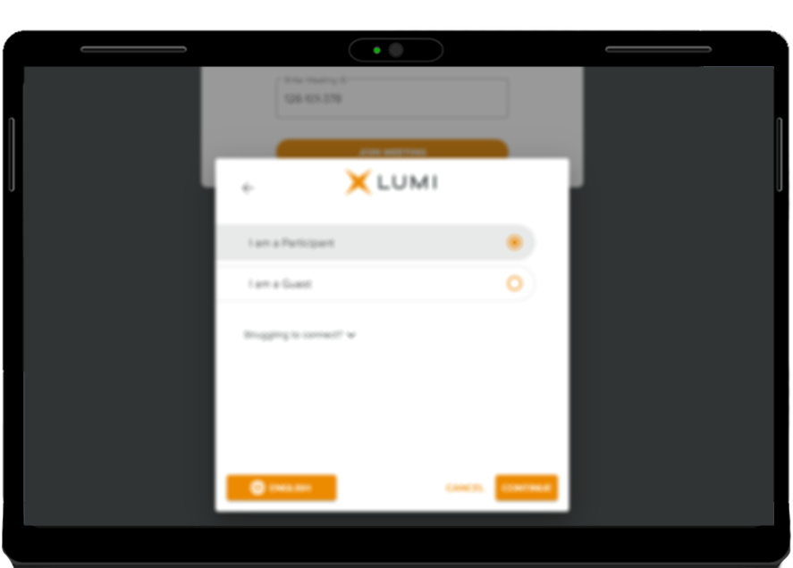
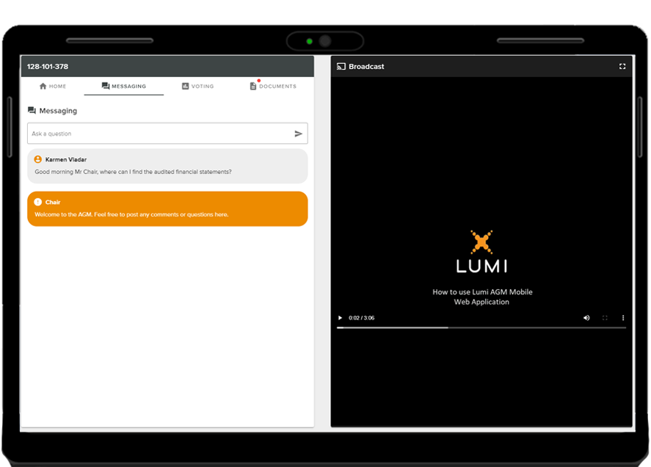
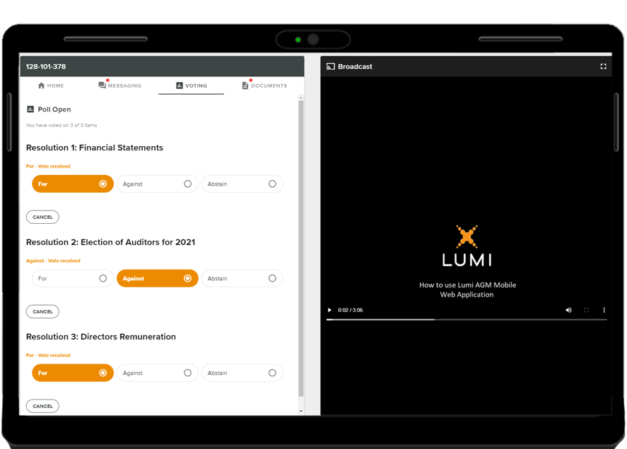
MEETING GUIDE
Meeting Platform
Features - Virtual Microphone
Should you wish to ask a verbal questions you can:
Dial the numbers provided in the HOME screen
or
Click on the REQUEST TO SPEAK in the BRAODCAST screen to access the
virtual microphone.
Make sure that you allow the web browser permission to use the
Device’s Microphone. Please note that it is important for you to
pause the webcast before you make use of the virtual
microphone.
Meeting Platform
Features - Messaging
The MESSAGING icon can appear on the navigation bar at the
top of the screen. In this section, you can ask questions and
comment on items discussed at the meeting and view your and
other participating members’ questions and comments.
To ask a question or comment, select the MESSAGING icon.
Type your message within the chat box and then press send
(the arrow button).
Meeting Platform
Features - Voting
Once the poll/s has opened, the VOTING icon will appear on the
navigation bar at the top of the screen. From here, resolutions or
motions will be displayed.
To vote, select the VOTING icon and select your voting direction
from the options shown on screen. A confirmation message will
appear to show your vote has been received.
If you wish to change your vote, simply select an alternate
choice while the voting is open or select cancel if you wish to
cancel your vote.
Once opened, voting can be performed at anytime during the
meeting until the Chairman closes the voting. At that point, your
last choice will be submitted.

Slide 3
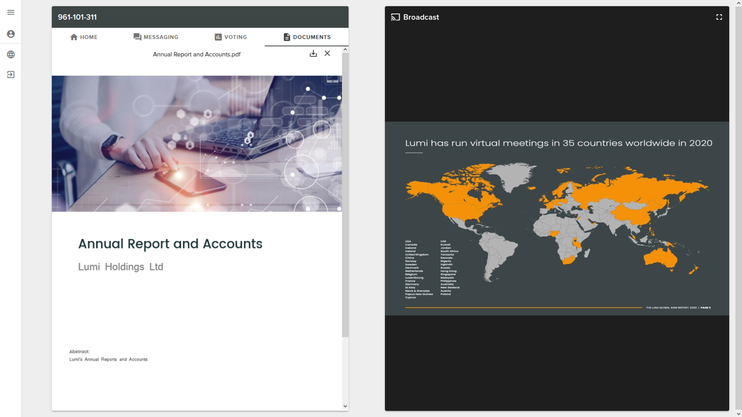
MEETING GUIDE
Meeting Platform
Features - Documents
If there are documents pertaining to the meeting, the
DOCUMENTS icon will appear on the navigation bar at the top of
the screen. You can view, download and print the pdf
documents.
Select the DOCUMENTS icon and then select the document.
Email supportza@lumiengage.com if you require any technical assistance.

