Slide 1







The conference is partly financed by the European Union

Slide 2




How to serve society Statistics Austria’s new ways to engage with Academia and the Scientific Community
Magdalena Six, Thomas Burg
Center for Methodology
Statistics Austria
Session 28
6th of June, 2024
The conference is partly financed by the European Union

Slide 3

Cooperation between NSOs and the Scientific Community – a Win-Win situation
STAT Strategy 2025: build capacity and strenghten cooperation with the scientific community
ÖAW-Statistics Austria lectures
Center for science
Austrian Microdata Center
Austrian Socio Economic Panel

Slide 4

ÖAW-STAT Workshops and Lectures Austrian Academy of Sciences – Statistics Austria
Workshops
started in 2021, twice a year
one general topic per workshop
kick-off speech by renowned invited (international) speaker from academia
sessions with two presentations per session by subject-matter experts from STAT and from academia
open discussions between invited participants
Lectures
subsequent to the workshop
lecture by invited (international) speaker
all members of ÖAW and all employees of STAT invited
Notes:
First you need a partner, then you need to agree on a way to cooperate, then you need to implement it and keep it alive
The ÖAW-/Statistik Austria Lectures shed light on trends and questions in applied statistics concerning societal challenges. By intensifying the dialogue, both science and Statistik Austria receive crucial impulses, thus strengthening empirical research at the Austrian science hub. At each event, international guest speakers will present top research papers utilizing data from statistical institutions or innovations in statistics.

Slide 5
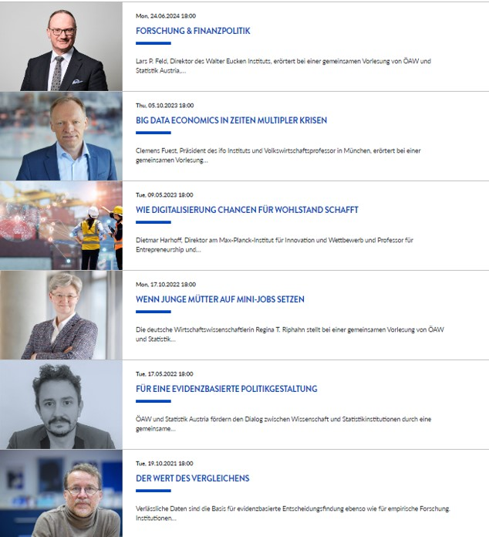
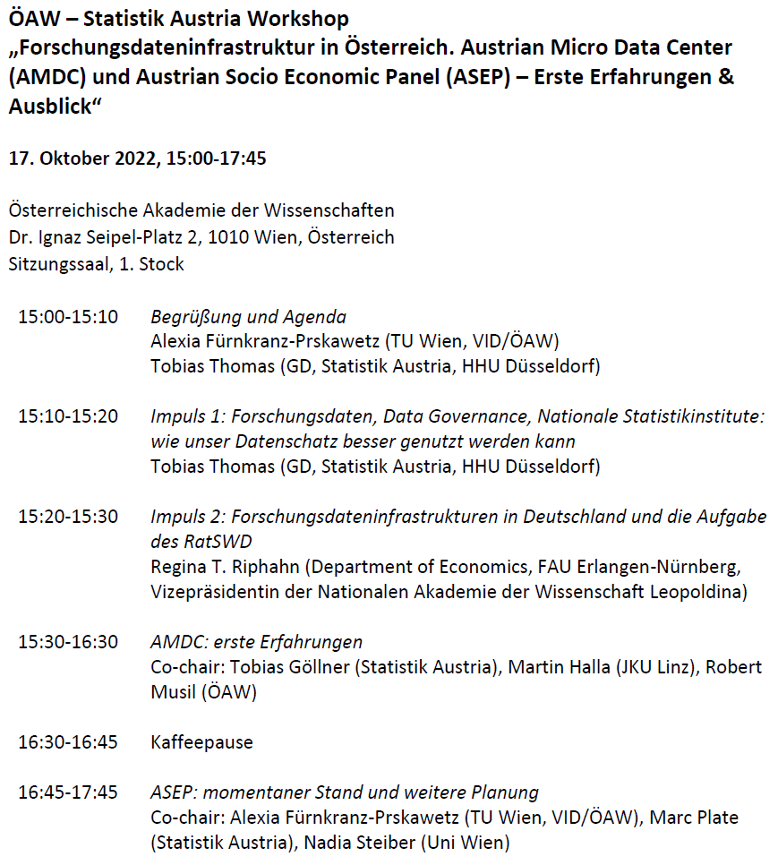
ÖAW-STAT Lectures so far

Slide 6
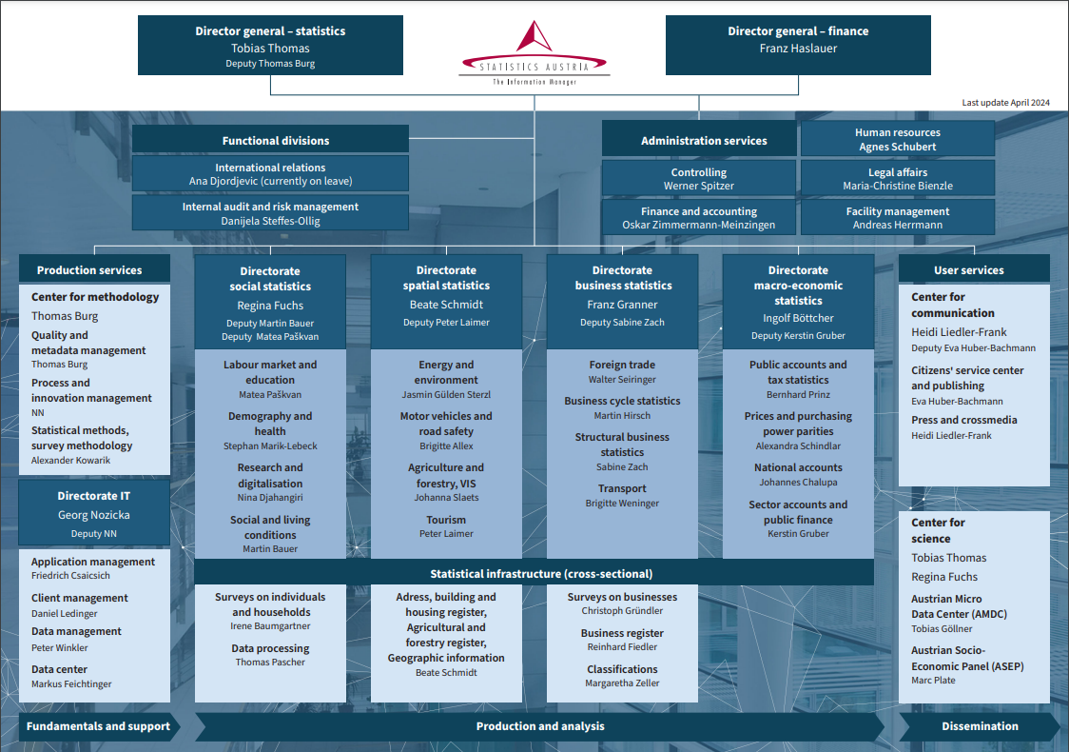
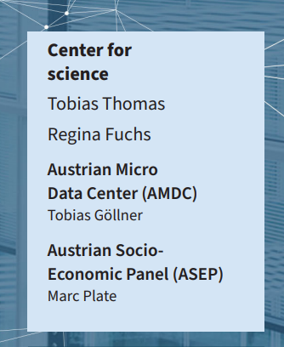
Center for science at Statistics Austria

Slide 7


Austrian Microdata Center (AMDC) Linkable Microdata for Adacemia
Amendment to the Federal Statistics Act enabled remote access to indirectly identifiable and linkable microdata for scientific purposes
Statistics Austria established new research data infrastructure, the Austrian Microdata Center (AMDC), start 1st of July 2022
Requirements for research entity to gain access
Conduct research at university level and make results available to the public free of charge
Legal personality with primary focus on research
Independent and autonomous in scientific activities
Fulfil technical and infrastructure requirements w.r.t to guaranteeing data security

Slide 8
What kind of data is available in the AMDC?
Fuchs,R., Göllner, T., Hartmann, S. and Thomas, T. (2023). Fostering Excellent Research by the Austrian Micro Data Center (AMDC), Journal of Economics and Statistics

Slide 9
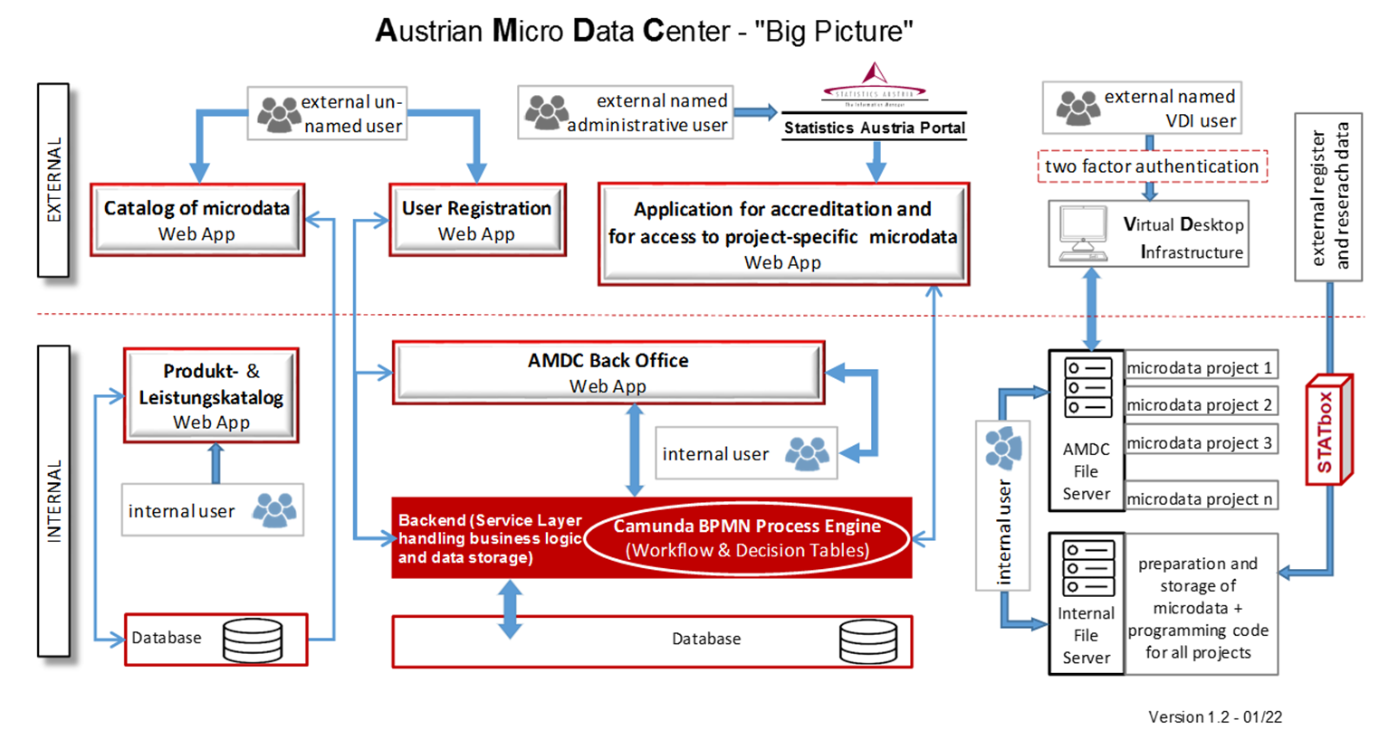
A researcher‘s way to microdata
Search microdata catalogue
Registration of organisation (accrediation)
Research proposal incl. needed microdata
Exchange with AMDC experts, formal offer & contract
Research phase via VDI
Statistical disclosure control by AMDC on output

Slide 10

Prerequisites for AMDC‘s success
Existence of a specific encrypted identifier (vbPK-AS for persons, exists since 2004)
Change of the law
Financing of the infrastructure
Human resources
Building searchable microdata catalogue incl. metadata (codebooks,..) https://www.statistik.at/amdc-data/#/product
Existence of relevant microdata (produced by Statistics Austria but also Federal State microdata)

Slide 11
AMDC Overview (May 2024)
Registered Organisation (Accreditation) | 60
§ 31 Abs. 8 Federal Statistics Law 2000 | 36
Other scientific ogansiation (incl. 9 foreign – more pending) | 24
Göteborgs Universitet
Geneva Graduate Institute
ifo Institut - Leibniz-Institut für Wirtschaftsforschung München
Katholieke Universiteit te Leuven
Okinawa Institute of Science and Technology Graduate University
Skills and Employability Division, Organization for Economic Cooperation and Development (OECD)
Università Luigi Bocconi, Milano
Universität Zürich
Vrije Universiteit Amsterdam
Available micro data | 106
Statistics Austria | 104
Federal Administration (§ 38b FOG regulation) | 2
Submitted project proposals | 85
Current projects | 27
Other pending project proposals | 53
Completed | 5
Federal Ministry of Education, Science and Research (BMBWF), more pending!

Slide 12
Austrian Socio-Economic Panel (ASEP)
The Austrian Socio-Economic Panel (ASEP) is a long-term research project offering researchers in Austria and beyond a unique analytical potential for longitudinal analyses. https://www.statistik.at/en/services/tools/services/center-for-science/austrian-socio-economic-panel-asep
Topcis: housing, income, work, family, health, education, demographics, values and attitures
Accessible for researchers as scientific use file and via AMDC, starting from end of 2024
Funding is provided by the Federal Ministry of Education, Science and Research (BMBWF)
Accompanied by scientific advisory board comprising international and national experts
ASEP consists of two different, but linkable sub-projects:
ASEP Survey
Pilot study wave 1 (2023) and wave 2 (2024), netto sample survey size: 1400 households
from 2025 onwards yearly survey (netto sample size 5000 households)
Survey mode: Tailored-Mixed-Mode Design, using CAWI, CAPI and CATI
ASEP Register
provides administrative data from Statistics Austria for scientific research
will be available retroactively from 2015 onwards
enables longitudinal analyses right from the start
enables analyses of data from the entire Austrian resident population for the characteristics provided

Slide 13



Thanks for the attention!
Magdalena Six
Magdalena.Six@statistik.gv.at
Questions about...
Center for Science
-> Tobias Thomas (Tobias.Thomas@statistik.gv.at), Regina Fuchs (Regina.Fuchs@statistik.gv.at)
Austrian Micro Data Center (AMDC)
-> Tobias Göllner (Tobias.Goellner@statistik.gv.at )
Austrian Socio Economic Panel (ASEP)
-> Marc Plate (Marc.Plate@statistik.gv.)
Further information:
https://www.statistik.at/services/tools/services/center-wissenschaft
The conference is partly financed by the European Union

Slide 14
The conference is partly financed by the European Union

