Slide 1
Trinity Innovation
&Entreprise
Main Space Screen
Guidelines & Template

Slide 2
Trinity Innovation
& Enterprise
Agenda
Slide Size
Panel Layout
Duplicating the Slide
Examples
Template
1. Slide Size
2. Panel Layout
3. Duplicating the Slide
4. Examples
5. Template

Slide 3
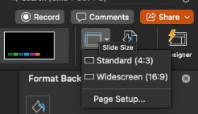
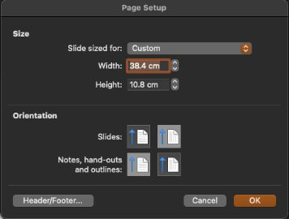
Trinity Innovation
& Enterprise
Slide Size
This template uses a custom slide format:
38.4 cm (width) × 10.8 cm (height)
Slide Size
Panel Layout
Duplicating the Slide
Examples
Template
To check or edit:
Design → Slide Size → Page Setup.. → Custom Slide Size
1
2
4
3

Slide 4
Trinity Innovation
& Enterprise
Panel Layout
The slide is divided into 3 clearly separated panels:
Left (1) – Centre (2) – Right (3)
Slide Size
Panel Layout
Duplicating the Slide
Examples
Template
2
We recommend using font sizes between 12 and 36 to ensure your text remains clear and readable across all panels.

Slide 5
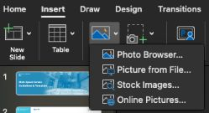
Trinity Innovation
& Enterprise
Panel Layout
The provided template is intentionally left blank, it’s your space to fill in with content.
You’ll need to add text, images, icons or visuals depending on your message.
Slide Size
Panel Layout
Duplicating the Slide
Examples
Template
To add an Image:
→ Insert → Pictures → Choose from your device or online.
→ Resize and position it within the panel.
To add text:
Go to Insert → Text Box to place text wherever needed.
2
1
2
1
2
3

Slide 6
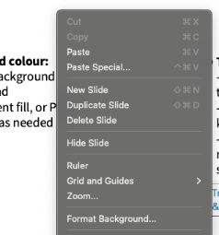
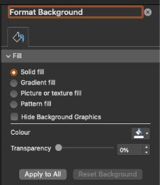
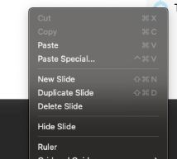
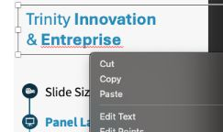
Trinity Innovation
& Enterprise
Panel Layout
To change the background colour:
→ Right-click on the slide background
→ Select Format Background
→ Choose a Solid fill, Gradient fill, or Picture
→ Apply to one or all slides as needed
To delete an element from a panel (e.g guide lines) :
→ Click on the text box, image, or shape you want to remove
→ Press Cut or Delete or Backspace on your keyboard
→ Make sure only the selected element is removed, not the slide itself, unless if you want to delete the slide
Slide Size
Panel Layout
Duplicating the Slide
Examples
Template
3
2
1
1
2
2

Slide 7
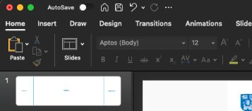
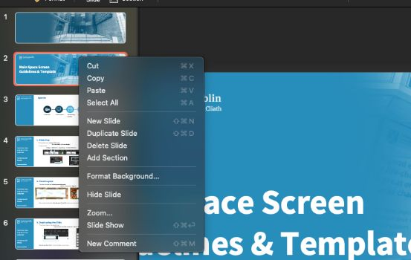
Trinity Innovation
& Enterprise
Duplicating the Slide
To maintain the layout and guide lines:
→ Right-click in the slide thumbnail
→ Select Duplicate Slide
Slide Size
Panel Layout
Duplicating the Slide
Examples
Template
2
1
2
Do not use “New Slide”, it won’t include the guide lines.

Slide 8
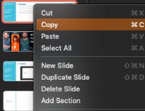
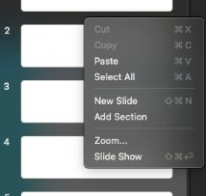
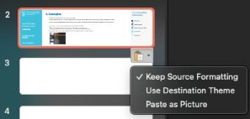
Trinity Innovation
& Enterprise
Examples
The following slides are here to inspire you. They show how you can use the template for different purposes (welcome slide, panel conference slide).
If you like one of the example slides, you can duplicate it and replace the content with your own. However if you want to move the slide to another PowerPoint file you need to:
→ Make sure the slide dimensions are the same in both files
→ Copy the desired slide,
→ Paste it into the new PowerPoint file
Don’t forget to select “Keep Source Formatting” when pasting, to preserve the layout.
Slide Size
Panel Layout
Duplicating the Slide
Examples
Template
1
2
3

Slide 9
School Of Design
You can keep these guide lines to help identify the left, centre, and right sections of the panel.
School Of Design
Graduation 2025
It’s always a good idea to place your logo in one of the corners.
Don’t be afraid to go big — large text and images are often the most effective!
If speakers are seated or standing in front of the screen, make sure key content is placed towards the top to remain visible.
Always consider how your audience will view the slide during your presentation.
Join us in celebrating the creativity, passion, and innovation of this year’s graduates.
From first sketches to final projects, they’ve shaped the future of design — one idea at a time.

Slide 10
Hannah
Morales
Looking for an abstract background image?
Check out pexels.com — it’s free and copyright-safe.
Give your event a great title here!
In this example, using the guide lines helps avoid cutting off faces or words, as the screen is slightly curved.
Collaborate with
Portal
Sponsored by.
Morgan
Maxwell
Studio
Shodwe
Warner & Spencer
Wardiere Inc.
Lars Peeters

Slide 11
Using a full-slide image? Make sure it’s sized exactly 38.4 cm × 10.8 cm for the best fit.
If it looks blurry on your screen, it will be blurry on the big screen too — always use a high-resolution image to keep your slide sharp and professional.

Slide 12
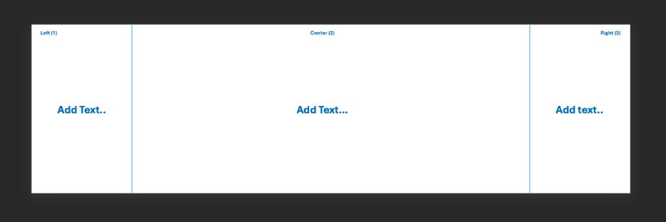
Trinity Innovation
& Enterprise
Template
Slide Size
Panel Layout
Duplicating the Slide
Examples
Template
2
1

Slide 13
Left (1)
Center (2)
Right (3)
Add Text..
Add Text…
Add text..

Slide 14
School Of Design
Join us in celebrating the creativity, passion, and innovation of this year’s graduates.
From first sketches to final projects, they’ve shaped the future of design — one idea at a time.

