Slide 1


Slide 2
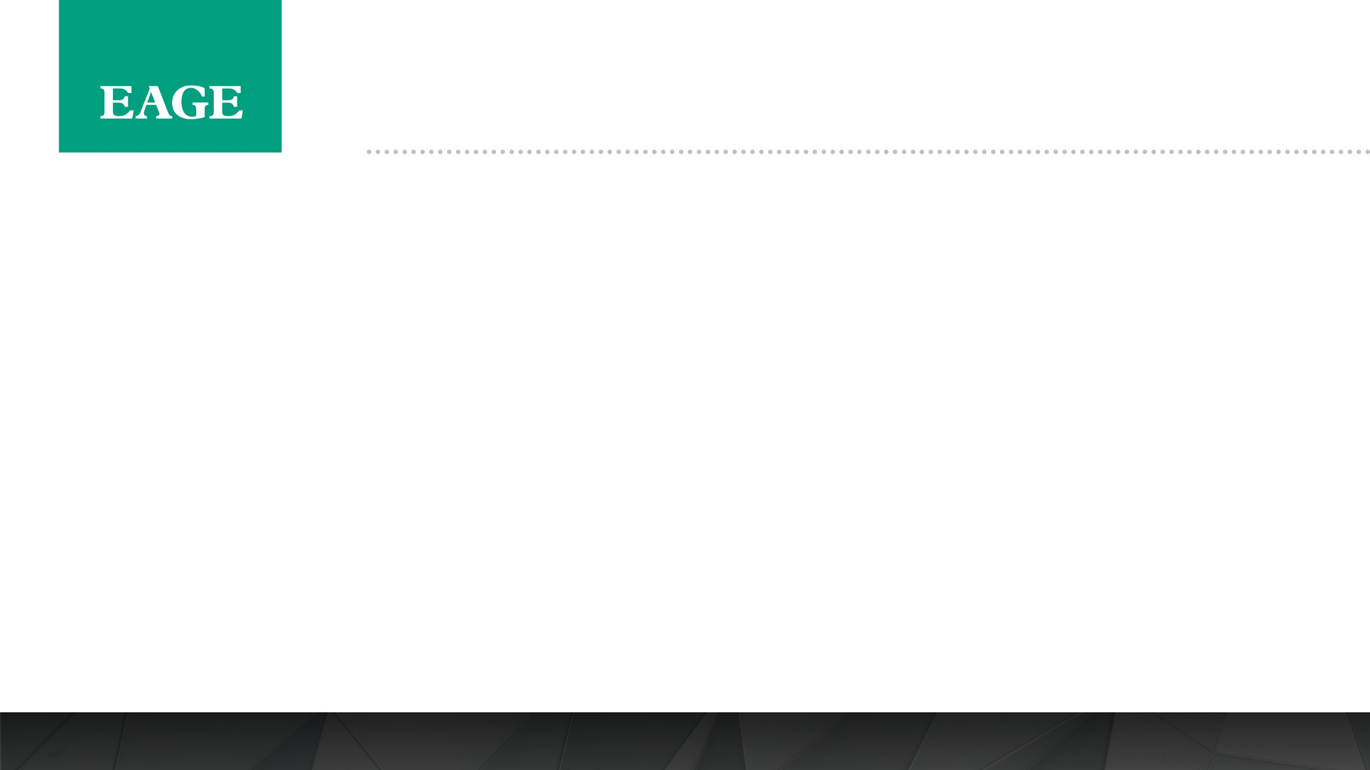
First EAGE Workshop on Pre-Salt Reservoir: from Exploration to Production
Date: 5-6 December 2019
Place: Rio de Janeiro, Brazil
Speaker Guidelines 2019

Slide 3
First EAGE Workshop on Pre-Salt Reservoir: from Exploration to Production
Event Title:
First EAGE Workshop on Pre-Salt Reservoir: from Exploration to Production
Date & Location:
5-6 December 2019
JW Marriott Copacabana
For booking your room you must contact the hotel directly and reserve. EAGE is not responsible for the rooms booking or availability. We suggest to book with anticipation to reassure your stay at the suggested hotel for the workshop.
Address: Av. Atlântica, 2600 - Copacabana, Rio de Janeiro - RJ, 22041-001, Brazil
Contact: +55 21 2545-6500
Overview:
Thursday 5 December 08:20-17:10 Technical Programme
18:00-20:00 Icebreaker Reception @ JW Marriott Terrace
Friday 6 December 08:00-17:10 Technical Programme

Slide 4
First EAGE Workshop on Pre-Salt Reservoir: from Exploration to Production
1.Confirm attendance – if you cannot attend the workshop to present your work and do not notify EAGE by 18 November 2019 (please confirm your participation if you have not done it), you will be considered a ‘no-show’ and this will disqualify you from presenting at all EAGE events for 3 years.
2.Extended Abstracts –Should you wish to make revisions to your abstract please do so no later than 18 November 2019 . After this date we cannot accept further revisions as the abstracts are being prepared for the proceedings and uploaded to Earth Doc.
3.Abstract Summary – did you provide a summary when submitting your abstract? If not then please log into the submission on the EAGE website and add a summary. Please do so by 18 November 2019.
4.Provide a short biography – If you have not provided your biography should be no more than 75 words and should include your current company and position, number of years experience, area of expertise and any notable awards/publications. Please do not provide your full CV. Deadline for submission 25 November 2019.

Slide 5
First EAGE Workshop on Pre-Salt Reservoir: from Exploration to Production
Register for the Workshop – as a speaker you are able to register at the early registration rate up to 2 weeks before the workshop. We recommend that you register via the website. https://eage.eventsair.com/pre-salt-reservoir-workshop/registration- if you are not able to do it, please send a mail to jpo@eage.org and we will do it manually for you.
Visa: Please check with your nearest embassy/consulate for up to date information on the application process. If needed
Venue: – JW Mariott Copacabana
For booking your room you must contact the hotel directly and reserve. EAGE is not responsible for the rooms booking or availability. We suggest to book with anticipation to reassure your stay at the suggested hotel for the workshop.
Address: Av. Atlântica, 2600 - Copacabana, Rio de Janeiro - RJ, 22041-001, Brazil
Contact Phone: +55 21 2545-6500
Please note that accommodation is not included in the registration fee and you may choose to stay at an alternate hotel to the workshop if you wish to.

Slide 6
First EAGE Workshop on Pre-Salt Reservoir: from Exploration to Production
Poster Presentations are scheduled on Thursday 5 December and will be made available on the foyer for all delegates from 17:10 to 18:00 to present and will be posted and available to the audience during the coffee breaks am / pm
Each presenter will have 10 minutes to explain their poster to the audience. Please, keep in mind this length of time to prepare your speech.
Posters should be brought to be displayed by no later than 10:00 am on 5 December 2019
Poster Display Boards
EAGE will provide each presenter with one display board
Your poster should be printed A0 in portrait orientation
EAGE will provide velcro tabs to affix the poster to the board
EAGE staff will hang the poster, please bring it to the registration desk during the early registration on the 5 December
Your poster should be removed at the end of the second day on 6 December 2019.

Slide 7
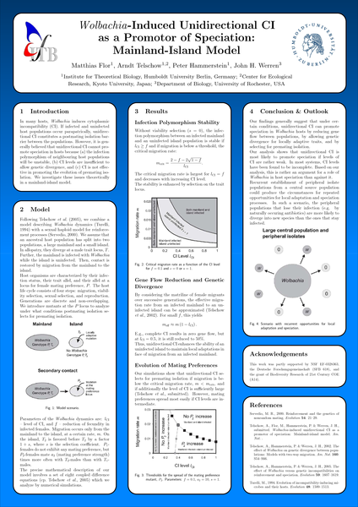



POSTER PRESENTATION GUIDELINES
INCORRECT FORMAT
If you print in landscape format the poster will not fit on the display boards
CORRECT FORMAT
The poster must be portrait orientation
Printed to size A0
Each board will be 1.2m wide x 2m tall

Slide 8
Slides – Do’s & Don'ts
If you have any queries please contact:
Laura Patiño (Event Coordinator EAGE) via jpo@eage.org or
Tel: +57 1 4232948
See you in Rio de Janeiro!

