Slide 1
WELCOME

Slide 2
Chairpersons’ Lunch – 3 June 2019
Chairpersons’ Lunch Monday 3 June 2019
Aart-Jan van Wijngaarden
TPO EAGE 2018 / 2019

Slide 3
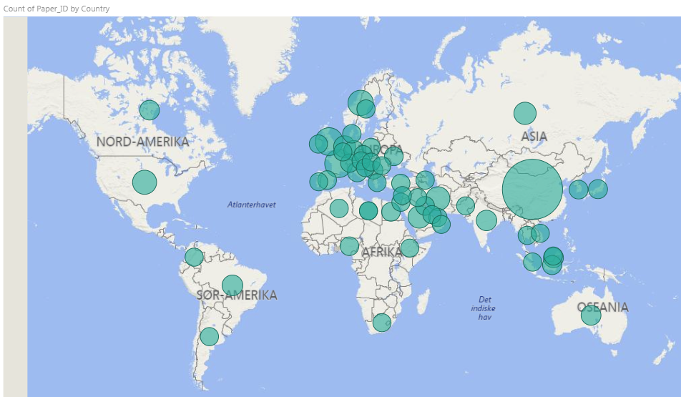
London 2019 – the numbers (including half sessions)

Slide 4
THANK YOU!
To the reviewers
To the EAGE and the SPE/EUROPEC Technical Programme Selection committees & staff
To YOU, the chairpersons

Slide 5
What else is on offer?
3 EAGE Forum sessions on Tuesday morning, Tuesday afternoon and Wednesday morning
Dedicated Sessions throughout the week
Young Professionals session (Tuesday)
AGM – meet the board (Wednesday)
Women in Geoscience & Engineering session (Wednesday)

Slide 6
Chairing: what’s involved?
Be in the room on time for the pre-meeting
As indicated on the preparatory meeting schedule
Introduce yourself to the technologist
Check if all presentations have been uploaded
Ask presenters if they have any videos or links in their presentations
Refer them to the technician to check how this will work
Make yourself familiar with the equipment & the room
Put the speakers at ease
Check the pronunciation of author’s names

Slide 7
Chairing: what’s involved – at the start
2 minutes before the start of the first paper
Welcome the audience, start with HSE instructions (on table)
State the title of the session
Introduce yourself and your co-chair
Mention the App to rate the papers (mentioned in break slides as well)
You can remind the audience during the session of this as well
Audience can evaluate the papers via the App.
Ask to put cell phone on silence
No filming or pictures to be taken during presentation
Introduce the first paper and speaker

Slide 8
Chairing: what’s involved – during presentation
Note the start time
There is a clock visible to the speaker and the chair
If speaker is still in full flow and there are no indication that he is wrapping up at 18-19 min, give the speaker an indication
Speakers should not talk beyond 22 min

Slide 9
Chairing: what’s involved – at the end of presentation
Thank speaker for paper and open paper for questions
Invite people to the microphone, request name and affiliation
Allow diversity of people to ask questions
No mic hoggers
If time is up, time is up. People can continue discussion outside of room
If there are no questions and there is time, you are obviously free to ask a question as well
Make sure the next paper starts on-time!

Slide 10
Chairing: what’s involved
Flexibility and friendliness
“The schedule is King!”, but
If someone is slightly late …
If someone technical issues, etc. etc. …
BUT “The schedule is King!” (and note the issues)
Complaints can be filed with the TPO

Slide 11
Chairing: e-Posters
Same duties as for oral presentations
Same on timing, but chairs keep time
No mics, so a bit simpler
Infodesk from Multieposter is located in the middle of the e-Poster boxes
Questions: ePoster desk or TP Info Desk

Slide 12
Chairing: what’s involved - Gaps
Gaps have been moved towards the start or end of the (half) sessions
That has not always worked
The schedule is King!
So do not start papers early
Fill that gap as you see fit:
Discussion?
Coffee break
Anything goes
Make sure the next paper starts on-time!

Slide 13
XI Professional & Ethical Standards
EAGE members seek to use their talents, skills and experience for the benefit of society and have regard for the impact of their actions upon the environment.
EAGE members treat each other and those with whom they interact with the same respect, courtesy and fairness that they seek for themselves.
EAGE members make professional judgements without regard to race, gender, nationality, beliefs, age or disability.
EAGE members respect confidentiality and maintain integrity in professional interactions, treating colleagues, clients, suppliers and contractors as equals.

Slide 14
Chairing: what’s involved
A number of sessions only have a single chair
It is a bit more hectic but doable
Let the technician know in the room.
If not comfortable, please let the TP info desk know as soon as possible
Feel free to rope in a friend, even if only for half a session
Let the TP info desk know if successful (before or after)

Slide 15
Evaluations
Chairs: paper version, please fill in your name
Delegates: via app
Note that these evaluations are very important, as they form part of the selection process for Best Paper and Best Poster awards.

Slide 16
Thank you!
Chairpersons gift:
You can collect your chairpersons’ gift at the TP Info Desk
(near lecture rooms at Level 3, ICC Capital Suite)

Slide 17
Questions?

