Slide 1


Slide 2
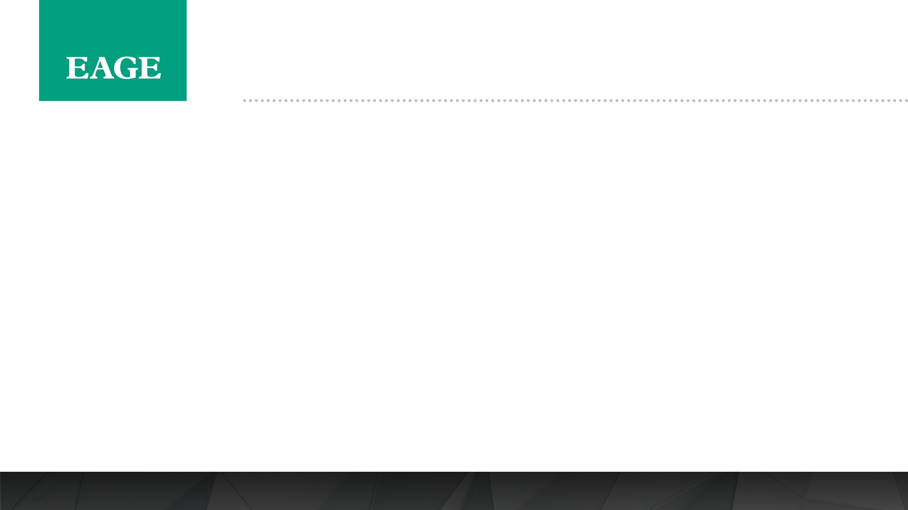
First EAGE Workshop on Pre-Salt Reservoir: from Exploration to Production
Date: 5-6 December 2019
Place: Rio de Janeiro, Brazil
Speaker Guidelines 2019

Slide 3
First EAGE Workshop on Pre-Salt Reservoir: from Exploration to Production
Event Title:
First EAGE Workshop on Pre-Salt Reservoir: from Exploration to Production
Date & Location:
5-6 December 2019
JW Mariott Copacabana
For booking your room you must contact the hotel directly and reserve. EAGE is not responsible for the rooms booking or availability. We suggest to book with anticipation to reassure your stay at the suggested hotel for the workshop.
Address: Av. Atlântica, 2600 - Copacabana, Rio de Janeiro - RJ, 22041-001, Brazil
Contact: +55 21 2545-6500
Overview:
Thursday 5 December 08:20-17:10 Technical Programme
18:00-20:00 Icebreaker Reception @ JW Marriott Terrace
Friday 6 December 08:00-17:10 Technical Programme

Slide 4
First EAGE Workshop on Pre-Salt Reservoir: from Exploration to Production
1.Confirm attendance – if you cannot attend the workshop to present your work and do not notify EAGE by 18 November 2019 (please confirm your participation if you have not done it), you will be considered a ‘no-show’ and this will disqualify you from presenting at all EAGE events for 3 years.
2.Extended Abstracts –Should you wish to make revisions to your abstract please do so no later than 18 November 2019 . After this date we cannot accept further revisions as the abstracts are being prepared for the proceedings and uploaded to Earth Doc.
3.Abstract Summary – did you provide a summary when submitting your abstract? If not then please log into the submission on the EAGE website and add a summary. Please do so by 18 November 2019.
4.Provide a short biography – If you have not provided your biography should be no more than 75 words and should include your current company and position, number of years experience, area of expertise and any notable awards/publications. Please do not provide your full CV. Deadline for submission 25 November 2019.

Slide 5
First EAGE Workshop on Pre-Salt Reservoir: from Exploration to Production
Register for the Workshop – as a speaker you are able to register at the early registration rate up to 2 weeks before the workshop. We recommend that you register via the website. https://eage.eventsair.com/pre-salt-reservoir-workshop/registration- if you are not able to do it, please send a mail to jpo@eage.org and we will do it manually for you.
Visa: Please check with your nearest embassy/consulate for up to date information on the application process. If needed
Venue: – JW Mariott Copacabana
For booking your room you must contact the hotel directly and reserve. EAGE is not responsible for the rooms booking or availability. We suggest to book with anticipation to reassure your stay at the suggested hotel for the workshop.
Address: Av. Atlântica, 2600 - Copacabana, Rio de Janeiro - RJ, 22041-001, Brazil
Contact Phone: +55 21 2545-6500
Please note that accommodation is not included in the registration fee and you may choose to stay at an alternate hotel to the workshop if you wish to.

Slide 6
First EAGE Workshop on Pre-Salt Reservoir: from Exploration to Production
Presenters have been allocated 20 minutes each to give their presentations.
The structure of a good presentation is as follows:
  •Define the subject, give a general outline and state the goals of your presentation in the introduction
  •Show the details of your work
  •Summarise the findings/conclusion
Please remember the findings/conclusions are often the most important part, leave time to get through these slides without rushing.
EAGE will provide a conference laptop with Microsoft Office to run PPT presentations. A laser pointer and clip microphone will also be provided. If you wish to run a movie please notify us via email as we will need to test that it works prior to your session.

Slide 7
First EAGE Workshop on Pre-Salt Reservoir: from Exploration to Production
Please provide your presentation on a USB key.
Your presentation can be uploaded during the coffee break/lunch preceding your session.
On Thursday 5 December, priority will be given to presenters in the Opening Session
All presentations are deleted from the workshop laptop at the end of each day. We ensure the recycle bin is also emptied.

Slide 8
Slides – Do’s & Don'ts
It is acceptable to use your company template for the PowerPoint slides provided that the logo is discreet.
Your presentation should not be commercial or a sales pitch in any way.
Check that all animation sequences are working correctly.
Run through the presentation to check you are within the 20 minute limit.

Slide 9
Slides – Do’s & Don'ts
Think about the colours you will use in the
presentation – yellow cannot be seen on a white
background
X Don’t place too many small images onto the same
slide. Some people may be seated 30m back from the
screen and will not be able to see them.
X Please limit the number of slides
X If you wish to read from notes please have these beside
you on the podium in case we are unable to use ‘presenter view’ with the venue’s systems.

Slide 10
Slides – Do’s & Don'ts
If you have any queries please contact:
Laura Patiño (Event Coordinator EAGE) via jpo@eage.org or
Tel: +57 1 4232948
See you in Rio de Janeiro!

