Slide 1
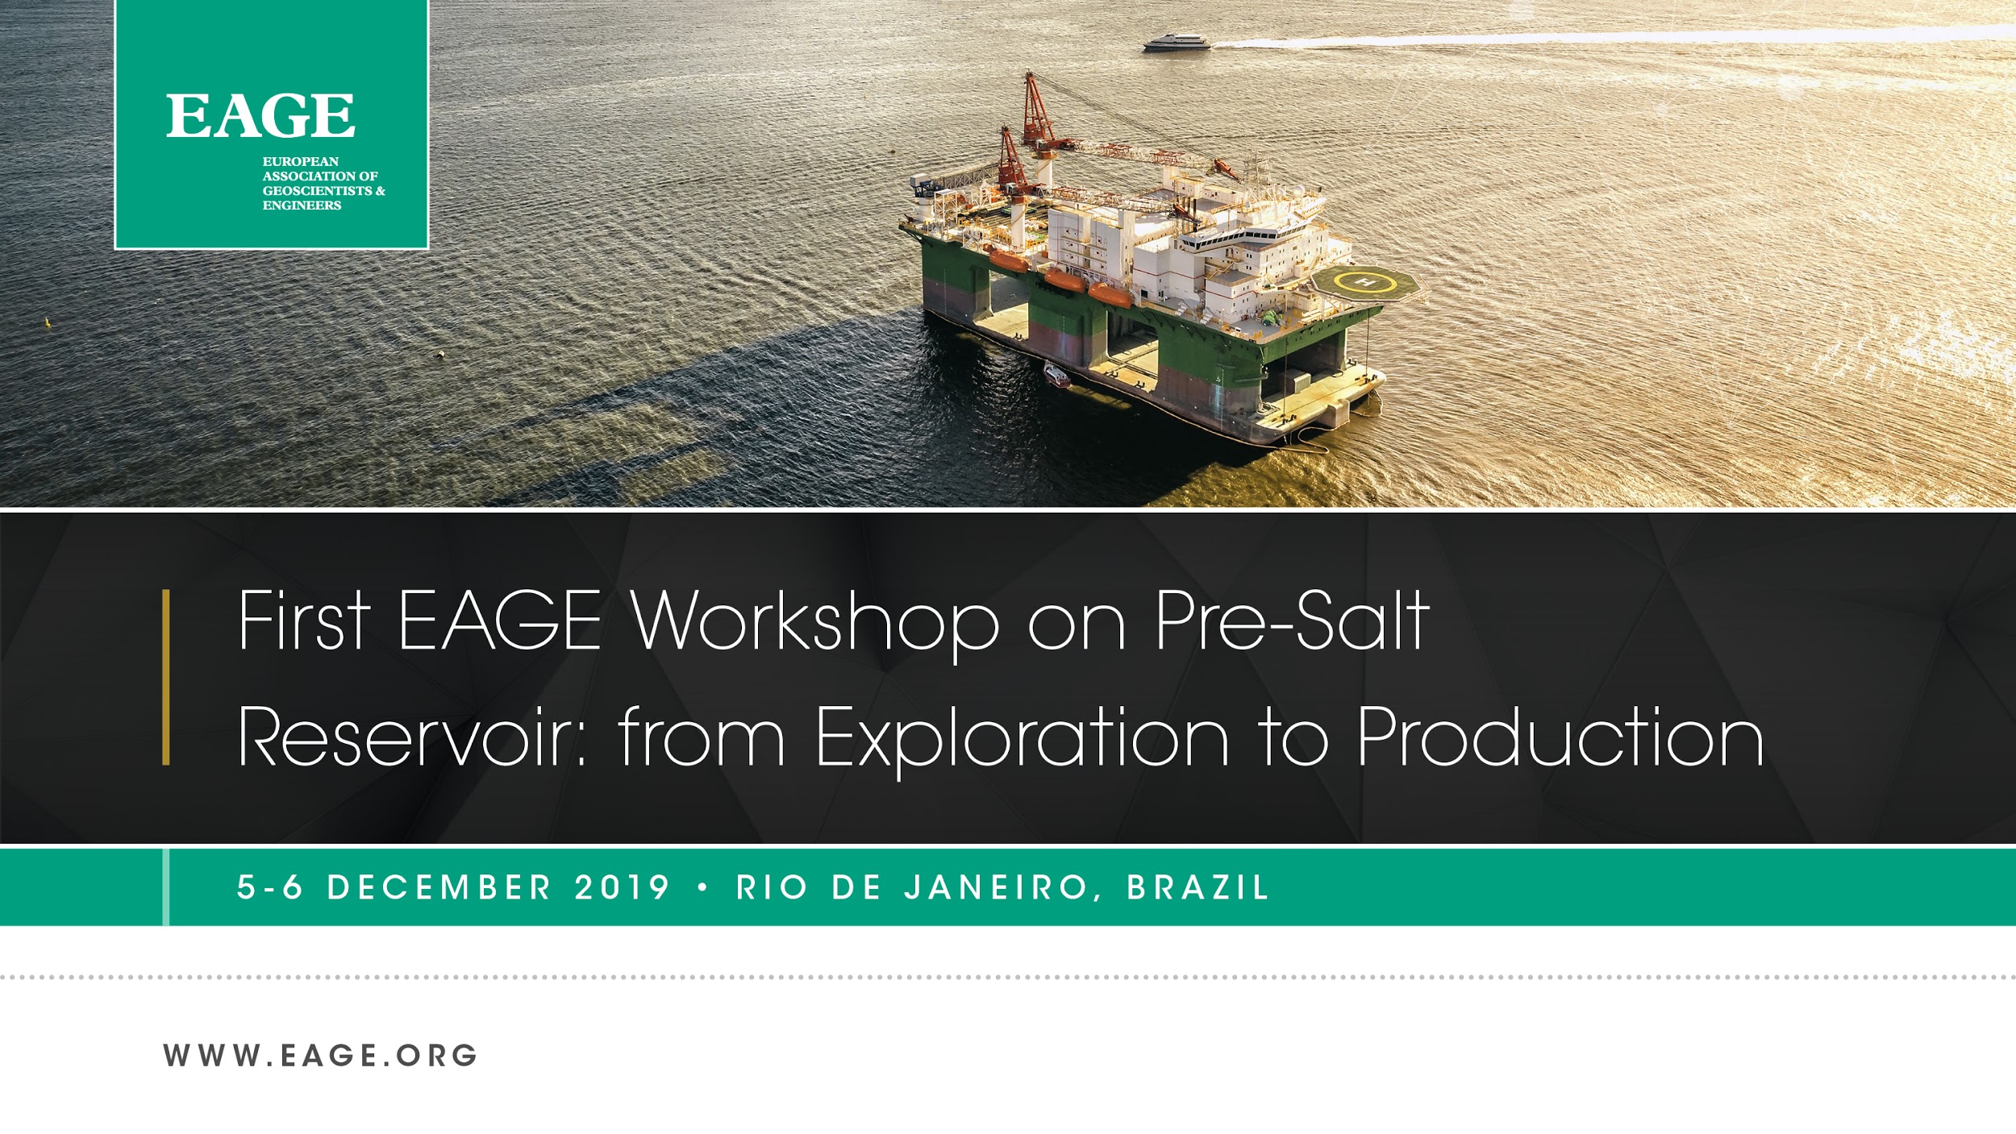

Slide 2

First EAGE Workshop on Pre-Salt Reservoir: from Exploration to Production

