Slide 1
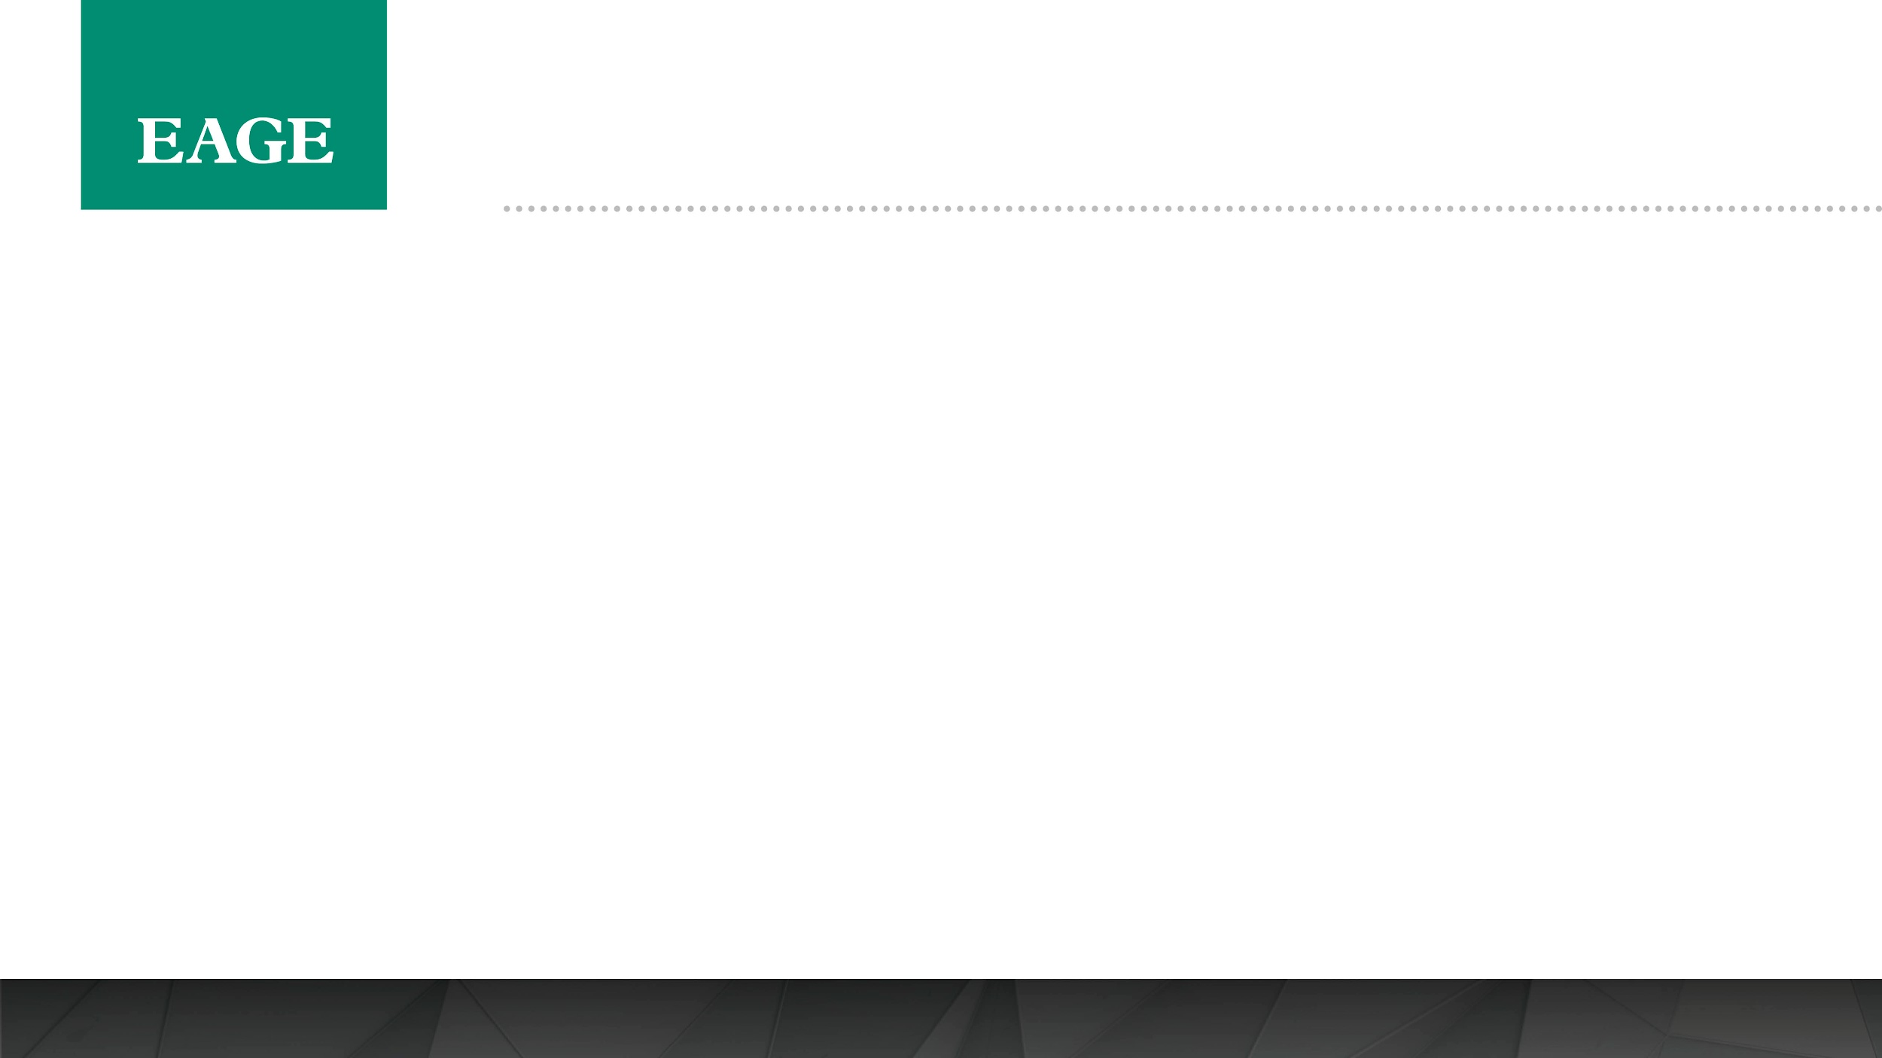
TEMPLATE INSTRUCTION: DELETE AFTER READING
Instructions on the use of the Fifth EAGE Eastern Mediterranean Workshop PowerPoint Template. Delete this page from the final presentation!
This template has been designed to aid you in the preparation of your presentation at the Technical Programme of the Fifth EAGE Eastern Mediterranean Workshop in Cairo, Egypt (1 – 3 December 2025).
The first slide (page 2) must include the EAGE logo and Workshop title. Presentation title may be included on the first slide (page 2) or on the second slide (page 3).
The second slide (page 3) may include the presentation title and (co-)author information.
Use page 4 for your presentation slides.
Company or professional names and logos are allowed only on the last slide.
We look forward to meeting you at the Fifth EAGE Eastern Mediterranean Workshop in Cairo!

Slide 2


