Slide 1
Internationalisation Fund

Slide 2


Our goal
The Internationalisation Fund programme assists SMEs to improve international trade performance
Supporting 7,600+ SMEs with:
High international growth potential
Products/services for new international markets
Management that see export as growth path
£500k+ sales/turnover, however all SMEs with high international growth potential are eligible

Slide 3
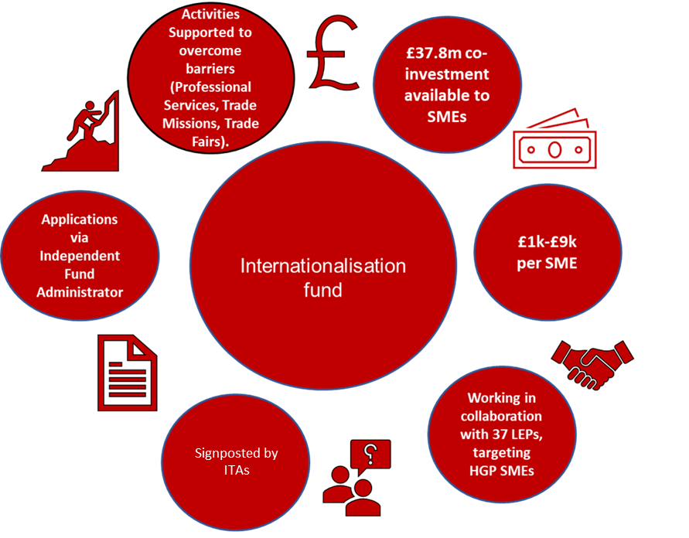
Helping SMEs overcome export barriers
European Regional Development Fund (ERDF) supported scheme
£37.8m co-investment to over 7,600 SMEs (£1k - £9k)
International Trade Advisors are gatekeepers to the Fund: they signpost suitable businesses and help them apply
Applications handled by an Independent Fund Administrator (Capita)
In collaboration with 37 Local Enterprise Partnerships across England

Slide 4

What funding is available?
SMEs will access funding via the ITA Service.
The programme will offer co-investment to SMEs between £1k and £9k
SME projects normally between £2k and £18k
  Technically no upper limit on SME expenditure
Grant beneficiaries can receive up to:
  50% in More Developed areas
  60% in Transition areas
Open to SME applications 14 December 2020 until early 2023
  Applications in some LEP areas will close earlier if funding is used up

Slide 5
How can funding be used?
Eligible expenditure: Advice from third party private sector experts to help SMEs prepare for international trade, which may include:
Market research
Market selection and entry advice,
Advice on Intellectual Property Rights,
Cross cultural negotiation support and standards
Translation and cultural advice
International trade legal advice
PR support
International social media and search engine optimisation
International marketing
Routes to market/agency advice,
Overseas business environment and due diligence
SME participation in Trade Fairs, Trade Missions and independent market development visits may also be eligible

Slide 6
What is ineligible?
Ineligible Sectors
Steel (primary production)
Coal (primary production)
Shipbuilding
Synthetic fibres
Transport and related infrastructure
Energy generation, distribution & infrastructure
Primary Agricultural Production
Financial and insurance institutions
Schools/school age educational establishments
Nuclear
Airport Infrastructure
Fisheries
Aquaculture
Tobacco

Slide 7
What is ineligible?
Ineligible Companies
Ineligible Expenditure
Likely to transfer operations overseas
With products that could cause offence or embarrassment
Offering illegal products
Breaching export controls
Not meeting SME definition (<250 staff, <€50m t/o, <€43m balance sheet)
Outside participating LEP areas with remaining funding
Production/operational costs
Direct subsidies
Routine expenditure
Capital expenditure
Salary/employment costs
Purchase of assets

Slide 8
What is ineligible?
Ineligible Activities
DIT’s OMIS Service
Transport and logistics
Packaging production
Export insurance
Export documentation services
Sales agent’s commission
Export training leading to qualifications
Warehousing
Assets such as Intellectual Property
Standards or accreditations
eCommerce platform registration fees
Production of sales collateral

