Slide 1

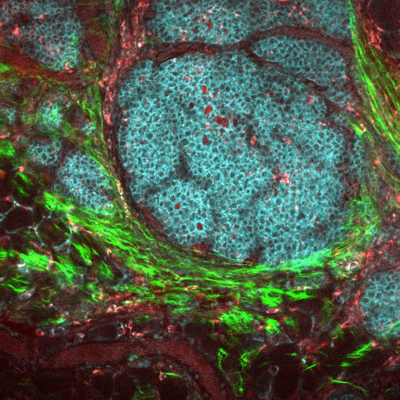

From Molecules to the Human Body: Transforming Healthcare for Every Community
BME 25th Anniversary Symposium
Tuesday, September 10, 2024
University of Wisconsin-Madison
Memorial Union
website link here
UW Logo here

Slide 2
Overview
In the University of Wisconsin-Madison BME Department:
We create cutting-edge tools to deepen our understanding of diseases and develop effective treatments.
By bringing together experts from engineering and medicine, we design advanced instruments for mechanical, electrical, and optical devices that lead to new ways of diagnosing illnesses
From quantum science to artificial intelligence, we use a wide breadth of knowledge and expertise to impact human lives and well-being.
As we continue to push the boundaries of what is possible in medicine, we invite you to join us in shaping the future!
Conference Chair
Filiz Yesilkoy, PhD Conference Co-Chair Paul Campagnola, PhD
Sponsor our 25th Anniversary
As a sponsor of the Biomedical Engineering Department’s 25th Anniversary celebration, you will benefit from excellent exposure and acknowledgement through ads, signs, website links, and event admisison, depending on your package. Get your services and products in front of this growing audience of field experts, direclty support the research goals and mission of BME at UW-Madison, and build valuable contacts.

Slide 3

2024 Sponsorship Opportunities
Sponsor A Networking Break
$2,500 (3 Needed)
Poster Reception
$5,000 (3 Needed)
This sponsorship recognizes your organization at your choice of a morning or afternoon refreshment break. Availability for these high-
impact opportunities are limited, so plan now to reserve a Networking Break Sponsorship for your organization. Benefits include:
One (1) complimentary conference registration
Signage with logo at your choice of a
refreshment break
This sponsorship associates your organization’s name with a poster session. Benefits include:
Acknowledgment & logo on website and
program
Two (2) complimentary conference registrations
Acknowledgment and signage with logo at
sponsored poster session
Welcome Reception
$10,000 (2 Needed)
Sponsor a Plenary Speaker
$5,000 (5 Needed)
This sponsorship associates your organization’s name with an opportunity to make an impression on attendees as they catch up on new
developments in the field and renew relationships with colleagues and friends. Benefits include:
Acknowledgment & logo on website and
program
Two (2) complimentary conference registrations
Acknowledgement and signage with logo at sponsored reception
This sponsorship associates your organization’s name with one of the keynote lectures and helps pay for travel stipends. Program Committee retains full responsibility for selecting speakers. Benefits include:
Acknowledgement & logo on website and
program
One (1) complimentary conference registration
Signage with logo at keynote lecture
Presenting Sponsor
$20,000 (1 Needed)
logo
here
This sponsorship associates your organization’s name with an opportunity to make an impression on attendees as they catch up on new
developments in the field and renew relationships with colleagues and friends. Benefits include:
Acknowledgment & logo on website and
program
Three (3) complimentary conference
registrations
Acknowledgement and signage with logo at the
sponsored banquet
Welcome remarks at the sponsored banquet

Slide 4
Notable Speakers
Bill Murphy, PhD
Harvey D. Spangler Professor & H.I. Romnes Faculty Fellow
Justin Williams, PhD
Vilas Distinguished Achievement Professor
And other notable alumni, faculty, and industry speakers

Slide 5

Sponsor Agreement
logo
here
Company Information
Company Name Contact Person Address City, State, Zip
Phone Email
Website Name of Sponsorship Opportunity Signature
Payment Information
All payments must be made in U.S. dollars. Applications and sponsorship money must be sent no later than Friday, August 9, 2024. Please contact Conference Management services at conferences@union.wisc.edu or (608) 890-2645 with more information or questions.
Paying by check - send agreement and check to the following address:
Conference Management Services - Wisconsin Union BME 25
800 Langdon Street Madison, WI 53706 USA
Other forms of payment:
Please email conference management at conferences@union.wisc.edu to arrange payment.

