Slide 1
Taking a scientific approach to science & engineering education
(& most other subjects)
Carl Wieman
Stanford University
Department of Physics and Grad School of Education
copies of
slides to be
available
*based on the research of many people, some from my science ed research group

Slide 2
I. General Intro--How the brain learns complex thinking.
II. Focusing down--Applying in university classrooms & measuring results.
III. Focusing tighter– detailed findings from classroom research. What works to improve learning and why. (things you can use in teaching.)

Slide 3
My background in education
Students:17 yrs of success in classes.
Come into my lab clueless about physics?
2-4 years later ⇒ expert physicists!
?????? ~ 30 years ago
Research on how people learn, particularly physics
explained puzzle
I realized were more effective ways to teach
got me started doing science ed research--
experiments & data, basic principles! (~ 150 papers later)
“Expertise” = thinking like good scientist or engineer

Slide 4

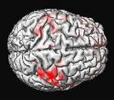
Major advances past 1-2 decades
New insights on how to learn & teach complex thinking
physicists, bio,
chemists
University
science & eng.
classroom
studies
brain
research
today
cognitive
psychology
Strong arguments for
why apply to most fields

Slide 5

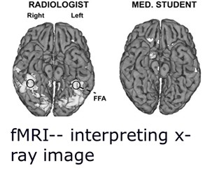
Rethinking how learning happens
old/current model
new research-based view
brain changeable
knowledge
~ same
transformation
soaks in, varies with brain
focus on:
selecting best brains
knowledge soup
Change neurons by intense thinking. Improved capabilities.

Slide 6
Brain research– learning is enhancing relevant neuron connections—Like muscle development.
Intensity & type of exercise critical.
Researchers learning more effective ways to teach– brains develop new skills.
“Perfect pitch”– long thought was some extraordinary natural talent.
Now we know how to teach it to almost every child.

Slide 7
I. General--How the brain learns scientific & engineering thinking.
II. Focusing down--Applying in university classrooms & measuring results.
III. Focusing tighter– detailed findings from classroom research. What works to improve learning and why. (things you can use)

Slide 8
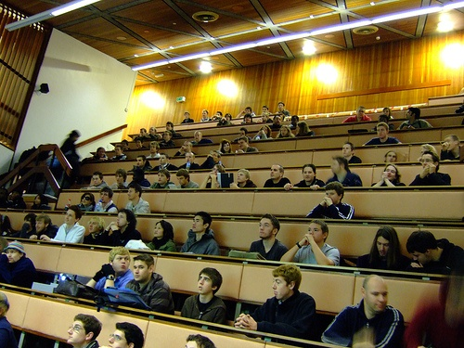
Learning in large intro class*
Comparing the learning in class for two ~identical sections. 270 students each.
UBC 1st year university physics for engineers.
Control--standard lecture class– highly experienced Prof with good student ratings.
Experiment–- new physics Ph. D. trained in principles & methods of research-based teaching.
They agreed on:
Same material to cover (Cover as much?)
Same class time (1 week)
Same exam (jointly prepared)- start of next class
*Deslauriers, Schelew, Wieman, Sci. Mag. May 13, ‘11
Notes:
review quickly

Slide 9
Experimental:
1. Short preclass reading assignment--Learn basic facts and terminology without wasting class time.
2. Class starts with question:
When switch is closed, bulb 2 will
a. stay same brightness, b. get brighter
c. get dimmer,
d. go out.
1
2
3
3. Individual answer with clicker/phone
Jane Smith
chose a.
4. Discuss with neighbors, revote. (“Peer instruction”)
Instructor circulating and listening in on conversations! What aspects of student thinking like physicist, what not?

Slide 10
5. Demonstrate/show result
6. Instructor follow up summary– feedback on which models & which reasoning was correct, & which incorrect and why. Many student questions.
For more mathematical topics, students write out on worksheets.
Students practicing thinking like physicists--
(choosing, applying, testing conceptual models, critiquing reasoning...)
Feedback—other students, informed instructor, demo
Identical surprise quiz given in both sections

Slide 11
Histogram of test scores
ave 41 ± 1 %
74 ± 1 %
guess
Learning from lecture tiny.
Clear improvement for entire student population.
Deslauriers, Schelew, Wieman, Sci. Mag. May 13, ‘11

Slide 12
Similar comparison of teaching methods. Computer science & looking at fail/drop rates over term. U. Cal. San Diego,
scientific teaching
same 4 instructors, better methods = 1/3 fail rate
Beth Simon et al., 2012
Notes:
Intuition behind CS1.5 is that CS1 is the immediate pre-curser to CS1.5. What likely occurred here was that, with standard instruction, the students who might have failed CS1.5 were already gone having failed CS1 and having not returned. So CS1.5 with standard instruction has a much improved fail rate, but that’s misleading...

Slide 13
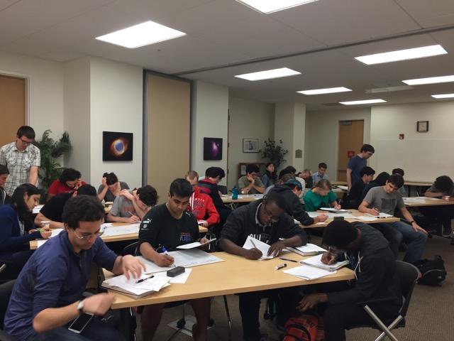
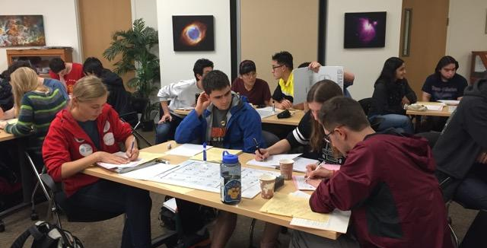
Research-based instruction—Advanced Courses
Design and implementation: Jones, Madison, Wieman, Transforming a fourth-year modern optics course using a deliberate practice framework, Phys Rev ST – Phys Ed Res, V. 11(2), 020108-1-16 (2015). 1 standard deviation improvement
Worksheets
Transformed teaching of Stanford physics majors
8 physics courses 2nd-4th year
Also works well for graduate courses
(P. Lepage Quant. Field Theo. Am J. Phys. 2021)

Slide 14
Structure of active learning class
Good for any subject, level, class size
Actions
Students
Instructors
Preparation
Complete targeted reading
Formulate/review activities
Introduction
(2-3 min)
Listen/ask questions on reading
Introduce goals of the day
Circulate, answer questions & assess students
Activity
(10-15 min)
Group work on activities
Listen/ask questions, provide solutions & reasoning when called on
Facilitate class discussion, provide feedback to class
Feedback
(5-10 min)
Two essential features:
students are thinking—practicing expert reasoning
instructor more knowledgeable about that thinking—more effective teaching & feedback (and they enjoy teaching more)

Slide 15
Evidence from the University Classroom
~ 1000 research studies from undergrad science and engineering comparing traditional lecture with “active learning” (or “research-based teaching”).
consistently show greater learning
lower failure & dropout rates
Meta-analysis
all sciences & eng. similar.
PNAS Freeman, et. al. 2014

Slide 16
But how to compress distribution?
74 ± 1 %
Good teaching methods not enough?
Other factors?
ave 41 ± 1 %
Got data on many things.
Lots of statistics
(multivariable regression)
What matters?
math taken?– no
demographics?
Move all to top?
Stanford students.

Slide 17
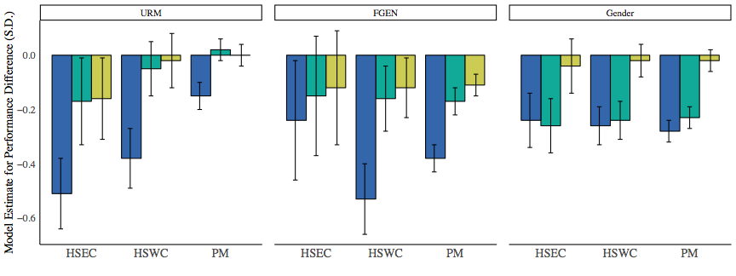
Origin of performance gaps by demographic groups
FGEN
Female
URM
0
Controlling for math SAT/ACT (general math & sci prep)
Controlling for math SAT/ACT + physics content FMCE
All demographic gaps gone when include these measures of prior preparation included. Only preparation gaps.
Prep is powerful predictor of course outcomes, but same for all students.
Demographic gaps or preparation gaps?: The large impact of incoming preparation on performance of students in introductory physics
Salehi, Burkholder, Lepage, Pollock, and Wieman Phys. Rev. Phys. Educ. Res. 15, 020114 (2019)
Notes:
difference in incoming preparation explained all & 2/3 of the gaps
difference in content specific incoming preparation explained all of these gaps
Emphasize that not really demographic gaps, but actually preparation looks like
Stress that there aren't demographic gaps people talk and focus but this shows preparation gaps
Didn’t really see that these groups take AP physics at different rates, so why? Difference in AP courses

Slide 18
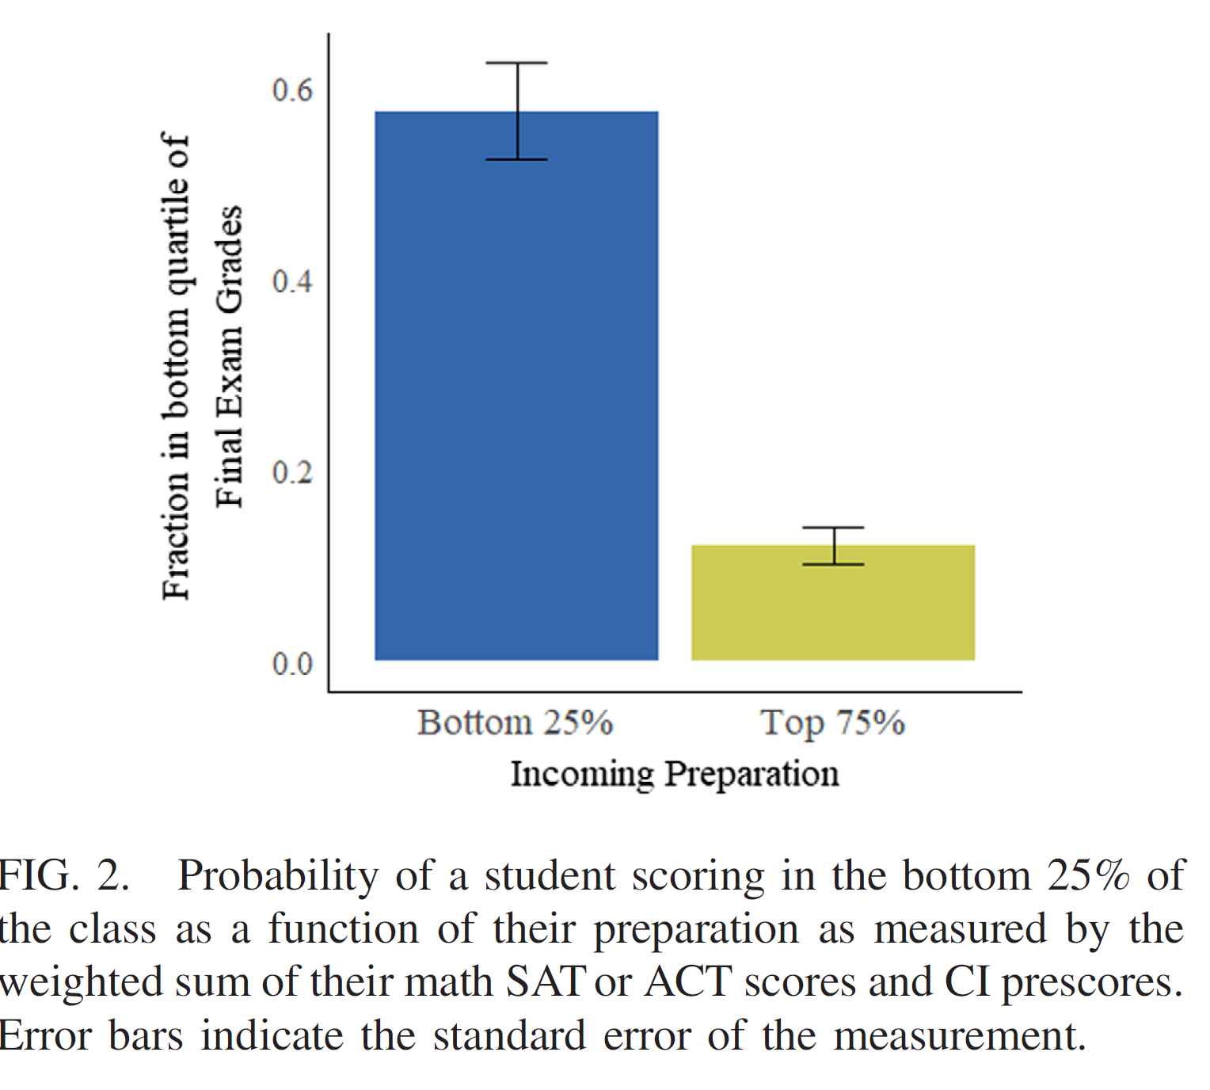
Why does this dependence of grades on prior preparation matter?
Doing poorly in physics 1 is barrier to physics & engineering major.
“Failure analysis”—how does probability of failing depend on preparation?
Math SAT & FMCE test crude measures of prior preparation!
Created our own diagnostic test.
30 minutes, explains ~ ½ variance,
most of failure risk.
Differences in “K-12 educational privilege" amplified by college teaching.
incoming preparation

Slide 19
Stanford and Colorado (and Cornell) very similar dependence on preparation factors!
nature of the teaching, not the students.
Optimizing coverage and pace for top 1/3 of the preparation.
Confusing educational privilege with talent.
Solution—match curriculum to the students and many more can succeed*
*Preliminary indications--“An equitable and effective approach to introductory mechanics”, https://arxiv.org/abs/2111.12504, Burkholder, Salehi, Sackeyfio, Mohamed-Hinds, Wieman

Slide 20
I. General--How the brain learns scientific & engineering thinking.
II. Focusing down--Applying in university classrooms & measuring results. Examples, research data, principles.
III. Focusing tighter– Research--What works to improve learning and why? (things you can use in teaching.)

Slide 21
III. Principles and Practices. Things you can use.
Teaching to think like physicist; what the research says is important.
Student variation
Disciplinary
expertise
Prior knowledge
& experience
Brain
constraints
Motivation
Learning--
practicing making decisions with good feedback
timely, specific, actionable
Implementation
Tasks/questions
+ deliverables
Social learning
Defines teaching expertise.
Practices that research shows produce more learning
(basis for better evaluations of teaching)

Slide 22
Student variation
Disciplinary
expertise
Prior knowledge
& experience
Brain
constraints
Motivation
Learning--
practicing making decisions
with good feedback
How enter into design of practice
activities (in class, then homework...)?
Tasks/questions
+ deliverables
Social learning
Implementation

Slide 23
Wieman Group Research
How experts in science, engineering, and medicine solve authentic problems.
Process defined by making set of decisions with limited information.
Same set of 29 decisions, all science & engineering!
  Decide: what concepts/models relevant
  Decide: What information relevant, irrelevant, needed.
  Decide: what approximations are appropriate.
  Decide: potential solution method(s) to pursue.
  ....
  Decide: does solution/conclusion make sense, how to test?
but, making the decisions requires specialized disciplinary knowledge. Organized to optimize.
Argenta Price, Shima Salehi, Karen Wang, Michael Flynn, Candice Kim, Eric Burkholder, CBE-LSE

Slide 24
  Decide: what concepts/models relevant
  Decide: What information relevant, irrelevant, needed.
  Decide: what approximations are appropriate.
  ‘’ : potential solution method(s) to pursue.
  ....
  does solution/conclusion make sense, how to test?
Learning good “expert” thinking*--
requires practicing making problem-solving decisions
in authentic problem context, using subject knowledge.
brain “exercise”
Nearly all these decisions removed from typical course problems!
Students learn information, not how to use!
* “Deliberate Practice”, A. Ericsson research. See “Peak;…” by Ericsson for readable summary

Slide 25
Student variation
Disciplinary
expertise
Prior knowledge
& experience
Brain
constraints
Motivation
Learning--
practicing making decisions
with good feedback
How enter into design of practice
activities (in class, then homework...)?
Tasks/questions
+ deliverables
Social learning
Implementation

Slide 26

Brain Constraints
Memory (simplified)
2. Long term memory
Large capacity
Long duration
“Short-term working memory” (buffer)
tiny capacity (5-7 items)
time scale of minutes
(what can pay attention to)
When hear or see new items, pushes out old. Not processed and into LTM

Slide 27
Designing thinking practice activities
Brain constraints:
1) working memory has limit 5-7 new items.
Additional items reduce processing & learning.
Split attention (checking email, ...)—learning disaster (worse online!)
Jargon, nice picture, interesting little digression or joke actually hurts learning.
2) long term memory– biggest problem is recall after learning additional stuff--interference.
Not just learn once and done. Interference suppressed by repeated interleaved recall.
So not just cover chapter 1 and done. Reconnect during chap 3, 4...

Slide 28
Student variation
Disciplinary
expertise
Prior knowledge
& experience
Brain
constraints
Motivation
Learning--
practicing making decisions with good feedback
Implementation
Tasks/questions
+ deliverables
Social learning

Slide 29
Implementation—
1. Design good tasks (as above) but with clear deliverables. Things student has to complete.
(define task & instructor use to guide feedback)
2. Social learning (working in groups, in class 3-4)
Talking to fellow students better than hearing expert instructor explain??
Yes! People teaching/explaining to others triggers unique cognitive process ⇒ learning
Very useful as a teacher to listen in on student conversations!

Slide 30
Conclusion—
Research shows what is good teaching design and implementation.
Better learning than traditional lecture & why.
Work teaching online?
Yes, but require more structure & attention to details.

Slide 31
“But traditional lectures can’t be as bad as you claim. Look at all us university professors who were taught by traditional lectures.”
Bloodletting was the medical treatment of choice for ~ 2000 years, based on exactly the same logic.
Need proper comparison group. (science)

Slide 32
Conclusion--Research shows good design and implementation.
Better learning than traditional lecture & why.
Brain learns what it practices. Develops new capabilities.
Good References:
S. Ambrose et. al. “How Learning works”
D. Schwartz et. al. “The ABCs of how we learn”
Ericsson & Pool, “Peak:...”
Wieman, “Improving How Universities Teach Science”
cwsei.ubc.ca-- resources (implementing best teaching methods), references, effective clicker use booklet and videos
A Detailed Characterization of the Expert Problem-Solving Process in Science and Engineering: Guidance for Teaching and Assessment, A. Price et al, ://doi.org/10.1187/cbe.20-12-0276
slides will be available

Slide 33
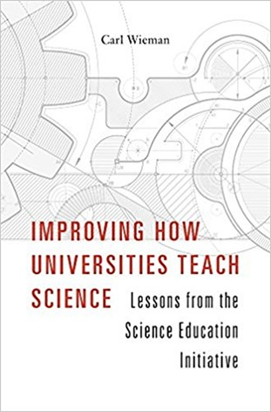
For administrators:
What universities and departments can do.
Experiment on large scale change of teaching.
Changed teaching of ~250 science instructors & 200,000 credit hrs/yr UBC & U. Colorado
Important results:
Large scale change is possible. (Entire departments)
When faculty learn how to teach this way (~50 hrs) they prefer to lecturing. Costs the same.
Need to recognize, support, and incentivize teaching expertise.
Need better way to evaluate teaching-

Slide 34
Linear regression results very similar across institutions*
Only math SAT/ACT & FMCE-pre predict performance
Stanford & Col have same coefficients (0.3), explain 1/3 of variation
Demographic gaps similar and only come from prior prepartion
URM
Performance Gaps
FGEN
Performance Gaps
Female
Performance Gaps
Cornell Stanford CU Boulder
Cornell Stanford CU Boulder
Cornell Stanford CU Boulder
Controlling for math SAT/ACT (general math & sci prep)
Controlling for math SAT/ACT + physics content FMCE
*Salehi et al., PHYS REV PER, 15, 020114 (2019)
Notes:
difference in incoming preparation explained all & 2/3 of the gaps
difference in content specific incoming preparation explained all of these gaps
Emphasize that not really demographic gaps, but actually preparation looks like
Stress that there aren't demographic gaps people talk and focus but this shows preparation gaps
Didn’t really see that these groups take AP physics at different rates, so why? Difference in AP courses

Slide 35
Teaching to think (make decisions) like expert, what research says is important
Student variation
Disciplinary
expertise
Prior knowledge
& experience
Brain
constraints
Motivation
Learning--
practicing making decisions with good feedback
Implementation
Tasks/questions
+ deliverables
Social learning

Slide 36
Conclusion:
Research has established teaching expertise at university level. Practices that are more effective.
When learned and applied:
students learn more
students and teaching staff prefer
Potential to dramatically improve post secondary education.
How to make it the norm at universities?

Slide 37
~ 20 extras below, not in talk

Slide 38
Final Exam Scores
nearly identical problems
practice & feedback 2nd instructor
practice & feedback, 1st instructor
1 standard deviation improvement
taught by lecture, 1st instructor, 3rd time teaching course
& instructors all greatly prefer to lecturing
Yr 1 Yr 2 Yr 3
Jones, Madison, Wieman, Transforming a fourth year modern optics course using a deliberate practice framework, Phys Rev ST – Phys Ed Res, V. 11(2), 020108-1-16 (2015)

Slide 39
Necessary 1st step-- better evaluation of teaching
“A better way to evaluate undergraduate science teaching” Change Magazine, Jan-Feb. 2015, Carl Wieman
Requirements:
measures what leads to most learning
equally valid/fair for use in all courses
actionable-- how to improve, & measures when do
is practical to use routinely
student course evaluations do only #4
Better way–characterize the practices used in teaching a course, extent of use of research-based methods. 5-10 min/course
“Teaching Practices Inventory” http://www.cwsei.ubc.ca/resources/TeachingPracticesInventory.htm

Slide 40
Categories of the 29 Science & Engin. Problem Solving Decisions
(Somewhat time ordered but involve extensive iteration)
Importance and fit (2)
Implications + communications (3)
Delineate goals, criteria, scope (1)
Frame problem: choose predictive framework(s), related known problems, potential solutions, hypotheses (8)
Test and refine candidate solution(s): meet criteria, match data, assumptions still valid, not fail (7)
Predictive Framework
Plan: decompose, simplify, priorities, steps to solve (8)
Collect and interpret info (7)
Blue arrows are iteration paths.
Depend on reflection .

Slide 41
Improving measure of prior preparation
FMCE & math SAT crude measures.
Created our own diagnostic. 20-30 minutes to complete.
Use to advise students on sequence (honors, physics 1, alg. based)
Phys 41 Exam Grade | Model 1 | Model 2
SAT Score |  | 0.25*** (0.060)
Diagnostic Score | 0.61*** (0.05) | 0.40*** (0.068)
FMCE Pre-Score |  | 0.18** (0.059)
R-squared | 0.39 | 0.46
25 minute test. Predict 0.4 of variance of grade, who will fail.
41

Slide 42

4. Surprisingly strong dependence. Course starts from 0.
Is Stanford special?
Did similar analysis for Cornell and Univ. of Colorado
 | Stanford | Colorado
# students/yr | ~ 500 | ~ 2000
selectivity | <1% | ~ 50%
% in top 10% of HS class | 96% | 29%
Ave percentile math SAT/ACT | 97 | 89
Average prescore on FMCE (%) | 55% | 43%
Normalized pre-post gain on FMCE | 46 | 52
Cornell & Stanford similar
Colorado very different student population

Slide 43
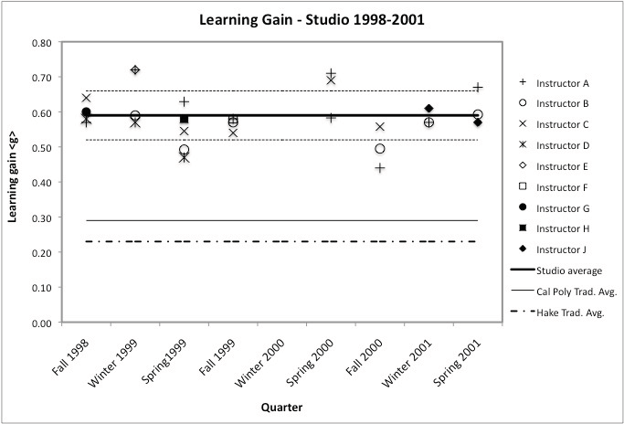
scientific teaching
Apply concepts of force & motion like physicist to make predictions in real-world context?
average trad. Cal Poly instruction
1st year mechanics
Cal Poly, Hoellwarth and Moelter,
Am. J. Physics May ‘11
9 instructors, 8 terms, 40 students/section.
Same instructors, better methods = more learning!

Slide 44
Transforming teaching of Stanford physics majors
8 physics courses 2nd-4th year, seven faculty, ‘15-’17
Attendance up from 50-60% to ~95% for all.
Student anonymous evaluation overwhelmingly positive
(4% negative, 90% positive): (most VERY positive, “All physics courses should be taught this way!”)
All the faculty greatly preferred to lecturing.
Typical response across ~ 250 faculty at UBC & U. Col. Teaching much more rewarding.

Slide 45
Applications of research instructors can use immediately (some very common but bad practices)
Organization of how a topic is presented
2. Feedback to students
4. Review lectures (why often worse than useless)
(see cwsei research papers & instructor guidance)

Slide 46
1. Organization of how topic is presented.
Very standard teaching approach:
Give formalism, definitions, equa’s, and then move on to apply to solve problems.
What could possibly be wrong with this?
Nothing, if learner has an expert brain.
Expert organizes this knowledge as tools to use, along with criteria for when & how to use.
Student does not have this system for organizing knowledge. Can only learn as disconnected facts, not linked to problem solving. Not recall when need.
Much higher demands on working memory = less capacity for processing.
Unmotivating— see no value.

Slide 47
A better way to present material—
“Here is a meaningful problem we want to solve.”
“Try to solve” (and in process notice key features of context & concepts—basic organizational structure).
Now that they are prepared to learn--“Here are tools (formalism and procedures) to help you solve.”
More motivating, better mental organization & links, less cognitive demand = more learning.
“A time for telling” Schwartz & Bransford (UW), Cog. and Inst. (1998),
Telling after preparation ⇒ x10 learning of telling before,
and better transfer to new problems.

Slide 48
3. Feedback to students
Standard feedback—”You did this problem wrong, here is correct solution.”
Why bad? Research on feedback—simple right-wrong with correct answer very limited benefit.
Learning happens when feedback:
timely and specific on what thinking was incorrect and why
how to improve
learner acts on feedback.
Building good feedback into instruction among most
impactful things you can do!

Slide 49
1. Designing homework & exam problems (& how to improve)
What expertise being practiced and assessed?
Provide all information needed, and only that information, to solve the problem
Say what to neglect
Possible to solve quickly and easily by plugging into equation/procedure from that week
Only call for use of one representation
Not ask why answer reasonable, or justify decisions
  Components of expert thinking:
  recognizing relevant & irrelevant information
  select and justify simplifying assumptions
  concepts and models + selection criteria
  moving between specialized representations
  (graphs, equations, physical motions, etc.)
  Testing & justifying if answer/conclusion reasonable
How to improve? Don’t do the bad stuff.

Slide 50
Enhancing Diversity in Undergraduate Science: Self-Efficacy Drives Performance Gains with Active Learning, CBE-LSE. 16
Cissy Ballen, C. Wieman, Shima Salehi, J. Searle, and K. Zamudio
Large intro bio course at Cornell
trad lecture
90
yr1-trad
course grade
85
80
URM
non-URM
(small correction for incoming prep)

Slide 51
Enhancing Diversity in Undergraduate Science: Self-Efficacy Drives Performance Gains with Active Learning, CBE-LSE. 16
Cissy Ballen, C. Wieman, Shima Salehi, J. Searle, and K. Zamudio
Large intro bio course at Cornell
yr1-trad lecture, yr2- full active learning
URM gap disappears
90
course grade
85
80
URM
non-URM

Slide 52
Applications of research instructors can use immediately (some very common but bad practices)
Organization of how a topic is presented
Design of homework and exam problems
3. Review lectures (why often worse than useless)
(see cwsei research papers & instructor guidance)

Slide 53
How it is possible to cover as much material?
(if worrying about covering material not developing students expert thinking skills, focusing on wrong thing, but…)
transfers information gathering outside of class,
avoids wasting time covering material that students already know
Advanced courses-- often cover more
Intro courses, can cover the same amount.
But typically cut back by ~20%, as faculty understand better what is reasonable to learn.

Slide 54

Most university instructors and administrators don’t know about, but growing recognition of research:
US National Acad. of Sciences (2012)
PCAST Report to President (2012)
Calling on universities to adopt
Amer. Assoc. of Universities (60 top N. Amer. Univ.’s—Stanford, Harvard, Yale, MIT, U. Cal, …)
Pre 2011-- “Teaching? We do that?”
2017 Statement by President of AAU--
“We cannot condone poor teaching of introductory STEM courses … simply because a professor, department and/or institution fails to recognize and accept that there are, in fact, more effective ways to teach. Failing to implement evidence-based teaching practices in the classroom must be viewed as irresponsible, an abrogation of fulfilling our collective mission ….”

Slide 55
“ A time for telling” Schwartz and Bransford,
Cognition and Instruction (1998)
People learn from telling, but only if well-prepared to learn.
Activities that develop knowledge organization structure.
Students analyzed contrasting cases ⇒recognize key features
Predicting results of novel experiment

Slide 56
Pre-class Reading
Purpose: Prepare students for in-class activities; move learning of less complex material out of classroom
Spend class time on more challenging material, with Prof giving guidance & feedback
Can get >80% of students to do pre-reading if:
Online or quick in-class quizzes for marks (tangible reward)
Must be targeted and specific: students have limited time
DO NOT repeat material in class!
Heiner et al, Am. J. Phys. 82, 989 (2014)

Slide 57
Student variation
Disciplinary
expertise
Prior knowledge
& experience
Brain
constraints
Motivation
Learning
through practice
with feedback
How enter into design of practice
activities (in class, then homework...)?
Tasks/questions
+ deliverables
Social learning
Implementation

Slide 58
Motivation-- essential
(complex- depends on background)
Enhancing motivation to learn
a. Relevant/useful/interesting to learner
(meaningful context-- connect to what they know and value)
requires expertise in subject
b. Sense that can master subject and how to master, recognize they are improving/accomplishing
c. Sense of personal control/choice

Slide 59
A few final thoughts—
1. Lots of data for college level, does it apply to K-12?
There is some data and it matches.
Harder to get good data, but cognitive psych says principles are the same.
2. Isn’t this just “hands-on”/experiential/inquiry learning?
No. Is practicing thinking like scientist with feedback.
Hands-on may involve those same cognitive processes, but often does not.

Slide 60
Reducing demands on working memory in class
Targeted pre-class reading with short online quiz
Eliminate non-essentential jargon and information
Explicitly connect
Make lecture organization explicit.

Slide 61
clickers*--
Not automatically helpful--
give accountability, anonymity, fast response
Used/perceived as expensive attendance and testing device⇒ little benefit, student resentment.
Used/perceived to enhance engagement, communication, and learning ⇒ transformative
challenging questions-- concepts
student-student discussion (“peer instruction”) & responses (learning and feedback)
follow up instructor discussion- timely specific feedback
minimal but nonzero grade impact
*An instructor's guide to the effective use of personal response systems ("clickers") in teaching-- www.cwsei.ubc.ca
Notes:
Putting research into practice in classroom
(and homework, and exams, etc.)
Knowing what students are thinking in classroom and connecting to that.
Enhanced communication and feedback.
Not about more quizes/test… not just because more alert.
Clickers provide powerful psychological combination:
personal accountability/commitment
peer anonymity
1. Feedback to instructor.
2. Feedback to students.
3. Students intellectually active-- a dialogue.
Using clickers for max benefits
communication system
Class built around series of questions to students: challenging concepts or applications, predictions or explanations of demonstration experiments, ...
Small group discussion ("peer instruct."), consensus answers
Explicit focus on novice/expert views, reasoning, problem solving.
Collaborative problem solving/scientific discourse, self-monitoring.

Slide 62
long term retention
Retention curves measured in Bus’s Sch’l course.
UBC physics data on factual material, also rapid drop but pedagogy dependent. (in prog.)
Notes:
cw

Slide 63
Design principles for classroom instruction
1. Move simple information transfer out of class. Save class time for active thinking and feedback.
2. “Cognitive task analysis”-- how does expert think
about problems?
3. Class time filled with problems and questions that call for explicit expert thinking, address novice difficulties, challenging but doable, and are motivating.
4. Frequent specific feedback to guide thinking.
DP

Slide 64
What is the goal of education?
Students learn to make better decisions.
Appropriate knowledge and processes of science to make better decisions with limited information.
Never more important than today
At course and program level:
In relevant contexts, use the knowledge and reasoning of the discipline to make good decisions (“expertise”).
Rest of talk– research on how to teach most effectively (“practice!”)

