Slide 1
Accommodations in Higher Education
KATE WEEKS, MS
DIRECTOR, STUDENT DISABILITY SUPPORT SERVICES

Slide 2
What is Student Disability
Support Services (SDSS)?
Student Disability Support Services (SDSS) provides guidance and support to all students with disabilities to ensure academic access. SDSS offers a broad range of services to create an inclusive environment and equal access to academics and their college experience in accordance with Section 504 of the Rehabilitation Act of 1973, and the ADA Amendments Act. SDSS is also committed to creating a welcoming environment free of stereotypes.

Slide 3
What laws apply in higher education?
Americans with Disabilities Act, as amended (ADAAA)
https://www.ada.gov/
Section 504 of the Rehabilitation Act of 1973
https://www.hhs.gov/sites/default/files/ocr/civilrights/resources/factsheets/504.pdf

Slide 4
What is considered a disability?
A person with a disability is defined as:
A student with a physical or mental impairment which substantially limits one or more major life activities (e.g. caring for one’s self, walking, speaking, seeing, hearing, thinking, learning, concentrating, working)
A student who has current documentation (e.g. recent psycho-educational evaluation confirming a learning disability) of such impairment from a qualified professional
A student who is regarded as having impairment
The Office of Student Disability Support Services (SDSS) reviews all documentation concerning disabilities.

Slide 5
Types of disabilities (Not Inclusive)
Visible:
Mobility impairments
Amputation
Some physical disabilities
Some medical disabilities
Some sensory impairments
Invisible:
Medical disabilities such as: Epilepsy, HIV/AIDS, Diabetes, Arthritis, Asthma, Cancer, Cystic Fibrosis, Migraines
Examples include short or long term, stable or progress,
constant or unpredictable and fluctuating, controlled by medication and untreatable.
Cognitive impairments
Psychiatric disabilities such as: major depression, bipolar disorder, schizophrenia and anxiety disorders
Traumatic Brain Injury
Multiple Concussion Syndrome; Post Concussion Syndrome
Hearing loss
Vision loss
Chronic Fatigue Syndrome
Attention Deficit-Disorder or Attention-Deficit/Hyperactivity Disorder(ADD/ADHD)
Learning Disabilities (LD)
Spectrum disorders

Slide 6
What are reasonable accommodations?
Modifications or adjustments to tasks, the environment or the way things are usually done so individuals with disabilities have equal access to programs or services.
Reasonable accommodations are not limited to, but may include:
Housing accommodations - close proximity to campus, first floor, elevator
Dining accommodations - specific diet, allergies
Classroom accommodations - note-taker, copy of professor’s notes/presentations, preferential seating, interpreter, ability to meet with the professor, ability to record lectures
Testing accommodations - reduced distraction environment, extended time, use of a dictionary, reader/scribe
Mobility accommodations - use of transit services

Slide 7
Process for registering with SDSS
Once an accepted student is connected with our office we require the following:
Completed Student Intake Form.
Current medical documentation supporting accommodation request(s).
A meeting with SDSS to review accommodation needs and to establish their Accommodation Memo.
Once registered with SDSS:
Students request updated Accommodation Memos each semester to provide to their professors.

Slide 8
Example of Accommodation Memo

Slide 9
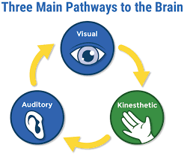
https://blog.allaboutlearningpress.com/kinesthetic-learning/

Slide 10
Potential accommodations for a student with ADHD
The student has been diagnosed with a qualifying learning disability and experiences the following:
Difficulty processing information auditorily.
Difficulty keeping materials organized.
Frequently missed due dates.
Notes taken during class are not helpful.

Slide 11
Possible Accommodations
Classroom
Ability to record lecture (we use the program, Glean)
Copies of professors notes
Preferential seating
Ability to take breaks
Testing
Extended time on tests (1.5x)
Alternative testing location in SDSS Testing Center (if available)
Outside of Academic Setting/SDSS
Tutoring
Use of Library or other quiet spot on campus

Slide 12
Note-taking Accommodations
OneNote
Evernote
Livescribe Pen
Notability
Sonocent
Zoom
Glean*

Slide 13
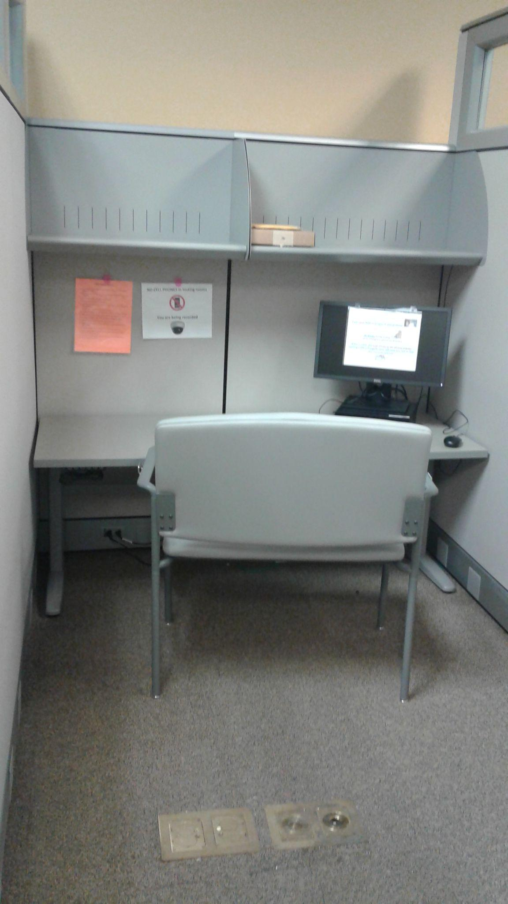
Test Taking Accommodations
Quiet space
Sound machine
Option of chairs
Computers
Variety of software
Fidgets
Ear plugs
Adjustable table
Camera to proctor

Slide 14
Remember…
All accommodations are on a case-by-case basis.
Not all accessibility/disability support offices are the same.
Know your learning style.
Learn self-advocacy skills.
Accommodations are not retroactive.

Slide 15
Supports on-campus, outside of SDSS
Tutoring
Counseling Center
Academic Advisor
Health Suite
Residence Life & Housing
Off-campus resources, like DORS

Slide 16
Recommendations – HS to HE
1. Updated documentation. Most colleges prefer documentation that is no more than 3-5 years old, some even less. You can ask for an assessment to be completed in high school.
2. Research colleges to be sure they have the features you need.
What is the campus size?
What are average class sizes?
Does the school offer tutoring and other supports?
3. Be sure to consider community college before a four-year college, if applicable.
4. Reach out to the disability support office before accepting.
5. Know that in college, you are your own self-advocate.
6. Have your student attend IEP meetings.

Slide 17
Teaching Tips for Professors-Notes
The goal is universal design for all students….
Make syllabi, assignment instructions, reading lists, studying tools, slides, etc. available in electronic format (e.g., email, Canvas, online).
Make slides clear with easy to read fonts and color contrasts (dark letters on light background). This assists both students with visual impairments but also with specialized software to access materials.
View slides from afar before showing to a class to ensure they are visible.
Provide notes or tools/visual aids.

Slide 18
Teaching Tips for Professors-Classroom
Arrange lab equipment so that it is accessible and demonstrations are visible by everyone.
If not included in class notes/outlines, write key phrases or outline for all students to see and follow.
Face the class when speaking.
Repeat discussion questions.
Minimize sensory distractions (e.g. closing the door).
Allow time for clarification questions.

Slide 19
Teaching Tips for Professors
Choose textbooks available in audio format.
Inform Bookstore of textbook choice before the end of the semester.
Be prepared to provide classroom information and tests/exams in a variety of methods. For example, verbally and in writing.
Design course web pages to be accessible to students with disabilities.
Provide feedback to students, privately.

Slide 20
FAQ’s
Do students have to be registered with Student Disability Support Services (SDSS) in order to receive reasonable accommodations?
Yes. Some professors are willing to accommodate, however it is recommended that all students needing accommodations register with SDSS. This allows for consistency and ensures the institution is following what is required by law.
Does SDSS provide evaluations or documentation?
SDSS does not provide evaluations. We provide referrals to qualified professionals (e.g. doctors, psychologists, etc.) based on the type of disability.
Does Student Disability Support Services (SDSS) offer tutoring?
The Office of SDSS does not offer tutoring, as we are not subject experts. However, we do try to assist students in finding appropriate tutoring on campus. It is recommended that professors supply information regarding tutoring and the
Writing Center within departments, if applicable.

Slide 21
FAQ’s
Are my records kept in my student file?
No, documentation is kept securely in SDSS. We value confidentiality and it is the students’ decision if they want to disclose their
disability.
A student feels their accommodations are not working for their class, what should they do?
First, the student should have a discussion with their professor discussing the difficulties they may be having. Sometimes there are alternatives to their accommodations. Students can also contact SDSS by making an appointment or emailing. At times accommodations do need to be adjusted.
Do course requirements or standards have to be lowered because a student has accommodations due to a disability?
No, essential course requirements and standards do not have to be lowered. Often reasonable accommodations
require altering the method in which information is provided or evaluated. For example, the focus should be what
the student learned and not how they are tested on the information.

Slide 22
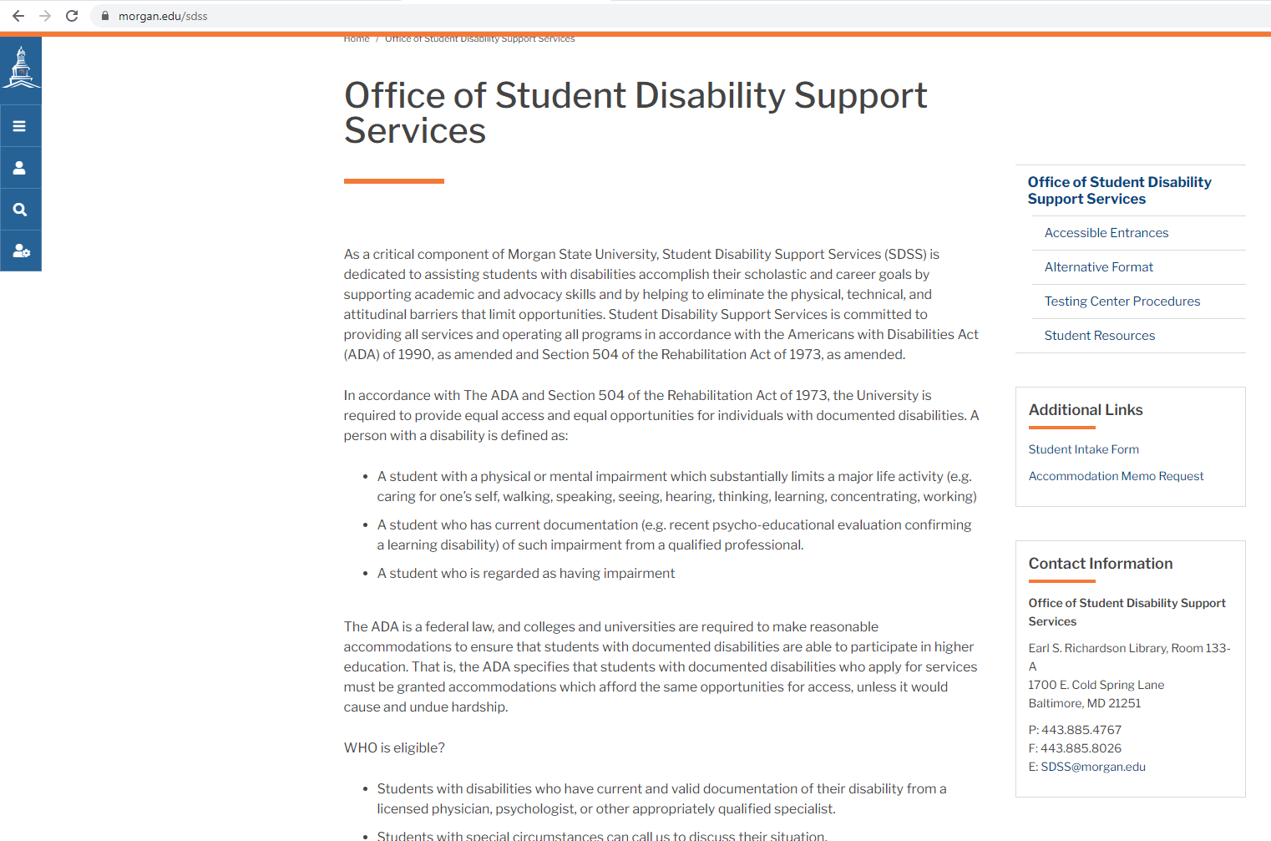
www.morgan.edu/sdss

Slide 23
Kate Weeks, MS
Director, Student Disability Support Services (SDSS)
kate.weeks@morgan.edu

Slide 24
Questions

