Slide 1
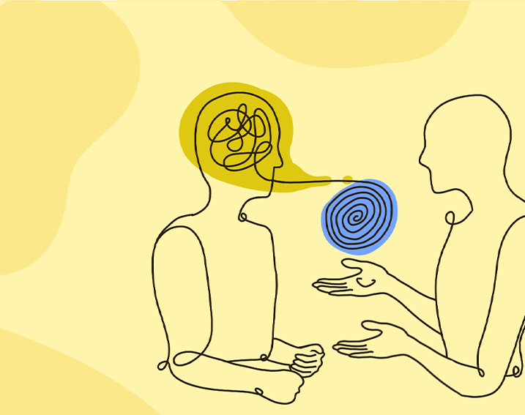
Let’s Get REAL About Your ADHD Relationship
Susan Dillon Tschudi, LMFT
CHADD Conference 2023

Slide 2
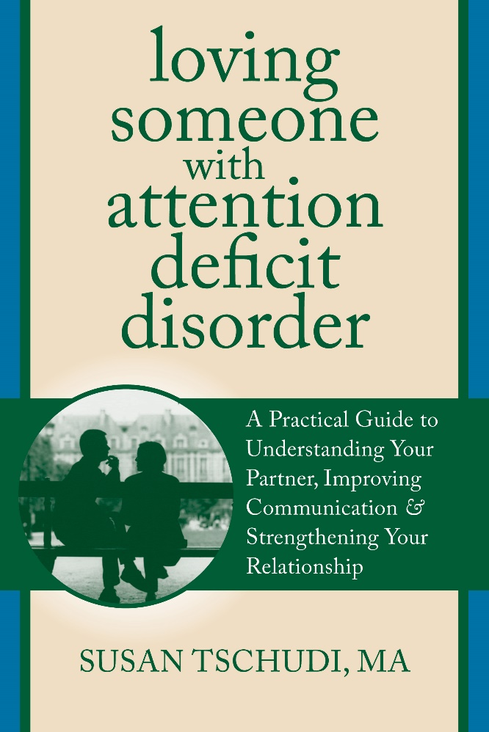
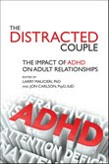
www.lovingsomeonewithadd.com

Slide 3
Learning Objectives
Articulate the diagnostic components of adult ADHD
Identify the symptoms of ADHD that may impact and interfere with a healthy partner relationship
Define conflictual issues that are present in the relationship due to ADHD symptoms
Help couples affected by ADHD find relational success

Slide 4
Sources
Knies, K, E. Bodalski, K. Flory 2021. “Romantic Relationships in Adults with ADHD: The
Effect of Partner Attachment Style on Relationship Quality.” Journal of Social and
Personal Relationships 38 (1):42-64
Luderer, M, J.A.R. Quiroga, S.V. Faraone, Y. Zhang-James, A. Reif. 2021. “Alcohol Use
Disorders and ADHD.&quot; Neuroscience and Biobehavioral Reviews (128):648-660.
Ersoy, M. A. and H. T. Ersoy 2019. “Gender-Role Attitudes Mediate the Effects of Adult ADHD
on Marriage and Relationships.” (23):40-50.
Al-Yagon, M., M. Lachmi, L. Shalev 2020. “Coping Strategies Among Adults with ADHD: The Mediational Role of Attachment Relationship Patterns.” (102):103657.
Barkley, R.A., & Gordon, M. (2002) Research on comorbidity, adaptive functioning, and cognitive impairments in adults with ADHD: Implications for a clinical practice. In S. Goldstein & A.T. Ellison (Eds.), Clinician's guide to adult ADHD: Assessment and intervention. San Diego, CA: Academic Press.
Rostain, A.L., & Ramsay, J.R. (2006) Adult with ADHD? Try medication + psychotherapy. Current Psychiatry, 5(2), 13-16, 21-24, 27.

Slide 5
Overview of ADHD

Slide 6
ADHD or ADD? Understanding the Subtypes
Attention Deficit Hyperactivity Disorder -
Predominantly Hyperactive/Impulsive Presentation
Predominantly Inattentive Presentation
Combined Presentation

Slide 7
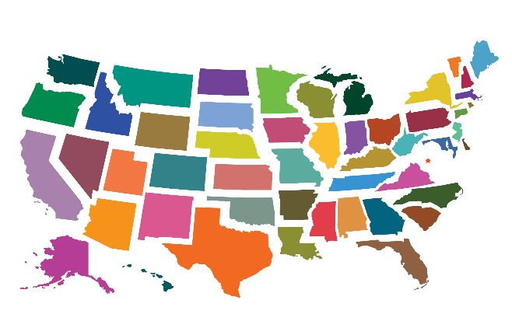
Neurobiological
Dysregulation of dopamine and norepinephrine in prefrontal cortex
Dopamine – attention, focus, staying on task
Norepinephrine – attention span, impulsivity and distractibility
Lifespan disorder
Highly heritable
Affects from 5 to 7% of adult population
5% of 328 million = 16.5 MILLION
7% of 328 million = 23 MILLION

Slide 8
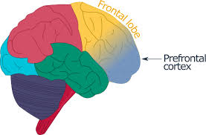
Neurobiological Impact of Adult ADHD
Prefrontal Cortex/Executive Function
Planning
Prioritizing
Organizing
Decision Making
Modulation of Emotion
Dysregulation of Prefrontal Cortex will affect
Attention Span
Judgement
Decision Making
Impulse Control
Emotional response
Dysregulation of PFC is remedied by STIMULATION

Slide 9
ADHD Symptoms
Easily distracted
Trouble concentrating on tasks/what others are saying
Problems remembering obligations or appointments
Misplaces/has trouble finding things
Problems with follow through
Difficulty with organization
Avoids or delays getting started on tasks
Trouble paying attention when doing boring or repetitive work
Careless mistakes
Impulsive behavior
Interrupt others
Reckless actions/decisions
Substance Use
Restlessness
Complaints of boredom
Emotional dysregulation
Moodiness
Defensiveness
Unprovoked angry outbursts
(Not a one size fits all BUT. . . .)

Slide 10
Comorbidity
ANXIETY
DEPRESSION
ADHD
Substance Abuse

Slide 11
The NON ADHD Partner
Attention Surplus Syndrome

Slide 12
The NON ADHD Partner
A.S.S.
Attention Surplus Syndrome

Slide 13
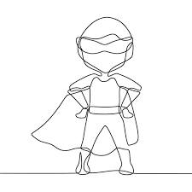
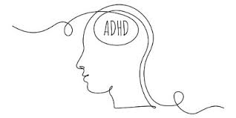
A.S.S.
The
NON Partner
The
WITH
Partner

Slide 14
Individuals with ADHD have a harder time starting and maintaining interpersonal relationships. (Adler, 2008)
Time Management
Relationship Roles
Communication
Impulsive Actions/Words
Distractibility
Emotional Dysregulation

Slide 15
What Can Be Done?
The With Partner
The Non Partner
The Couple

Slide 16
Before Knowing
vs.
After Knowing

Slide 17
What Can Be Done
For the WITH partner
Come to terms with the diagnosis
Education
Manage co-morbidity (anxiety/depression)
Limit substances
Consider medications
Good self care
Adjunct services

Slide 18
What Can Be Done?
For the Non partner
Education
Come to terms with the diagnosis
Relearn communication
Good self care
Establish boundaries
Empathy

Slide 19
What Can Be Done?
For the Couple
Couples therapy with an expert
Communication
Conflict resolution

Slide 20
Things to Consider

Slide 21
Motivators
The With Partner
Novelty
Interest
Challenge
Urgency
Passion
The Non Partner
Importance
Reward/Consequences

Slide 22
SHAME FACTOR
“By [the age of] 12, children with ADHD receive twenty thousand more negative comments than their peers who do not have ADHD.”
William Dodson, M.D.

Slide 23
Q&A
Susan Tschudi, LMFT
Lovingsomeonewithadd.com
therapybysusan@gmail.com

