Slide 1
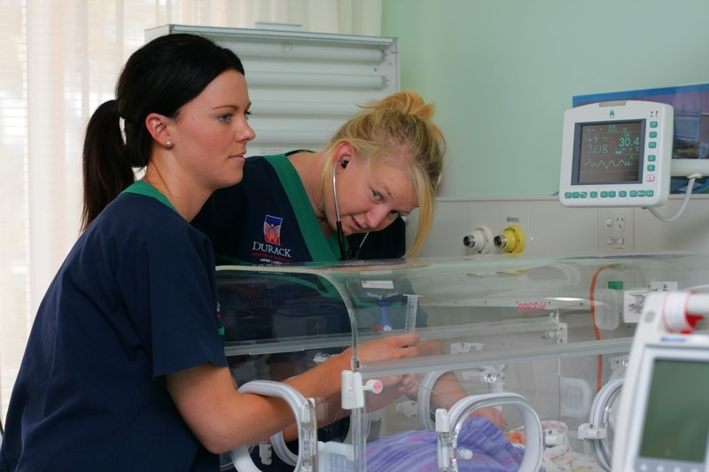
Fostering the retention of a skilled paediatric clinical workforce through undergraduate and postgraduate nurse education
Presenters: - Dr Geraldine Rebeiro
Ms Mandy El Ali

Slide 2
Aim
Supporting the recruitment and retention of a qualified paediatric nursing workforce through undergraduate and post graduate education opportunities.

Slide 3
Background
ANMAC does not specifically require a standalone subject on caring for the paediatric patient (Gamble, 2017).
BN more generalist offering sporadic exposure to paediatric nursing clinical experience.
The commonwealth supports a generalist RN degree (Mould, 2012).
“Paediatric patients are not ‘small adults’. They suffer from unique diseases, disabilities and mental health issues; have different physiological, emotional, psychological and social needs; and react to illness and injury in unpredictable ways” (Ryan & Green 2021 p14).
Risk of a paediatric workforce that may be challenged by children’s diverse physical, psychological and social presentation.
Notes:
Since the pandemic, the nursing workforce has faced significant recruitment and retention challenges particularly in specialist settings (Mannix, 2021). ANMAC does not specifically require a standalone subject on caring for the paediatric patient, hence nursing students may not necessarily receive adequate theoretical and practical preparation even if they are offered a paediatric experience (Gamble, 2017). Uptake of post graduate studies in paediatric nursing is dependent on attitudes of registered nurses towards postgraduate education for specialty practice (Ng et al., 2016). As the Bachelor of nursing degree becomes more generalist offering sporadic exposure to paediatric nursing clinical experience, there’s a risk of a paediatric workforce that may be challenged by children’s diverse physical, psychological and social presentation.
Despite advocacy for children to be cared for by paediatric specialist nurses, the commonwealth supports a generalist RN degree (Mould, 2012). There is no longer a focussed paediatric subject offering in many contemporary nursing curriculums.

Slide 4
Current BN Curriculums
A scoping review of BN curriculums nationally was undertaken
Of the 30 university Nursing Programs 14 offered a derivative of a paediatric subject whether through a core or elective capacity.

Slide 5
Promoting a career in paediatric nursing involves:
Advocating at local university level for inclusion of paediatrics in BN curriculum.
Promote paediatric nursing at PG level aiming for Master's Degree
Supporting development of a paediatric nursing qualification in undergraduate and postgraduate nurse education through partnerships between industry and tertiary education providers.
Exploring alternative ways for students to interact with children
This Photo by Unknown Author is licensed under CC BY
Notes:
1 Despite advocacy for children to be cared for by paediatric specialist nurses, the commonwealth supports a generalist RN degree (Mould, 2012). There is no longer a focussed paediatric subject offering in many contemporary nursing curriculums. Since generalist nurses have the required registration to work across a diverse clinical space, no post graduate education is required to work with children, however the challenges of working in paediatric and family health settings don’t become apparent until graduate nurses begin employment (El Ali, 2006).
2 Since generalist nurses have the required registration to work across a diverse clinical space, no post graduate education is required to work with children, however the challenges of working in paediatric and family health settings don’t become apparent until graduate nurses begin employment (El Ali, 2006).
3Recruitment and retention of a qualified and prepared paediatric nursing workforce can be supported by undergraduate and postgraduate nurse education through the partnership between industry and tertiary education providers.

Slide 6
Traditional industry partnerships to support Paediatric nursing exposure
Recruitment and retention of a qualified and prepared paediatric nursing workforce begins in an UG BN program
Education institutions have a precedent for providing undergraduate nursing students with high-quality learning experiences, but these opportunities can often be scarce, particularly when they must meet unique learning outcomes such as those focused on paediatric populations (Ryan & Green 2021).
Notes:
Recruitment and retention of a qualified and prepared paediatric nursing workforce can be supported by undergraduate and postgraduate nurse education through the partnership between industry and tertiary education providers.
Working with healthy children, children with stable chronic health conditions or those with a disability can provide unique insights into paediatric nursing that extends beyond acute care. Non-traditional placement
models such as service-learning placements and interprofessional learning in these community settings are successful in nursing and other health disciplines such as physiotherapy and occupational therapy
Therefore, partnerships with industry organisations can assist education institutions in creating targeted learning experiences
for students that meet the needs of the
student and education provider

Slide 7
Alternative partnerships to support Paediatric nursing exposure
Use of alternative placement experiences
Partnerships between industry and universities provide opportunities
Partnerships with industry organisations can assist education institutions
This Photo by Unknown Author is licensed under CC BY-ND
Notes:
Expand on this from the VU experience
Use of alternative placement experiences such as with primary and secondary schools nurses, early childhood education centres, holiday camps/disability or health condition specific camps (Ryan & Green 2021) and maternal and child health nurses
Partnerships between industry and universities provide opportunities to achieve these learning experiences and promote the benefits of undergraduate professional practice experiences derived from working with paediatric populations (Ryan & Green 2021).
Partnerships with industry organisations can assist education institutions in creating targeted learning experiences for students that meet the needs of the student and education provider.
Immersive simulation is a recognized means by which clinical learning goals can be achieved without the risk of patient harm (Gamble 2017)
Working with healthy children, children with stable chronic health conditions or those with a disability can provide unique insights into paediatric nursing that extends beyond acute care.
Placement models such as service-learning placements and interprofessional learning in these community settings are successful in nursing and other health disciplines such as physiotherapy and occupational therapy
Alternate placement experiences working in the community promote interprofessional collaboration, autonomy, age-appropriate communication with children, clinical assessment and triage skills, community engagement, health promotion, cultural competence, and professional capacity building in an authentic context.
Alternate placement experiences can also be tailored to meet learning objectives focused on several elements of
Standard 2 in the registered nurse standards for practice – ‘Engages in therapeutic and professional relationships’.
Davies et al. (2012) acknowledge that simulating a typical shift can enable learners to manage a complex set of clinical issues arising from caring for children and their families. In their study, 3rd year undergraduate children's nursing students undertook a complex clinical shift incorporating activities directly related to both the curriculum and common issues they may encounter dur- ing their ﬁnal clinical placement. The simulation focussed on giving learners the opportunity to participate in clinical care delivery, decision-making, ward management, leadership and working as part of a team. Overwhelmingly, their results showed that this was a positive experience, with learners demonstrating improvements in the application of their clinical skills. USE THIS AS BASIS TO EXPAND UPON WHAT WE NOW DO FOR 376 IE PAEDIATRIC WARD

Slide 8
Industry partnerships, professional development and PG pathways to support Paediatric nursing exposure
In any health care discipline education or professional development is important in updating skills and keeping with trends in health care.
Post graduate courses with Master’s degree pathway as a target delivers a valuable knowledgeable staff basis for practice.
Continuing education by means of ward PD sessions specific to the care of children would also move this specialty in a positive direction.
Nursing children is a rewarding profession. In expressing learning and possibilities and recognition of abilities and growing confidence, the encounter of graduate nurses when nursing children concludes positively.
Notes:
In any health care discipline education or professional development is important in updating skills and keeping with trends in health care. As such educational preparation prior to practice would provide an advantage, especially in the specialty area of paediatric nursing. An important area at present is the recognition by endorsement of those who have the qualifications as experienced paediatric nurses, in Australia. Endorsement by title of paediatric or sick children’s nurse as well as monetary recognition might increase the incentive towards professional development. It would be very positive to prepare nurses at an undergraduate level for nursing children,
Despite the stressors and pressures placed upon nursing staff, the involvement of nurses in helping families through sickness and recovery of a child or supporting the families through the loss of children is in it self-gratifying.

Slide 9
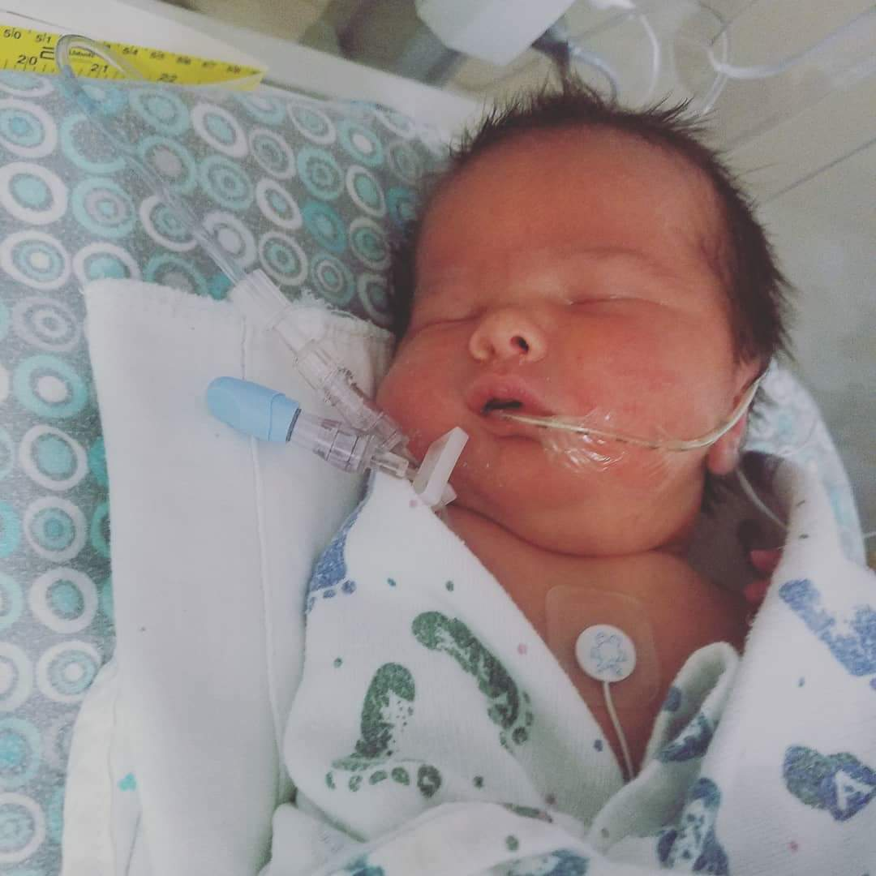
Paediatric nurses hold specialist skills to be able to care for our most vulnerable population and this is supported in the literature (Buckley et al., 2021)
Australian Universities are accredited to deliver a generalist nursing qualification not equipping the registered nurse for this specialty area (ANMAC, .
The Australian position coupled with the current nursing shortage may contribute to an increase in unqualified staff in this specialty area posing a potential safety risk to this population.
Implications of ignoring the need for a specialty paediatric nursing work force
Notes:
These concerns are felt in a broad sense in the area of paediatric nursing as reported in the literature. relating to the quality of care these children will receive. these clinical situations are dangerous as nurses coming from adult care are lack the experience in family centred care.
“Pediatric nurses are a separate population from nurses who care for adults because of the specialized nature of providing care to children. Children are typically seen as a vulnerable population, and along with this, there is a high potential for empathetic engagement and inherent complexities in the relationships with families.” (Buckley et al., 2021).
Risk
a possible situation on wards where the staffing skills mix could be made up of a few experienced staff members from adult wards, new graduate nurses, and nurses that have just finished their graduate year. It is possible that the skills mix in this situation might cause more stressors, not only affecting the recruitment and retention of staff but also the safety of the children in their care.” Page 79
. Buckley, L., Berta, W., Cleverley, K., & Widger, K. (2021). The Relationships Amongst Pediatric Nurses' Work Environments, Work Attitudes, and Experiences of Burnout. Frontiers in pediatrics, 9, 807245. https://doi.org/10.3389/fped.2021.807245

Slide 10
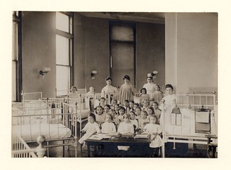
Conclusion
Recruitment and retention of a qualified and prepared paediatric nursing workforce can be supported by undergraduate and postgraduate nurse education through the partnership between industry and tertiary education providers at both the UG and PG level.

Slide 11
References
Buckley, L., Berta, W., Cleverley, K., & Widger, K. (2021). The Relationships Amongst Pediatric Nurses' Work Environments, Work Attitudes, and Experiences of Burnout. Frontiers in pediatrics, 9, 807245. https://doi.org/10.3389/fped.2021.807245
Doleman, G., Twigg, D., Bayes, S., & Chivers, P. (2021). Paediatric nurses’ satisfaction with organisational communication, job satisfaction, and intention to stay: A structural equation modelling analysis. Collegian, 28(4), 376-384. https://doi.org/https://doi.org/10.1016/j.colegn.2020.11.005
El Ali, M. (2006). Nursing children : new graduates' encounters : a phenomenological approach Victoria University. Melbourne, Vic.
Gamble, A. S. (2017). Simulation in undergraduate paediatric nursing curriculum: Evaluation of a complex ‘ward for a day’ education program. Nurse education in practice, 23, 40-47. https://doi.org/https://doi.org/10.1016/j.nepr.2017.02.001
Mannix, K. (2021). The future of Australia’s nursing workforce: COVID-19 and burnout among nurses, . https://www.unimelb.edu.au/__data/assets/pdf_file/0004/4085194/katelyn_mannix_report.pdf
Mould, J. M. (2012). Paediatric nursing : an investigation of the effect of specialist paediatric nurse education on the quality of children’s nursing care in Western Australia Edith Cowen University. Australia. Retrieved from https://ro.ecu.edu.au/theses/508
Ng, L., Eley, R., & Tuckett, A. (2016). Exploring factors affecting registered nurses' pursuit of postgraduate education in Australia. Nursing & health sciences, 18(4), 435-441. https://doi.org/10.1111/nhs.12289

Slide 12
Ryan, E. & Green, E. (2021). How can we support future rural generalist nurses to learn about working with paediatrics? ANMJ, 27(5), pp.14-16.
Gamble, A. (2017). Simulation in undergraduate paediatric nursing curriculum: Evaluation of a complex ‘ward for a day’ education program. Nurse Education in Practice. 23, pp.40-47.

