Slide 1
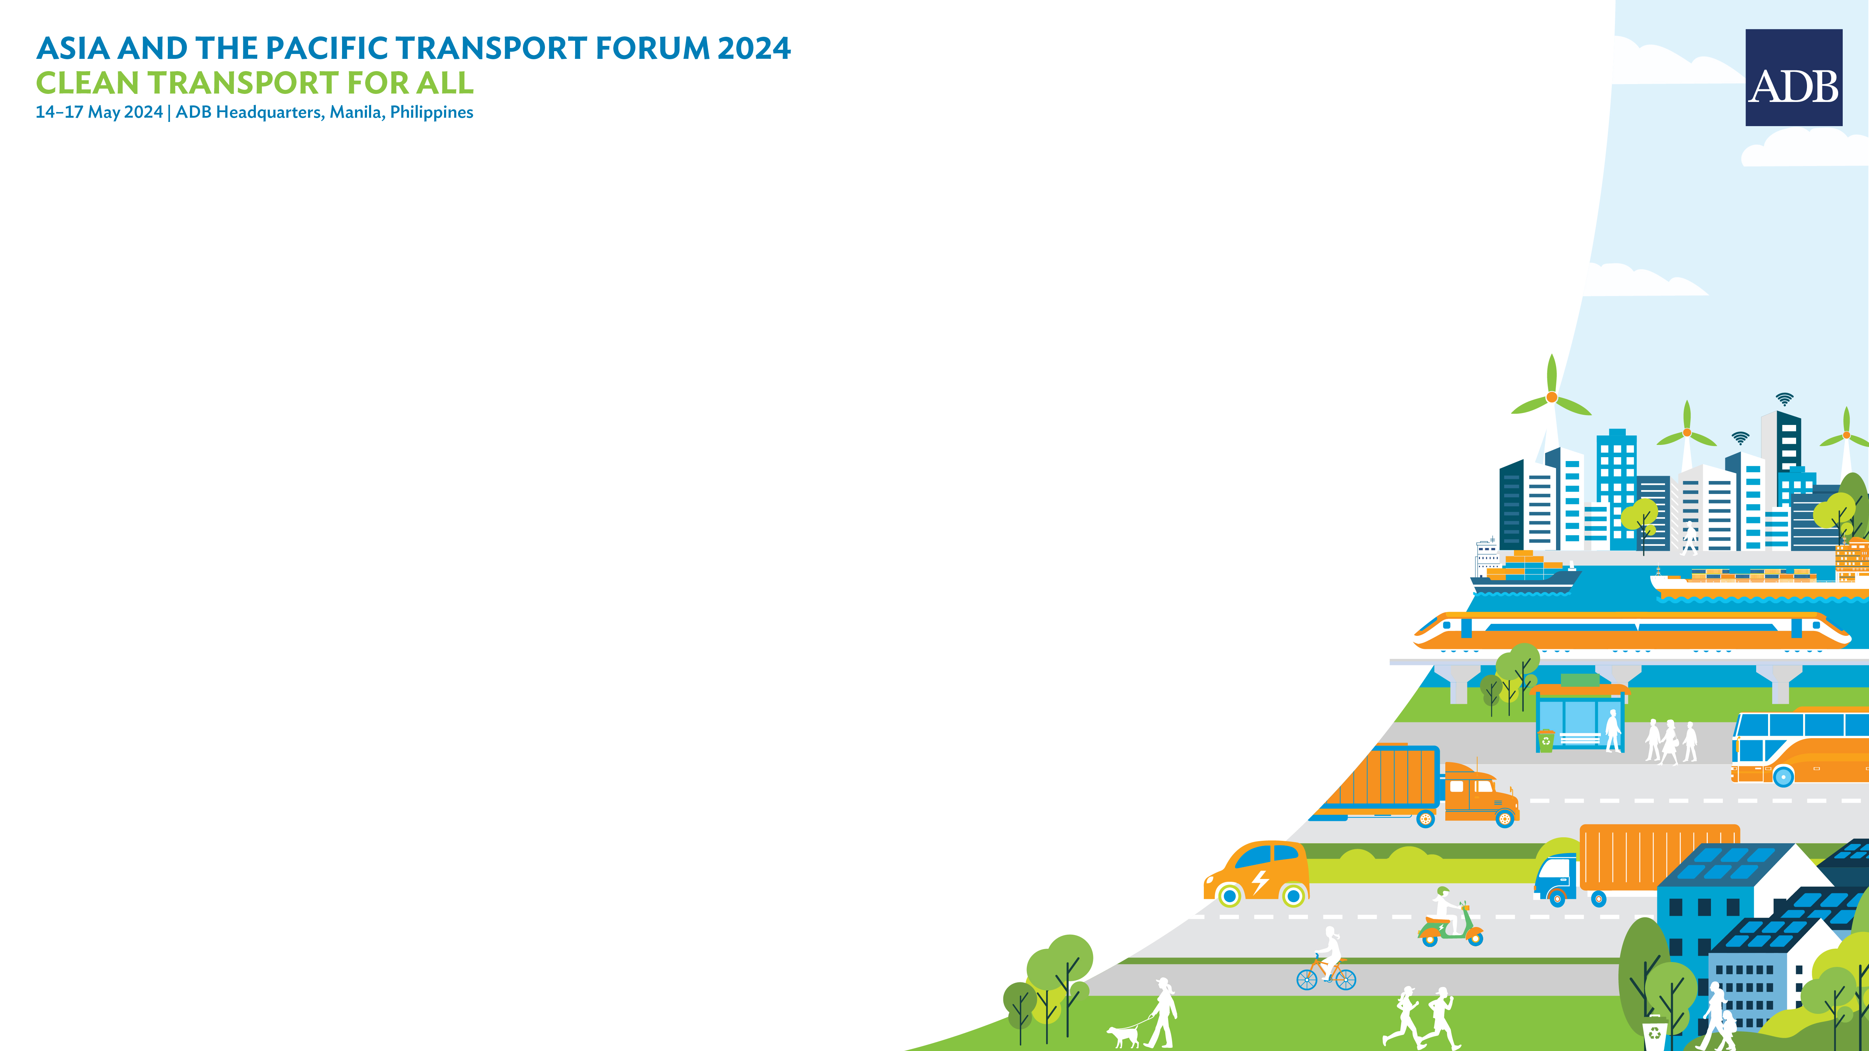
Asia and the Pacific Transport Forum 2024:
Strategic Directions for ADBs future Transport Sector assistance

Slide 2
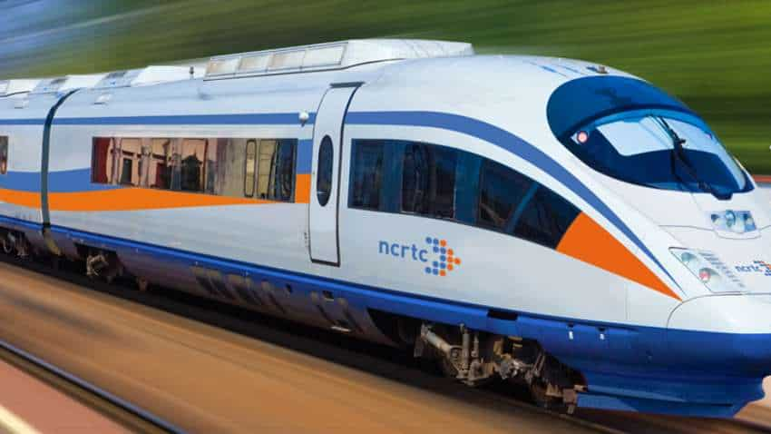
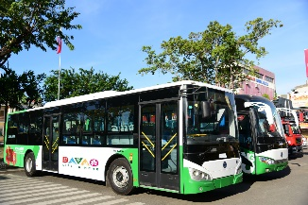
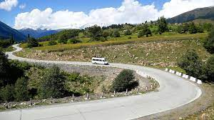
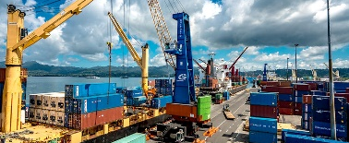
Vision
To mobilize efficient, clean and resilient
integrated multimodal transport and logistics systems

Slide 3
Key Trends and Challenges
$560 billion* annual transport infrastructure investment (climate adjusted) needs
Increasing concentration of GHG emissions, and climate/disaster impacts
Aging transport infrastructure
Fastest growing urbanization in the world,
High traffic congestion,
60% of global road crash fatalities
Major supplier of global markets – with 45% of global export flows produced in the region by 2050
*Asian Development Bank (2017). Meeting Asia’s Infrastructure Needs, Manila.

Slide 4
Climate Change Shift
Transport climate finance of $5 billion in 2020 more than doubled to $10.9 billion by 2023 and projected to reach $25 billion by 2030, supported by significant subsector assistance shift
Transport Sector in 2010
Transport Sector in 2023

Slide 5
Key Focus Areas
• Rail, road, and maritime connectivity and logistics
• Smart mobility including urban transport and mobility services
• Cross-cutting emerging areas including asset management,
safety, resilience, and e-mobility

Slide 6
Future Opportunities
Consolidated Approach to Technical Assistance for Transport Vision
Physically and digitally integrate networks/modes as part of a managed transport ecosystem, including logistic chain for the efficient movement of people and goods
Complex multisectoral: extend multisectoral project/programs to encompass urban, agriculture/food chain, finance, IT and public sector for access from farm/factories to local/collection centers and processing facilities and markets, for access to opportunities and services
Climate financing towards ADB’s $100-billion pledge through planned and new investments with solid pathways for climate change customized for country’s context, including climate resilience/adaptation of transport infrastructure and assets
Climate shifts: transformative pathways to include shifts to low carbon (greening railways, mass transit) and decarbonized systems, explore hydrogen and sustainable aviation fuel, system electrification, e-mobility, optimizing fleet utilization of shipping, and innovative arrangements in the industry
Private sector financing, bringing in financing and technologies for complex solutions, operation and maintenance, logistics center, transit-oriented development through viability gap financing, hybrid annuity approaches

Slide 7
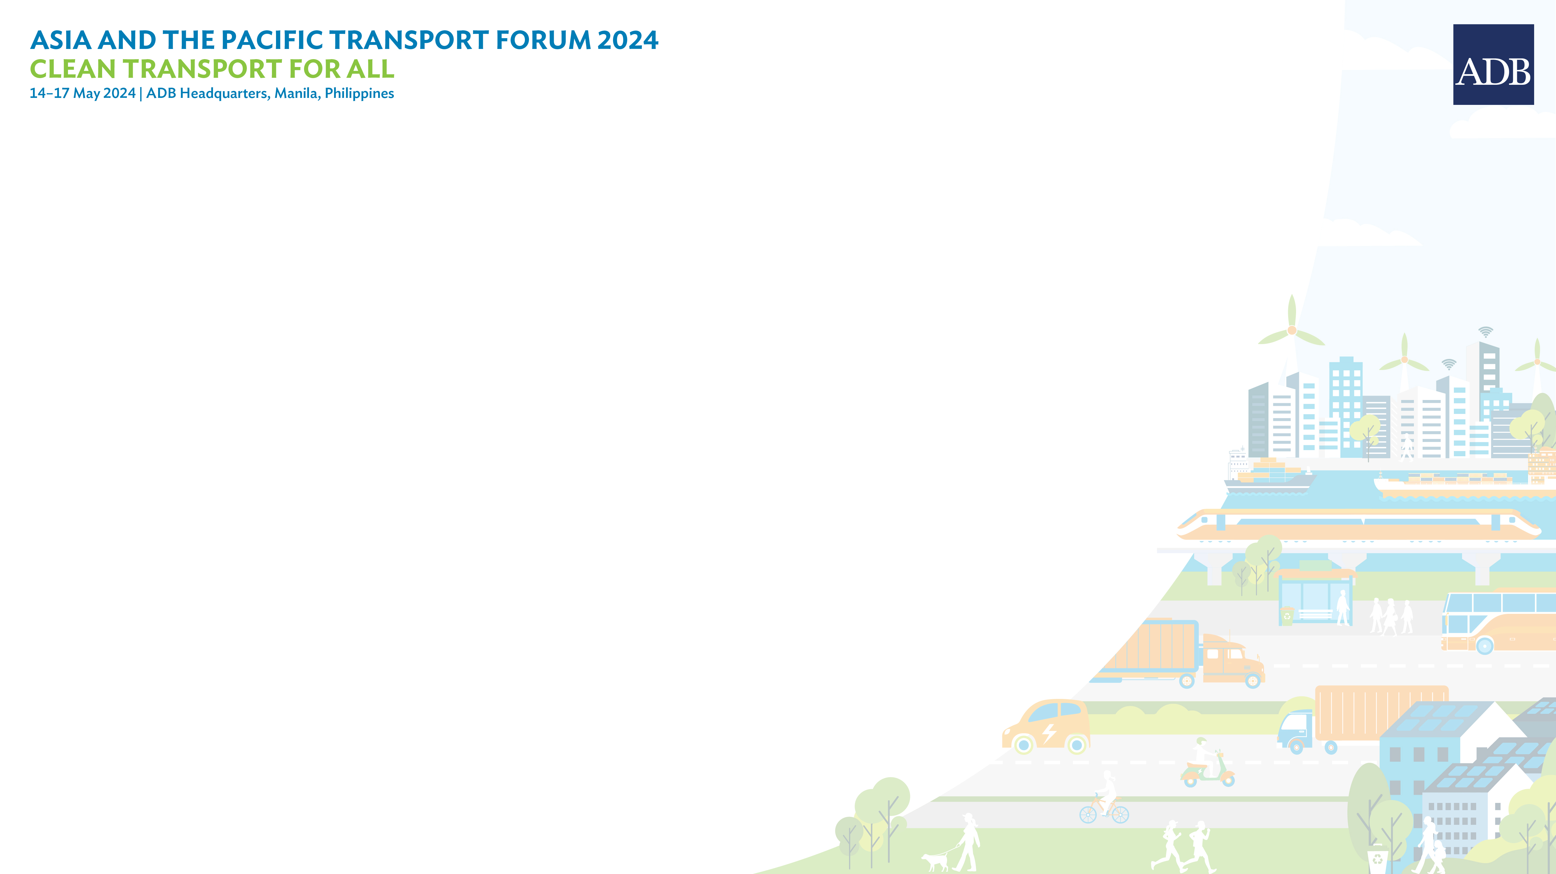
THANK YOU!
Jamie Leather, Director Transport ADB

