Slide 1
Data-2-Deal:
Low Carbon Pathways to Investment & Finance
Mark Howells
ClimateCompatibleGrowth.com [Loughborough University & Imperial College London]

Slide 2
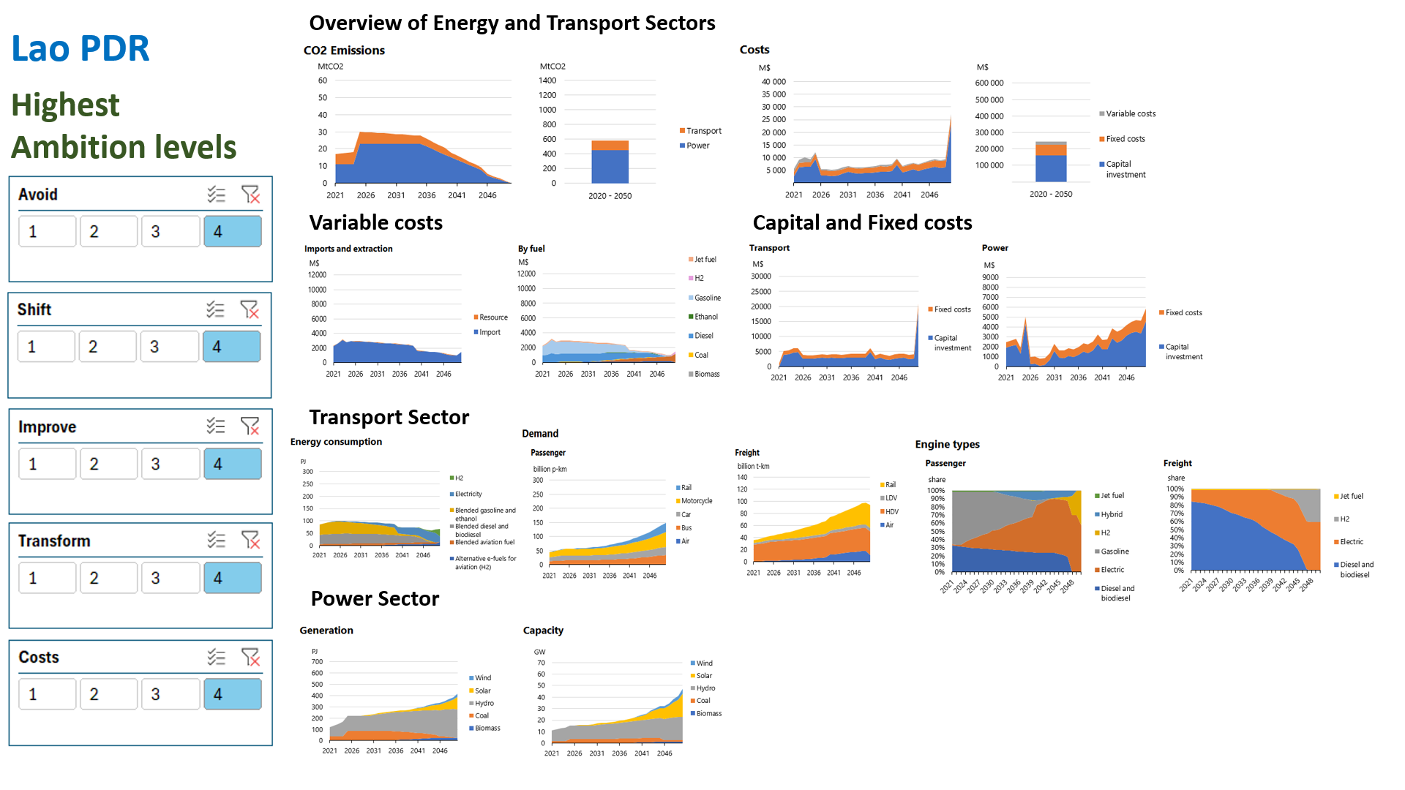
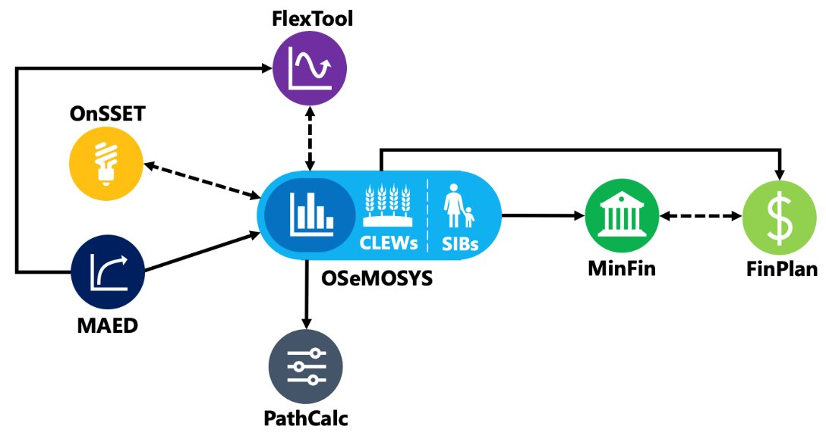

Slide 3
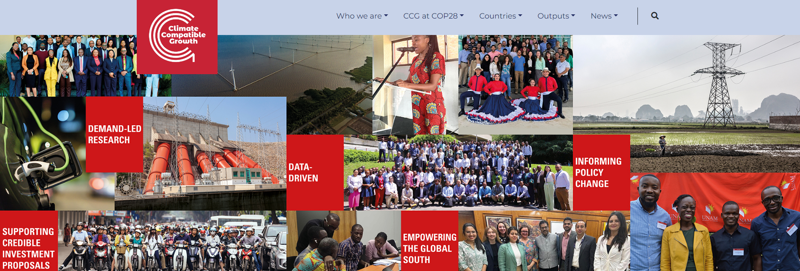
THANK YOU!
Mark Howells
ClimateCompatibleGrowth.com

