Slide 1
Governance of On-Demand Mobility Service in Asia and Pacific Region
Poornima Singh, Manager for Research @ UITP Asia-Pacific (Union Internationale des Transports Publics)

Slide 2
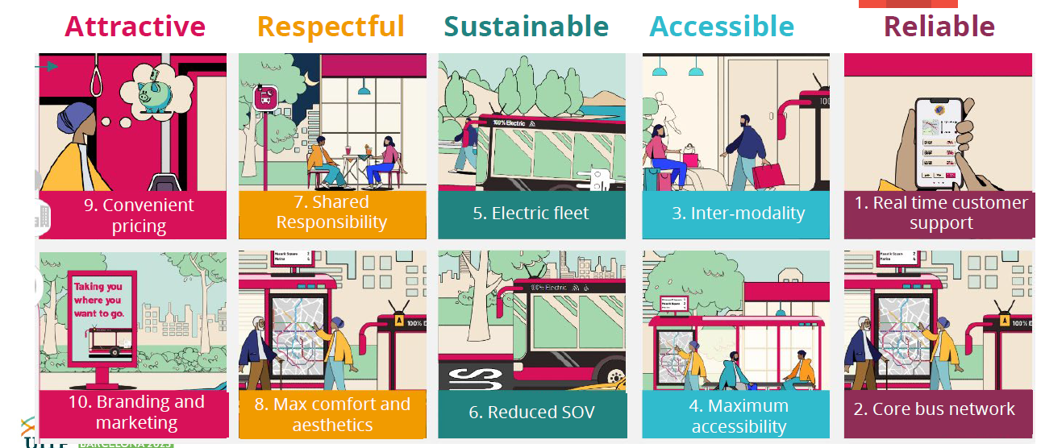
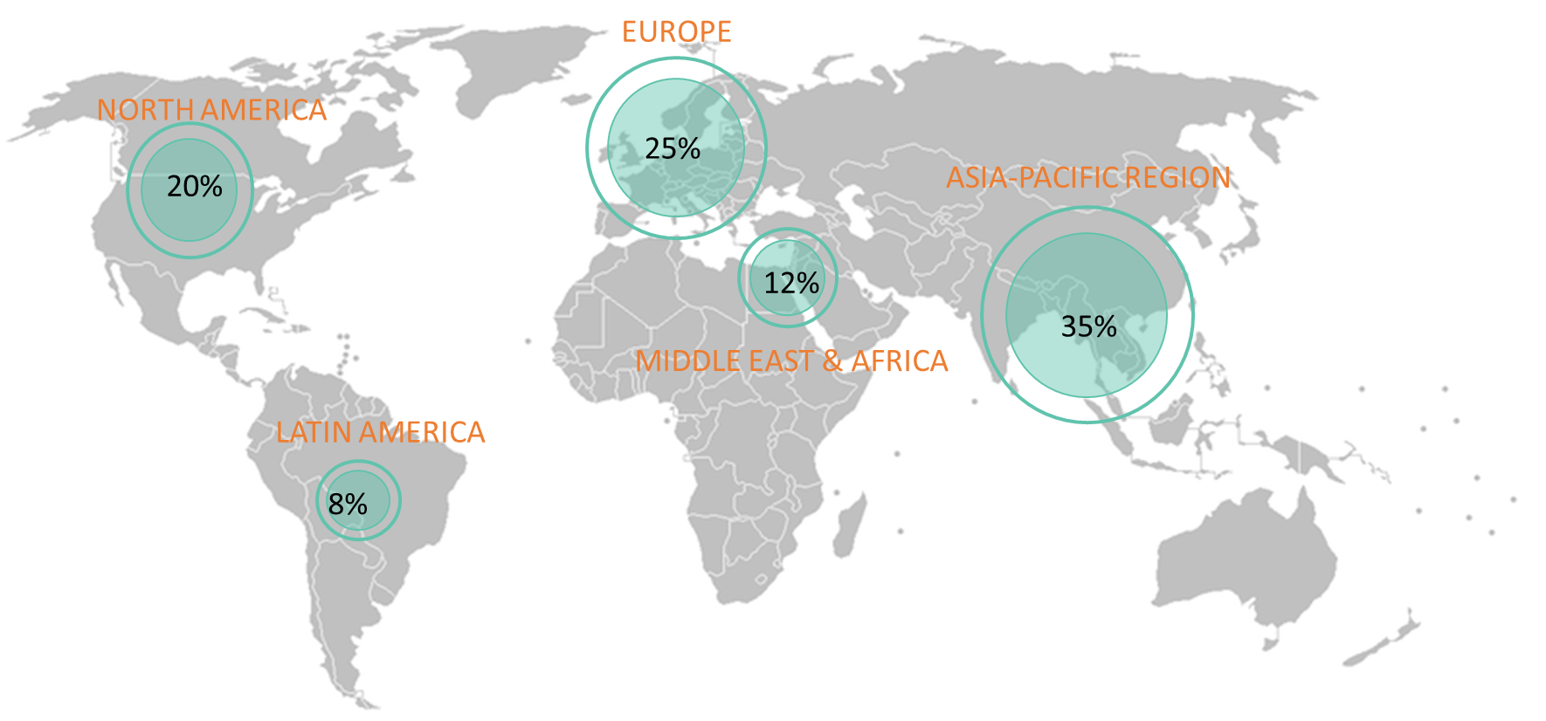
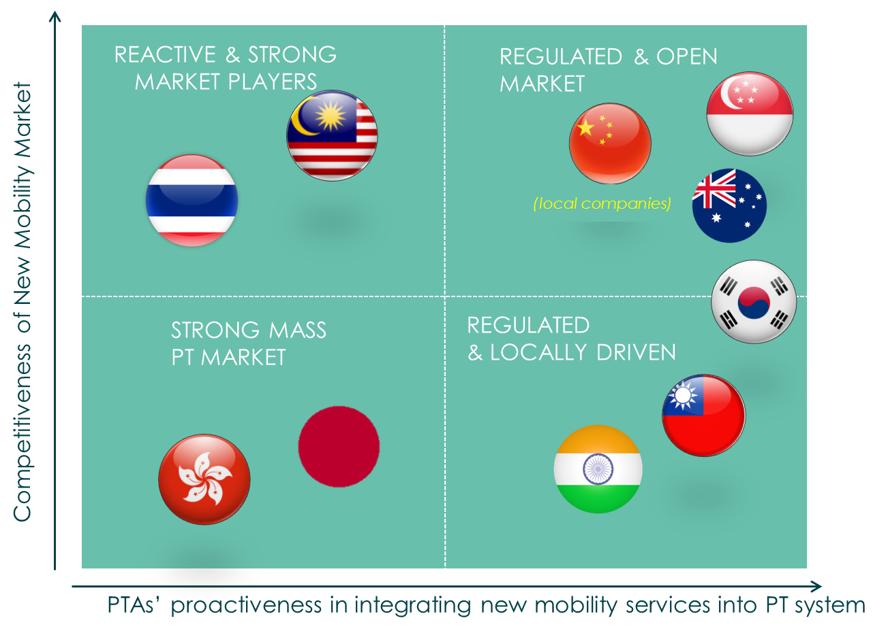
On-demand mobility Regulatory outlook in SELECTED Asia Pacific Countries
“The traditional model of public transport systems is being challenged as never before.”
Global On-demand Mobility Market Regional Synopsis by 2033
Source: UITP

Slide 3
THANK YOU!
Contact Poornima Singh at-
poornima.singh@uitp.org

