Slide 1
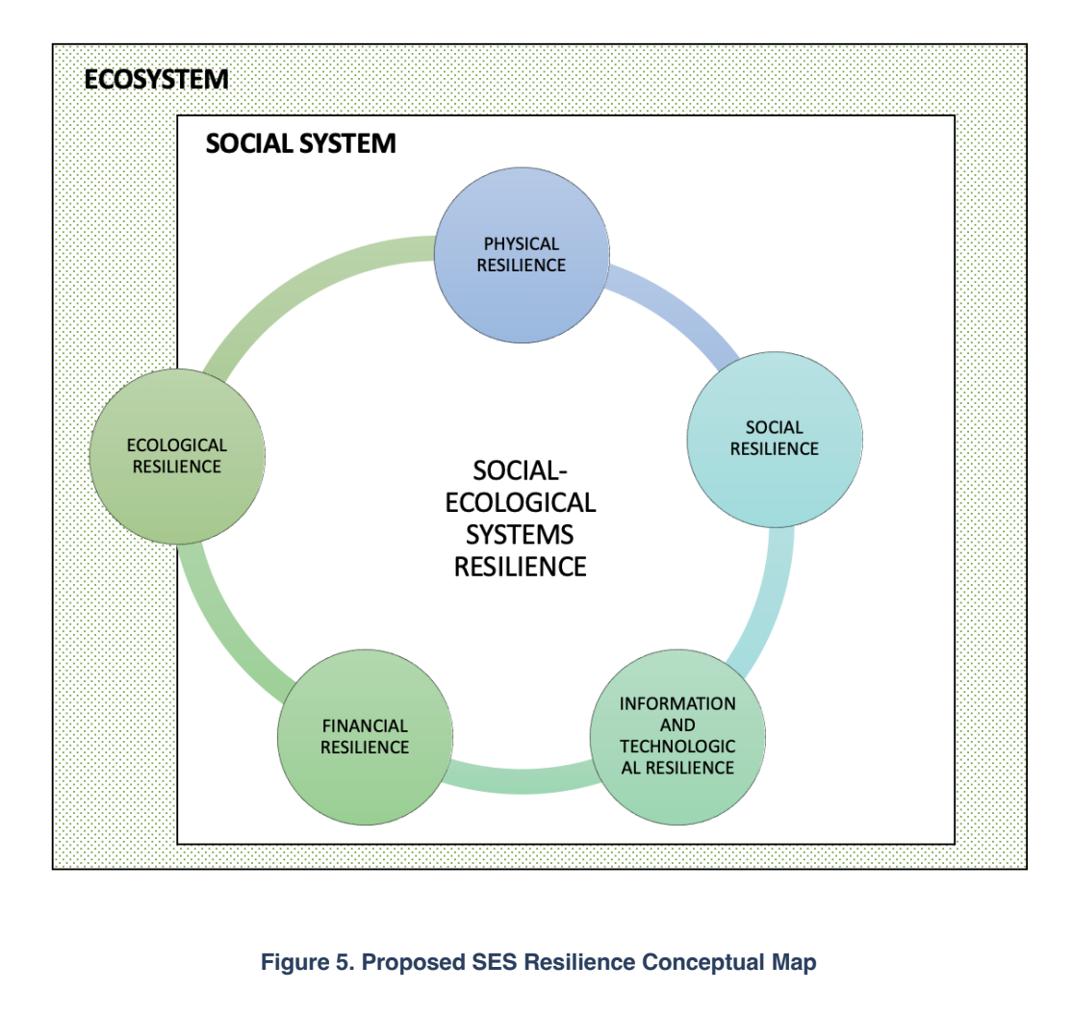


Integrated Risk Management Approach
Build Back Better
Updating of Building Codes
Retrofitting
Flood Management Program
Asset Management
Preventive Maintenance
Nature-based solutions
Ecological Protection
Replanting
Ecological Services (Mountain Ranges)
Social Protection Schemes
Administrative Resilience Disaster Preparedness Plans
Capacity Building and Training Programs
Disaster Risk Financing Strategy
Contingent Financing
Disaster Funds
Risk Transfer Mechanisms
Budget Planning and Allocation
NARS
GeoRiskPH
PAGASA monitoring
PHIVOLCS monitoring
(Chua, 2022)

Slide 2
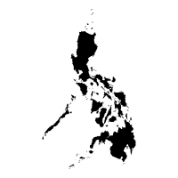


Disaster Risk Finance
Strategic Policy Goals
LOCAL
LEVEL
INDIVIDUAL LEVEL
NATIONAL LEVEL
To develop sustainable financing mechanisms for local government units, necessary to provide immediate liquidity at the onset of a disaster
To reduce the impact on the poorest and most vulnerable and prevent them from falling into a cycle of poverty, while also shielding the near-poor from slipping back into poverty
To maintain sound fiscal health at the national government level, necessary to support long term rehabilitation and reconstruction needs

Slide 3
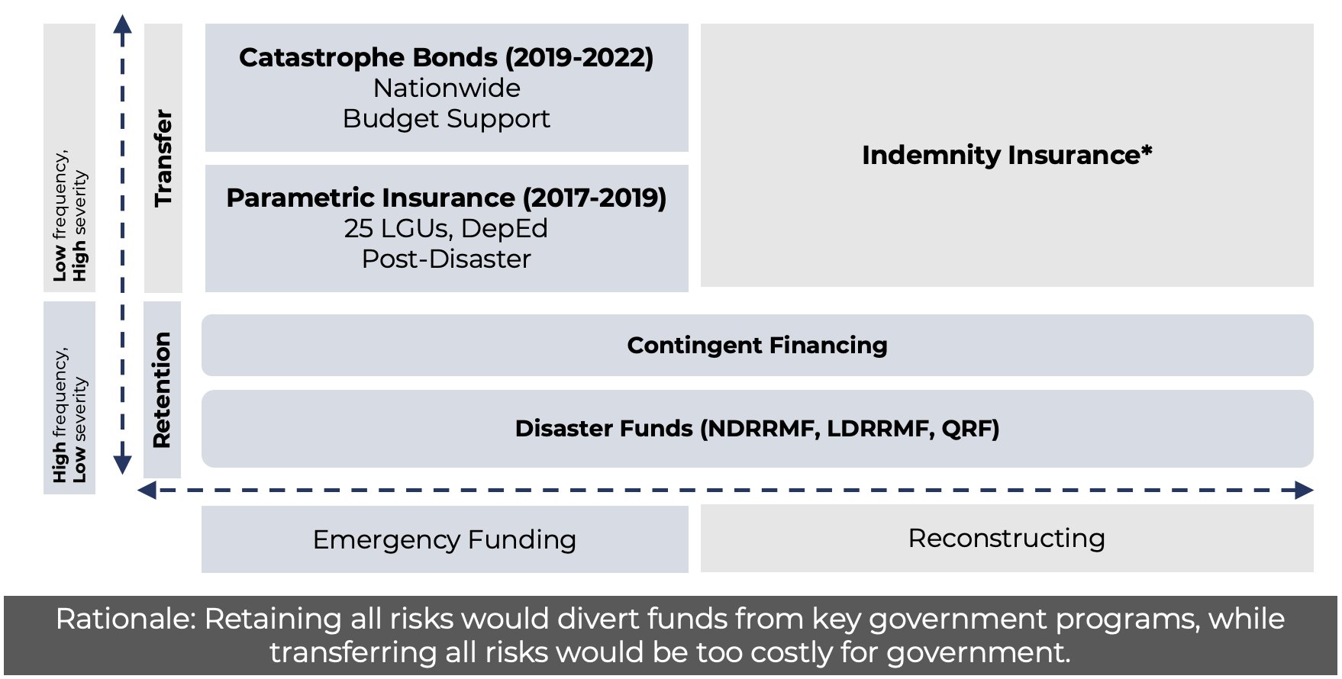
Disaster Risk Finance

Slide 4
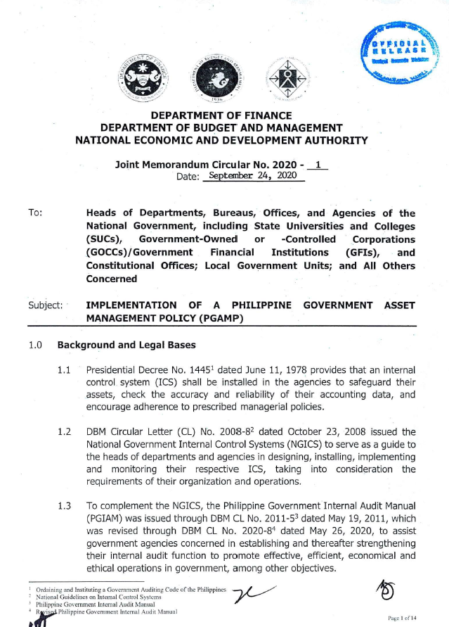
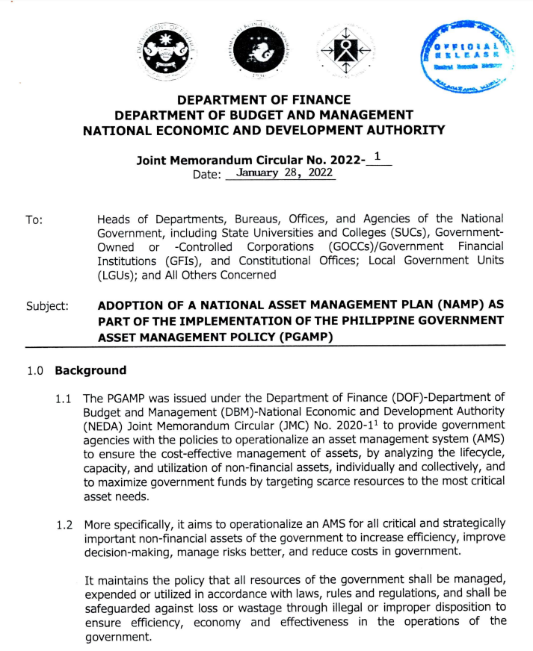
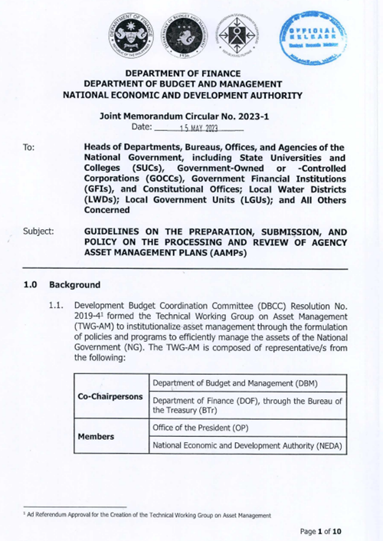

Philippine Government Asset Management Policy
Issuances
JMC 2020-1: Implementation of the Philippine Government Asset
Management Policy (PGAMP)
Section 8.8
JMC 2022-1: Adoption of a National Asset Management Plan as Part of the Implementation of the PGAMP
JMC 2023-1: Guidelines on the Preparation, Submission, and Policy on the Processing and Review of Agency Asset Management Plans (AAMPs)
“Agencies are required to submit their NARS dataset for the review of the BTr with regards to data quality and at the frequency as defined in the NARS Manual. “
Notes:
NARS is our consolidated database of critical and strategically important non-financial assets of the government. With the NARS, we hope to enable more efficient financial risk management, enhance service delivery, and improve risk reduction programs.
Our rationale for establishing the NARS was for government to know its non-financial assets, better manage these assets throughout its lifecycle, track the ownership of these assets, and eventually improve decision making, especially with regard to asset and risk management.
To achieve these, we require our partner agencies to submit the following information on their critical and strategically important assets. General information such as what type of asset it is. Location information, ideally geolocated, financial information, including book value, replacement value, assessed value, market value, or appraised value. Legal and ownership information. Insurance information. And, technical specifications such as what materials were used in its construction.

Slide 5
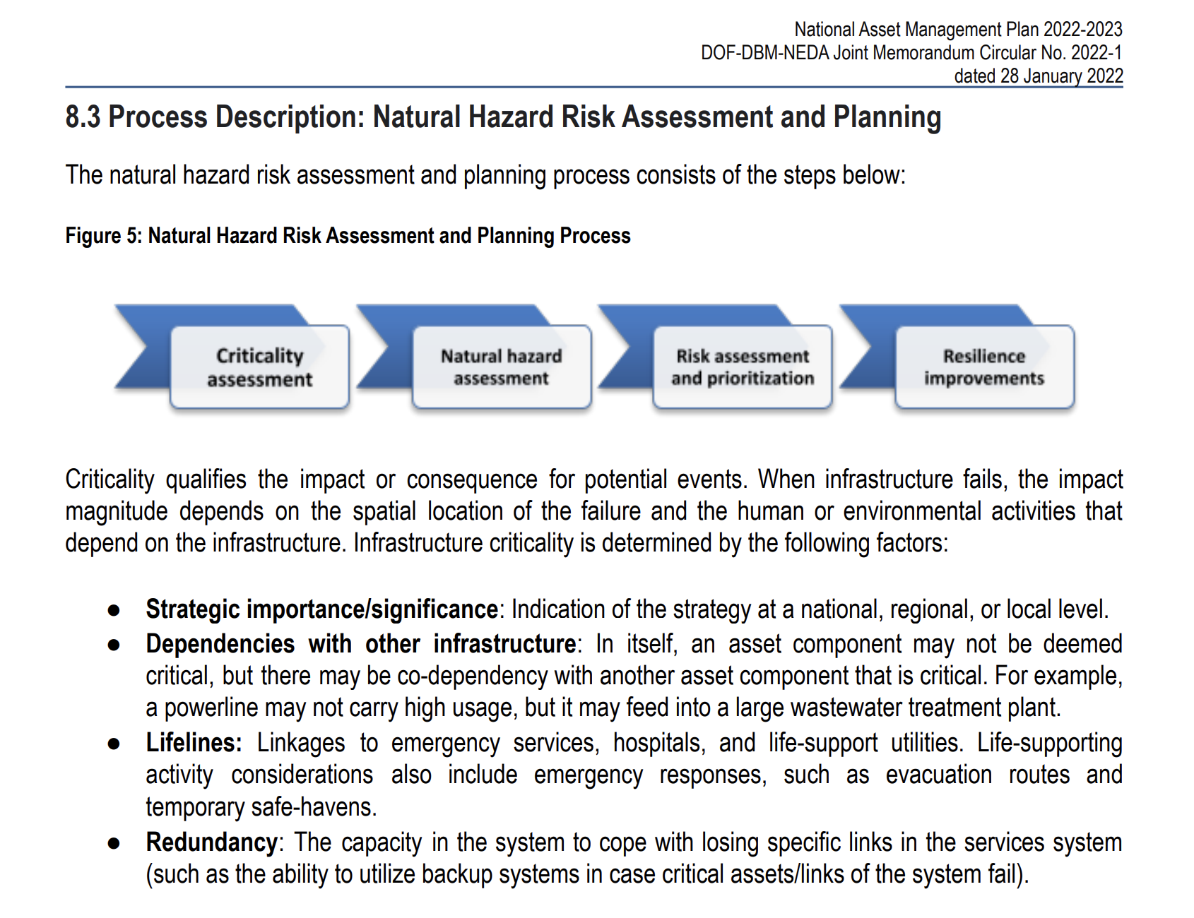
National Asset Management Plan

Slide 6
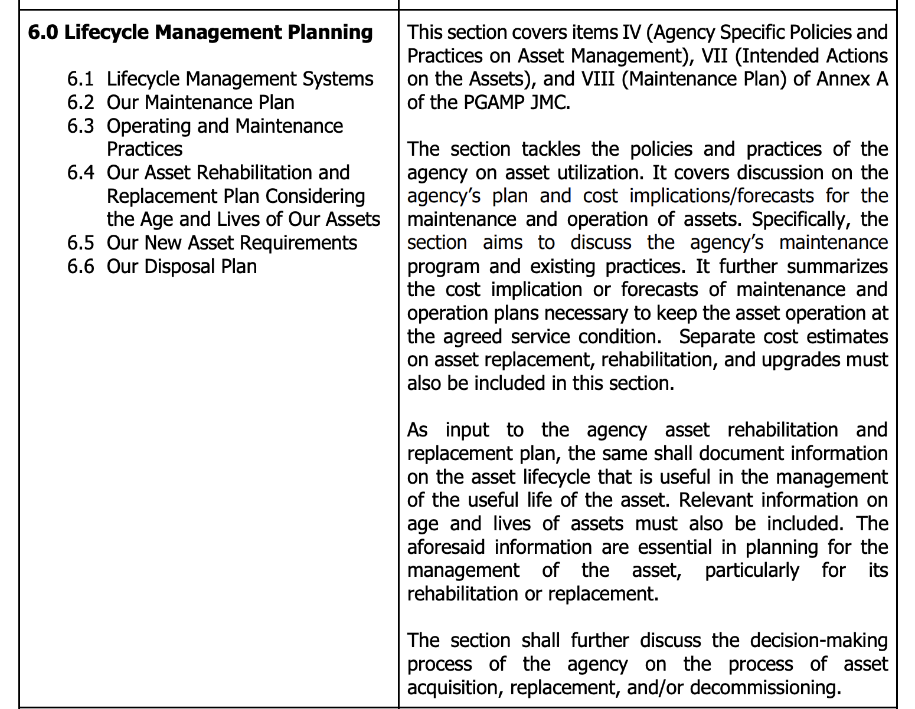
Agency Asset Management Plan

Slide 7
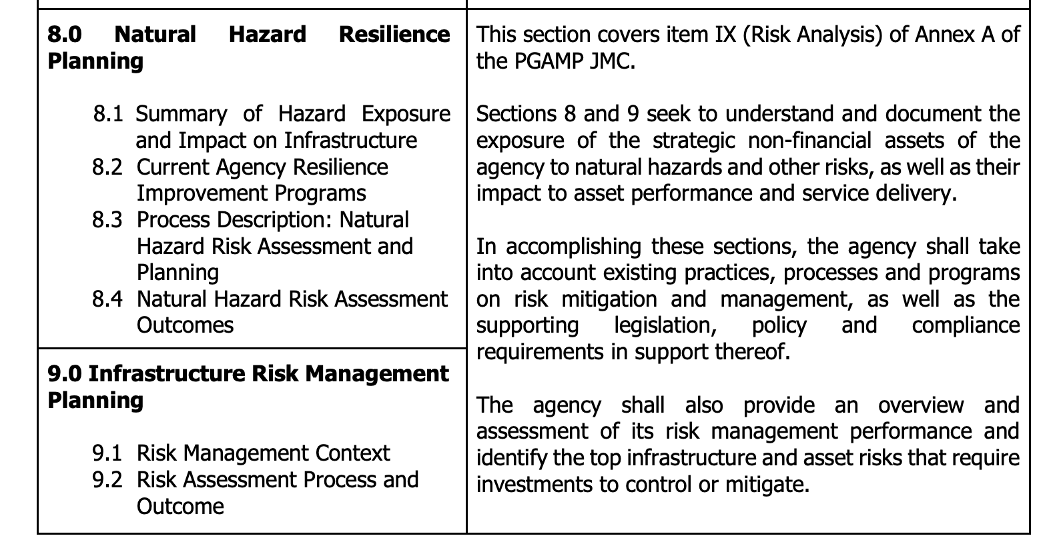
Agency Asset Management Plan

Slide 8





National Asset Registry System
What is the NARS?
Consolidated database of non-financial critical and strategically important government assets.
Goal is to enable more efficient financial risk management, enhance service delivery, and improve risk reduction for sustainable asset management in the long term.
Rationale
For government to KNOW their non-financial assets
For government to better MANAGE their assets throughout its lifecycle
For government to TRACK ownership of their assets
For government to IMPROVE DECISION MAKING especially with regard to disaster risk
Notes:
NARS is our consolidated database of critical and strategically important non-financial assets of the government. With the NARS, we hope to enable more efficient financial risk management, enhance service delivery, and improve risk reduction programs.
Our rationale for establishing the NARS was for government to know its non-financial assets, better manage these assets throughout its lifecycle, track the ownership of these assets, and eventually improve decision making, especially with regard to asset and risk management.
To achieve these, we require our partner agencies to submit the following information on their critical and strategically important assets. General information such as what type of asset it is. Location information, ideally geolocated, financial information, including book value, replacement value, assessed value, market value, or appraised value. Legal and ownership information. Insurance information. And, technical specifications such as what materials were used in its construction.

Slide 9
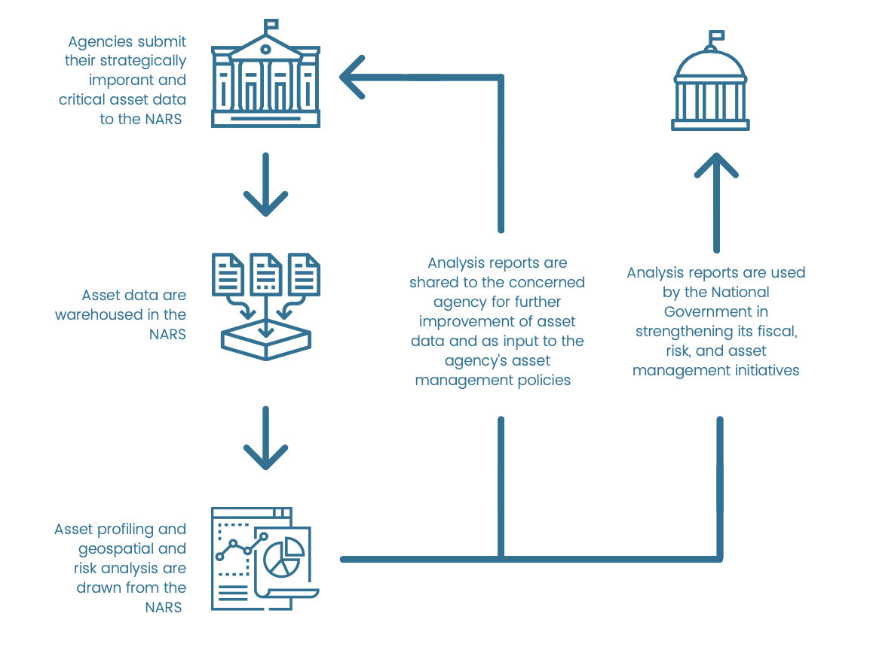
National Asset Registry System
Goals of the NARS
NARS Process
Comprehensive list and inventory of the National Government’s non-financial assets
Acquire and maintain an asset IT/Database system for the recording and updating of the status of the non-financial assets of the National Government
To serve as the central repository of the National Government asset information for fiscal and risk management.
Notes:
NARS is our consolidated database of critical and strategically important non-financial assets of the government. With the NARS, we hope to enable more efficient financial risk management, enhance service delivery, and improve risk reduction programs.
Our rationale for establishing the NARS was for government to know its non-financial assets, better manage these assets throughout its lifecycle, track the ownership of these assets, and eventually improve decision making, especially with regard to asset and risk management.
To achieve these, we require our partner agencies to submit the following information on their critical and strategically important assets. General information such as what type of asset it is. Location information, ideally geolocated, financial information, including book value, replacement value, assessed value, market value, or appraised value. Legal and ownership information. Insurance information. And, technical specifications such as what materials were used in its construction.

Slide 10
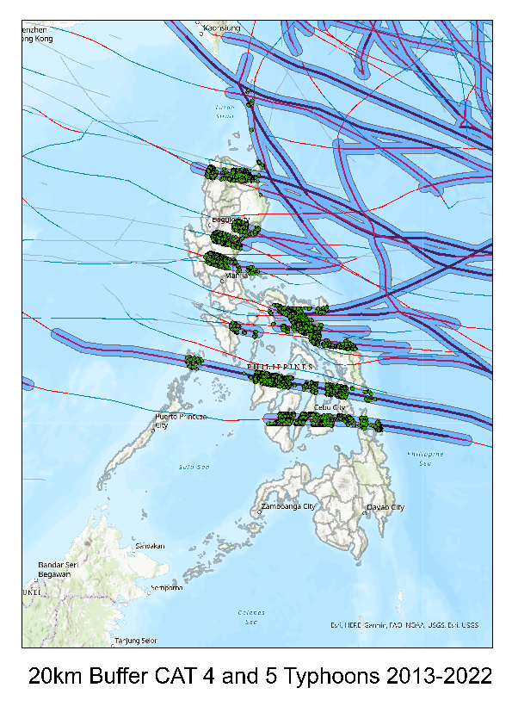
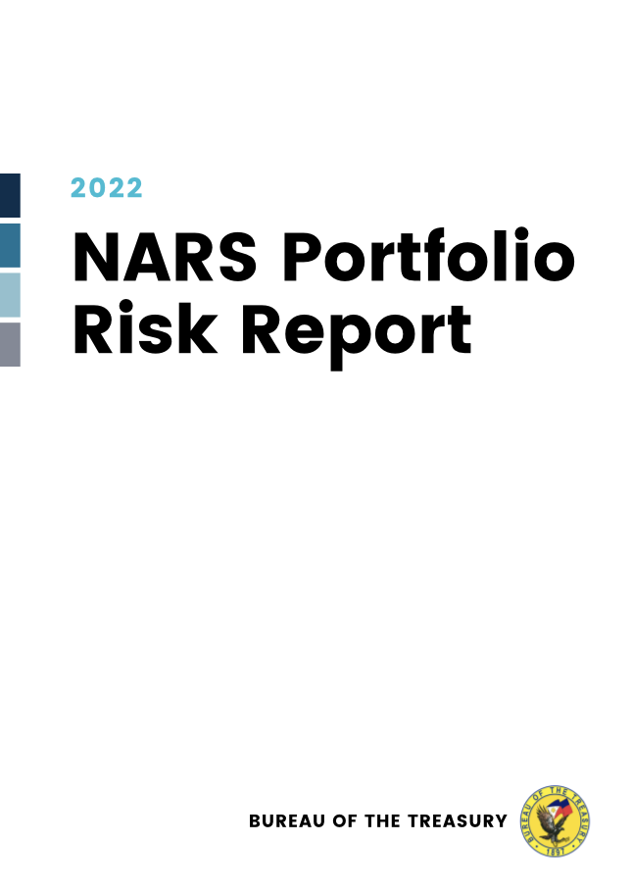
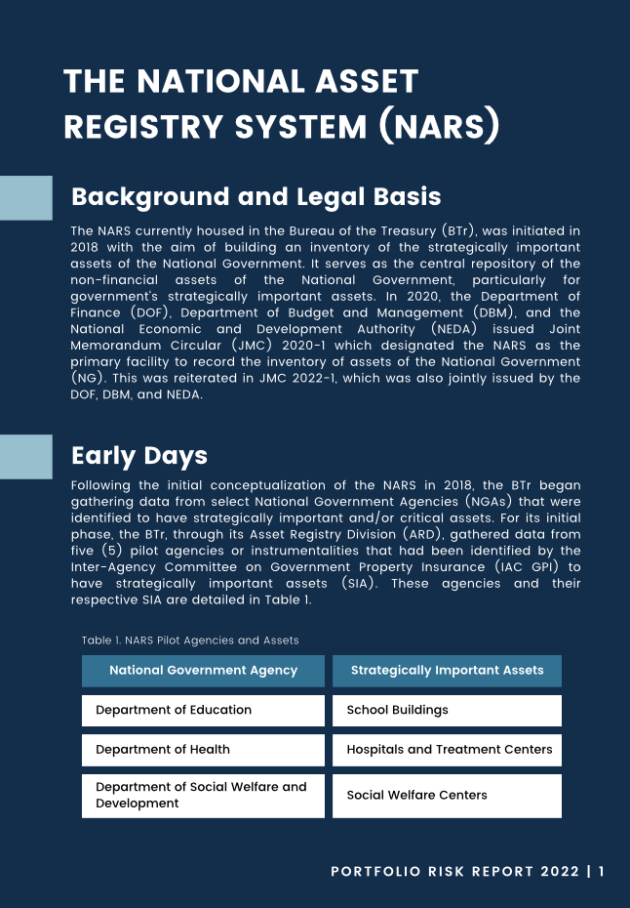
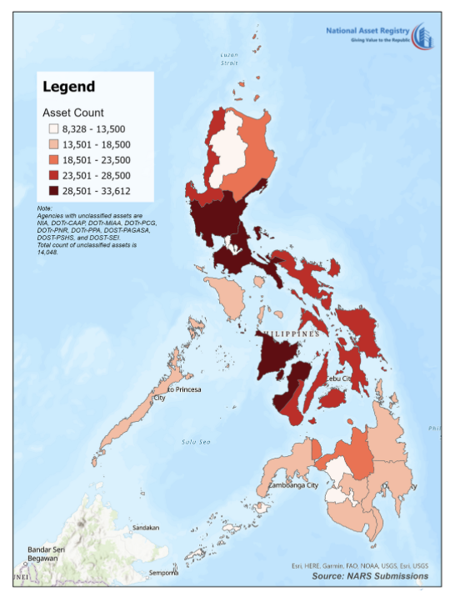
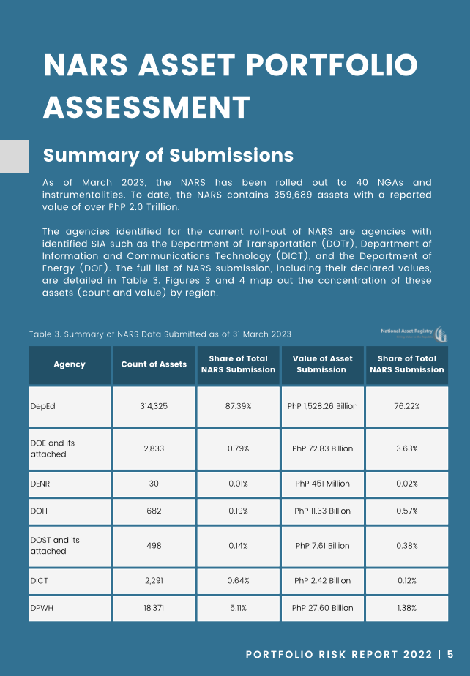
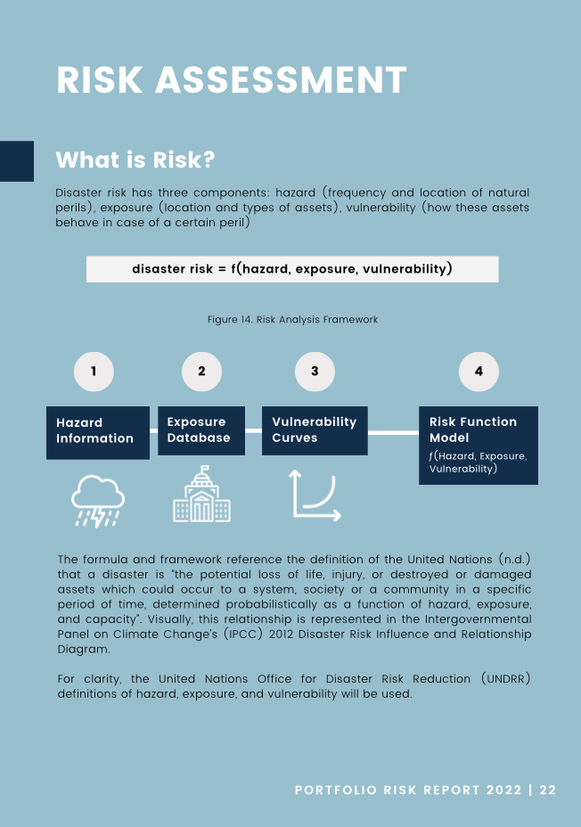
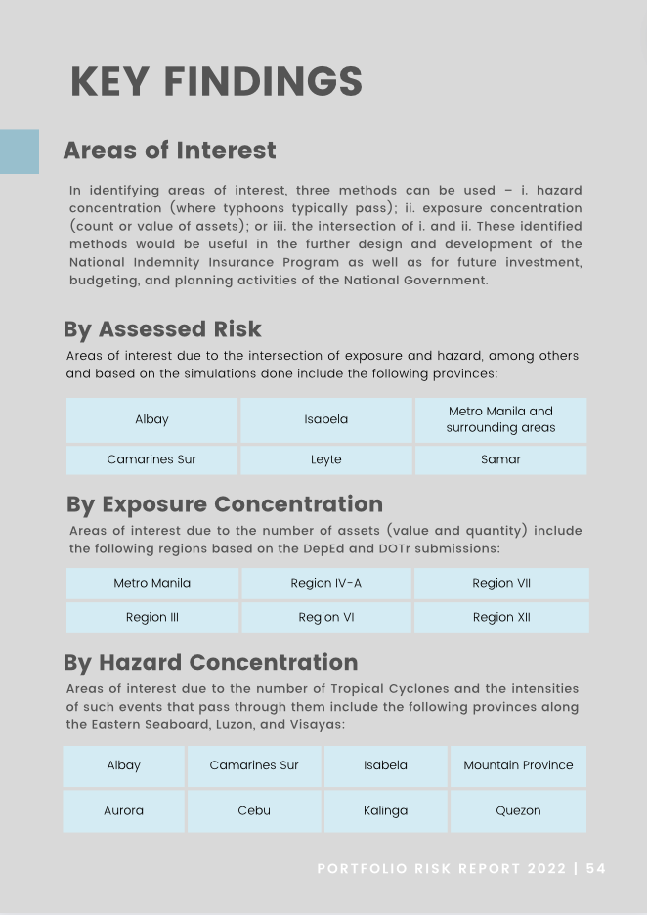
National Asset Registry System
Linkage with GIS
NARS Portfolio Risk Report
Visualize areas of risk concentration
Identify areas of hazard exposure by different time periods
Simulate events and assess potential losses
Conduct extreme case scenario modeling
Updates on the progress of NARS
Assessment of agency submissions
Risk analyses on available NARS asset data

