Slide 1
Association between a new healthcare access index and life expectancy in the Kanto region of Japan
1 / 17
21–24 August 2024, WONCA APR Conference 2024, Singapore
Akihisa Nakamura, Kazuhiko Kotani
Division of Community and Family Medicine,
Center for Community Medicine, Jichi Medical University, Japan
Notes:
First, let me thank you for your helpful introduction. We appreciate the opportunity to present this paper here.
The title of today’s presentation is ‘Validation of cold spots using the two-step floating catchment area method: Geographic information system-based ecological study in a Japanese prefecture’.

Slide 2
WONCA APR Conference 2024 COI Disclosure
2 / 17
Authors: Akihisa Nakamura, Kazuhiko Kotani
The authors have no conflicts of interest
to disclose regarding this presentation.

Slide 3
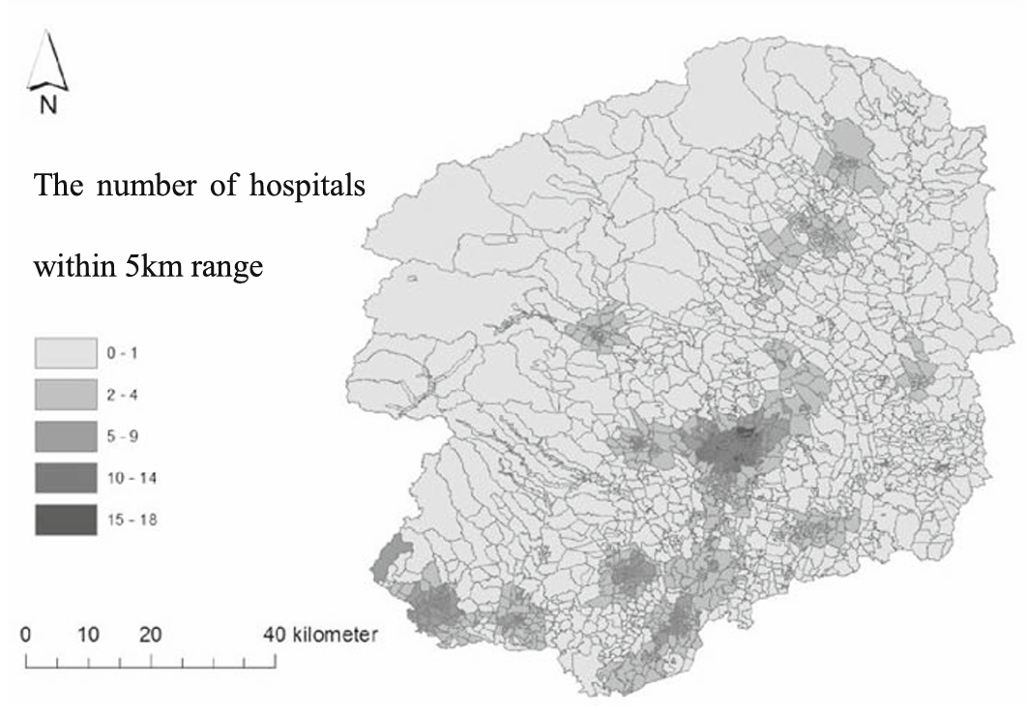
Introduction (1)
3 / 17
・Accessibility to medical institutions is crucial for primary care.
・Previous studies estimate that accessibility to medical institutions might affect life expectancy.
Gulliford M, Lancet Public Health. 2017.
Cutler DM, N Engl J Med. 2006.
Bunker JP, Milbank Q. 1994.
・In these studies, only specific medical institutions (e.g., clinics, hospitals) were included (Fig 1). Spatial accessibility to multiple-scale medical institutions has not been simultaneously evaluated.
Fig. 1 Geographical distribution of number of hospitals within 5 km range.
Nakamura T, BMC Health Serv Res. 2017
McGrail, Int J Health Geogr. 2012
Fujiwara, J Stroke Cerebrovasc Dis. 2018

Slide 4
Introduction (2)
4 / 17
The shift from hospital-based to community-based care has been proceeded in Japan, due to factors, such as declining and super-aging populations.
A method is needed to simultaneously assess accessibility to medical institutions of different sizes, such as clinics, hospitals, and tertiary hospitals.
Kotani K, Biosci Trends. 2023.

Slide 5
Purpose
5 / 17
This study aimed to develop an accessibility scale to simultaneously assess accessibility to medical institutions of different sizes, such as clinics, hospital, and tertiary hospitals (Japan-Spatial Accessibility Scale for Medical Institutions; J-AMI).
To assess the association between the accessibility scale and life expectancy.

Slide 6
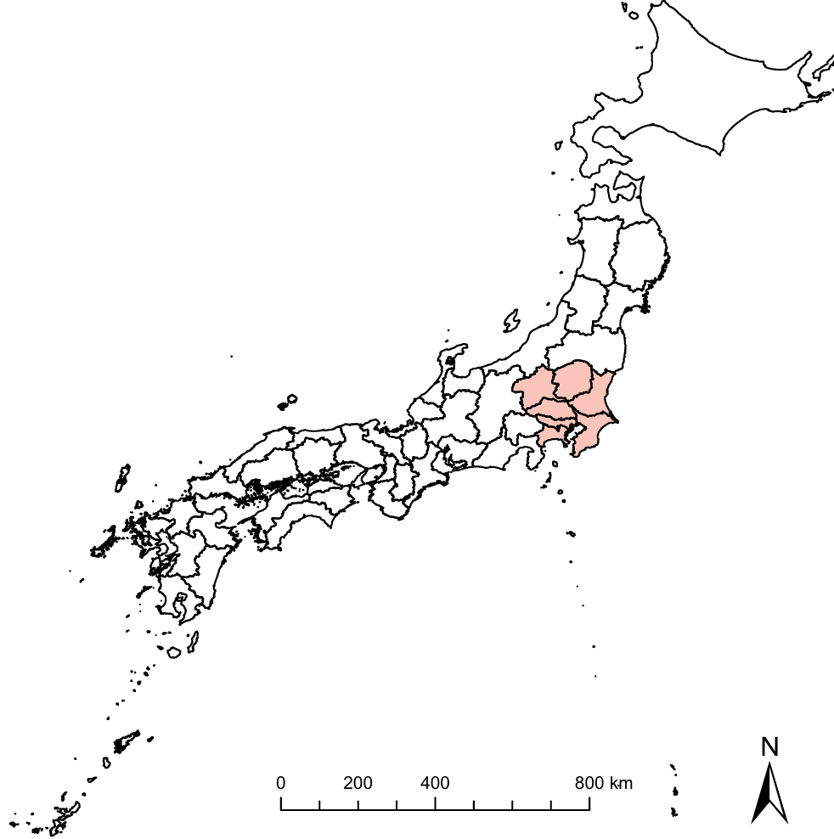
Methods (1): Subject area and life expectancy
6 / 17
【Design】
This study is a descriptive study using a geographical information system with publicly available data from 2020.
【Subject area】
The study included 32,017 administrative census mesh blocks (“Cho-cho-aza”), 30,323 clinics, and 2,014 hospitals across seven provinces in the Kanto region, including Tokyo (Fig 2). The population of this area is approximately 43 million.
Subject Area
Tokyo
【Life expectancy】
Life expectancy by municipality was obtained from the Life Expectancy Table by Municipality 2020, published by the Ministry of Health, Labour, and Welfare.
Fig. 2 Subject area in this study.

Slide 7
Methods (2): Developing the J-AMI
7 / 17
[1] The J-AMI comprises three elements:
1. Road distance from each mesh block to the nearest clinic
2. Road distance from each mesh block to the nearest hospital
3. Road distance from each mesh block to the nearest tertiary hospital
[2] Calculating the distance from each block to each medical institution
The center of gravity of each mesh block was taken as the representative point. The road distance from each mesh center of gravity to the nearest medical institution was calculated by provinces.

Slide 8
Methods (3): Developing the J-AMI
8 / 17
[3] Scoring methods
1. Clinics: scored by every 1 km
(1 pt ≤ 1 km, 1 km < 2 pts ≤ 2 km, …, 6 km < 7 pts ≤ 7 km, 7 km < 8 pts)
2. Hospitals: scored by every 2 km
(1 pt ≤ 2 km, 2 km < 2 pts ≤ 4 km, …, 12 km < 7 pts ≤ 14 km, 14 km < 8 pts)
3. Tertiary hospitals: scored by every 4 km
(1 pt ≤ 4 km, 4 km < 2 pts ≤ 8 km, …, 24 km < 7 pts ≤ 28 km, 28 km < 8 pts)
The scores (each score; 1−8 points) for clinics, hospitals, and tertiary hospitals were aggregated for each mesh and the total was treated as the J-AMI score for the mesh (score; 3−24 points).

Slide 9
Methods (4)
9 / 17
RD＝1.5 km
C
RD＝17 km
T
Administrative census mesh block
J-AMI Score 11 (C2H4T5)
RD＝7 km
H
Figure 3. Example: Calculating J-AMI scores
C
Since the RD 1.5 km to the nearest clinic is greater than 1 km and less than 2 km, the score is 2 points.
H
Since the RD 7 km to the nearest hospital is greater than 6 km and less than 8 km, the score is 4 points.
T
Since the RD 17 km to the nearest tertiary hospital is greater than 16 km and less than 20 km, the score is 5 points.
RD; road distance, C; clinic, H; secondary hospital, T; tertiary hospital

Slide 10
Methods (5) Calculating the population-weighted municipal J-AMI score (PWM-J-AMI score)
10 / 17
J-AMI scores weighted by the population of each administrative census mesh block were calculated by each municipality, which became the population-weighted municipal J-AMI score (PWM-J-AMI). The formula for calculating the PWM-J-AMI is shown in Equation (1):
$$PWM‐J‐AMI Score i=\frac{\sum_{j}{Pj×J‐AMI Score j}}{\sum_{j}{Pj}}$$
(1)
Where PWM-J-AMI Score i is the PWN-J-AMI Score of municipality i, Pj represents the population of block j, and J-AMI Score j represents the J-AMI Score of block j.
Notes:
なぜ、市町村ごとに計算する必要があったのかについて口頭で説明する。

Slide 11
Methods (6): Statistical analysis
11 / 17
The correlation between the PWM-J-AMI and life expectancy per municipality was examined, using Spearman’s rank-order correlation. SPSS version 27 (IBM, Armonk, NY, USA) was used for statistical analyses.
Geographical information was analyzed using ArcGIS Pro 3.0 (ESRI, Redlands, CA, USA).

Slide 12
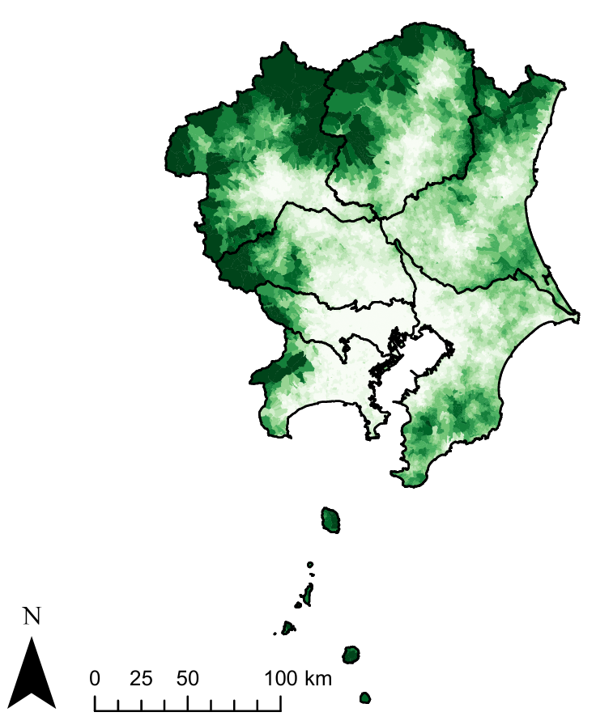
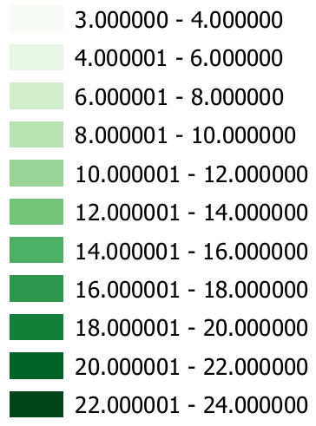
Results (1)
12 / 17
Table 1. General characteristics and J-AMI scores
of administrative census mesh blocks (n = 32,017)
 | Median (IQR)
Population of administrative census mesh block (person) | 811 (289–1850)
Area of administrative census mesh block (km²) | 0.22 (0.12–0.77)
J-AMI score (point) | 5 (4–8)
Mountainous Area
Urban Area
Tokyo
J-AMI; Japan-Spatial Accessibility Scale for Medical Institutions, IQR; interquartile ranges.
3.0 ≤, ≤ 4.0
4.0 <, ≤ 6.0
6.0 <, ≤ 8.0
8.0 <, ≤ 10.0
10.0 <, ≤ 12.0
12.0 <, ≤ 14.0
14.0 <, ≤ 16.0
16.0 <, ≤ 18.0
18.0 <, ≤ 20.0
20.0 <, ≤ 22.0
22.0 <, ≤ 24.0
Increasing accessibility
Figure 4. Regional distribution of J-AMI scores by administrative census mesh blocks in the Kanto region.

Slide 13
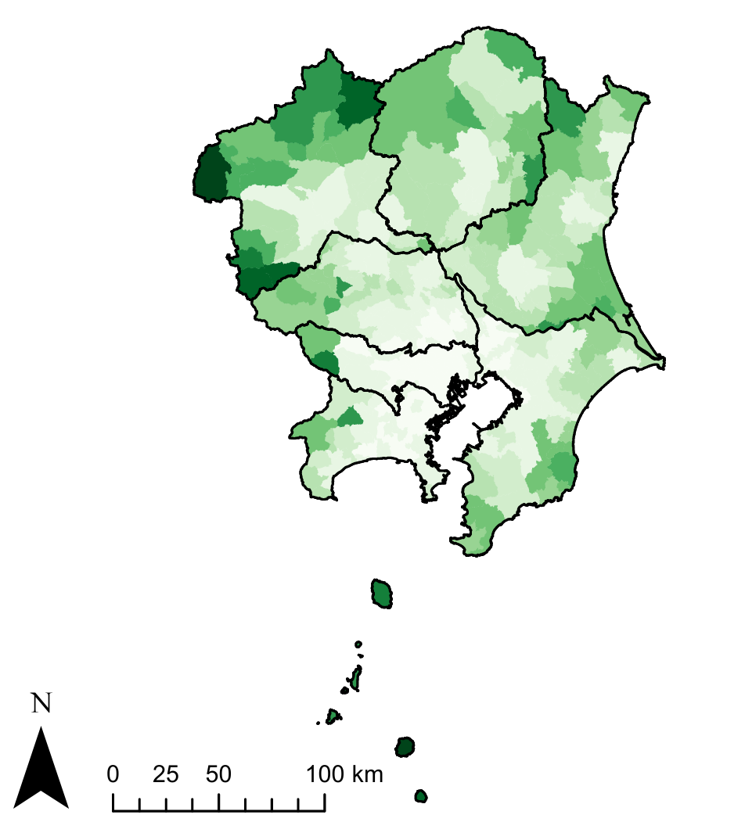
Results (2)
13 / 17
Table 2. General characteristics and PWN-J-AMI scores for each municipality (n = 335)
 | Median (IQR)
Population of municipality (person) | 74,283 (24,201–169,179)
Area of municipality (km²) | 46 (22–109)
Male mean life expectancy (years) | 81.3 (81.0–81.9)
Female mean life expectancy (years) | 87.3 (87.1–87.8)
PWM-J-AMI score (point) | 5.9 (4.1–9.3)
Mountainous Area
Urban Area
Tokyo
3.0 ≤, ≤ 4.0
4.0 <, ≤ 6.0
6.0 <, ≤ 8.0
8.0 <, ≤ 10.0
10.0 <, ≤ 12.0
12.0 <, ≤ 14.0
14.0 <, ≤ 16.0
16.0 <, ≤ 18.0
18.0 <, ≤ 20.0
20.0 <, ≤ 22.0
22.0 <, ≤ 24.0
Increasing accessibility
PWN-J-AMI; population-weighted municipal J-AMI score, IQR; interquartile ranges.
Figure 5. Regional distribution of PWM-J-AMI scores by municipalities in the Kanto region.

Slide 14
Results (3)
14 / 17
Table 3. Association between PWM-J-AMI scores and life expectancy by municipality in the Kanto region (n = 335)
 | Male mean life expectancy |  | Female mean life expectancy
 | Correlation coefficient | p value | Correlation coefficient | p value
PWM-J-AMI | -0.459 | <0.001 | -0.546 | <0.001
PWM-J-AMI; population-weighted municipal J-AMI

Slide 15
Discussion (1)
15 / 17
・This study developed the J-AMI, which simultaneously assessed accessibility to medical institutions of different sizes, and visualized the scores on maps.
▶
This is the first study when evaluating physical accessibility to medical institutions.
・J-AMI scores were lower in urban areas and higher in mountainous areas.
▶
This indicates good access to medical institutions in urban areas and poor access to medical institutions in mountainous areas.
▶
It is significant that the previously abstract subject of accessibility has now been objectively quantified and visualized.

Slide 16
Discussion (2)
16 / 17
・The PWM-J-AMI score was negatively correlated with mean life expectancy by municipalities.
▶
This indicates that the better a region’s access to medical care,
the longer the life expectancy in the region.
▶
Accessibility to medical institutions can be associated with cancer life expectancy.
Kou K, Cancer Epidemiol. 2020.
Agata C, Int. J. Environ. Res. Public Health. 2022.
▶
Inaccessibility to medical institutions may increase the risk of asthma mortality.
Jones AP, Int J Epidemiol. 1999.

Slide 17
Conclusions
17 / 17
This study developed the J-AMI as a new healthcare access index for the Kanto region.
The PWM-J-AMI score was negatively correlated with mean life expectancy by municipalities, indicating that the better a region’s access to medical care, the longer the life expectancy in the region.
A future nationwide analysis is needed to confirm the study findings.

