Slide 1
Presentation Title
Presenter Name
Organization / Company

Slide 2
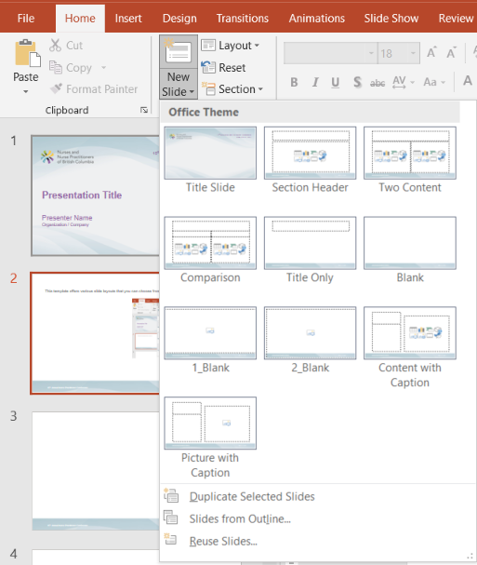
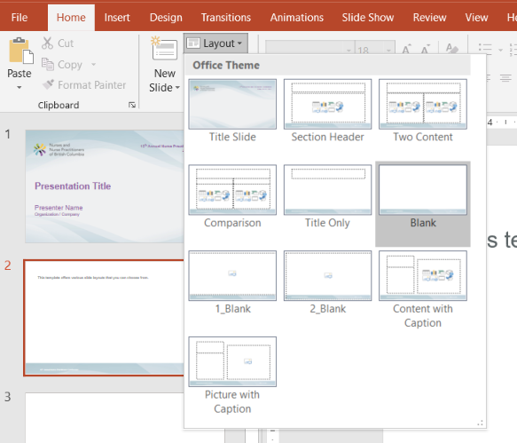
This template offers various slide layouts that you can choose from.
Insert new slide
Apply layout to existing slide

