Slide 1
Navigating Capital Upgrades
An Operational Perspective
Scott Collis - Hunter Water Treatment Alliance
Notes:
Thank Introducer
Introduce the presentation - Navigating Capital upgrades - I wanted to present the lessons I have learnt over the many upgrades I have been an operational SME and to provide a bit of a playbook for operations team members participating in capital upgrades.

Slide 2
1
P&IDs
They Matter!
2
Concept Design CHAIR 1
3
Detailed Design
CHAIR 2 / 3
4
O&M Manuals
5
Training
6
Acknowledgements
Notes:
I have 5 keys items to discuss where best to achieve value for the projects we participate in and where our attention needs to be directed when there is a large quantity to digest.
P&ID’s - I want to discuss why they are important to use and what we need to be on the lookout for early in design
Concept design and CHAIR 1 - This is early in a the design process, but we can provide important information here and identify quick easy wins
Detailed design - CHAIRs 2 / 3 these critical steps are important steps where our operational knowledge is key to providing a safe and efficient workplace
O&M Manuals can be quite complex, so they usually sit in the bookcase and never get used, but they are full of great information we should be utilising, and to ensure we have the right information I have some targeted areas we need to reviewed in depth to ensure they done just sit on the bookcase
Finally, Training, we all know how important it is to properly trained on new equipment, but how do we get the most value out of it - hopefully I can provide you with some ways and some ammunition to take to your managers to fund.

Slide 3
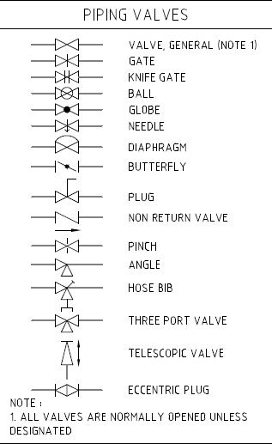
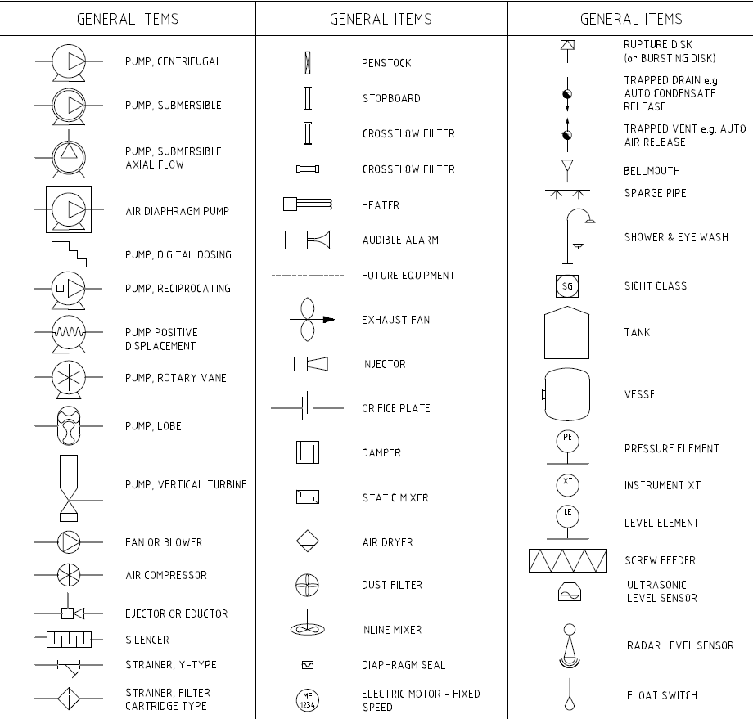
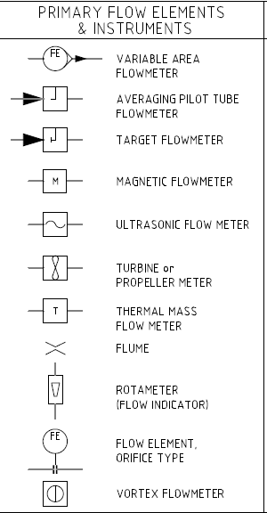
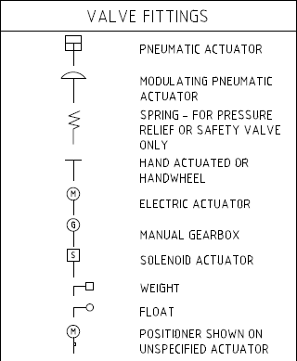
Process and Instrument Diagram’s
Notes:
There are a significant amount of symbols utilised in P&ID drawings, and in every P&ID set there needs to be a legend which provides a name to each symbol
CLICK
But what we need to be ensuring that the right equipment has been selected by the design team, so ensuring we understand the symbols is important, more importantly is we use them and do not gloss over the drawings lightly.
We are also going to see these drawings in subsequent design reviews and in particular these are key in HAZOP studies in which we are looking to ensure the systems are built with sufficient safety mechanisms to prevent incidents
CLICK
Just see the variety of valve types here, should the isolation valve be a butterfly or should it really be a ball or gate valve.
CLICK
Again a large variety of pumps, if a drawing shows a air diaphragm pump, but in that area, there is no pneumatic system present, that may lead to costs later in the construction phase.
CLICK
Sometimes we know through experience that certain flow meters do play nice with certain products or are difficult to manage in certain environments. Propellor flow meter vs thermal mass is a good example. Its good to seek feedback if you can from your mechanical and electric team on certain equipment if you are able too. They are important contributors to this also.

Slide 4
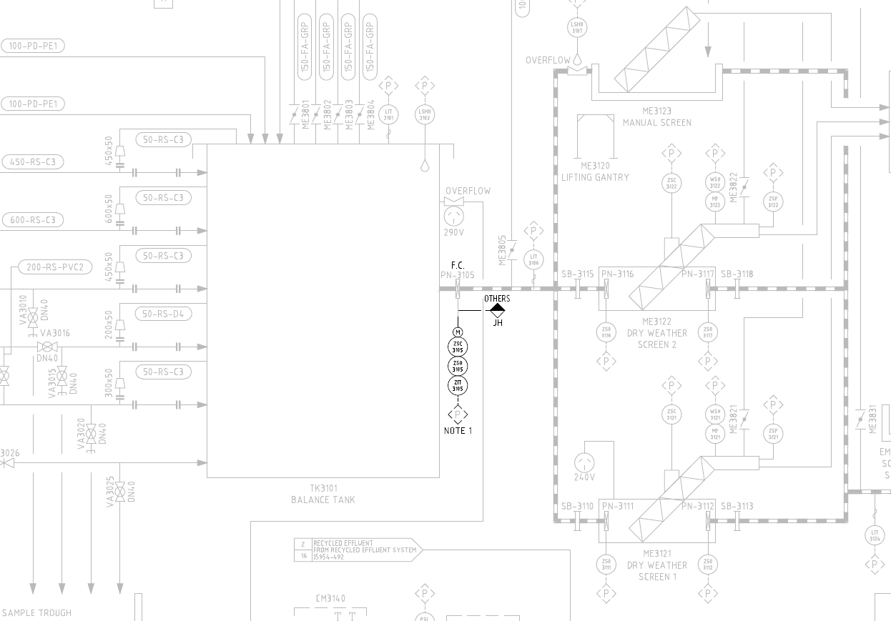
The Importance of Drawings
One Drawing
One Change
Huge Implications
Notes:
SMALL CHANGES CAN BE IMPROVED WITH EARLY IDENTIFICATION
When we build around our existing plant and equipment sometimes we have minor tweaks or additions to our process. At Farley with the addition of an membrane bioreactor, a actuated penstock was required to be installed on the inlet to he plant to prevent downstream overflows of the plant structures. One thing we missed early on was this penstock was
Fixed position over modulating
Modulating would add in greater operational/process optimisation - but was not in scope, but also we did not raise it early enough during the design to have it added, it was too late in the design to push the operational benefits of attenuating flow through the plant to improve process performance and efficient plant operations.

Slide 5
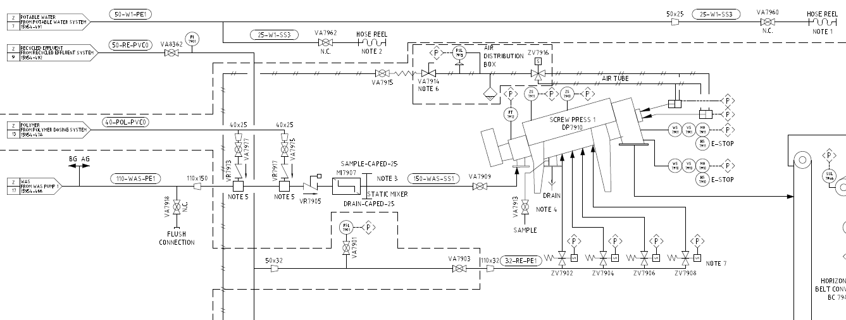
The Importance of Drawings
Notes:
With new equipment we have the opportunity to ensure we have sufficient operational mechanisms for operations and maintenance. A good example of ensuring this are
CLICK
Flushing points - an important but overlooked addition to equipment, we should ensure we have sufficient places to flush out equipment such as chemical systems and sludge. For chemicals flushing is important for safe work and for sludge handling, when we need to take equipment offline for an extend period of time, flushing the system with water will prevent blockages etc when we bring the equipment back online. Easy to install in construction rather than during operations.
CLICK
Sampling is an important operational task to ensure our equipment is running efficiently and producing what we expect it to. Without proper sampling points the task can be impractical or dangerous, we then miss out on crucial information later during operations
CLICK
Sufficient water supplies or hose reels for cleaning up spills or flushing equipment

Slide 6
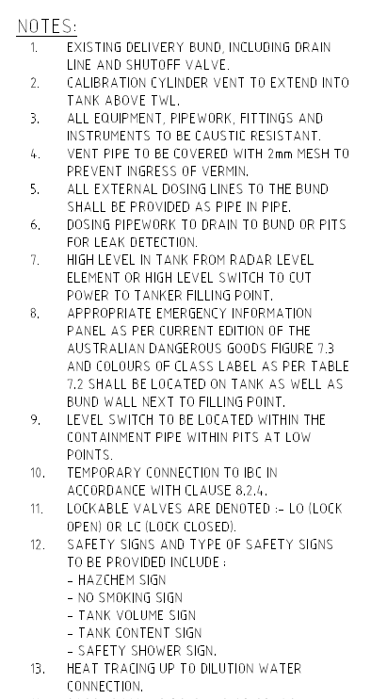
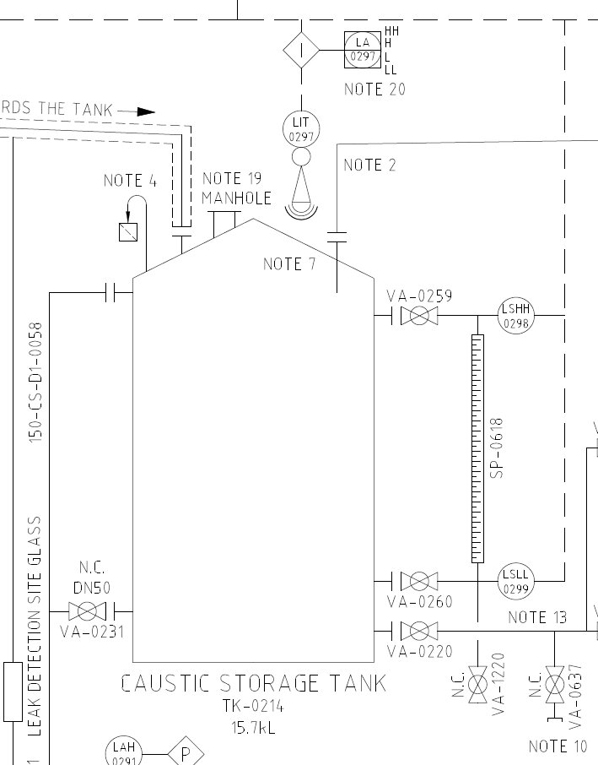
The Importance of Drawings
Notes:
In this one section of a chemical system P&ID there are 7 notes. Notes are an important part that tell you more of the story.
CLICK Note 4 - Gives us more information that the vent has vermin guarding
CLICK Note 7 - describes what the high level switch will do when activated
CLICK Note 10 - Tells us that valve is a temporary connection point for an IBC to be used - Important for when we have to take the tank offline for an internal inspection or eventual replacement.
CLICK
This is extremely important information given to us so we can ensure that the system is designed to be very operable and importantly maintainable. We use this information in our HAZOP workshops during detailed design to ensure we have sufficient process or system in place to prevent significant incidents from occurring such as chemical spills or equipment damage.

Slide 7
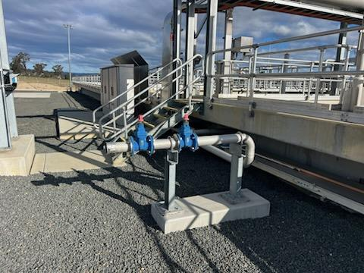
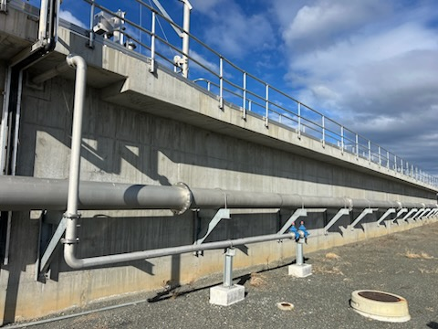
Concept Design and CHAIR 1
Notes:
Discuss the process of identifying and advocating for the fixed suction points for the different zones at Cessnock. This contract was delivered different with two constructors providing a design through early contractor engagement. This allowed for a greater feel for the design and therefore could identify potential operational issues and safety hazards early before moving into detailed design.
Previous experience
3D model showed significant heights between ground and top of tank
Early identification of manual handling concerns = early adoption of controls

Slide 8
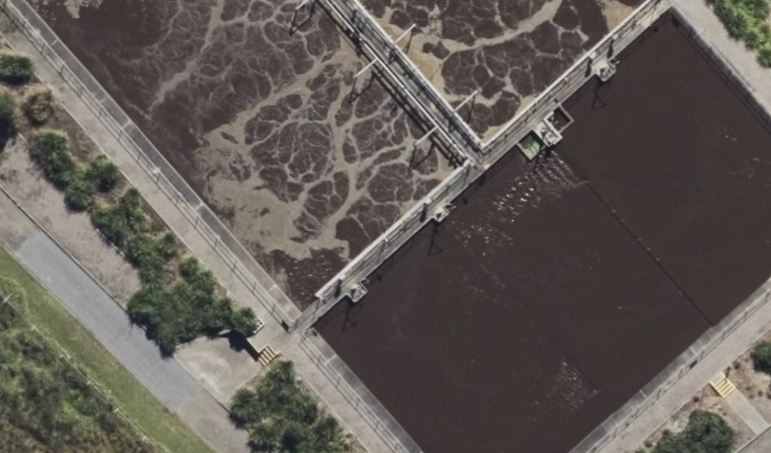
Detailed Design - CHAIR 2
Notes:
At the Kurri Kurri HAZCHEM upgrade CHAIR 2 workshop which looks at safety during construction
OVERLAND PIPEWORK It was suggested to install overland pipework rather than buried across walkway and install a step over.
OPS KNOWLEDGE Operational knowledge and experience played a critical role is preventing this from happening
RED CIRCLES to BLUE The red circles represent the anoxic zone mixers of which when they fail and need to be removed are lifted, placed onto a trolley and pushed along the walkway to the platform in blue.
PREVENTED MIXERS BEING REPLACED The pipework would have prevented that from occurring, meaning cranes would have to be brought into lift out the small mixers and they would also sit in the walkway for a time waiting on that to occur (poor housekeeping)
We also couldn't get operating mixers from spares into position rapidly affecting process effectiveness.
IMPORTANCE OF INPUT Without operational input, this would have lead to rework or worse it could have been left after construction for operations and maintenance to “manage” increasing costs, safety hazards/risks and reliability of the process.

Slide 9
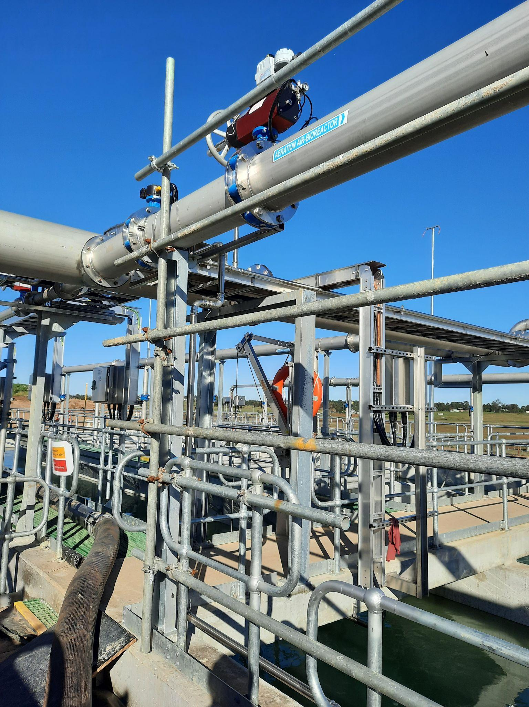
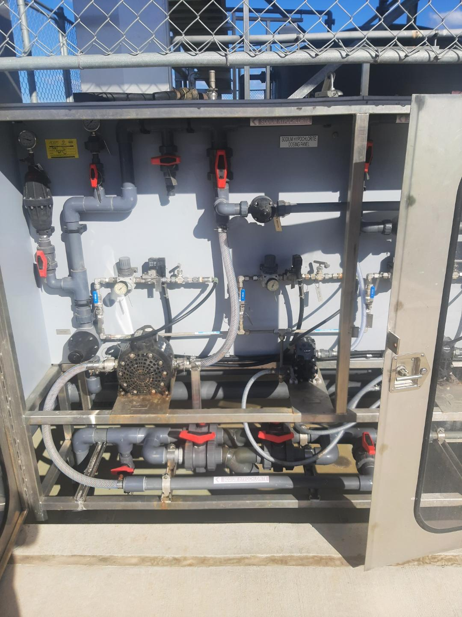
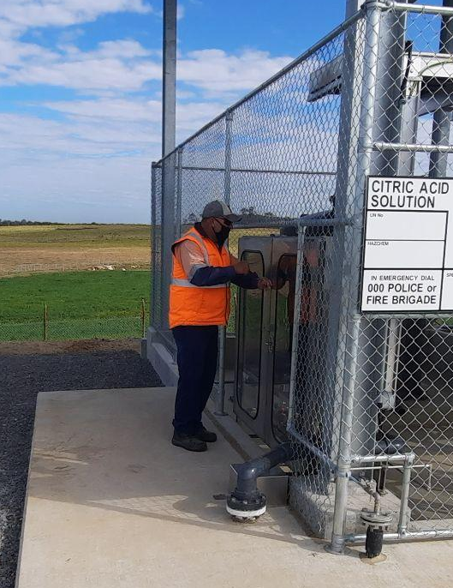
Detailed Design CHAIR 3 - The Bad
Notes:
Now some examples of where we missed important details in the design reviews, particular the CHAIR 3, which is the operability and maintainability study.
CLICK
Aeration control actuator sitting above with temporary guarding to allow safe access
CLICK
Citric dosing cabinet sits at ground level leading to poor ergonomics for operators and maintainers
There are examples on every site that can be put down to being missed during design for whatever reason

Slide 10
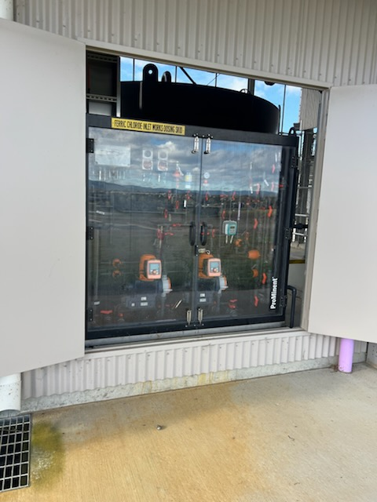
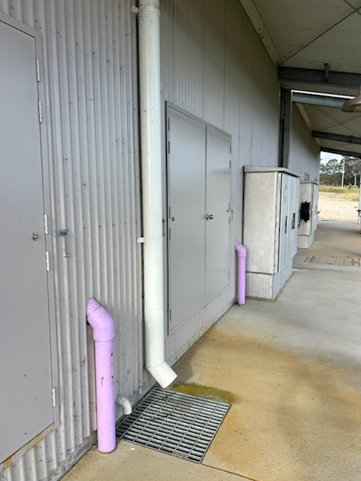
Detailed Design CHAIR 3 - The Good
Notes:
Cabinets are at a good working height and are protected from the elements (North facing aspect identified in early design)
Extension of roof over cabinets to protect operators and maintainers during adverse weather conditions
I have been apart of a combined CHAIR2/3 meeting. These tend to be 90% CHAIR2 then we rush the CHAIR 3, this when you think about the time spent constructing vs operating is completely wrong, it should be the other way around in my “operational “ opinion. What I now ask is that its ether spilt over separate meetings or we complete CHAIR3 first then do CHAIR2, normally I end up with a separate meeting. When we have taken this approach, I have seen much greater improvements in operations and maintainability. But remember, we never get anything perfect, things will still be missed or overlooked. We just need to work to our best ability and results will show themselves. I always get a fuzzy feeling when people comment on certain areas of new equipment where I know I have provided input and the project delivered an excellent outcome.

Slide 11
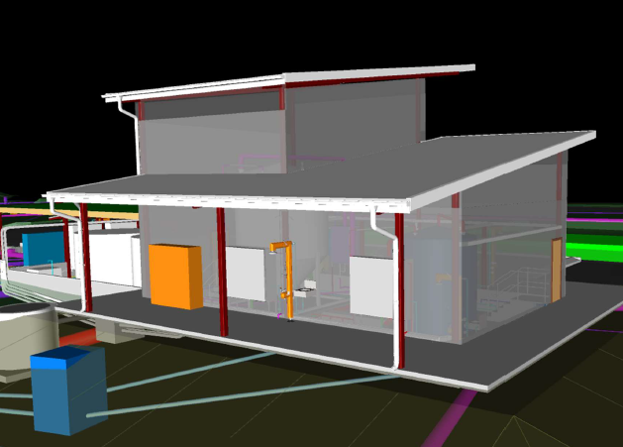
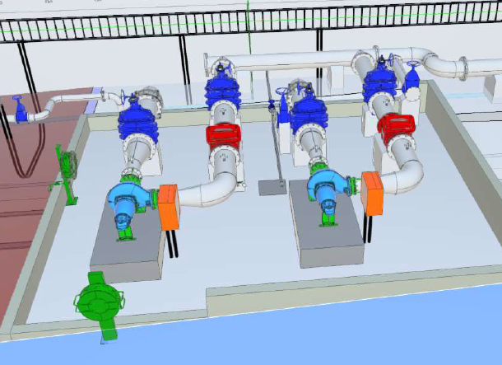
What was the Difference - 3D Models
Notes:
I can not emphasis anymore that 3D models are so critical in identifying potential safety hazards, potential maintainability issues and potential operational hazards.
A design change here can cost nothing during construction, but save variations during constructions or ongoing risks during operations.
We can see from the model we have great access around the chemical building and the pumps at Cessnock, we aren't having to jump or crawl under pipework to access valves or other equipment.
What we missed at Farley was the 3D model to bring together all three different design teams detail into a single source allowing us to see any issues.
Even in one design we moved the local control panels to another position as they we in the path of a pump being lifted out of a pit, we had the room and removed the risk of the pump contacting an electrical panel during removal or installation

Slide 12
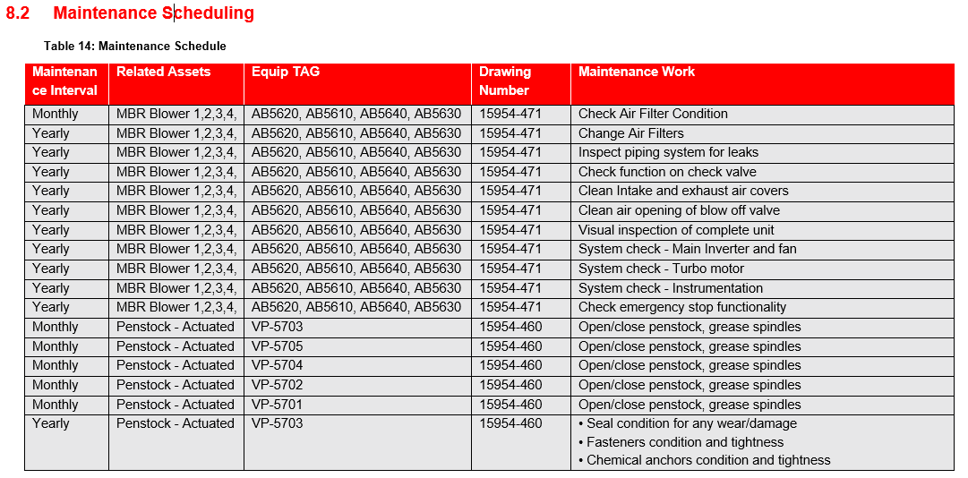
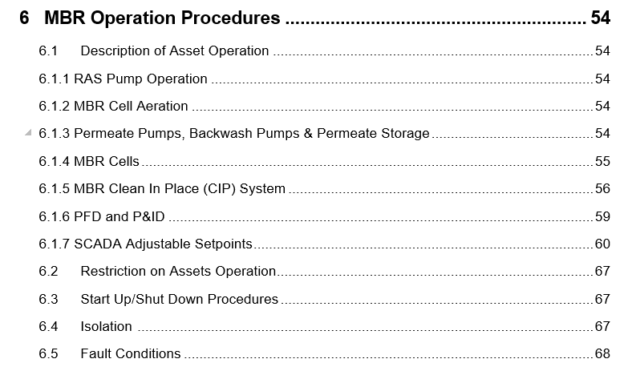
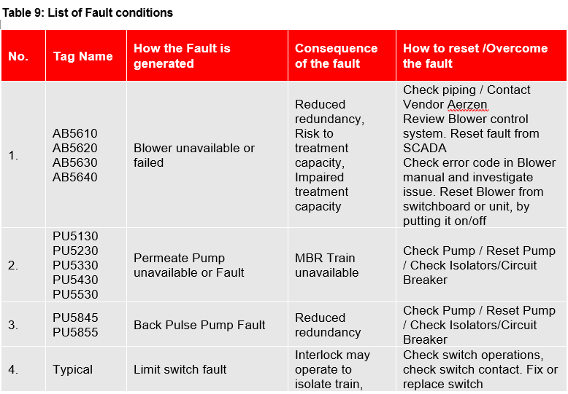
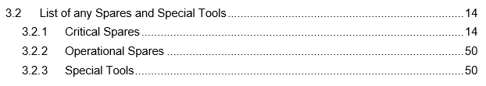
Operational and Maintenance Manuals
Notes:
I am going to be identifying four key items within an Operational and Maintenance Manuals we as operational SMEs need to focus in on
CLICK
Operating Procedures - SOPs, WIs, commissioning information. We don’t know what we don’t know, so we need to have the tools ie SOPS/WI so we know how to isolate, recommission and importantly operate our new equipment or new process.
CLICK
Troubleshooting - Most equipment comes with its own troubleshooting guides, but what we should expect in larger capital upgrades where we have new processes built, we should expect to see at least a basic level of troubleshooting. We should not expect complex troubleshooting as we know, we operate complex processes and sometime it is a complex problem that needs solving, but the significant number of problem we expect to see such as equipment failure types etc should be listed with proposed remedies and required checks etc.
CLICK
Critical Spares - If critical spares have been discussed previously and agreed upon, they should all be listed in this section. There also be some items that pop up here, or spares that might have been missed during reviews. These should be discussed as early as possible so gaps in redundancy can be covered. One thing we do not need is critical equipment failing only to find out there is no spares and its a 16 week wait for a replacement.
CLICK
Maintenance Schedules - What I normally see is a copy and paste of equipment manufacturers maintenance schedules. This could be sufficient, but what that tends to lack is sites specific requirements like operating environment (ie close to ocean or high temperatures) which may require additional maintenance activities to be performed.

Slide 13
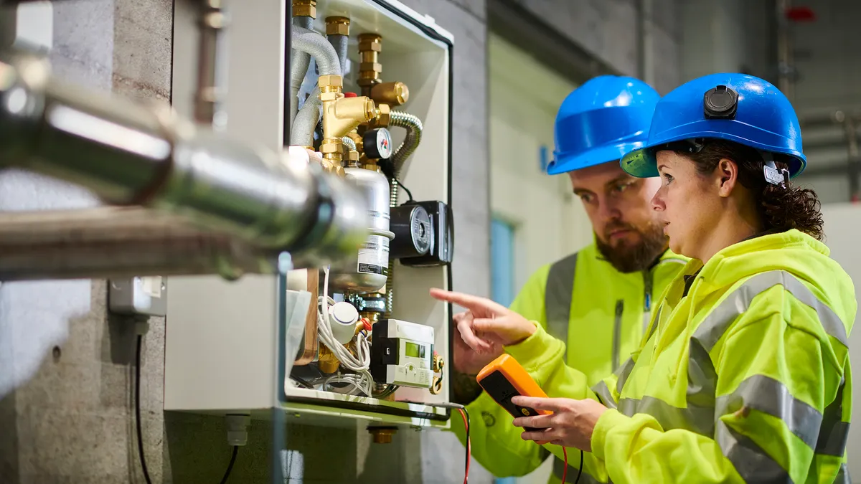
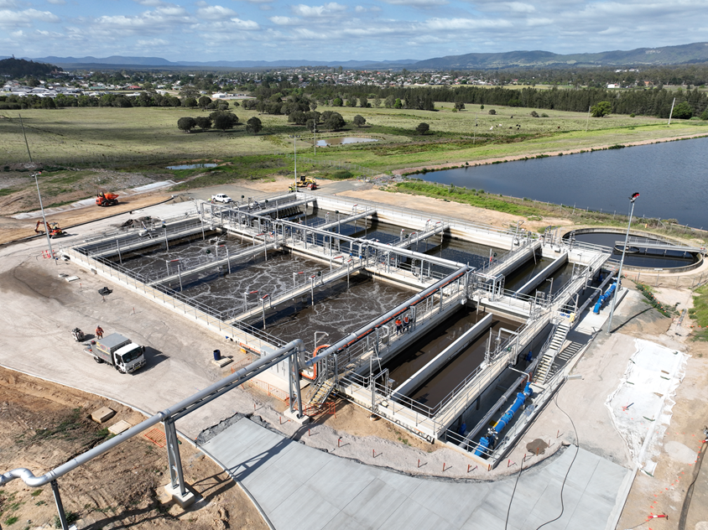
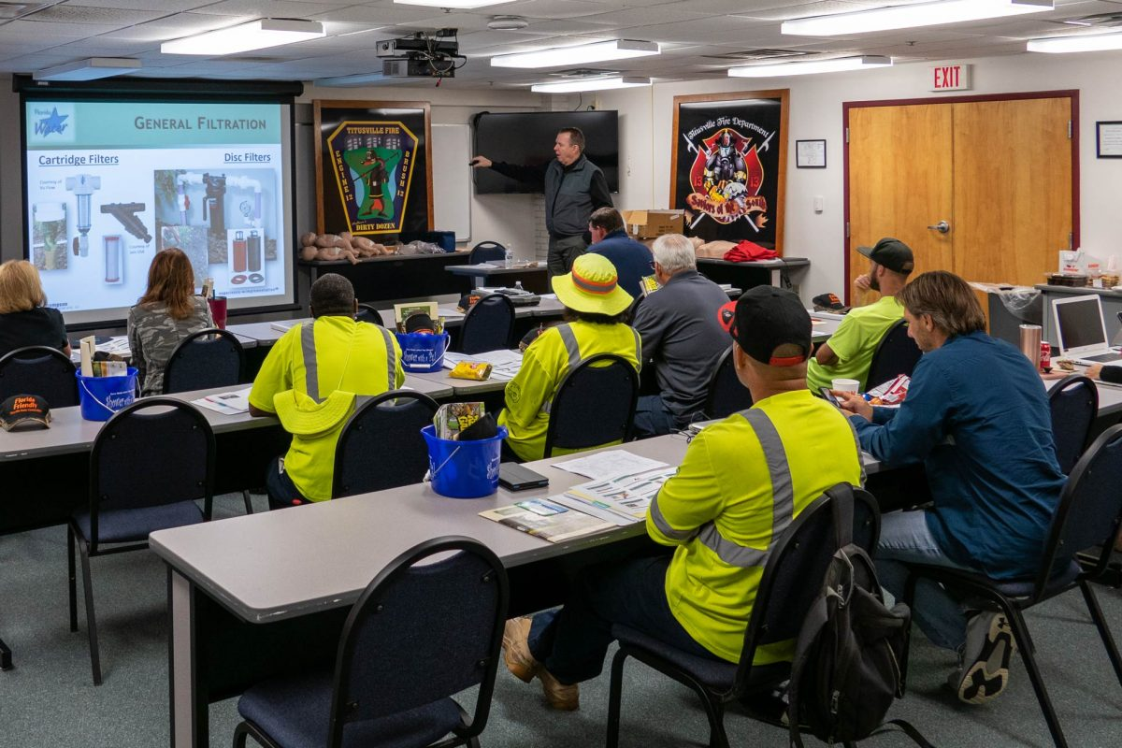
Training - What is Best?
Notes:
CLICK
Good - Classroom based / e-learning - discussion of SOPs, equipment, process documentation etc. No site based training. No real limit on class size apart from room size
CLICK
Great - Site based SOP/WI instruction and physical completion, ie lifting out equipment using speciality equipment/cranes etc. Isolation of process or equipment. Operation of plant via SCADA/HMIs to see physical actions occur and consequences (should only be done prior to process coming online). Great for small to medium size groups, large groups 12 plus it may need additional sessions or prioritising who attends.
CLICK
Excellent - Operator immersion with contractor during pre-commissioning, commissioning and process proving periods - Could be large cost to project, but complex upgrade this could be very valuable training for operators, can offset contractor cost for additional staff for commissioning and operations when under their control.
A training plan should be developed for large projects which should provide the details of the the classroom and practical training along with any commentary of operator immersion during commissioning activities. This should be reviewed and agreed upon during construction prior to training being undertaken. Where gaps are identified in training, it is imperative we push for these to be closed in the best method possible.
If training is poorly executed or poorly designed this could be a significant risk to our ongoing operations. If operators do not know how to operate a complex piece of equipment it can lead to ether a WHS or environmental hazard, or if insufficient process training is not undertaken, there is a risk that the plant may not perform well or be running inefficiently.
The hardest bit it determining what is acceptable for the project, there is budget, time and people constraints, what works for one project may not be enough for another. But put simple there is no simple formula, but basically the more complex a project, the training should be adjusted to suit. New Plant - Operator immersion, new inlet screen - site base SOPs, Like for Like ish replacements - classroom style training.

Slide 14
Acknowledgments
Hunter Water Treatment Alliance Team - Hunter Water and Veolia
Hunter Water Asset Solutions Team
Notes:
In conclusion - P&IDs are extremely important, add value throughout your design process, priotorise the right sections of the O&Ms and define your training objectives early in the project.
Hunter Water Treatment Alliance Team – Both Hunter Water and Veolia temas for there ongoing commitment to achieving quality outcomes for our site operators to ensure they are safe and effective every day.
Hunter Water Asset Solutions Project Managers and Engineers– Invaluable support for operational needs during capital upgrades.
Closing statement - Thank you

