Slide 1


Slide 2

WCE 2027 is a unique platform for scientific exchange, innovation, education & collaboration
Prestigious 4-day Congress will bring together leading clinicians, researchers, scientists, and healthcare professionals from around the world
Shared goal of improving & advancing the understanding, research, treatment strategies, and patient care in endometriosis

Slide 3
Scientific Programme offering:
Keynote Presentations
Invited Seminars
Free Paper & Poster Presentations
Pre-Congress Workshops
Industry Forums
Social Programme offering:
Welcome Reception
Optional Congress Celebration
Industry Exhibition offering
exposure to top diagnostic and pharmaceutical companies

Slide 4
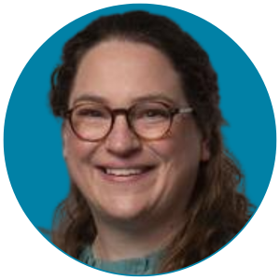
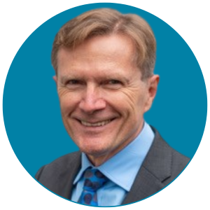

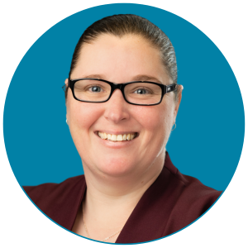
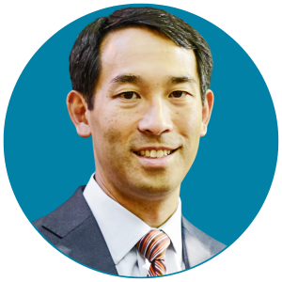
Keynote Speakers
Dr Katie Burns
University of Cincinnati, USA
Presenting on “Neutrophils: A Tool for a Non-invasive Diagnosis and First Responders in
Endometriotic Lesion Development”
Prof Davor Jurkovic
University College
London, UK
Presenting on
“Advanced Ultrasound and Its Impact on Our Perception and Management of Endometriosis”
Prof Mario Malzoni
Paiedeia International
Hospital, Italy
Presenting on
“Tailoring the Surgical Strategy for Bowel Endometriosis: From Shaving to Segmental Resection”
Dr Rebecca O’Hara
Flinders University,
Australia
Presenting on “Endometriosis as a Chronic Disease: The Role of Self-Management”
Dr Frank Tu
Endeavor Health and University of Chicago, USA
Presenting on
“Nociplastic Pain in Endometriosis: When the Problem is in the CNS, Not the Peritoneum – Lessons from Studying Dysmenorrhea”

Slide 5
Invited Seminar Speakers
Presentation Topic Presenter
Imaging Assoc. Prof. Ligita Jokubkiene (Sweden)
Surgery Prof. Sukhbir (Sony) Singh (Canada)
Pain Dr Juan Diego Villegas-Echeverri
(Colombia)
Adenomyosis Prof. Charles Chapron (France)
Basic Sciences, Pathogenesis of Endometriosis and Adenomyosis Prof. Serdar Bulun (USA)
Endometriosis and Adenomyosis at the Extremes of Reproductive Ages Prof. Sylvia Mechsner (Germany)
Fertility, Reproductive and Obstetric Outcomes in Relation to Endometriosis Prof. Barış Ata (Türkiye)
and Adenomyosis
Social Sciences and Epidemiology Prof. Annalise Weckesser (UK)
Beyond Pain and Fertility: Mental Health, Nutrition, Complementary Medicine, Prof. Annemiek Nap (The Netherlands)
and Lifestyle Interventions
Non-Surgical Treatments: HIFU, Radiofrequency and Other Minimally Invasive Dr Xiaoming Gong (China)
Techniques
Non-Surgical Treatments: Medical Treatment Prof. Silvia Vannuccini (Italy)

Slide 6
Call For Abstracts Now Open!
Submission deadline: Friday 15 January 2027
Join us in Istanbul
Visit www.wce2027.com for more information

