Slide 1
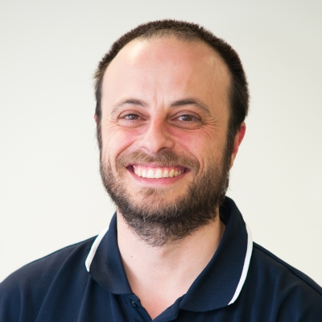
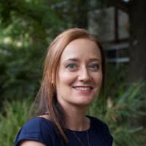
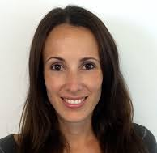
Applying for a teaching award
Dr Maurizio Costabile (Uni of South Australia)
Dr Tracey Kuit (Uni of Wollongong)
Dr Rebecca LeBard (Uni of NSW)

Slide 2
Maurizio: My background
2009, Division of Health Sciences Award.
2013, UniSA Citation (Immunology).
2014, Office of Learning and Teaching (OLT) Citation (Immunology).
2015, UniSA Digital Citation (Biochemistry).
2016, Online Learning Consortium, Effective practice award, New Orleans (Biochemistry).
2017, Finalist, SA Science Excellence Awards for STEM Educator of the Year: Tertiary Teaching.
2018, Leader of the Teaching Innovation and Research Team (for Learning) (TIRTL) at UniSA.

Slide 3
Tracey: My background
2011, Outstanding Contribution to Teaching and Learning (OCTAL) – Vice Chancellor’s Faculty Early Career Academic Award, University of Wollongong.
2012, Outstanding Teacher Recognition Award, Australian College of Educators.
2013, National Citation for Outstanding Contributions to Student Learning, Australian Office for Learning and Teaching (OLT).
2018, Shimadzu Education Award, ASBMB.
Reviewer and mentor of OCTAL and OLT awards at the University of Wollongong.

Slide 4
Rebecca: My background
2015, Vice Chancellor’s Award for Teaching Excellence, UNSW.
2016, National Citation for Outstanding Contributions to Student Learning, Australian Office for Learning and Teaching (OLT).

Slide 5
Why apply for an education award?
Award application:
provides an opportunity to think about your teaching and define areas of excellence and areas for improvement.
provides an opportunity to consider how you work with colleagues – is a joint award possible?
Receiving an award provides and enables:
recognition at various levels (University and professionally) as well as dissemination of excellent practice to your colleagues.
academic promotion (Teaching focussed academic/balanced).
personal satisfaction.
a springboard for future awards and roles within your institution.

Slide 6
What is excellence in teaching?
UniSA defines their awards as a mechanism to provide:
“recognition of educators who have outstanding presentation skills and who have made a broad and deep contribution to enhancing the quality of learning and teaching at UniSA.”
Your university will have a similar statement.
“Presentation skills” can relate to face-to-face and/or online teaching.
“Enhancing the quality” of teaching and learning should be measured against the metrics your university uses.
To address these points, you need evidence for each claim.

Slide 7
What is excellence in teaching?
This example from UOW shows a set of criteria for excellence:
 | Category A - Teaching and Learning & Provision of Key Services (for nominees who are directly engaged in teaching/supporting students) | Category B - *Programs that Enhance Learning (for contribution to, and/or development of, a program which enhances the quality of learning)
CRITERIA | Approaches to teaching and the support of learning that influence, motivate and inspire students to learn | Distinctiveness, coherence and clarity of purpose
 | Development of curricula, resources or services that reflect a command of the field | Influence on student learning and student engagement
 | Evaluation practices that bring about improvements in teaching and learning | Breadth of impact
 | Innovation, leadership or scholarship that has influenced and enhanced learning and teaching and/or the student experience | Addressing equity and diversity
EVALUATION | Applications are judged on the extent to which they show evidence, including evaluation, that the nominee’s contribution has: Influenced student learning, student engagement or the overall student experience Gained recognition from fellow staff, the institution and/or the broader community Showed sustained activity (no less than three years or two years for Early Career applicants) | In judging applications the review panel will take into account: Evidence of the effectiveness of the program in formal and informal evaluation The degree of creativity, imagination or innovation Evidence of sustained effectiveness of the program for no less than three years
How does your institution define excellence/outstanding?

Slide 8
The ASBMB Education Award
The SHIMADZU Education Award (from ASBMB) rewards outstanding achievement in education in biochemistry or molecular biology, especially innovation and creativity in education, with a view to fostering leadership in this important area of the Society's objectives.
Assessment criteria:
Teaching philosophy and methods.
Personal teaching performance, quality and outcomes.
Biochemistry and Molecular Biology research and teaching: evidence of involvement in research (education, scientific or both).
External role, peer review and influence beyond host department/institution.
Purpose of Award: Quality of proposed activity for which the Award is sought.

Slide 9
Evidence your excellence: diversity is key
Evidence can be qualitative and quantitative; try to use both approaches.
Peer review of teaching.
can be both formal and informal.
Industry related feedback.
e.g., instigation of a new approach to teaching that has impacted on students and has been acknowledged at the industry accreditation level or by an industry colleague.
Unsolicited student feedback.
e.g., an E-mail from a student thanking you for an educational resource, especially if they explain how it impacted their learning.
Some form of independent benchmarking.
Can you use university analytics as reference your teaching? e.g., compare your performance to other staff in your school, division, or university.
Student evaluation of teaching/course.
The student voice is usually the easiest form of evidence for staff to obtain, since you university collects it; it is important, but it should not be the sole type of evidence used.
Uptake of your work.
Evidence that others in your field use your innovations at their institutions

Slide 10
How to write your application: the basics
Identify the timeline of the awards on offer. Begin a minimum of 6 months ahead.
Determine your eligibility for the selected award.
Clearly read the application form.
Address ALL selection criteria.
Ensure you identify suitable referees (e.g., HOS, colleagues, collaborators), speak to them early and give them a copy of your application so they can provide a relevant commentary.
Seek feedback from people BOTH within (e.g., colleagues) and outside (e.g. family) your area of expertise.
Invite, accept, and act on valid criticism.

Slide 11
How to write your application: key points
Identify your area of excellence.
Identify what makes it “Excellent”.
How does your work differ from what is normally expected of you as an academic?
If unsure, speak to the Teaching & Learning unit of your institution.
Use past successful applications as a guide.
Define and explain your teaching philosophy.
Write a story about your area of excellence.
Use diverse and relevant forms of evidence for all key claims.
Include relevant references to the educational literature.

Slide 12
How to get your application rejected
Don’t address the selection criteria.
Don’t identify and articulate your unique area of excellence.
Don’t differentiate the outstanding from the inherent requirements of the job.
Don’t include diverse evidence
Don’t show a sustained contribution to learning and teaching.
Don’t show a reflective approach to your teaching (i.e., just telling the panel you are amazing doesn’t work; you must to show awareness of how you have developed your work in response to student needs).
Don’t tell the story of why your work has impact (i.e., it is not enough to just write a list of achievements, add student quotes, and expect the review panel to connect the dots).
Choose poor referees.
Notes:
Activity: have presenters and participants share any stories of rejection and most importantly what they did afterwards....

Slide 13
How to deal with rejection
Feeling disappointed is normal, but don’t let it stop you from moving forward.
Seek feedback from the assessors panel (if possible).
Seek help from colleagues with experience in your area.
Collect more, diverse evidence of the impact and quality of your work.
Ask for a peer review of your work, and include material from the review in your next application.
Look back at your application, identify areas of weakness and re-write.
Re-submit.

Slide 14
Contact Details
If you would like some further advice/help in your application please feel free to contact us:
Maurizio Costabile: Maurizio.Costabile@unisa.edu.au
Tracey Kuit: tburnett@uow.edu.au
Rebecca LeBard: r.lebard@unsw.edu.au

